Slide 1


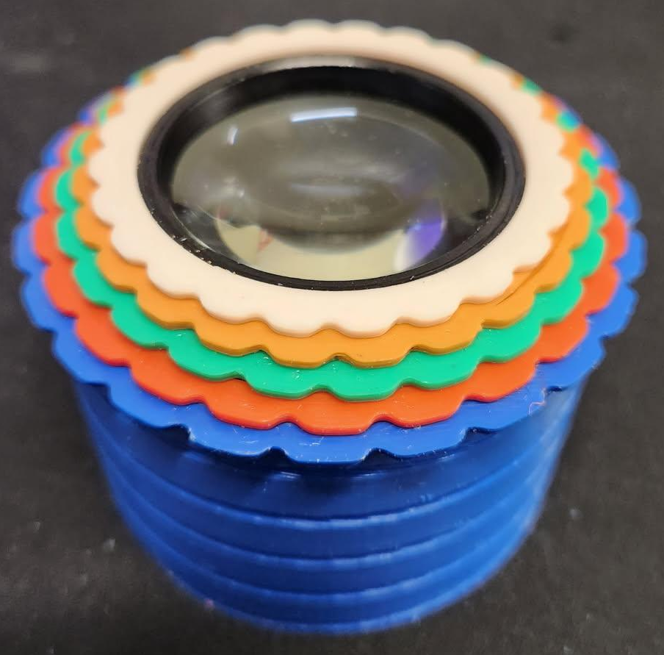
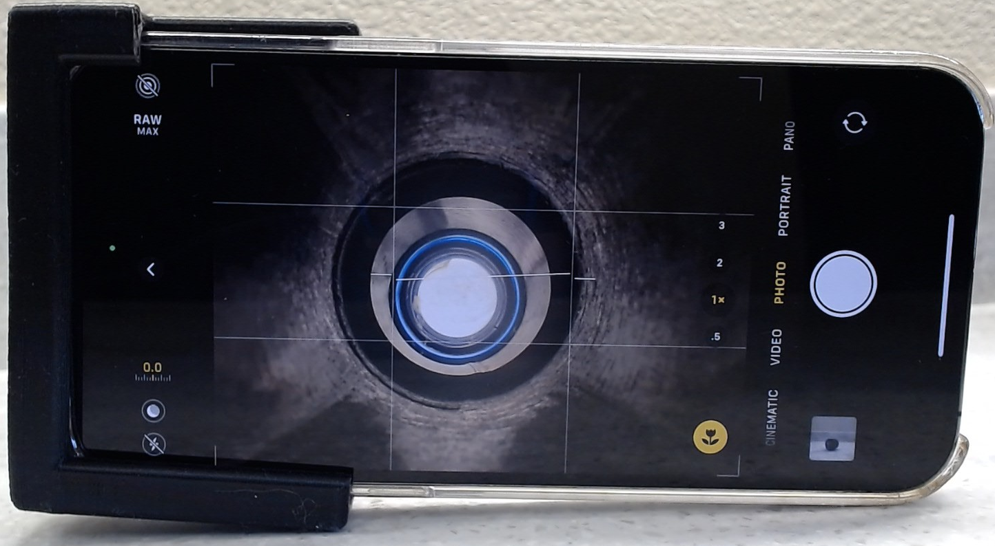
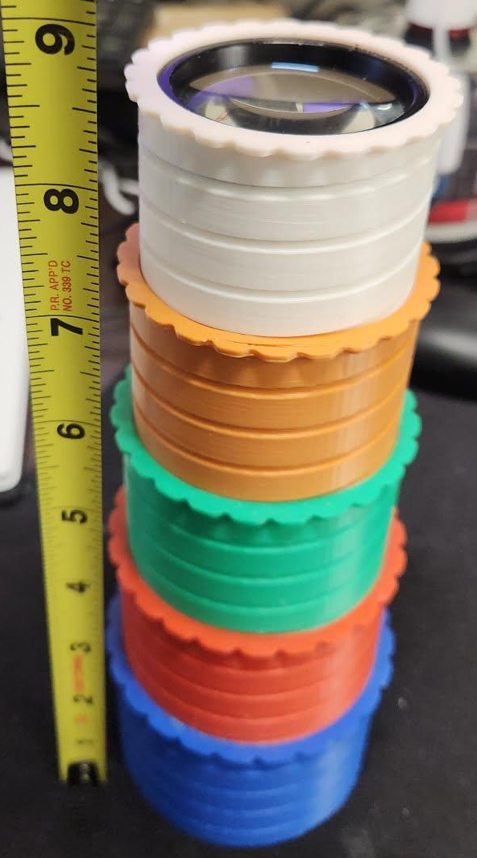
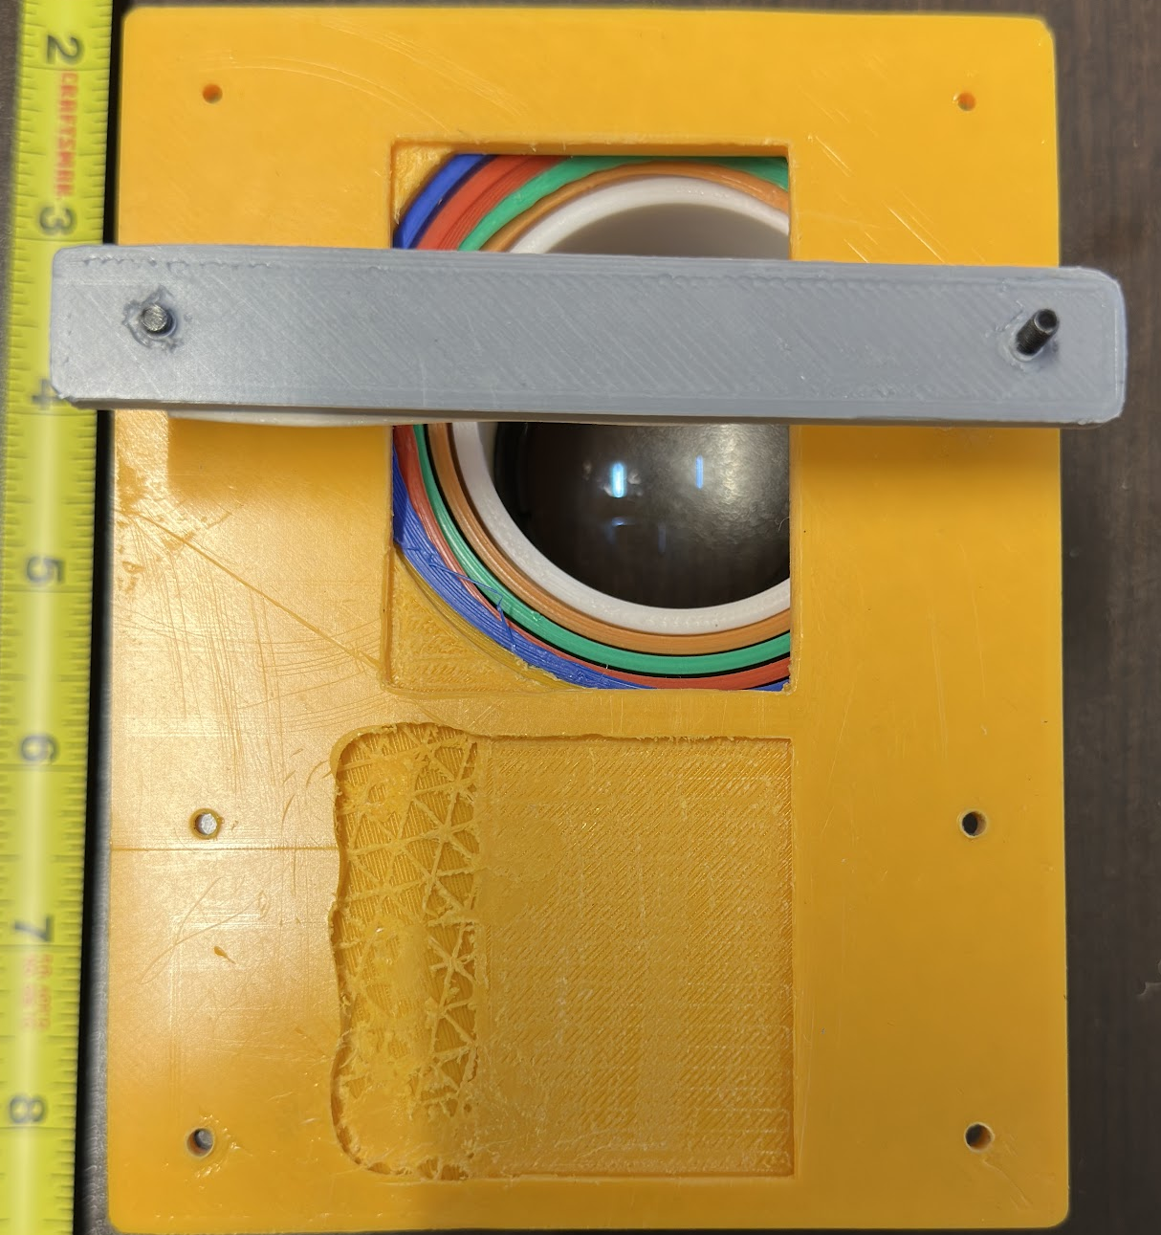
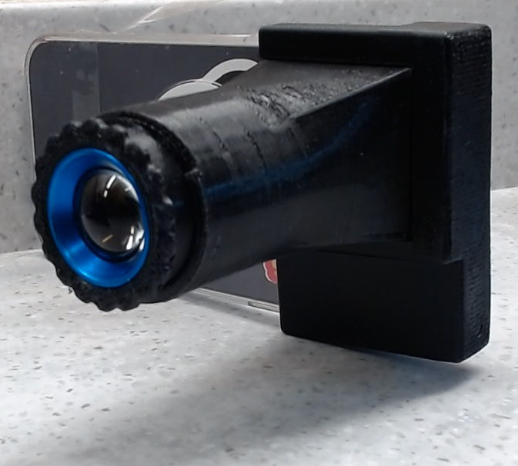
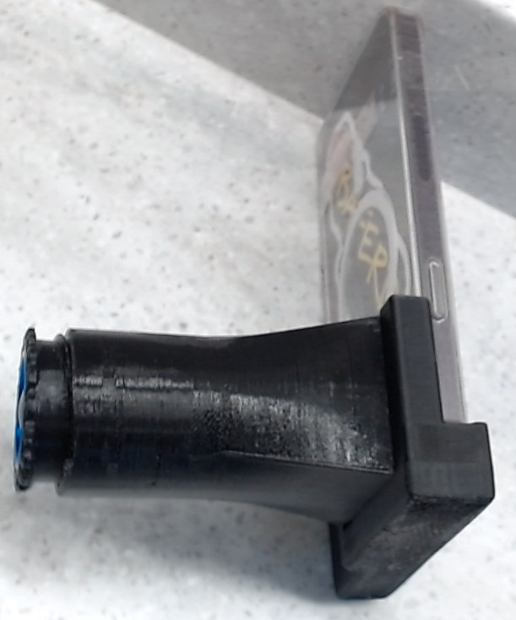

Feasibility Study for a Low-Cost DIY Ophthalmic Fundoscopic Camera via 3D Printing for Emergency Resident Physicians
L.S. Urita, MD MPH; S. Lake, RN; J. Thiesen, DO; S. Alhadi, M.D.; R. Gill, DO
Saint Agnes Medical Center Emergency Department
Introduction
Conclusion
Ophthalmic fundoscopic examinations are essential in
Emergency Medicine (EM) for assessing ocular and neurologic conditions,
including hypertensive retinopathy, papilledema, and retinal detachment. However traditional direct ophthalmoscopes present several challenges: 1. technical difficulty, 2. limited field of view, 3. patient discomfort. Achieving a clear view of the fundus requires significant skill, and many practitioners struggle to perform effective examinations. With limited field of view, the direct ophthalmoscope offers a narrow viewing field of 5 to 10 degrees and can vary between devices (Matsui, 2019), making it challenging to assess the entire retina and optic nerve comprehensively.
A low-cost, 3D printed, smartphone based fundoscopic camera offers a potential solution by integrating widely accessible smartphone cameras with commercially available optical components. This approach not only reduces costs but also enhances usability and facilitates remote consultations. Furthermore, it serves as an educational tool, helping emergency medicine residents develop hands-on skills in both ophthalmic examination and medical device innovation.
This project explores the feasibility of a low-cost, 3D-printed,
smartphone-based fundoscopic camera for EM use. The prototype combines
a smartphone camera, a 90D or 20D condensing len, and an external LED light
source to visualize the retina. Despite careful design, early versions failed to produce a
usable fundus image due to inadequate light penetration and poor coaxial alignment.
Fundus imaging requires precise optical geometry - specifically, coaxial illumination where light enters and exits the eye along the same axis. The offset between the iPhone camera and flash, and even minor misalignment with external LEDs, resulted in light scattering and reflection off anterior ocular structures. These findings underscore the inherent complexity of retinal imaging and the need for more refined optical design, even in simplified, cost-conscious tools.
The project continues to evolve with plans to incorporate fiber-optic lighting, ring
illumination and improved lens stabilization systems.
Limitations: Optical alignment sensitivity,
Dependence on external components, image quality.
Materials
Design and Materials:
OnShape
CAD (Computer Aided Design)
Development to create the initial CAD
designs for the camera housing tailored
to incorporate essential optical
components (lens system, LED
illumination) and adapter.
3D Printer
Artillery Sidewinder X3 Pro
Filament
Rapid PETG
Diameter
1.75 + 0.02 mm
Printing Temperature
230 C - 260 C
Utilize 3D printing to produce the initial prototype housings.
Prototypes
Lenses
20 diopter
90 diopter
iPhone
16 (Standard)
16 Pro Max
Fig. 1 Prototype 3
Methodology
There are three stages for the prototyping process which occur in tandem:
Design/Revision, Prototype Production, Feedback
Design/Revision Phase
The first iteration based on the preliminary design will be produced. An assembly trial to evaluate the ease of assembly, integration of components, and overall design functionality will be conducted.
Revision of the CAD models and prototype designs for design refinement based on feedback and observed challenges to arrive at the final prototype that meets technical feasibility and cost benchmarks
Fig.2 Prototype 5 (Final)
Design/
Revision
Feedback Phase
The anonymous informal feedback verbal and/or written feedback will be collected from EM residents and technical experts.
0
Prototype Production
Prototype Production Phase
CAD (Computer Aided Design) Development to create the initial CAD designs for the camera housing tailored to incorporate essential optical components (lens system, LED illumination) and a smartphone adapter. Low-cost electronic and optical components appropriate for fundoscopic imaging will be selected. Utilize 3D printing to produce the initial prototype housings.
01
0
Feedback Phase

