Slide 1



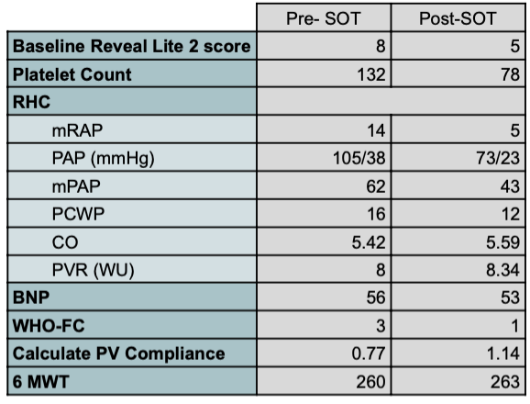

Sotatercept and the Vascular-Endothelial Connection:
A Case of Thrombocytopenia and Telangiectasia
Hamna Javed, MD; Mahwish Sheikh, MD; Andrew Clark, MD; Aftab Arif, MD;
Vijay Balasubramanian MD, MRCP (UK), FCCP
Internal Medicine Residency, Saint Agnes Medical Center, Fresno, CA
Pulmonary & Critical Care Medicne, Valley Advanced Lung Disease Institute, Fresno, CA
Introduction
Pulmonary arterial hypertension (PAH) is a progressive disorder marked by increased pulmonary vascular resistance and right ventricular failure. Despite existing treatments, many patients experience disease progression, highlighting the need for novel therapies.
Sotatercept (SOT), an activin signaling inhibitor, is a promising addition to PAH treatment. Clinical trials, including the STELLAR trial, have shown that sotatercept improves pulmonary vascular resistance, six-minute walk distance (6MWD), and overall clinical outcomes. We present the case of a patient who experienced some uncommon adverse effects associated with SOT such as thrombocytopenia and telangiectasia.
Case Presentation
Image 1: Telengectasia of the patient post-medication
Conclusion
A 45-year-old African-American female with a past medical history of hyperlipidemia, diabetes mellitus type 2, anxiety, and WHO group 1 Pulmonary arterial hypertension (PAH) due to underlying connective tissue disease (CTD) presented to the pulmonary clinic with complaints of worsening symptoms despite triple therapy for PAH (Parenteral prostacyclin therapy (PPT) + Endothelin receptor agonist (ERA) + Tadalafil (TAD). She was started on Sotatercept (SOT) infusions for the progression of PAH. She tolerated the medication initially however after her second infusion, she noted an itchy rash on her neck and chest as well as face and ankles. She also noted multiple episodes of epistaxis that were easily controlled with pressure.
She noted a significant improvement in her symptoms, including improved exercise tolerance and functional status. However, after her fourth infusion, there was a considerable increase in the telangiectasia all over her body and her labs showed a decreased platelet count.
Due to the adverse reactions, the infusions were held and the patient was monitored. In the meantime, mycophenolate was held by her rheumatologist due to increased pruritus. She was monitored with the SOT infusions on hold. She reported feeling tired and an increase in shortness of breath. In the interim, there was improvement in both the thrombocytopenia and the telangiectasia. Due to the significant improvement in her symptoms, she was rechallenged with SOT four months after her last dose. Unfortunately, she noted worsening of her telangiectasia and her labs showed progression of her thrombocytopenia. Due to her propensity for adverse reactions to SOT, it was stopped completely. Image 1 shows the progression of her labs and telangiectasia.
Sotatercept is a promising therapy for PAH, improving pulmonary vascular resistance and functional capacity. However, it can cause complications such as telangiectasia and thrombocytopenia, increasing the risk of bleeding and vascular fragility. These effects may be linked to sotatercept’s modulation of the activin signaling pathway, which influences vascular homeostasis and platelet regulation.
Clinicians should monitor patients for hematologic and vascular abnormalities to manage potential risks. Further research is needed to understand these side effects fully. Despite these concerns, sotatercept remains a valuable PAH treatment when adverse effects are promptly identified and addressed.
Table 1: Comparison of RHC, labs and Reveal Lite 2 score pre and post-medication
Discussion
Sotatercept is a novel activin signaling inhibitor showing significant promise in treating pulmonary arterial hypertension (PAH), with trials like STELLAR demonstrating improved pulmonary vascular resistance and six-minute walk distance¹². However, rare adverse effects, including thrombocytopenia and telangiectasia, have been reported³. These complications may stem from sotatercept impact on vascular remodeling and platelet regulation⁴. Our patient’s experience underscores the need for vigilant hematologic and dermatologic monitoring during therapy. Although sotatercept can substantially improve functional status, individualized risk-benefit assessment is critical. Further research is necessary to better characterize and manage these emerging adverse effects⁵.
References
Simonneau G, Hoeper MM, Badesch D, et al. Sotatercept for the treatment of pulmonary arterial hypertension. N Engl J Med. 2024;390(2):123–134. doi:10.1056/NEJMoa2302773
Humbert M, McLaughlin VV, Gibbs JSR, et al. Sotatercept improves exercise capacity and hemodynamics in PAH: STELLAR trial results. Lancet Respir Med. 2024;12(1):45–57. doi:10.1016/S2213-2600(23)00312-5
Zamanian RT, et al. Adverse event profile of sotatercept in PAH: Insights from clinical trials. Chest. 2023;164(6):1407–1415. doi:10.1016/j.chest.2023.06.021
Spiekerkoetter E, et al. Pathophysiology of vascular remodeling in PAH: Role of the activin pathway. Am J Respir Crit Care Med. 2019;199(3):331–340. doi:10.1164/rccm.201805-0967PP
McGoon MD, et al. Emerging therapies for pulmonary arterial hypertension: Focus on sotatercept. Eur Respir Rev. 2023;32(169):220175. doi:10.1183/16000617.0175-2022

