Slide 1


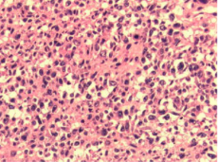

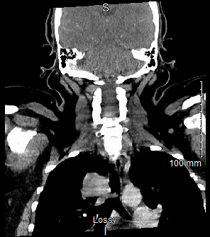
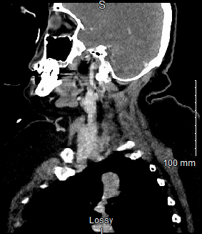
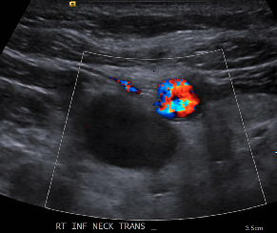
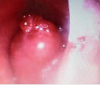
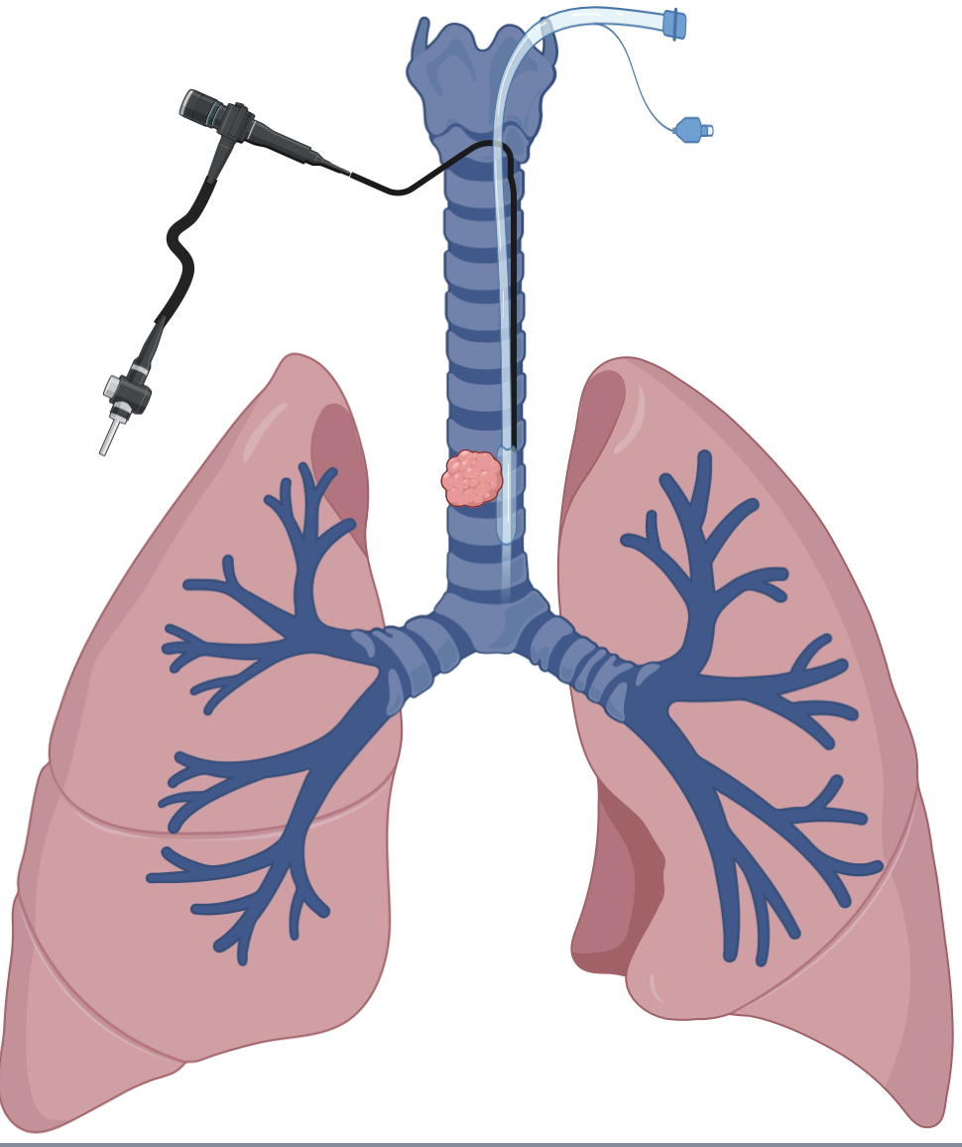
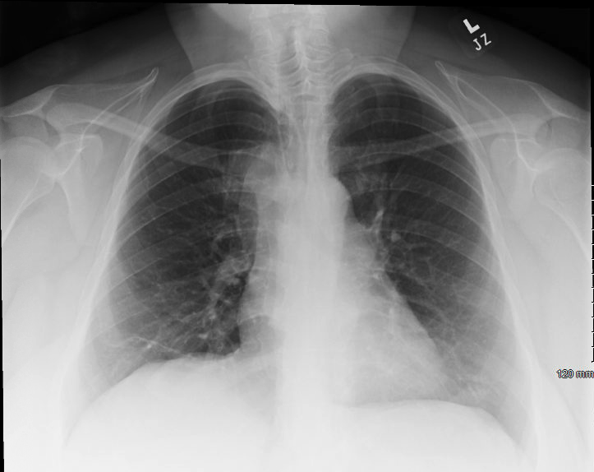
Framing Bias and Life-Changing Decisions: A Rare Airway Neoplasm
Presenting as a One-Way Ball Valve During Emergent Bronchoscopy
Robert A. Price, Hamna S. Javed, Talal M. Arab
Saint Agnes Medical Center, Fresno CA
Introduction
Case Presentation Part 2
Discussion
Conclusions
The estimated global incidence of Non-Hodgkin’s lymphoma (NHL) in 2018 was 509,590. Fortunately for those affected by NHL, airway involvement is rare. There are, however, cases of secondary airway invasion, but less than thirty cases have been reported in the last five years. Thus, it is crucial for those treating patients with asthma history to avoid framing bias when shortness of breath is a chief complaint, and invasive neoplasms are under consideration. Here, we describe a case where a forty-four-year-old, obese, Spanish-speaking woman with a month-long history of coughing attributed to asthma, presented with shortness of breath refractory to steroids and bronchodilators.
Availability of interventional pulmonology limited management in our community hospital and in the evening a second emergent bronchoscopy was completed to guide advancement of the ET tube past the tumor and restore airway patency (1E). Ultimately, due to concerns about decompensation, the patient was transferred to a tertiary referral facility with interventional pulmonology and subsequent resection of the tumor allowed for histopathologic analysis, revealing a CD30+, Anaplastic Lymphoma Kinase – negative Anaplastic Large Cell Lymphoma (ALK- ALCL) (1G,1H). After resection, the patient was discharged from the hospital with improved ventilation and plans for oncology follow up.
Ultimately, after oncology follow up with the patient weeks after her initial presentation the patient was readmitted to the hospital with concerns about repeat invasion of the airway and new imaging demonstrated sustained local growth of the tumor. A theoretical risk of local seeding through the early emergent intubation was considered at that time and, in hindsight, a more controlled intubation with interventional pulmonology may have made reemergence of the lymphoma less likely. Nevertheless, as of the most recent follow up, the patient has been started on an appropriate chemoradiotherapy regimen and curative management was, most recently, regarded as an appropriate goal despite the challenges of early management.
This case represents a rare endotracheal presentation of ALK- ALCL. Crucially, while it highlights how framing-bias can prevent early diagnosis of NHL subtypes, it also illustrates how bias can contribute to high-risk intubations. While this case is ongoing, local growth of the tumor may have been contributed to by the unplanned advancement of the ET tube. While such complications cannot always be avoided, it is possible that bias-awareness could promote improved management choices in similar future cases.
There were several instructive lessons from this case. Firstly, the presence of a language barrier in the initial workup may have led to premature conclusions about the simplicity of the shortness of breath and the framing of the case predisposed our team to treat for asthma when alternative diagnoses were prematurely dismissed. Secondly, a preliminary report from radiology that the airway was patent misled our team to continue asthma treatments when an early airway intervention would have been preferable. While language barriers and errors in clinical reasoning and communication are not always possible to avoid greater awareness of their potential to mislead may help practitioners facing similar cases in future
There are a variety of cognitive errors often made in the workup of airway tumors; chief amongst these is the assumption of asthma as an explanation for shortness of breath. In this rare case of endotracheal ALK-ALCL there were a few red-flag findings that should be watched for in similar future cases including (1) stridor on examination, (2) complaints about ”something stuck in the throat, and (3) refractoriness to early asthma treatments with steroids and inhaled bronchodilators making no difference in work of breathing.
Case Presentation Part 1
In the emergency department our patient discussed an abnormal feeling in her throat that prompted a chest x-ray (1A) and neck ultrasound (1B). These studies detected enlarged paratracheal and jugulodigastric lymph nodes that were not considered causative despite airway proximity. After eight hospital days the patient developed acute hypercarbic respiratory failure and stridor was heard. During transfer to the ICU a CT scan (1D,1F) revealed an endotracheal mass, but before this was reported, an emergent endotracheal intubation was completed. Surprisingly, this intubation failed to provide adequate ventilatory volumes. Due to this imminent life threat, a bronchoscopy was completed and a mass acting as a one-way ball valve was visualized (1C).
1G
1H
Future Considerations
Future approaches for similar cases in the future may consider the following steps to avoid high risk intubations when invasive airway neoplasms are considered:
In-person translation to avoid confusion related to airway history
Direct imaging review with radiology to clarify airway patency
Consider refractoriness of shortness of breath suggestive of alternative diagnosis to asthma and/or other obstructive lung pathology --especially in patients without smoking history.
1B
1C
References
1F
Armitage JO, Gascoyne RD, Lunning MA, Cavalli F. Non-Hodgkin lymphoma. Lancet. 2017;390(10091):298-310. doi:10.1016/S0140-6736(16)32407-2
Swerdlow SH, Campo E, Pileri SA, et al. The 2016 revision of the World Health Organization classification of lymphoid neoplasms. Blood. 2016;127(20):2375-2390. doi:10.1182/blood-2016-01-643569
Attygalle AD, Cabeçadas J, Gaulard P, et al. Peripheral T-cell and NK-cell lymphomas and their mimics; taking a step forward - report on the lymphoma workshop of the XVIth meeting of the European Association for Haematopathology and the Society for Hematopathology. Histopathology. 2014;64(2):171-199.
Kinney MC, Higgins RA, Medina EA. Anaplastic large cell lymphoma: twenty-five years of discovery. Arch Pathol Lab Med. 2011;135(1):19-43. doi:10.5858/2010-0507-RAR.1
Pavlov N, Pavlov V, Culić S, et al. Endobronchial ALK+ anaplastic large-cell lymphoma resembling asthma in a 13-year-old girl. J Pediatr Hematol Oncol. 2013;35(1):e4-e6. doi:10.1097/MPH.0b013e31827076c4
1A
1D
1E
Saint Agnes Medical Center, Fresno California, 1303 E Herndon Avenue

