Slide 1
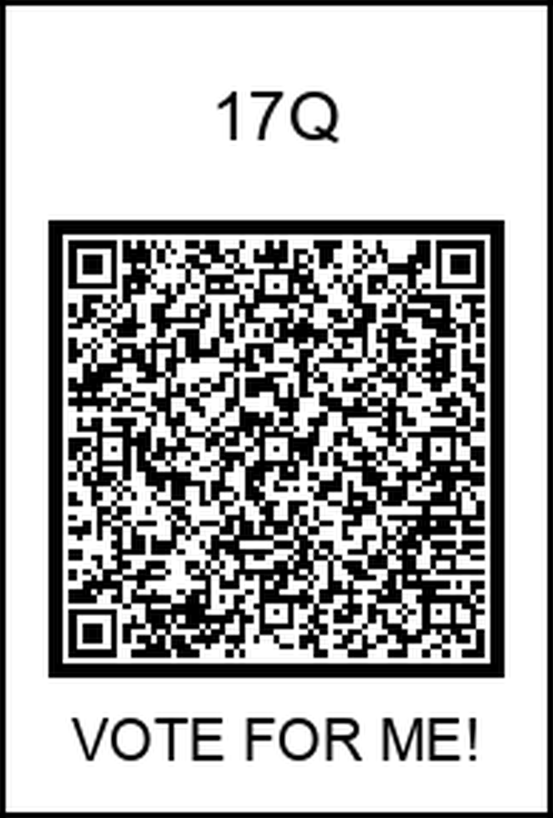
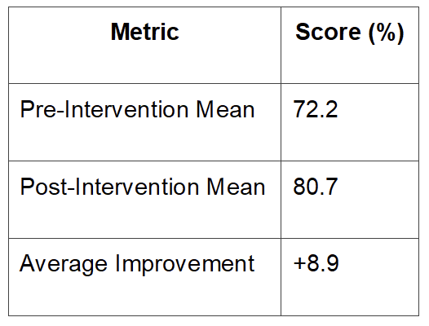
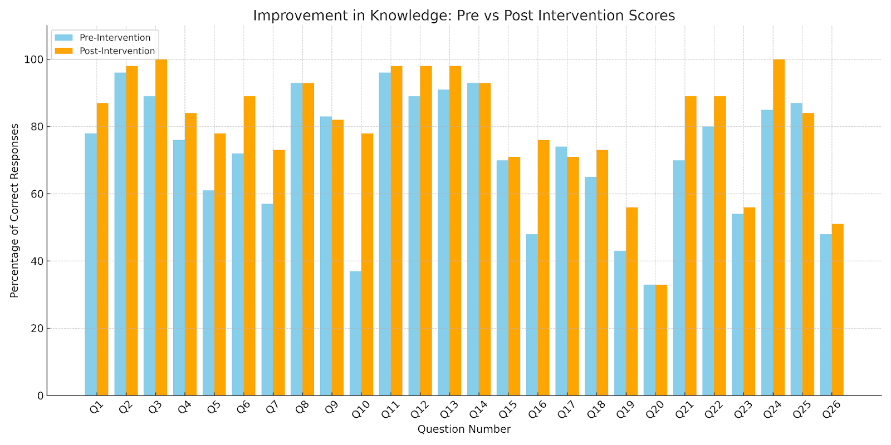

CLEARING THE AIR: Boosting Resident Knowledge of Lung Cancer Screening
Rukhsar Nadeem MD, Hamna Javed MD, Mahwish Sheikh MD, Anupama Poliyedath MD, Mehdi Hakimipour MD
Saint Agnes Medical Center, Fresno, CA
Introduction
Results Cont.
Lung cancer remains the leading cause of cancer-related deaths in the U.S., yet screening practices are often underutilized or misunderstood. Internal medicine residents play a vital role in preventive care, but knowledge gaps may hinder appropriate screening recommendations. This project aims to enhance resident understanding of lung cancer screening guidelines and protocols through targeted education.
These results suggest that a targeted educational session can effectively enhance resident knowledge on lung cancer screening, particularly in areas of guideline comprehension and evidence-based eligibility criteria.
Limitations:
Small sample size from a single residency program
Short follow-up time limits long-term knowledge retention analysis
Lecture format may not address all learning styles
Figure 1: Table showing the average score in percentage pre and post intervention.
Methods
Conclusion
Participants: PGY-1 to PGY-3 Residents & Medical Students
Intervention Design:
Pre-Intervention Assessment: 26-question quiz covering USPSTF recommendations, Lung-RADS criteria, screening eligibility, risks, benefits, and management (QR code above).
Intervention: 30-minute interactive lecture reviewing evidence-based screening guidelines, key clinical trial data (NLST & NELSON), and case-based scenarios.
Post-Intervention Assessment: Same quiz administered to evaluate knowledge retention.
Topics Covered:
Lung cancer epidemiology & risk factors (questions 1 & 2)
Screening eligibility criteria & guidelines (questions 3, 4, 5, 6, 15 & 16)
Screening methods, benefits, and harms (questions 7, 8, 9, 11, 14 & 20)
Lung-RADS Classification & Nodule Management (questions 12, 13, 17, 18, 19, 21, 22, 23, 24, 25 & 26)
Evidence Base & Smoking Cessation (questions 10, 14, 15 & 19)
A focused educational intervention significantly improved resident knowledge of lung cancer screening guidelines. Periodic reinforcement and integration into clinical practice discussions may help sustain knowledge and promote evidence-based screening.
Figure 2: Graph showing the improvement in knowledge pre and post intervention
References
Results
Krist AH, Davidson KW, Mangione CM, et al. Screening for Lung Cancer: US Preventive Services Task Force Recommendation Statement. JAMA. 2021;325(10):962–970. doi:10.1001/jama.2021.1117
National Lung Screening Trial Research Team. Reduced lung-cancer mortality with low-dose computed tomographic screening. N Engl J Med. 2011;365(5):395-409. doi:10.1056/NEJMoa1102873
de Koning HJ, van der Aalst CM, de Jong PA, et al. Reduced lung-cancer mortality with volume CT screening in a randomized trial. N Engl J Med. 2020;382(6):503-513. doi:10.1056/NEJMoa1911793
A total of 46 residents & medical students completed pre- and post-intervention questionnaires. The pre-intervention average score across all questions was 72.2%, which improved to 80.7% post-intervention—a mean increase of 8.9 percentage points.
Question 10 (regarding clinical trial evidence) showed the greatest improvement, with a gain of 17.4 percentage points.
Question 17 (likely addressing nuanced Lung-RADS classification) had the least improvement, suggesting a need for deeper reinforcement of complex radiologic criteria.
20 out of 26 questions showed an improvement in correct response rate post-lecture. (Figure 2)

