Slide 1
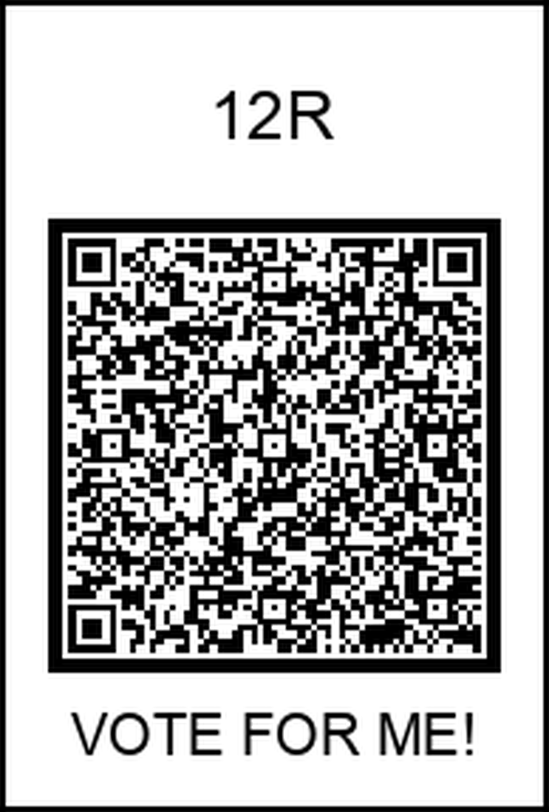
Impact of Asynchronous Resident Pre-Dictation on Radiology Report Finalization Time (RFT) and RVU Generation in an ER Setting
Christian Lee, Kal L. Clark
UT Health San Antonio Long School of Medicine, Radiology Department
Abstract
Methodology
Results
Conclusion
Previous studies on resident involvement in radiology workflows have shown mixed effects on report turnaround time (rTAT), with less experienced residents often delaying reporting due to teaching, while experienced residents may improve efficiency. These effects vary by scan complexity and impact RVU generation. With the rise of asynchronous workflows—where residents pre-dictate reports before attending finalization—new efficiencies are possible. This study examines the impact of asynchronous resident pre-dictation on report finalization time (RFT) in a 24-hour ER radiology department, finding that RFT increases with less experienced residents and decreases with experienced ones. These differences were used to estimate changes in RVU productivity.
This was a retrospective cohort study analyzing one year (2023) of radiology report data from a 24-hour emergency radiology department. A total of 537,509 studies were included. Due to the lack of precise scan start and end timestamps, RFT was operationalized as the time between consecutive finalized reports by the same attending. This approach assumes continuous reading patterns but may overestimate actual time spent per case, especially when delays or interruptions occur.
Data were filtered to include only finalized reports and cases with valid timestamps. Reports were flagged for resident involvement if they listed multiple “Reading Providers,” indicating pre-dictation by a trainee. Cases were stratified by attending, resident involvement, and presence of preliminary reports. Welch’s t-tests were performed to compare RFT across provider types, and subgroup analysis was conducted by scan type.
This study evaluated the effect of resident pre-dictation on report finalization time (RFT) in an asynchronous emergency radiology workflow using a large dataset of over half a million radiology reports. Although true RFT was not directly measurable from the dataset, our use of estimated RFT—calculated as the time between sequential report finalizations by the same attending—revealed significant trends that remain relevant to departmental efficiency.
Experienced residents (e.g., PGY-4) were associated with significantly shorter RFTs, particularly for simpler studies, compared to attending-only cases. This suggests that senior trainees can meaningfully contribute to report throughput even within an asynchronous workflow model. Conversely, less experienced residents were associated with increased RFTs, especially in complex studies like MRI, likely due to longer pre-dictation and attending correction time. Furthermore, attending-specific variability in RFT was substantial, highlighting the influence of individual workflow styles and possible confounding factors such as breaks, multitasking, or interruptions.
While the average RFT values reported (e.g., 217 minutes for attending-only cases) appear long, they reflect limitations in the data source—not actual reading time, but rather the time between finalized reports. This proxy is imperfect but internally consistent, allowing valid comparisons across provider types and study types. These findings emphasize the need for improved time-tracking granularity in radiology information systems and suggest that targeted workflow interventions—such as pairing junior residents with senior mentors or leveraging AI-assisted pre-dictation—may optimize efficiency.
In conclusion, asynchronous workflows in emergency radiology can benefit from experienced resident involvement, both in terms of efficiency and RVU generation. Institutional efforts to streamline resident education, report pre-dictation, and attending supervision should be guided by these findings and further validated using more precise timing data.
Of the 537,509 reports analyzed, 7,365 (1.4%) included resident pre-dictation. Across all attendings, the mean estimated RFT was 217 minutes for cases without resident involvement. When residents were involved, RFTs varied significantly depending on experience. For example, one attending had an average RFT of 4.8 minutes with experienced resident involvement versus 217 minutes without (p < 0.001). Similar reductions were observed for other attendings when partnered with senior residents.
Subgroup analysis by scan type indicated that simpler studies (e.g., chest X-rays) were less impacted by resident involvement, while more complex studies (e.g., MRI) showed increased RFT when handled by less experienced residents.
RVU generation correlated inversely with RFT: attendings with shorter RFTs produced more RVUs per hour, especially when partnered with PGY-4 residents.
Introduction
Radiology report finalization time (RFT) is a key performance metric in emergency imaging, reflecting the interval from study acquisition to finalized interpretation. While prior studies have examined resident impact on synchronous workflows, asynchronous workflows—where residents pre-dictate reports before attending review—remain underexplored. Understanding the effects of resident pre-dictation on RFT is essential for optimizing workflow efficiency, educational value, and patient care outcomes.
This study seeks to quantify the impact of resident involvement on RFT in an asynchronous ER setting. Specifically, we analyzed how the presence of additional reading providers, presumed to be residents, affects RFT compared to attending-only finalizations.
Acknowledgements
We would like to thank Dr. Vanputten, Program Director at St. Agnes Medical Center, for his support and for allowing dedicated time to work on this research project. We are also grateful to St. Agnes Medical Center for fostering an academic environment that values resident-driven scholarship and supports independent inquiry.

