Slide 1



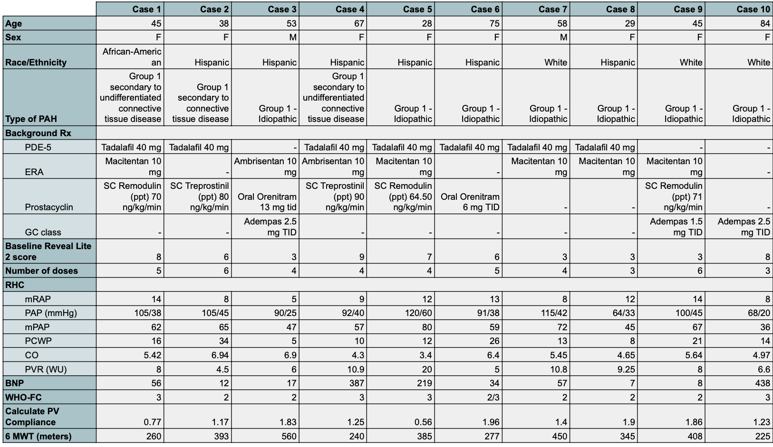
The PHourth pathway in PAH: Experience in the
“underserved” Central Valley of California
Hamna Javed, MD; Mahwish Sheikh, MD; Andrew Clark, MD; Aftab Arif, MD; Vijay Balasubramanian MD, MRCP (UK), FCCP
Internal Medicine Residency, Saint Agnes Medical Center, Fresno, CA
Pulmonary & Critical Care Medicne, Valley Advanced Lung Disease Institute, Fresno, CA
Introduction
Pulmonary arterial hypertension (PAH) is characterized by progressive narrowing of pulmonary vasculature leading to right heart failure & Death. Historically, 3 pathways were targeted for treatment – Endothelin, Nitric oxide, and Prostacyclin. Sotatercept (SOT) is the new activin inhibitor recently added as the fourth pathway. Central Valley of California (CVC) is an underserved part of California with severe access to care challenges (CVC had a PHCCC). Our case series describes early CVC experience with this novel drug.
Methodology
Table 1 summarizes data from 10 patients with Group 1 Pulmonary Arterial Hypertension (PAH), noting demographics, treatment regimens, risk score, RHC data, and functional assessments.
The age ranged from 28 to 84 years, with a predominance of females (8/10). The majority were Hispanic (6), followed by White (3), and African-American (1). Most cases were idiopathic (7), while 3 were associated with connective tissue disease. Prostacyclin therapy was administered to 7 patients—5 received subcutaneous agents (Remodulin or Treprostinil) and 2 received oral Orenitram. Guanylate cyclase stimulators (Adempas) were used in 3 patients. Triple therapy was used in 3 patients, double therapy was used in 6 patients while one patient was on single agent adempas. All the patients received at least 3 doses of sotatercept. The mean number of doses given to the patients was 4.
Reveal Lite 2 scores varied from 3 to 9, and all patients had elevated mean pulmonary artery pressures (36–80 mmHg). Pulmonary vascular resistance ranged from 4.5 to 20 Wood units, with PV compliance between 0.56 and 1.96. Cardiac output spanned 3.4 to 6.94 L/min. Most patients were WHO Functional Class II–III, and 6-minute walk distances ranged from 225 to 560 meters. BNP levels were elevated in several cases, reaching up to 438 pg/mL.
Table 1 illustrates key patient demographics and PAH-related clinical data.
Discussion
Conclusion
The Phase 3 STELLAR Trial led to the approval of sotatercept as an agent for the treatment of pulmonary arterial hypertension. The activin pathway is considered the fourth pathway in the treatment of PAH. This case series highlights the use of SOT in the underserved population of the Central Valley. In contrast to the STELLAR trial (96%) and ZENITH trial (84%) data was done on predominantly white individuals, 96% and 84% respectively. In contrast to that, our case series includes mostly hispanic females which is reflective of the population in the Central Valley. Although our small case series is based on the experience at a single center, it shows evident racial disparities and will lead to increased data on the effects of SOT in other ethnicities.
These cases illustrate favorable responses to SOT in patients with progressive PAH. Often, Symptom improvement was perceived as soon as after 1 st dose. Of the 10 patients, SOT had to be stopped in 1 patient due to significant Thrombocytopenia despite favorable clinical response. Our Real-world experience with SOT illustrates the efficacy of this intervention in keeping with the recommendations from the 7th World Symposium.
References
Hoeper MM, Badesch DB, Ghofrani HA, Gibbs JSR, Gomberg-Maitland M, McLaughlin VV, Preston IR, Souza R, Waxman AB, Grünig E, Kopeć G, Meyer G, Olsson KM, Rosenkranz S, Xu Y, Miller B, Fowler M, Butler J, Koglin J, de Oliveira Pena J, Humbert M; STELLAR Trial Investigators. Phase 3 Trial of Sotatercept for Treatment of Pulmonary Arterial Hypertension. N Engl J Med. 2023 Apr 20;388(16):1478-1490. doi: 10.1056/NEJMoa2213558. Epub 2023 Mar 6. PMID: 36877098.
Humbert M, McLaughlin VV, Badesch DB, Ghofrani HA, Gibbs JSR, Gomberg-Maitland M, Preston IR, Souza R, Waxman AB, Moles VM, Savale L, Vizza CD, Rosenkranz S, Shi Y, Miller B, Mackenzie HS, Kim SS, Loureiro MJ, Patel MJ, Koglin J, Cornell AG, Hoeper MM; ZENITH Trial Investigators. Sotatercept in Patients with Pulmonary Arterial Hypertension at High Risk for Death. N Engl J Med. 2025 Mar 31. doi: 10.1056/NEJMoa2415160. Epub ahead of print. PMID: 40167274.

