Slide 1


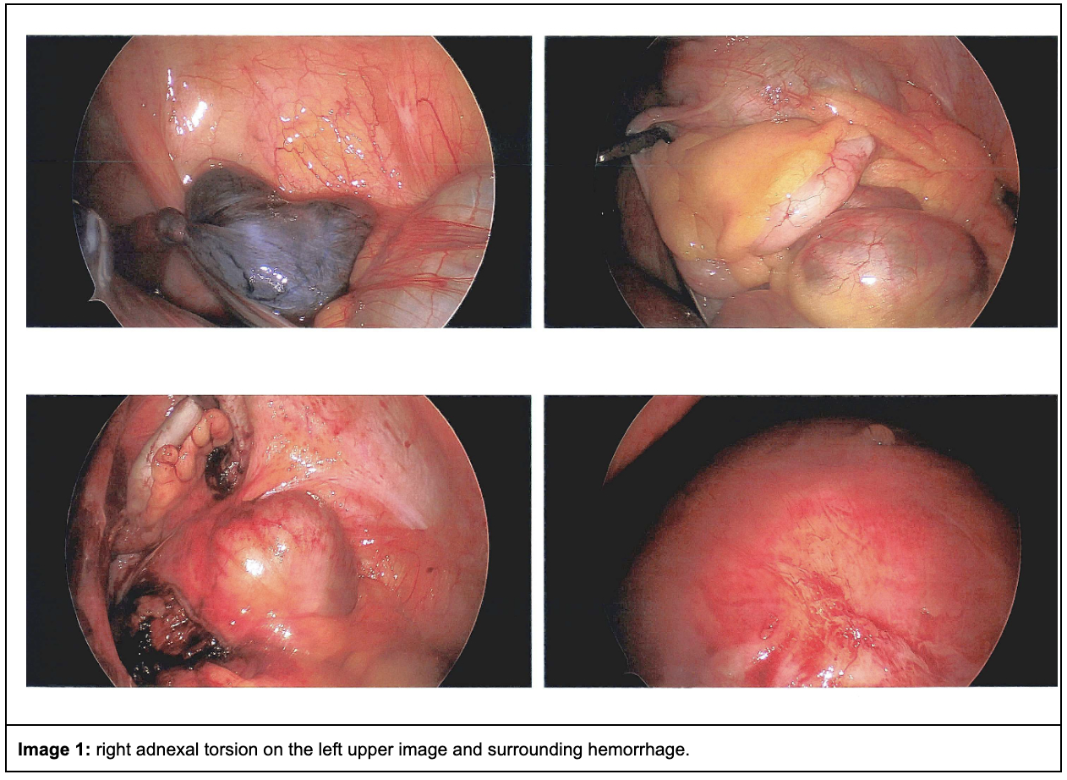
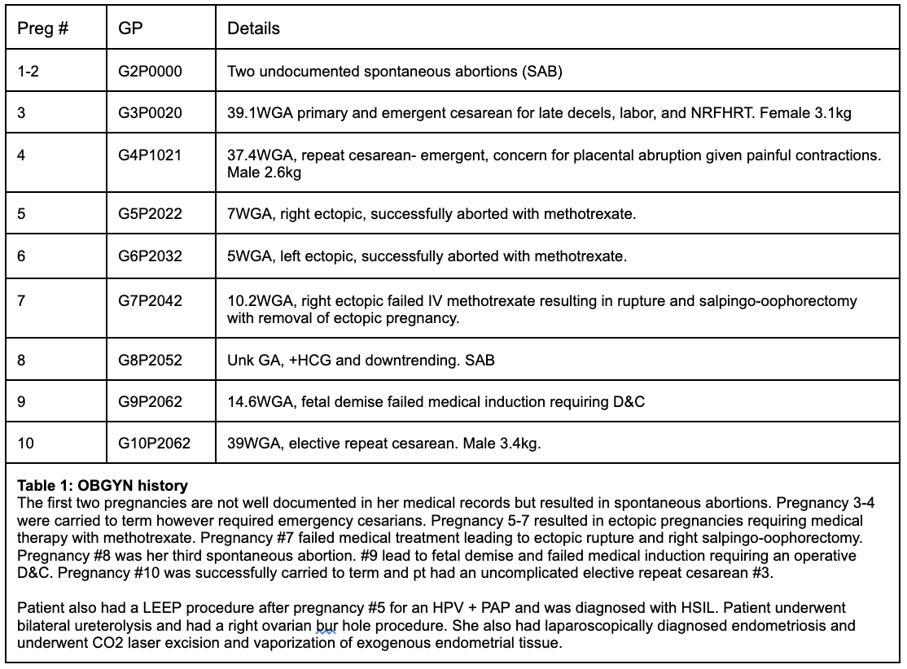
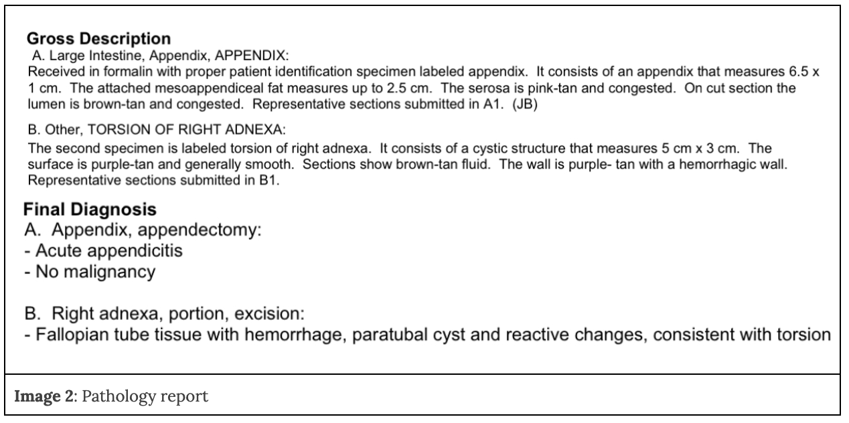

Right Adnexal Torsion with Appendicitis, Rare Non-Obstetric
Complications in Pregnancy
Gullerana Ahmad, MD*, Dildeep Dhaliwal, MD MSc*, Ruqayya Gill, DO MBS FACEP*
Jesse Kellar, MD MBA FACEP*, Russell Martin, MD FACS, Gilbert Moran, MD FACOG
Emergency Medicine*, General Surgery, OBGYN
Introduction
Results, Imaging
Surgical Pathology
Discussion
Ultrasound is often the first imaging modality used in pregnancy, given its easy accessibility, no radiation risk, and low cost. The sensitivity for ovarian torsion in pregnancy is reported as 62.5% and 44.9% for appendicitis respectively [7,8]. MRI, should be utilized earlier on since it has a sensitivity of 100% in adnexal torsion (AT) and 96% in appendicitis in pregnant women [9,10].
The diagnosis for this patient took approximately 32 hours since additional imaging was required and ultimately was definitely made intraoperatively. This delay in diagnosis can be attributed to several factors, such as nonspecific imaging/physical exam. Additionally the patient was afebrile and had multiple visits for pelvic pain on record. Her labs were largely non-contributory. Adnexal torsion on imaging has features of unilateral ovarian enlargement, ovarian edema, hemorrhage, infarction, pelvic free fluid, and mass [11]. These findings are similar to what was seen in our patients' imaging, such as trace-free fluid and tubular dilation with fluid/gas-filled structure in the right hemipelvis.
Her pathology report was notable for a paratubal cyst and appendicitis, even though she underwent a right-sided salpingo-oophorectomy in 2022. It is plausible that the cyst formation was due to paramesonephric remnants, as ~76% of paratubal cysts are, or the cyst formation could be due to ovarian remnant syndrome (ORS). ORS is a condition where remnants remain from improper tissue extraction from the previous surgery. Endometriosis can be a risk factor for ORS [12,13]. Regardless, she successfully underwent a laparoscopic appendectomy and removal of the paratubal cyst. Laparoscopic surgery is noted to have better surgical outcomes, shorter length of hospital stays, and postoperative complications [14]. Following her surgery, she continued to do well and safely delivered her son full term at 39WGA as planned.
This case report describes a rare instance of concurrent right adnexal torsion and acute appendicitis in a 29-week pregnant patient with a history of endometriosis and multiple ectopic pregnancies. The case underscores the diagnostic challenges of acute abdominal pain in pregnancy and emphasizes the importance of maintaining a high index of suspicion for multiple pathologies, particularly when imaging is inconclusive.
Paratubal cysts are fluid-filled sacs, remnants of the mesonephric Wolffian and paramesonephric Mullerian ducts. Paratubal torsions (PTT) occur when the cyst twists around its pedicle. Processes such as PTT and appendicitis occurring individually are rare in pregnancy. Appendicitis occurs in ~0.05-0.15% of pregnancies and the incidence of PTT is ~3-5 per 10,000 pregnancies [1,2,3]. However, both occurring concurrently in a patient with a history of salpingo-oophorectomy is exceedingly rare and this case presents the first instance in literature.
A timely diagnosis is imperative since the patient is at risk of perforation from appendicitis, a lower chance of preserving the ovary, and ultimately leads to a higher risk of maternal and fetal mortality [4]. Thus, having a high clinical suspicion for multiple co-occurring underlying processes is of the utmost importance, though it can be clinically challenging. The clinical challenge is often difficult due to various reasons, such as physiological/anatomical changes, overlapping symptoms, and varying imaging diagnostic accuracy.
Our patient was 29 weeks pregnant with a past medical history of endometriosis, bicornuate uterus, and a right salpingo-oophorectomy due to ectopic pregnancy. She presented to the emergency department with right lower quadrant (RLQ) pain along with nausea and vomiting since that morning. Misdiagnosis often occurs when the patient's nonspecific symptoms mimic other pathologies such as pregnancy-related symptoms, appendicitis, urinary tract infection, placental abruption, ovarian cyst rupture, pyelonephritis, or round ligament pain [5,6]. Furthermore, a gravid uterus can also alter normal abdominal anatomy, further contributing to a misleading diagnosis. Clinicians often diagnose PTT during surgical exploration, trying to rule out other pathologies, such as appendicitis similar to this patient's case [5].
Patient's labs including CBC showed mild stable anemia compared to previous baseline Hemoglobin, CMP showed no acute abnormalities, PT and INR were normal.
Ultrasound of the abdomen revealed a normal-appearing uterus, a 3.2 cm right ovarian cyst with an otherwise normal right ovary, and a 1.9 cm left corpus luteal cyst with a normal left ovary. No free fluid was identified. The appendix was not visualized, and appendicitis could not be excluded.
MRI of the abdomen without contrast was limited due to the patient's condition but showed no definite acute abdominal pathology. A small fluid focus was noted in the right lower quadrant, possibly representing focal fluid or a partially imaged bowel loop. The gravid uterus contained a fetus in breech position.
MRI of the pelvis reported that the appendix was not definitively identified; however, a tubular, dilated, fluid- and gas-filled structure was seen in the right hemipelvis without clear communication with the cecum. Trace fluid was present in the right hemipelvis.
The patient underwent surgical exploration, which revealed right adnexal torsion of what appeared to be the right ovary with ischemia and gangrene. There was no gross purulence in the pelvis and no perforation of the appendix, although the appendix appeared mildly dilated. The appendix was transected and removed. Pathology results confirmed acute appendicitis without malignancy. Examination of the right adnexal specimen revealed fallopian tube tissue with hemorrhage, a paratubal cyst, and reactive changes consistent with torsion. Grossly, the appendix measured 6.5 × 1 cm with a congested lumen and attached mesoappendiceal fat, and the torsed adnexal structure measured 5 × 3 cm with a purple-tan, smooth surface. The patient had right adnexal torsion secondary to development of a paratubal cyst (see image 2 for pathology report).
Case Presentation
A 33-year-old G10P2 woman at 29+1 (WGA) presented with right lower quadrant pain that began periumbilically at 5:00 AM, migrated, and was associated with vomiting and worsening with standing. Her history included laparoscopically diagnosed endometriosis, prior four ectopic pregnancies, right salpingo-oophorectomy, medically treated chlamydial cervicitis and PID, HPV + PAP and subsequent LEEP procedure. She also had an intraoperatively observed and US diagnosed bicornuate uterus with the right side being significantly larger compared to the left. Her OB/GYN history was complicated (see table 1 for details). She was G10P2072 at the time of this visit. She had multiple emergency department visits for pelvic pain requiring multiple ultrasounds and CT scan unable to pinpoint her pelvic pain.
On exam, she had right lower quadrant tenderness without peritoneal signs. Labs were inconclusive however imaging showed a right ovarian cyst and a trace amount of free fluid in the right pelvis. There was also a gas filled tubular and dilated structure without clear communication to the cecum. General surgery was consulted due to persistent, worsening pain. The patient underwent surgical exploration which revealed right adnexal torsion with what appeared to be the ovary and acute appendicitis. Appendicitis was confirmed on pathology. The patient was admitted to OB for observation and concern for preterm labor. She had no acute events in the post-op period and was discharged 3 days later. She had her post-op check with general surgery without complications. Patient had a scheduled and uncomplicated repeat cesarean at 39 WGA two months after this diagnosis.
Conclusion
This case emphasizes the need for heightened clinical vigilance when evaluating pregnant patients with persistent abdominal pain, particularly in those with complex gynecologic histories. Concurrent intra-abdominal pathologies, though rare, should remain on the differential when symptoms are unexplained by a single diagnosis. Early surgical intervention may be warranted despite inconclusive imaging to prevent maternal and fetal morbidity.
References

