Slide 1

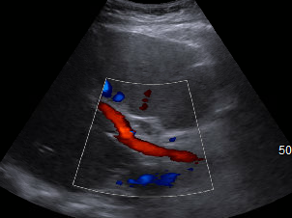
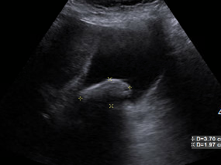
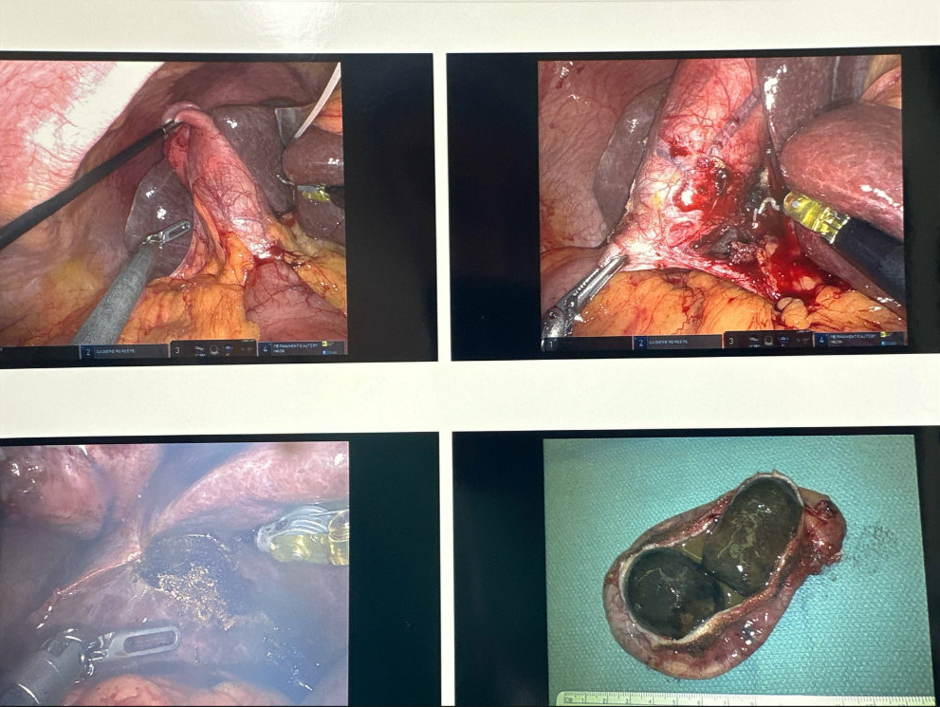
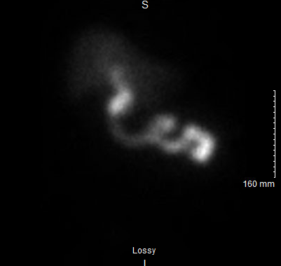

An unusual case of hydrops gallbladder as a source of sepsis
Kevin Yao, MD MPH, Navdeep Gill, MD, Robert Tevendale, MD
Internal medicine and Family medicine
Introduction
Findings and Results
Discussion
A 70 year old female with PMH paroxysmal atrial fibrillation, heart block, HTN, HLD, obesity, who presented to the ED after 3 days of rhinorrhea, chills, 2 episodes of fevers, nausea/vomiting, myalgias. Initially denied chest pain, abdominal pain, RUQ pain, or diarrhea. In the ED, workup found leukocytosis of 21.2k, lactate of 3.0, ESR 83, and was admitted for suspicions of sepsis which was initially thought to be pneumonia due to findings of interstitial opacities on CXR. She was started on cefepime 1g IV in the ED and upgraded to the FM team who switched to levofloxacin 750mg under same initial suspicions.
Hydrops gallbladder:
Rare condition due to obstruction of cystic duct without stones or congenital malformations
Usually in children
Increasing prevalence in all populations including adults
Mimics other abdominal presentations
Often due to or associated with other conditions like infections, systemic or inflammatory diseases, but were primarily studied in pediatric populations in the 90s
Typically presents with expected gallbladder-related symptoms such as RUQ abdominal pain, nausea/vomiting, bloating, labs with cholestatic pattern, etc
Often assumed typical gallstones until after surgery
Background
Ultrasound abdomen showing cholelithiasis without cholecystitis, and patency of CBD
Later in the admission, blood cultures grew MDRO ESBL E coli of unknown source as this is atypical of infections of lung. ID was consulted, and as this is a typical intraabdominal pathogen, abdominal workup was initiated including abdominal ultrasound and HIDA scan. Source was narrowed to suspected gallbladder as she also had mild right flank pain, and negative UA ruled out UTI. However, US was negative for cholecystitis but showed cholelithiasis and HIDA was indeterminate due to poor visualization with patent CBD, but antibiotics were changed again to cover intra-abdominal pathogens with ceftriaxone 2g, and pt underwent robotic laparoscopic cholecystectomy on recommendation of ID.
Surgery team reached out to primary and ID teams with findings and a picture of the hydrops gallbladder.
CONCLUSION
This case:
Did not present with typical expected symptoms
Had negative or indeterminate imaging
Without any indication that the cholelithiasis was a source of infection except for blood culture.
Does not align with prior cases published detailing incidence in adults
Highlights the importance of understanding sources of various bacteria in narrowing origins of sepsis
References
Images post laparoscopy, with two mucocele seen
HIDA scan showing poor visualization of gallbladder but patent CBD

