Slide 1


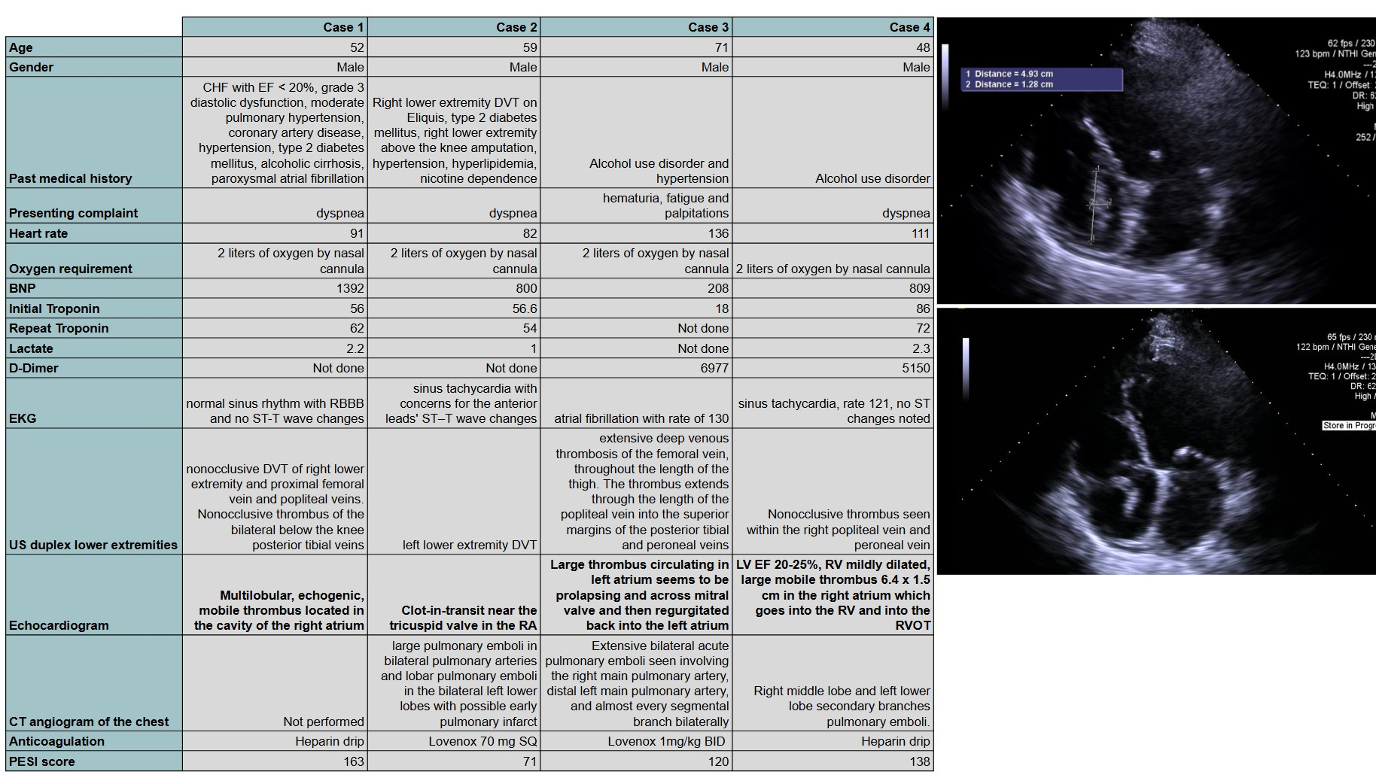
Clot Chronicles: Documenting Cases Of Thrombi In Transit
Aftab Arif, MD; Hamna Javed, MD; Andrew Clark, MD; Pankaj Bharati, MD; Sean Tower, MD
Saint Agnes Medical Center, Fresno, CA
Introduction
A clot-in-transit (CIT) is a rare but serious complication associated with venous thromboembolism. Increasingly recognized due to the availability of point-of-care ultrasound (POCUS). CIT has a five times greater mortality rate ascompared to high-risk pulmonary embolism. We present 4 cases of diagnosed clots in transit at a community hospital with a (Pulmonary Embolism Response Team) PERT team.
Case Presentation
Table1 displays a table with patient demographics, presenting complaints, associated labs. Figure 1 & 2 show echocardiogram findings.
Case 1:
A 52-year-old male with a past medical history of congestive systolic and diastolic heart failure, hypertension, coronary artery disease, type 2 diabetes mellitus, alcoholic cirrhosis, paroxysmal atrial fibrillation was evaluated for dyspnea in the emergency department (ED). He had an intracardiac thrombus, was started on a heparin drip, and underwent aspiration of the clot. A thrombophilia workup was negative.
Case 2:
A 59-year-old male with a past medical history of right lower extremity DVT, type 2 diabetes mellitus, right above-the-knee amputation, hypertension, hyperlipidemia, and nicotine dependence presented to the ED withdyspnea. He was found to have an intracardiac thrombus which was aspirated. He remained stable and was discharged on apixaban.
Case 3:
A 71-year-old male with a past medical history of alcohol use disorder and hypertension presented to the ED with complaints of hematuria, dyspnea, and palpitations. The workup revealed an intracardiac thrombus and bilateral pulmonary emboli. He was started on Lovenox therapeutically, underwent aspiration of intracardiac thrombus, thrombectomy of bilateral pulmonary emboli, and switched to a heparin drip. He remained stable and was discharged on apixaban.
Case 4:
A 48-year-old male with a past medical history of alcohol use disorder presented to the ED with dyspnea. He was diagnosed with a low ejection fraction on a bedside ultrasound. His condition worsened and he underwent cardiopulmonary arrest. He was successfully resuscitated and diagnosed with an intracardiac thrombus. He had right pulmonary emboli and right lower extremity DVTs. He underwent aspiration of the intracardiac thrombus and thrombectomy of the right pulmonary emboli. He remained stable and was discharged with apixaban.
Table 1 illustrates key patient demographics and related clinical data.
Figure 1 and 2 show clot in the left ventricle on a transthoracic echocardiogram
Discussion
References
Clot-in-transit (CIT) is a rare but life-threatening complication of venous thromboembolism, associated with mortality rates up to 100% without treatment[1][2]. Prompt diagnosis with bedside imaging and intervention is critical. Our cases highlight the success of aspiration thrombectomy combined with anticoagulation, guided by a multidisciplinary PERT approach[3][4]. Percutaneous aspiration offers a minimally invasive alternative to surgery or thrombolysis, particularly in unstable patients[5]. Post-procedural anticoagulation with direct oral anticoagulants (DOACs) is supported by current guidelines[6]. Early recognition, rapid multidisciplinary coordination, and individualized therapy remain key to improving outcomes in patients with CIT.
Rose PS, Punjabi NM, Pearse DB. Treatment of right heart thromboemboli. Chest. 2002;121(3):806-814. doi:10.1378/chest.121.3.806
Torbicki A, Galie N, Covezzoli A, et al. Right heart thrombi in pulmonary embolism: results from the International Cooperative Pulmonary Embolism Registry. J Am Coll Cardiol. 2003;41(12):2245-2251. doi:10.1016/S0735-1097(03)00476-4
Chartier L, Béra J, Delomez M, et al. Free-floating thrombi in the right heart: diagnosis, management, and prognostic indexes in 38 consecutive patients. Circulation. 1999;99(21):2779-2783. doi:10.1161/01.CIR.99.21.2779
Barrios D, Rosa-Salazar V, Morillo R, et al. Prognostic significance of right heart thrombi in acute symptomatic pulmonary embolism: systematic review and meta-analysis. Chest. 2017;151(2):409-416. doi:10.1016/j.chest.2016.09.037
Kearon C, Akl EA, Ornelas J, et al. Antithrombotic therapy for VTE disease: CHEST Guideline and Expert Panel Report. Chest. 2016;149(2):315-352. doi:10.1016/j.chest.2015.11.026
Greco F, Spina R, Capodanno D, et al. Catheter-directed treatment of right heart thrombi and massive pulmonary embolism: a review. Eur Heart J Acute Cardiovasc Care. 2020;9(4):329-337. doi:10.1177/2048872618787974

