Slide 1

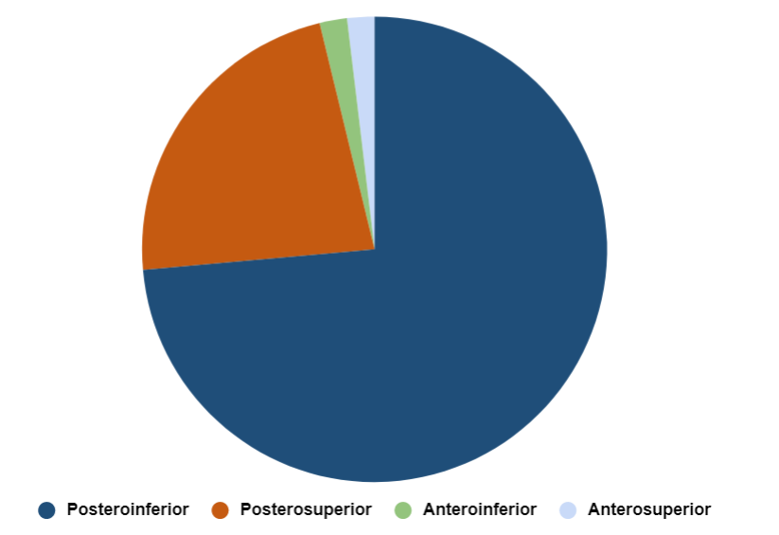
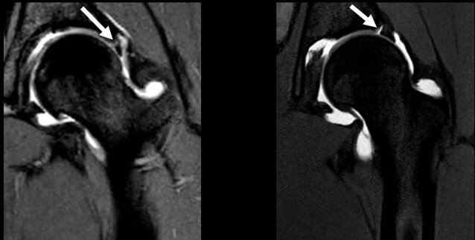

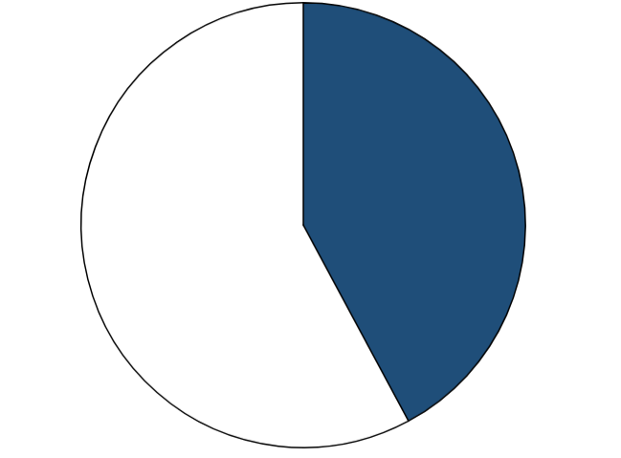
Anatomic Variants of the Acetabular Labrum of the Hip
Brandon E. Knight¹, Kimberley Brown², Alfred Mansour³, Kumaravel Manickam²
¹Saint Agnes Medical Center, Department of GME, ²Department of Radiology, University of Texas Health Science Center at Houston (UTHealth Houston),
³Department of Orthopaedic Surgery, UTHealth Houston
s
Methods (Continued)
Sublabral Sulci Occurrence by Quadrant
Figure 2. Sublabral Sulci found in each quadrant, as a
percentage of the total number of Sublabral Sulci found.
Introduction
Results (Continued)
The acetabular labrum of the hip is a ring of fibrocartilaginous tissue continuous with the distal edge of the acetabulum, completed inferiorly in its arc by the transverse acetabular ligament, and which performs multiple physiologic functions at the hip joint.
Tears of the acetabular labrum of the hip are relatively common, occurring in up to 22% of athletes presenting with groin pain and diagnosed by clinical signs and imaging.
Labral Sulci are non-pathologic anatomic variants of the acetabular labrumD4K18QR that include Sublabral Sulci, which may occur in all labral quadrants, and Transverse Sulci, which may occur in the anteroinferior quadrant. Both Sublabral and Transverse Sulci may appear on imaging similar to labral tears (as shown in Figure 1, below).
Because of their similar appearances, proper differentiation of labral sulci from labral tears is essential for correct diagnosis. Little observational data has been reported on acetabular labral sulci.
Surgical findings were used to determine the presence of labral tears, which if present precluded a diagnosis of physiologic labral sulcus. MR imaging was reviewed to determine the presence of sulci, which were confirmed by surgical findings of sulci, or by a lack of abnormal surgical findings at that location.
Prevalence, location, and additional attributes were observed of sublabral and transverse sulci. Prevalence and location of pathologic findings (labral tears and paralabral cysts) were additionally observed for comparative characteristics of our hip surgical patient population.
Anterosuperior
1.9%
Anteroinferior
1.9%
Posterosuperior
23.6%
Population Characteristics
Table 1. Study population demographics.
Table 2. Prevalence of baseline pathologic findings in study population.
Sulci Prevalence
Table 2. Prevalence of sublabral sulci (one or more) and
transverse sulci in study population.
Sublabral Sulci Transverse Sulci
Posteroinferior
73.6%
Results
Mean Age: 28 | 79% Female
Median Age: 26 | 21% Male
Labral Tear
Labral Sulcus
Conclusion
 | Prevalence among Cases
Labral Tears | 96.6%
Paralabral Cysts | 20.5%
Femoroacetabular Impingement | 96%
Normal anatomic variants, including sublabral sulci and transverse sulci, are relatively common in the acetabular labrum of the hip, and may be mistaken on imaging for tears of the acetabular labrum.
39% of patients were found to have at minimum one sublabral sulcus
42% of patients were found to have a transverse sulcus
Sublabral Sulci location varied widely but appeared in all quadrants of the hip, with most being in the posterior quadrants of the acetabular labrum.
Correctly differentiating acetabular labral tears from acetabular labral sulci increases the specificity of labral tear diagnosis, decreasing the false positive rate and thus improving patient outcomes while preventing unnecessary surgeries and saving resources
Figure 1. Coronal MRI comparison of a Labral Tear (left) to a Labral Sulcus (right). Labrum is seen as the dark area to the right of the tear/sulcus in both images Labral Sulci display smooth borders, homogenous signal, and​ homogeneous adjacent labrum, while labral tears display the opposite.​ Department of Radiology, UTHealth Houston.
 | Prevalence among Cases
Sublabral Sulci | 39%
Transverse Sulci | 42%
Summary
The acetabular labrum of the hip is fibrocartilaginous extension of the acetabulum which is commonly injured in athletes. Tears of the labrum appear similar on imaging to labral sulci, non-pathologic anatomic variants.
Our study sought to further quantify prevalence and location of labral sulci.
This study demonstrates the high prevalence of acetabular labrum sulci in hip surgical patients, with the purpose of ultimately improving diagnostic specificity of acetabular labral tears.
To observe the prevalence and locations of non-pathologic anatomic variants of the acetabular labrum of the hip, including sublabral sulci and transverse sulci.
Purpose
39%
42%
Methods
Hip MR imaging of 121 hip surgical cases from patients who presented to our hospital system for hip arthroscopy was retrospectively reviewed for the presence of labral sulci and additional anatomic findings.
Acknowledgements & References
Figure 2. 39% of total hip surgical cases were positive for a Sublabral sulcus.
Figure 3. 42% of total hip surgical cases positive for a transverse sulci.
1. Saddik et al.
Notes:
Three main methods in the treatment regimen of cancer; surgery, radiotherapy, and chemotherapy. For chemotherapy delivery, systemic IV is perhaps the easiest method of drug administration, but it also have negatives, including that a low percent of drug passes the BBB (need high dose), and it causes systemic side effects (exacerbated by the high dose required)
Intrathecally delivered therapies (injected into the subarachnoid space) combats the negatives of systemic CNS chemotherapy by delivering high concentrations of drug directly to the CNS while maintaining low systemic concentrations, lowering systemic side effects.
However, Intrathecally delivered drugs display expedient clearance from the CSF, and have higher potential for neurotoxicity due to bolus administration.
Nanotechnology has great potential for improving treatment outcomes for CNS patients via Long in vivo lifetime (longer effect on cancer cells since chemodrugs cell cycle dependent), are more tolerable (encapsulation lowers free drug concentration in CSF at any one time, lowering acute toxicity), and have controlled release profiles.
Therefore the purpose of my research was to characterize new formulations of HDAC inhibitor loaded cyclodextrin nanoparticles. We hypothesized that multiple types of HDACi chemotherapy drugs could be loaded into CDNs, and that characterization of these would allow selection of HDACi-CDN formulas capable of optimally prolonging drug activity in the CNS while decreasing toxicity.
There were 4 main methods in CDN formulation and characterization; Synthesis, Drug loading with HDACi’s, Drug loading measruements, and Drug time release measeurements
To formulate these Nanoparticles, we combined cyclodextrin, an amine, and diacrylate linker arm to create a meshwork; the first three CDNs had another amine as the R group, creating an amine sidearm. The last CDN had PEG polymer as a sidearm group to determine sidechain effect on molecule properties.
CDN Amine 2 had twice as many diacrylate linkers as CDN amine 1, while CDN amine 3 had longer diacrylate linkers than CDN 1. The purpose of this comparison was to attempt to increase the intra-nanoparticle volume to see if it could hold more drug etc.
We then measured surface charge of the drug loaded molecules. All of the amines showed a largely positive surface charge, while the PEG CDN showed a more neutral/negative charge (which is more favorable in bio)
The potential drug loading of CDNs were measured by loading with increasing amounts of representative HDACi drug, Panobinostat. Increased loading with PEG chain or increased/longer diacrylate linkers; more volume, more loading, and PEG drug can enter into PEG chain cloud and be held there, effectively increases particle space.
Next, we compared how well each CDN could hold different HDACi’s. We tested Panobinostat loading, as well as Quisinostat, Dacinostat, and Camptothecin, and found Quisinostat loaded best across all amine CDNs, Panobinostat loaded best in PEG CDN, and Campothecin loaded most poorly of all HDACi’s across each CDNs, due to lack of as many ionizable groups along with less of a dipole like shape.
3 Ways HDACi’s interacted with CDN networks: Hydrophobic inner CDN with hydrophobic side of drug; Ionizable outer amine on Amine CDNs, and PEG outer chain interactions.
Initial burst release of ion interaction/outer drug. More hydrophobic inner core resists particle and drug degradation 5% theoretical.
After the primary characterizations, it was time to move on to secondary characterization, testing the time release of an HDACi (Panobinostat)

