Slide 1

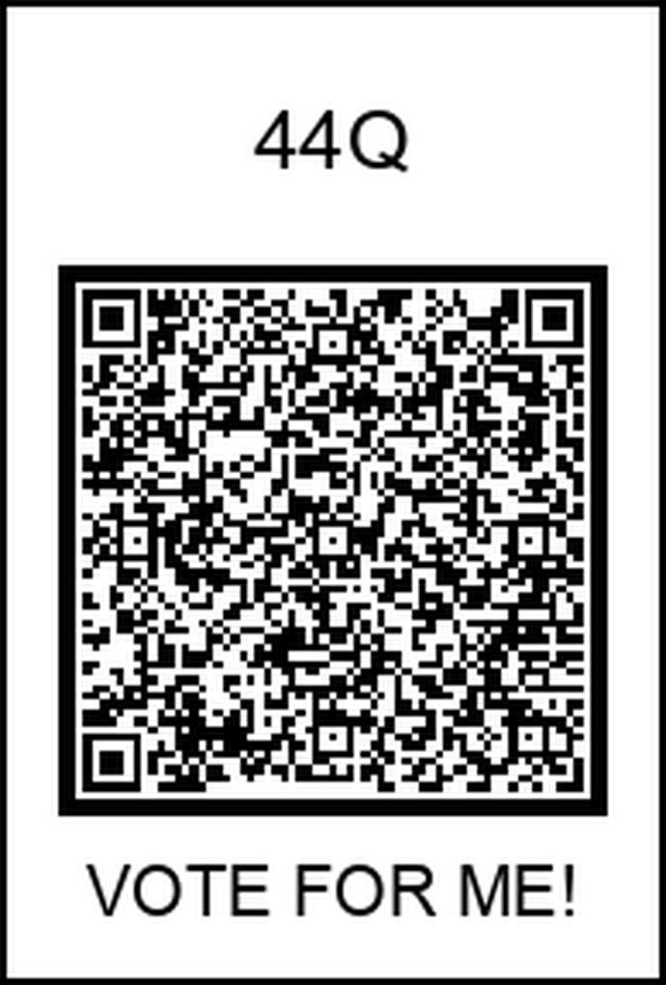
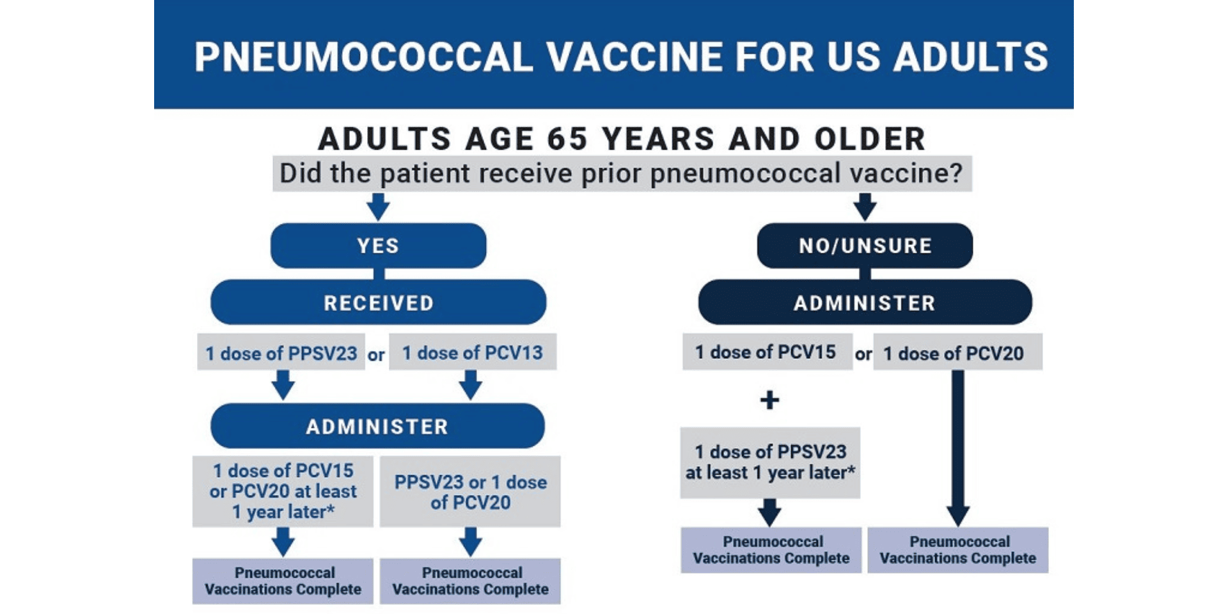
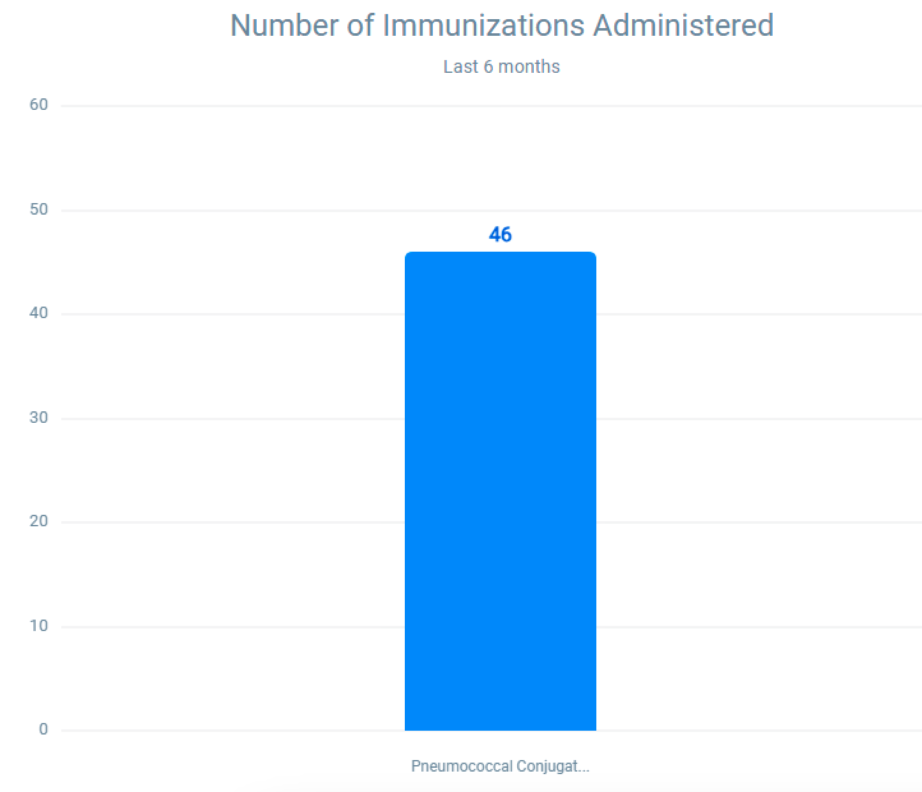
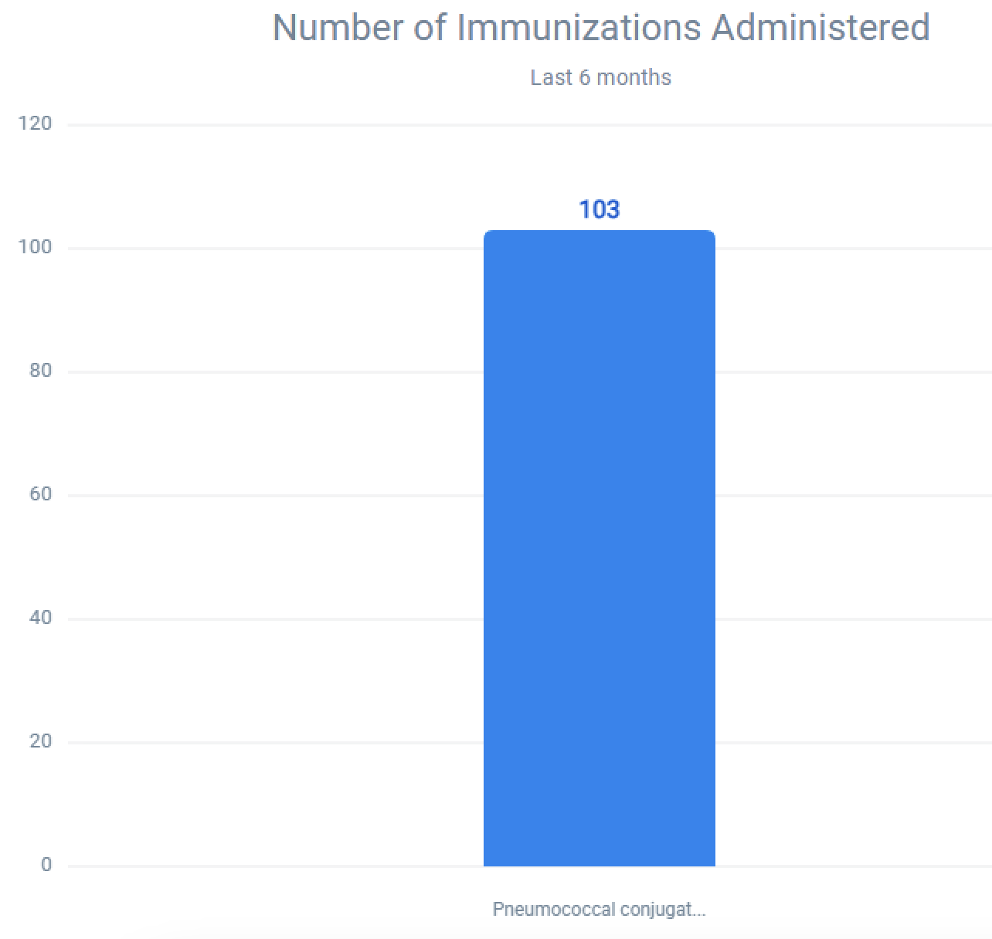
Increase PCV20 Vaccine Administration Rates
Mehar Kahlon MD, Sager Singh Deol MD, Anupama Poliyedath MD
Saint Agnes Medical Center, Fresno, CA
Introduction
Methods
In the general population, Streptococcus pneumoniae causes significant disease, including bacteremia, meningitis, and pneumonia, and is responsible for approximately 4,000 deaths each year in the US.
Prevnar20 is a vaccine indicated for active immunization for the prevention of pneumonia and invasive disease caused by 20 Streptococcus pneumoniae strains (1, 3, 4, 5, 6A, 6B, 7F, 8, 9V, 10A, 11A, 12F, 14, 15B, 18C, 19A, 19F, 22F, 23F, and 33F) in adults 18 years of age and older.
CDC recommendation charts placed in each exam room to help remind residents to order PCV20 vaccines when indicated.
Prevnar20 brochures/guides available for patients in the waiting area/lobby to read up on and determine if further discussion is warranted.
Continuous data monitoring via EPIC SlicerDicer to track progress.
Data
Guidelines/Goal
Prior to implementing our project methods, 46 vaccines had been administered in the past 6 months (Oct 2023 - April 2024) as depicted by graph 1.
After implementing our project methods, 103 vaccines have been administered in the past 6 months (Oct 2024 - April 2025) as depicted by graph 2.
CDC recommends PCV15 or PCV20 for adults who have never received a PCV and meet the following the criteria:
- 65 years of age or older
- 19-64 years of age with certain risk conditions
CDC recommends PCV20 for adults 65 years of age or older and meet the following the criteria:
- received PCV13 at any age
AND
- received PPSV23 at or after 65 years of age
If PCV15 was administered, it should be followed by a dose of PPSV23.
Goal: Increase PCV20 (Prevnar20) vaccine administration rates in the Saint Agnes Physician Residency Clinic amongst adults who meet the CDC recommended criteria.
References
“Vaccines for Pneumococcal.” Centers for Disease Control and Prevention, Centers for Disease Control and Prevention, 21 Sept. 2023.
“Protecting Adults against Pneumococcal Disease.” NFID, National Foundation for Infectious Diseases, 9 June 2023, Olson, Diana.
“Lesson 4. Immunizations in Adults.” National HIV Curriculum, www.hiv.uw.edu/go/basic-primary-care/immunizations/core-concept/all#pneumococcal-vaccination.

