Slide 1


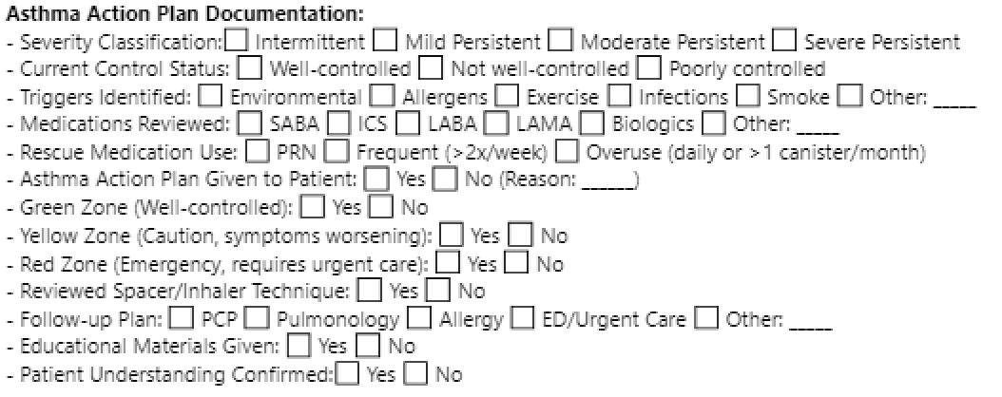
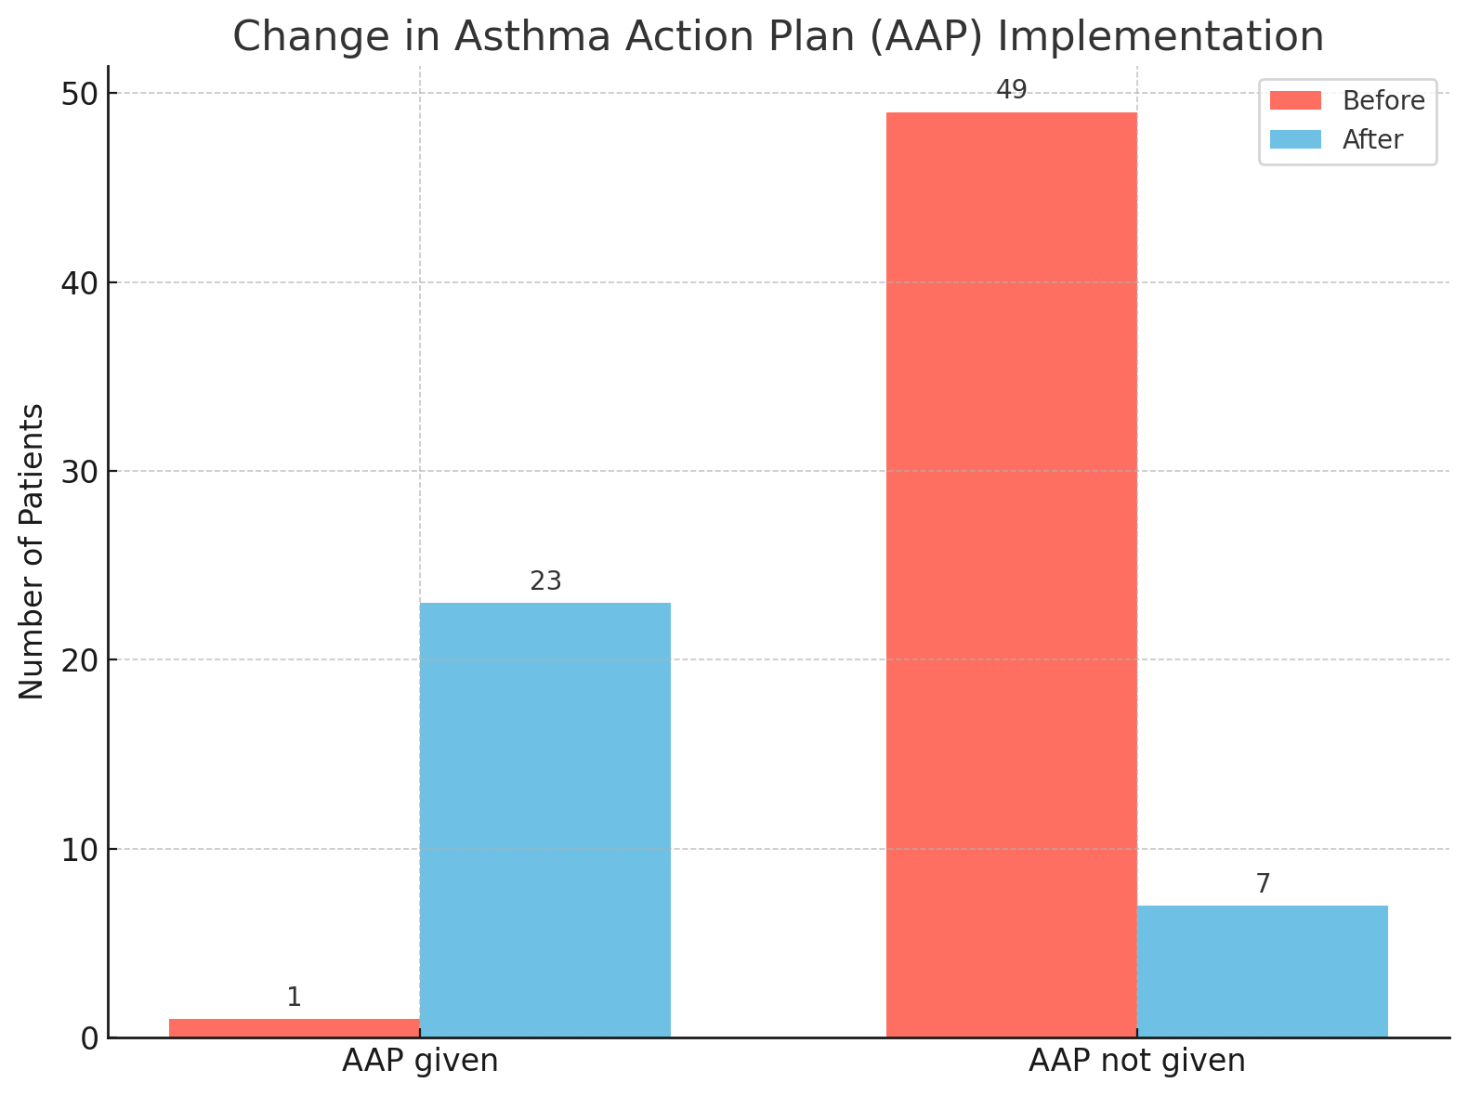
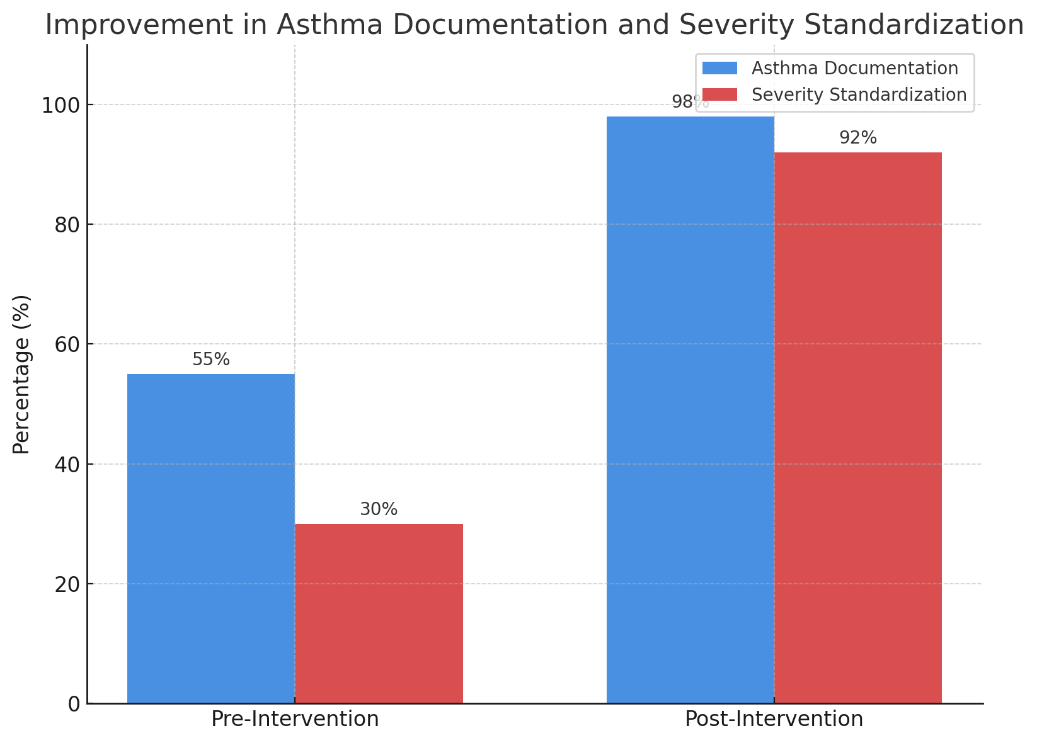
Breath by Breath: A Dual-Intervention Quality Initiative
to Enhance Asthma Care Through Action Plans and Documentation
Ayesha Shahzad MD, Hamna Javed MD, Mahwish Sheikh MD, Aftab Arif MD, Andrew Clark MD, Anupama Poliyedath MD
Saint Agnes Medical Center, Fresno, CA
Introduction
Results
Asthma is a common chronic respiratory condition affecting over 25 million individuals in the United States, including 8.7% of adults. Despite advances in treatment, many patients continue to experience poor asthma control, leading to increased emergency visits, hospitalizations, and impaired quality of life. Two key components of effective outpatient asthma care are the use of personalized Asthma Action Plans (AAPs) and accurate documentation of asthma severity, which guide evidence-based treatment decisions. At our internal medicine residency clinic, baseline review revealed low AAP utilization and inconsistent severity classification. To address these gaps, we implemented a dual-intervention quality improvement initiative involving resident education, printed AAP templates, and a standardized EMR smart phrase. This project aimed to enhance asthma self-management, improve documentation, and promote guideline-concordant care through sustainable, low-cost interventions.
After 4 weeks, measurable improvements were observed:
AAP Utilization: Increased from 2% to 78% — the majority of patients received personalized printed plans.
Education Documentation: Improved from 2% to 70%, with better use of the teach-back method during counseling.
Severity Classification: Improved from 54% to 93%, reflecting increased resident awareness and documentation consistency.
Use of Smart Phrase: Increased from 32% to 87%, standardizing documentation and ensuring inclusion of severity, control level, and follow-up plans.
Discussion
This dual-intervention quality improvement project demonstrated that simple, low-cost strategies—such as educational emails and EMR-integrated tools—can lead to significant improvements in both asthma care documentation and patient education. Weekly reminders and the use of a smart phrase (.ASTHMAACTIONPLAN) promoted consistent classification of asthma severity and standardized charting, while printed AAP templates and the teach-back method improved patient engagement and understanding.
Residents quickly adopted the interventions, leading to measurable gains in documentation and clinical workflow. These findings align with previous QI initiatives and highlight the power of combining educational outreach with EMR optimization.
In conclusion, integrated, multipronged approaches can successfully bridge communication gaps and improve asthma care delivery in residency clinics. Future steps include embedding AAP templates directly into the EMR and utilizing Best Practice Alerts to sustain improvements and further support guideline-based asthma management.
Methods
Baseline Assessment: A retrospective chart review of 50 adult asthma visits conducted between February 2024 and February 2025 evaluated the presence of documented AAPs, asthma severity classification (intermittent to severe persistent), and evidence of patient education, particularly the teach-back method.
Interventions: Two key interventions were introduced over a 4-week period:
AAP Implementation – PDSA Cycle 1:
Weekly educational emails emphasized the importance of AAPs and guideline-based asthma management.
Printed AAP templates were distributed across clinic workspaces to facilitate real-time use.
The teach-back method was encouraged to ensure patient understanding during education.
Documentation Standardization:
A smart phrase .ASTHMAACTIONPLAN was created in the EPIC EMR to standardize charting, including asthma severity, control level, management steps, and follow-up.
Residents received weekly reminders and documentation tips to reinforce usage.
References
National Asthma Education and Prevention Program. EPR-3 Guidelines for the Diagnosis and Management of Asthma.
NHLBI, 2007 Cloutier MM, et al. Pediatrics. 2020;146(6):e2020062345.
Boston Children’s Hospital. Pediatr Qual Saf. 2023;8(2):e607. doi:10.1097/pq9.0000000000000607.
Pate CA, Zahran HS. The Status of Asthma in the United States. Prev Chronic Dis 2024;21:240005. DOI: http://dx.doi.org/10.5888/pcd21.240005
To T, Stanojevic S, Moores G, Gershon AS, Bateman ED, Cruz AA, Boulet LP. Global asthma prevalence in adults: findings from the cross-sectional world health survey. BMC Public Health. 2012 Mar 19;12:204. doi: 10.1186/1471-2458-12-204. Erratum in: BMC Public Health. 2021 Oct 8;21(1):1809. doi: 10.1186/s12889-021-11859-6. PMID: 22429515; PMCID: PMC3353191.

