Slide 1

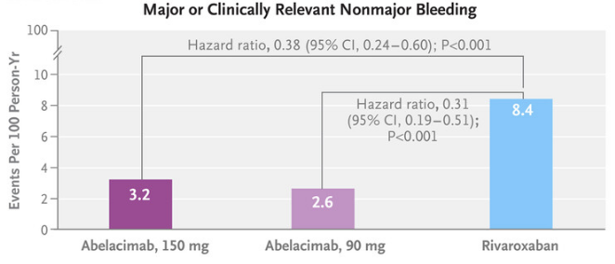
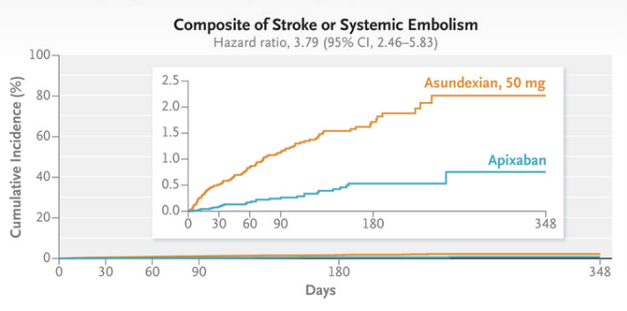
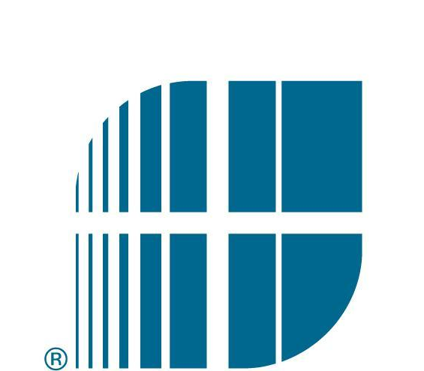
Efficacy of Factor XIa Inhibitors Compared to Factor Xa Inhibitors or Placebo in Stroke Prevention for Atrial Fibrillation – A Systematic Review.
Sameed Arshad MD, Muhammad Zahid MD, Abhishek Karn MD, Muhammad Bakhsh MD FACC
Saint Agnes Medical Center, Fresno, CA
Introduction
Discussion
The ACC/AHA have estimated the global prevalence of Atrial Fibrillation (AF) to be approximately 50 million as of 2020 (Joglar et al., 2024). AF was historically treated with Warfarin, which required regular INR monitoring to assure therapeutic levels (Meschia et al., 2014). The switch to direct-acting oral anticoagulants (DOACs) was made in most countries after the 2014 ACC/AHA guidelines, receiving FDA-approval. However, the risk of complications, such as stroke and bleeding, still remains high. This study aims to review the current and most up-to-date literature involving novel Factor XIa inhibitors and aims to compare the efficacy of these medications to traditional first-line therapies in prevention of cerebrovascular disease and the risk of bleeding.
Our preliminary results outline the major progress recent trials looking at Factor XIa inhibitors have made. Many of these trials have had similar outcomes with regards to reducing the risk of major bleeding compared to placebo, such as Apixaban or Rivaroxaban. The most recent trial update for AZALEA in 2025 showed Abelacimab to have such a significant reduction in bleeding compared to Rivaroxaban that it was stopped early. However, question of a clinically significant reduction in the outcome of ischemic stroke or systemic embolism in patients with AF taking Factor XIa still remains to be answered. Our study aims to investigate this further by continued data extraction of the identified trials.
Methods
Figure 1: Update from AZALEA-TIMI-76 - lower bleeding rates vs Rivaroxaban (Ruff et al., 2025).
Future Directions
Studies were selected according to the following criteria:
Randomized Control Trials (RCTs) - phase 2 and 3.
Population - persons >18 years of age with atrial fibrillation at risk for stroke or systemic embolism.
Interventions - Factor XIa inhibitor use versus any control group (Factor Xa inhibitor or other placebo).
Case studies and case reports were not considered. Non-English studies were not included.
Published within the last 5 years, i.e. 2020 to 2025.
The primary efficacy outcome we sought to identify was thromboembolic events according to the definition in the identified studies. The primary safety outcome we sought to identify was the composite of major bleeding, or clinically relevant non-major bleeding.
We performed a systematic database search using the above criteria from the following databases: PubMed, Science Direct, Web of Science, Google Scholar, and ClinicalTrials.gov. The search strategy was based on predefined MeSH terms and keyword strategies to search for related RCTs and observational studies. We searched relevant articles by applying keywords and MeSH terms individually.
PRISMA guidelines were followed as part of our methodology and 213 studies were initially identified and screened, with five studies currently included in our review after applying the above defined criteria.
The RCTs that we selected were screened independently by three reviewers. We have extracted sample size, study outcome, study design, and year of publication. In the case of conflict, this was solved by mutual discussion on the study in question.
The Cochrane Risk of Bias assessment tool was used to assess the risk of bias in these RCTs.
As the use of direct-acting oral anticoagulation continues to take precedence over traditional anticoagulation, bleeding remains a significant risk and an important point of discussion with patients and their families. As mentioned above, preliminary data is showing Factor XIa inhibitors to have lower incidences of major bleeding events as compared to current therapies. However, long-term data is still lacking with regards to the prevention of ischemic stroke and other thromboembolic events in patients taking Factor XIa inhibitors.
There are many ongoing studies, such as the LILAC trial, aiming to answer some of these questions raised by these recently published studies.
References
Figure 2: Update from OCEANIC-AF - higher rates of stroke/systemic embolism with Asundexian (Piccini et al., 2025).
Preliminary Results
Joglar, J.A. et al. (2024) ‘2023 ACC/AHA/ACCP/hrs guideline for the diagnosis and management of atrial fibrillation’, Journal of the American College of Cardiology, 83(1), pp. 109–279. doi:10.1016/j.jacc.2023.08.017.
Meschia, J.F. et al. (2014) ‘Guidelines for the primary prevention of stroke’, Stroke, 45(12), pp. 3754–3832. doi:10.1161/str.0000000000000046.
Ruff, C.T. et al. (2025) ‘Abelacimab versus rivaroxaban in patients with atrial fibrillation’, New England Journal of Medicine, 392(4), pp. 361–371. doi:10.1056/nejmoa2406674.
Piccini, J.P. et al. (2025) ‘Asundexian versus apixaban in patients with atrial fibrillation’, New England Journal of Medicine, 392(1), pp. 23–32. doi:10.1056/nejmoa2407105.
Five studies encompassing 21,026 participants have been identified, investigating Asundexian, Milvexian, and Abelacimab. In PACIFIC-AF, the pooled incidence of major bleeding with Asundexian compared to Apixaban was 0.03 [0.09-0.97]. AZALEA-TIMI-76 was stopped early due to greater-than-anticipated reduction in bleeding with Abelacimab 150 mg and 90 mg, compared to Rivaroxaban, giving a hazard ratio of 0.38 [95% CI, 0.24-0.60] and 0.31 [95% CI, 0.19-0.51]. PACIFIC-STROKE showed that Asundexian did not reduce covert brain infarction or ischemic stroke and did not increase major or clinically relevant non-major bleeding compared to placebo. AXIOMATIC-SSP which studied Milvexian, had similar findings as PACIFIC-STROKE. OCEANIC-AF was stopped early due to clinically significant increase in stroke or systemic embolism with Asundexian compared to Apixaban, with a hazard ratio of 3.79 [95% CI, 2.46-5.83]. It however did show lower rates of major bleeding, HR 0.32 [95% CI, 0.18-0.55] and similar incidence of adverse events.

