Slide 1

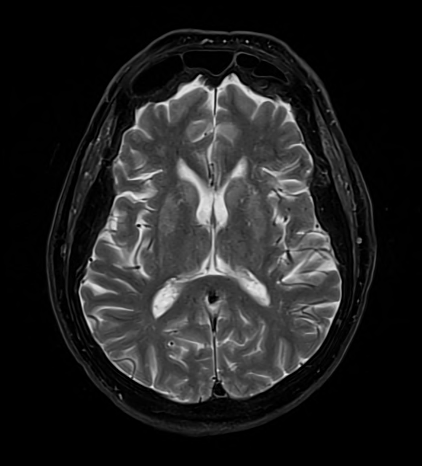
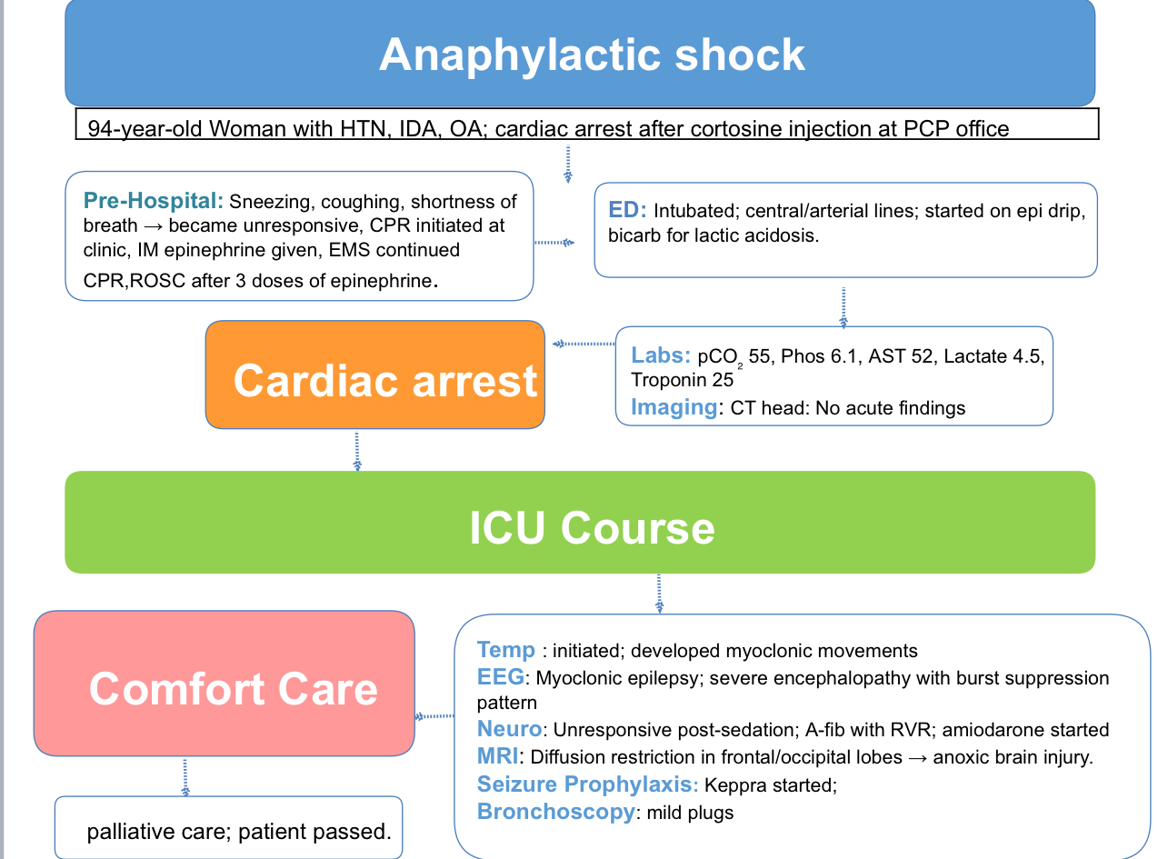

The Shot that shocked the System: Corticosteroid-Induced Anaphylaxis leading to Anoxic Brain Injury
Ayesha Shahzad MD; Mareza Tatulyan MD; Sukhmeet Dhillon MD; Reema Salim MD; Mehdi Hakimipour MD
Saint Agnes Medical Center, Fresno, CA
Introduction
Discussion
Kenalog (triamcinolone acetonide) injections are commonly used to treat chronic allergic, rheumatologic, dermatologic, and other inflammatory conditions due to their strong anti-inflammatory and anti-allergic effects. Although rare, hypersensitivity reactions can occur either to the steroid itself or to components in the preparation. Immediate allergic reactions are infrequent but may present as pruritus, rash, dyspnea, and, in rare cases, anaphylaxis and shock.
We present a case of severe anaphylaxis occurring immediately after a Kenalog injection at a primary care clinic, leading to cardiac arrest, anoxic brain injury, and eventual death after transitioning to comfort care.
Corticosteroid injections are widely used in clinical practice and are generally safe. However, rare cases of hypersensitivity reactions have been reported, which can be either immediate or delayed. Delayed reactions are more commonly associated with topical steroids, while immediate systemic reactions can occur even after prior tolerance. Symptoms may include erythema, rashes, pruritus, and in rare instances, severe anaphylaxis.
In this case, the patient had a history of receiving steroid injections without prior complications but developed severe anaphylaxis immediately after administration, leading to cardiac arrest and anoxic brain injury. Proposed mechanisms include true anaphylaxis to the steroid itself or to additives used in the preparation.
This case highlights that even commonly used medications like corticosteroids can rarely cause life-threatening reactions. Clinicians should remain vigilant and be prepared to recognize and manage hypersensitivity reactions promptly, even in patients with prior tolerance.
Case presentation
Conclusion
A 94-year-old female with a history of hypertension, iron deficiency anemia, and osteoarthritis presented to the hospital after suffering cardiac arrest following a cortisone injection at her primary care office. Shortly after receiving the injection, she developed sneezing, coughing, shortness of breath, and then became unresponsive. CPR was initiated at the clinic, and intramuscular epinephrine was given. EMS continued resuscitation, and ROSC was achieved after three doses of epinephrine. The patient was intubated upon ED arrival and admitted to the ICU.
Initial labs were notable for respiratory acidosis (pCO₂ 55), elevated phosphorus (6.1), mild transaminitis (AST 52), elevated lactate (4.5), and a troponin of 25. A central and arterial line were placed, and she was started on an epinephrine drip for presumed anaphylaxis and bicarbonate for lactic acidosis. CT head showed no acute findings. She underwent targeted temperature management but developed myoclonic movements. EEG showed generalized myoclonic epilepsy in the setting of severe encephalopathy with a burst suppression pattern.
Despite stopping sedation, the patient remained unresponsive. She developed atrial fibrillation with RVR and was started on an amiodarone drip. MRI brain showed subtle diffusion restriction and increased T2 signal in the frontal and occipital lobes, concerning for global anoxic brain injury. She was started on Keppra for seizure prophylaxis. Bronchoscopy revealed mild mucus plugging without significant obstruction. Given persistent unresponsiveness and poor neurological prognosis, palliative care was consulted. After family discussions, care was transitioned to comfort measures, and the patient passed away.
Figure 1: There is subtle diffusion restriction in the cortex of the frontal lobes and occipital lobes with mildly increased T2 signal and minimal thickening. These findings raise concern for diffuse process such as anoxic brain injury.
Severe allergic reactions to corticosteroid injections, although rare, can occur even in previously tolerant patients. Early recognition and management are crucial to prevent catastrophic outcomes.
References
Laisuan W, Wongsa C, Dchapaphapeaktak N, Tongdee M, Chatmapanrangsee J, Rerkpattanapipat T. Anaphylaxis following intralesional triamcinolone acetonide (Kenacort) injection. Asia Pac Allergy. 2017 Apr;7(2):115-118. doi: 10.5415/apallergy.2017.7.2.115. Epub 2017 Apr 6. PMID: 28487843; PMCID: PMC5410410.
Kamm GL, Hagmeyer KO. Allergic-type reactions to corticosteroids. Ann Pharmacother. 1999 Apr;33(4):451-60. doi: 10.1345/aph.18276. PMID: 10332537.
Swiss Med Wkly. 2023;153:40025
Patterson DL, Yunginger JW, Dunn WF, Jones RT, Hunt LW. Anaphylaxis induced by the carboxymethylcellulose component of injectable triamcinolone acetonide suspension (Kenalog). Ann Allergy Asthma Immunol. 1995 Feb;74(2):163-6. PMID: 7697477.
Brandt N, Garvey LH, Bindslev-Jensen U, Kjaer HF, Bindslev-Jensen C, Mortz CG. Three cases of anaphylaxis following injection of a depot corticosteroid with evidence of IgE sensitization to macrogols rather than the active steroid. Clin Transl Allergy. 2017 Jan 10;7:2. doi: 10.1186/s13601-016-0138-3. PMID: 28078080; PMCID: PMC5223300.
Son JH, Park SY, Cho YS, Chung BY, Kim HO, Park CW. Immediate Hypersensitivity Reactions Induced by Triamcinolone in a Patient with Atopic Dermatitis. J Korean Med Sci. 2018 Mar 19;33(12):e87. doi: 10.3346/jkms.2018.33.e87. Erratum in: J Korean Med Sci. 2022 Nov 28;37(46):e350. doi: 10.3346/jkms.2022.37.e350. PMID: 29542298; PMCID: PMC5852418.

