Slide 1


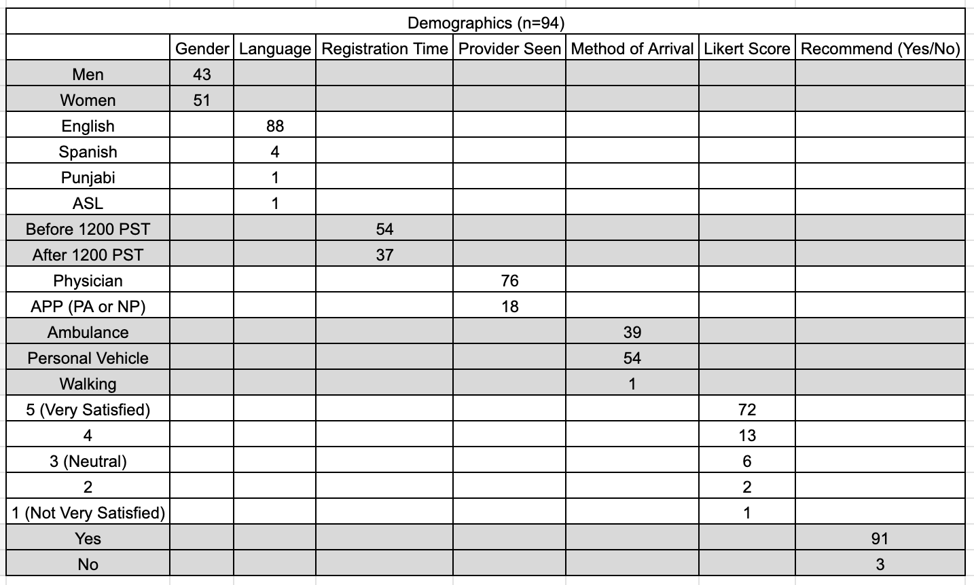
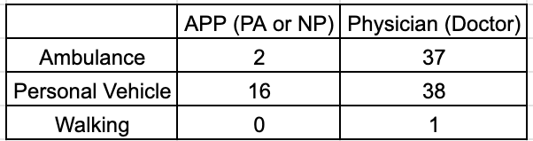
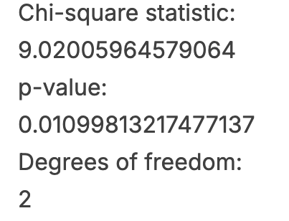
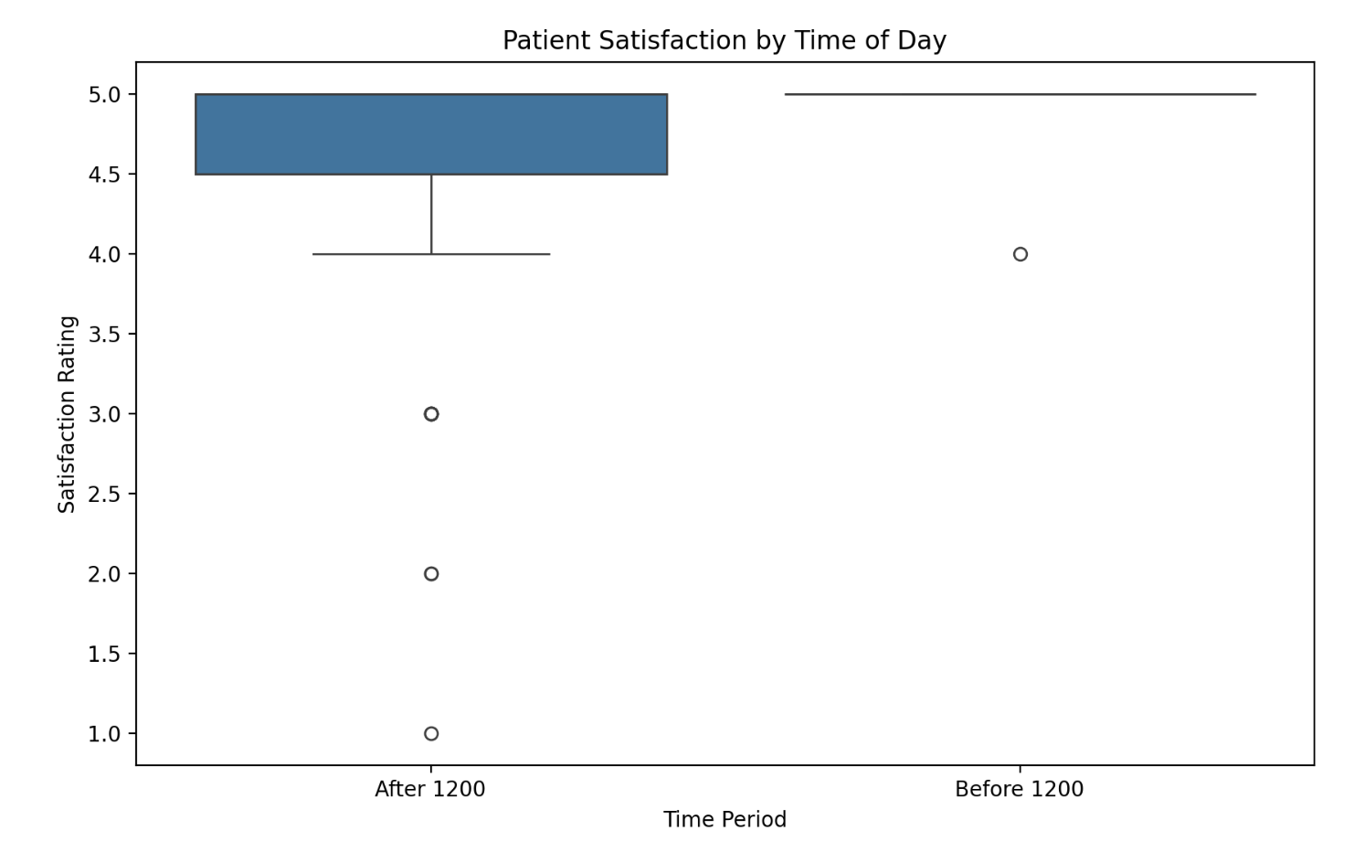
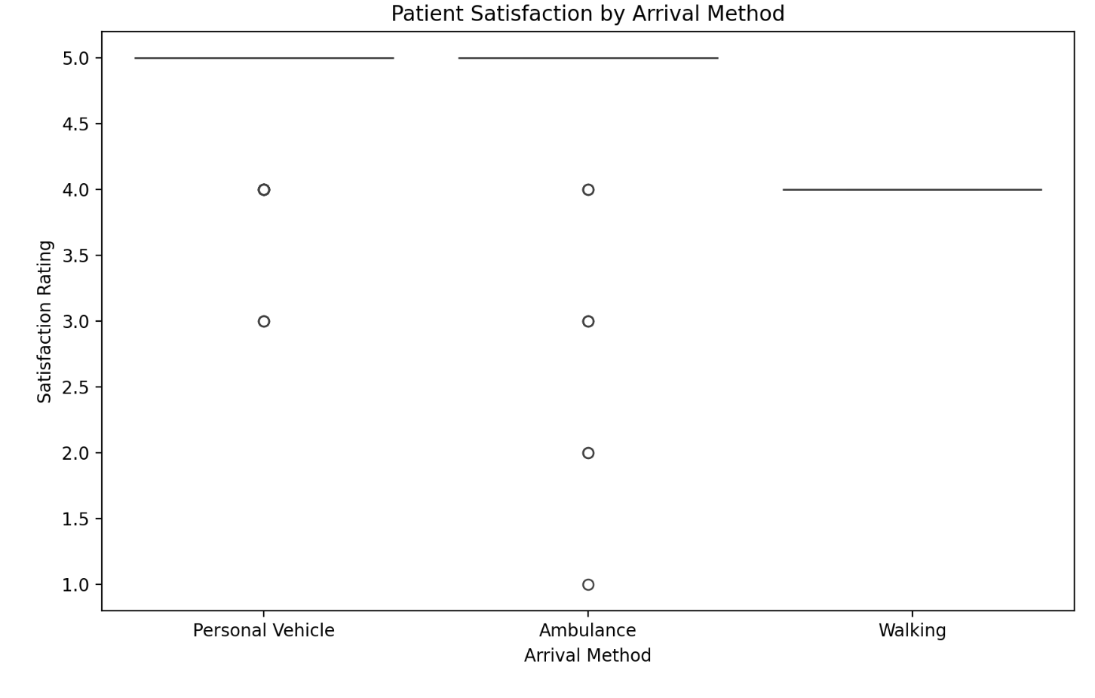
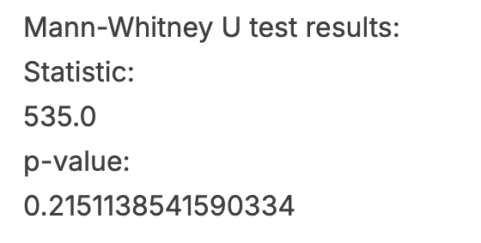

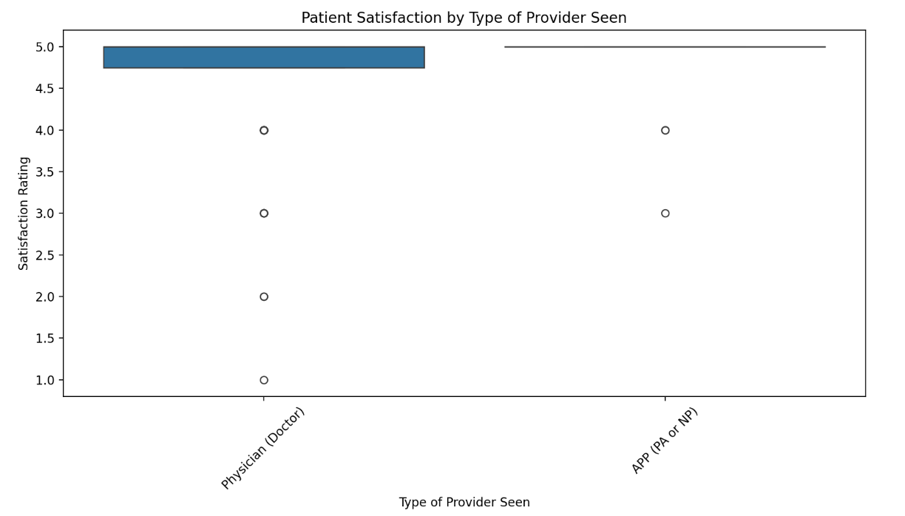
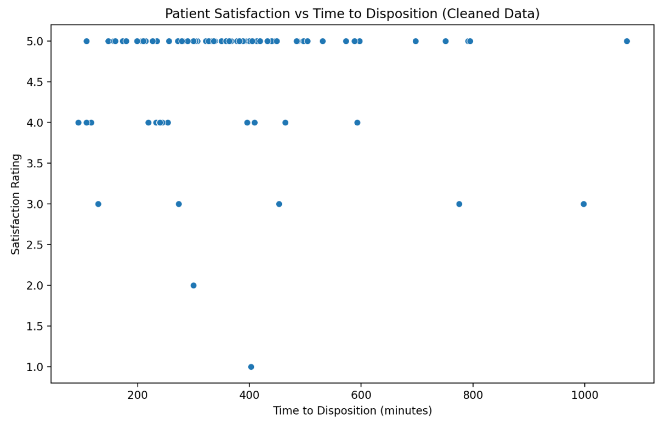
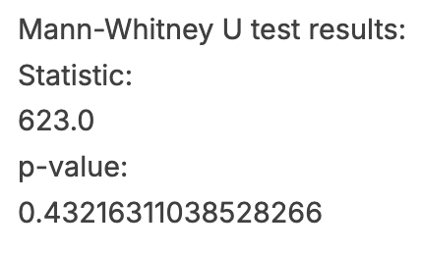
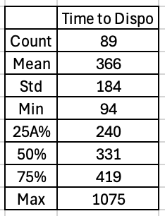

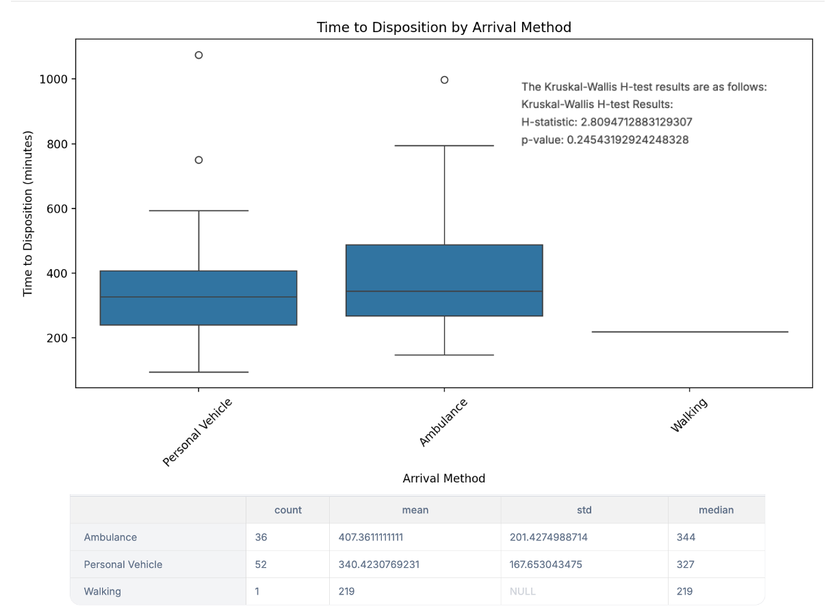
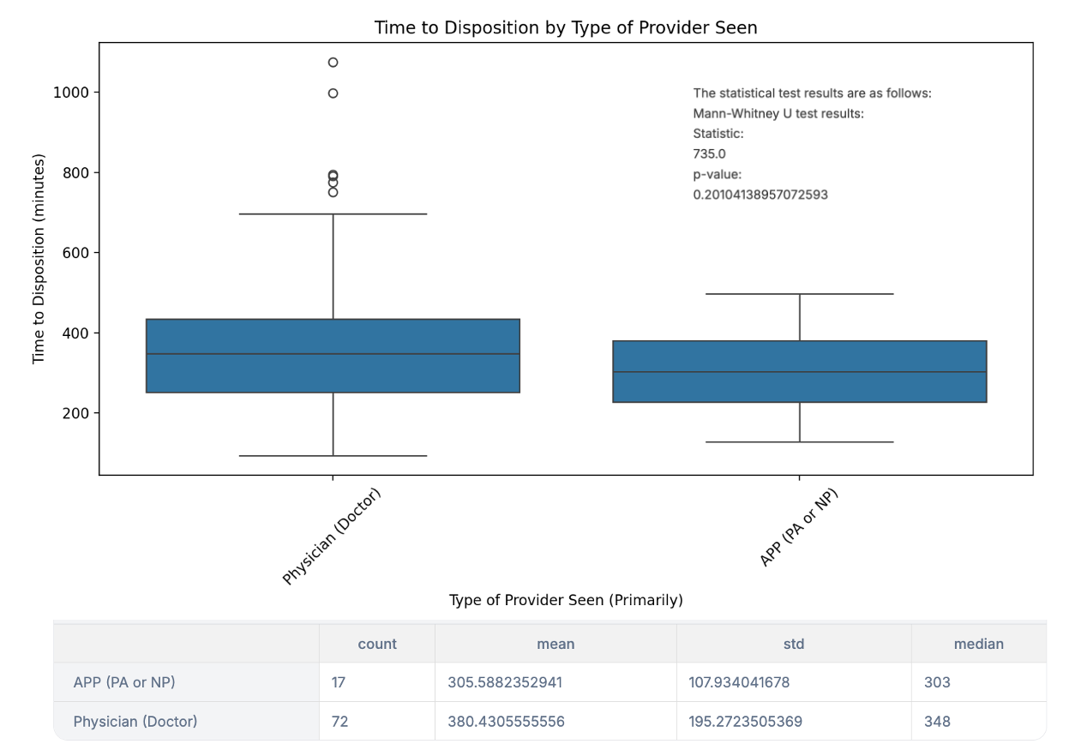
Method of Arrival and Patient Experience in the Emergency Department
Stephen J. Howell, MD*; Lea S.Urita, MD, MPH; Sonja Joplin, PA-C, MPAP; Ezekiel Vanstaaveren, BS; Vince Co, BS; Camie Sorensen, MD, MPH; Ruqayya Gill, DO
Introduction
Survey Questions
Discussion
Saint Agnes Medical Center (SAMC) in Fresno, CA receives the second highest volume of Emergency Medical Services (EMS) patients in California and serves over 800,00 in the medically underserved Central Valley. A diverse patient population that is generalizable to many EDs across the country.³ With limited access to primary care, many in the region rely on the ED as their main entry into the healthcare system - mirroring trends seen nationally. Many EDs are experiencing an increased census of patients likely due to the lack of access to primary care.¹ This increased census results in longer wait times and decreased satisfaction in their experience of the ED as well as the hospital. Compounding this problem, after the COVID-2019 pandemic, EDs continue to be overcrowded with patients.² Therefore, understanding what influences patient experience in this setting is increasingly important. While many factors determine the overall satisfaction of a patient experience, the method of arrival likely is one of the leading factors. At SAMC, specially trained nurses triage both in the waiting room and ambulance bay determining who goes directly to a bed or to the waiting room. This may significantly shape patient perception, at least at Saint Agnes. This study aims to evaluate the effect of the method of arrival on patient experience in the ED, using SAMC as a high-volume, generalizable site.
Discharge or Admit Time Recorded on Medical Record (Discharge time is time discharged by nursing staff, Admit time is first time from order placed by admitting physician, see times in patient tracking on epic in patient's chart)
Type of Provider Seen (Primarily)
Arrival Method
Rate your Satisfaction with today’s visit: 1-5 on Likert Scale
Would you recommend the Emergency Department of Saint Agnes Medical Center for future visits?
The target goal for the study is 400 survey participants to provide a strong sampling for the total population of the Fresno Metropolitan area approximately 800,000. Over approximately 6 weeks, 94 survey responses were collected with a margin of error 9.9%. About half of the participants were male (n=43), the majority spoke English (n=88), slightly more were polled before 1200 PST (n=54), the majority were seen by a physician (n=76), the majority arrived by private vehicle (n=54), most were very satisfied(5) (n=72), and the majority would recommend SAMC ED for future visits (n=91).
There was no significant correlation between method of arrival and patient experience, nor time of day and patient experience, nor type of provider and patient experience. Furthermore, there was no significant difference between total time to disposition and patient experience, nor method of arrival and total time to disposition nor type of provider and total time to disposition. There was a significant difference between method of arrival and type of provider seen p=0.01.
Physicians see more patients that arrived by ambulance compared to APPs at SAMC ED but there was no significant difference in experience between physicians and APPs. Patient experience showed few responses for Not Very Satisfied (1), (2), and neutral (3) which may be accurate however more responses are required for a better representation for the population of Fresno and Clovis.
More surveys need to be collected.
Descriptions for patient experience can be assigned to (2) and (4) such as “slightly satisfied” and “partially satisfied” or change (1) to “Dissatisfied,” (2) to “slightly dissatisfied,” (3) to “neither dissatisfied nor satisfied,” (4) to “slightly satisfied,” and (5) to “satisfied.”
Despite no significant difference between time to disposition and provider seen, the time to disposition was less for APPs, however, the level of acuity and/or chief complaint was not recorded and if the patients were admitted or discharged. The survey should address these variables in the future.
Of note, patients who were dissatisfied with their care were more likely to decline the survey over those who were satisfied.
Date
Current Time
Gender
Age
Language
Registration Time
Results
*For analysis including time to disposition, n=89 due to problems with registration time and time to disposition recording.
Hypothesis and Objectives
Hypothesis: Is patient experience affected by the method of arrival to the Saint Agnes Medical Center Emergency Department?
There may be a significant difference in patient experience, depending on the patient’s arrival to the ED. Patients arriving by ambulance may be found to be more satisfied with their patient experience. These patients may highly rate their experience on the Likert scale with this method of arrival (5 out of 5).
Study Population
The study will include patients who are seen in the ED at SAMC. The study will include patients who meet inclusion criteria, agree to study participation, and do not meet exclusion criteria.
This study will include both healthy individuals and sick individuals. Patients will present with a variety of acuity both high and low as well as a variety of medical problems, such as but not limited to diabetes, heart failure, hypertension, renal disease, pulmonary, and cardiac problems. All ages above 18 years of age, all genders, and ethnic backgrounds will be included provided they are willing and able to consent to study participation. The diverse population of patients is appropriate because it provides generalizability of patients seen in the ED.
Conclusion
There was no significant correlation between patient experience and time of day, method of arrival, type of provider seen, or time to disposition. There was no significant correlation between time to disposition and method of arrival or type of provider seen. However, limitations such as possible nonresponse bias and small sample size may have influenced results. Further improvements to the survey and addressing potential bias will be made to better capture patient experience in the ED.
Inclusion Criteria:
Patients aged greater than 18 Years old presenting to the ED
Must not meet any of exclusion criteria
Patient consents to survey
Exclusion Criteria:
Altered Mental Status (including but not limited to intoxication, dementia, acute agitation)
Hemodynamically unstable (BP <90/60 or MAP <65)
Involuntary Hold
Left AMA or Eloped
Age less than 18 years old
References
¹Culbert, Gregory Scotty. An Analysis of the Underlying Factors Driving Use of the Emergency Room in the United States, 2018-2020. Diss. Southern University and Agricultural and Mechanical College, 2024.
²Hsia, Renee Y., et al. "Patterns in patient encounters and emergency department capacity in California, 2011-2021." JAMA network open 6.6 (2023): e2319438-e2319438.
³Davis, Adam, and Adrienne Kim. “Report to Commission: Ambulance Patient Offload Delays.” Edited by Elizabeth Basnett et al., California Emergency Medical Services Authority, State of California, June 2024, emsa.ca.gov/wp-content/uploads/sites/71/2024/06/CA_APOT_June2024_CommissionReport_Updated_6.25.2024.pdf.

