Slide 1

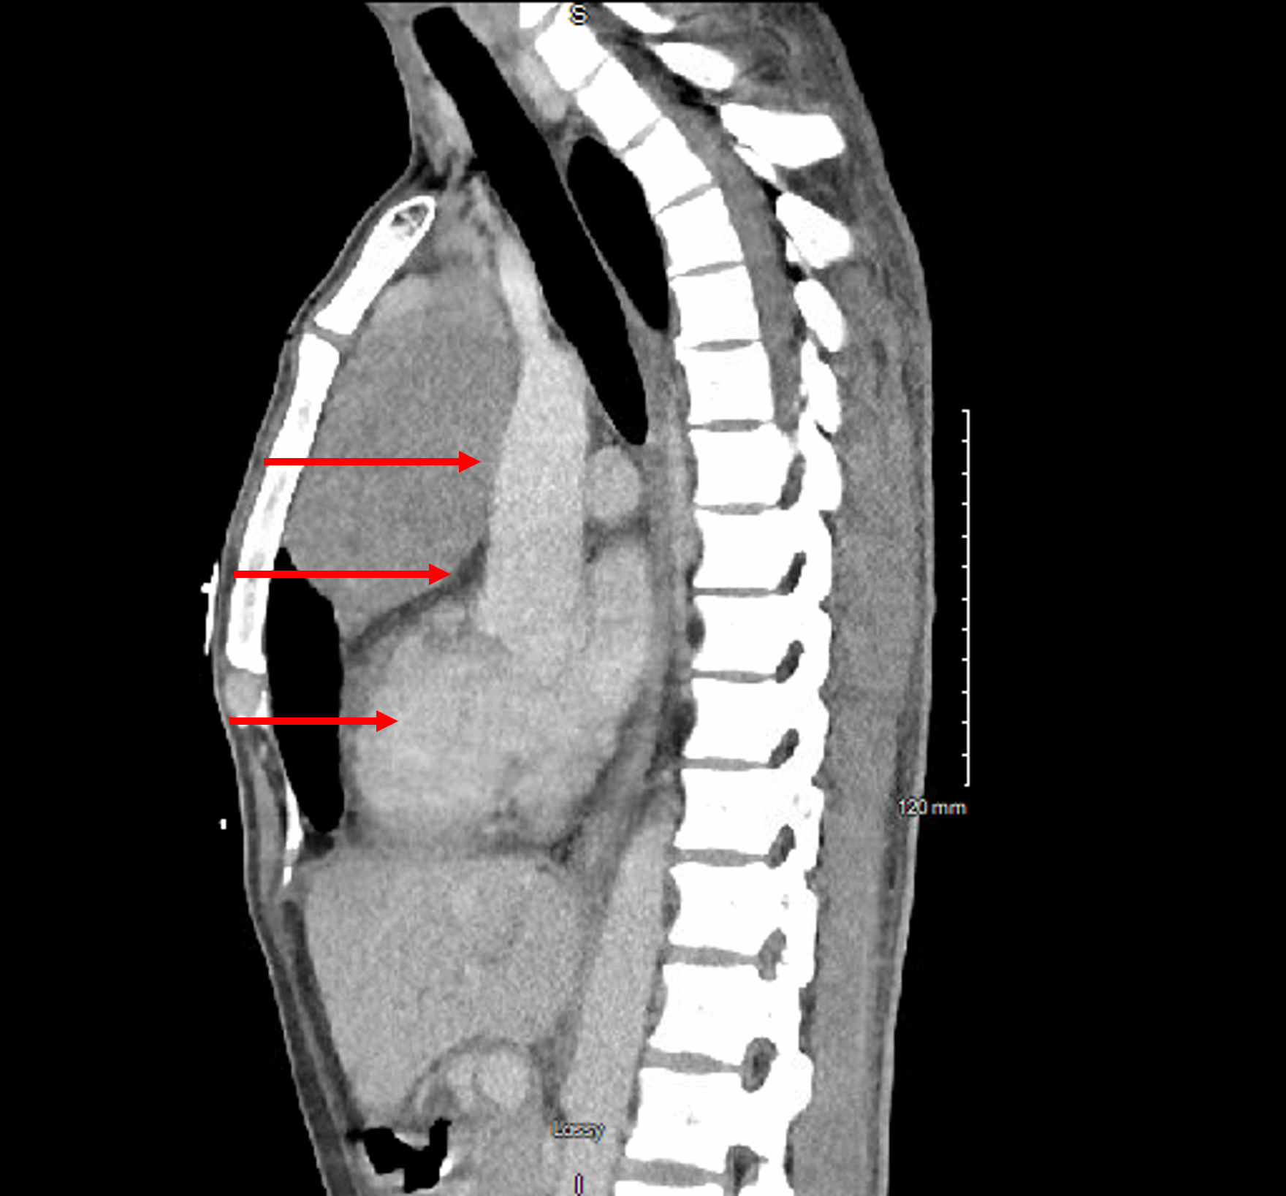
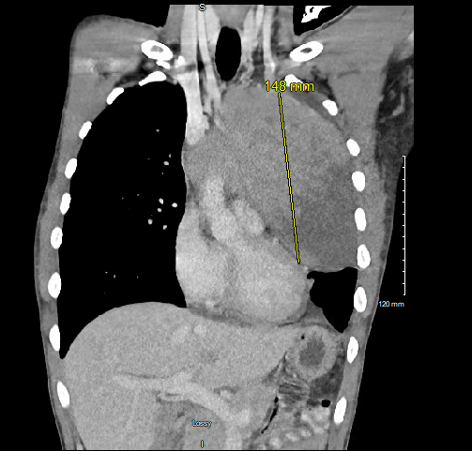
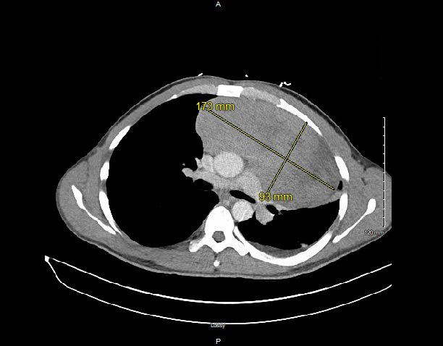
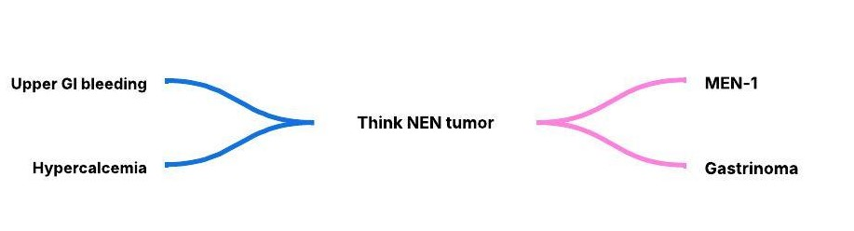

A Rare Mediastinal Neuroendocrine Neoplasm presenting with
Hypercalcemia and Severe Duodenal Ulcer Bleeding
Nasrin Nikravangolsefid, Abhishek Karn, Maryam Hadipour, Rukhsar Nadeem, Mohammed Elhassan
Internal medicine department, Saint Agnes Medical Center, Fresno, CA
Introduction
Case presentation
Neuroendocrine neoplasms (NEN): a heterogeneous group of tumors derived from neuroendocrine cells, frequently originating in the gastrointestinal or pulmonary systems.
These tumors present a spectrum of clinical manifestations, ranging from incidental findings to endocrinopathies and hormone-related complications. Neuroendocrine neoplasms of the mediastinum are extremely rare.
A CT-guided biopsy of the mediastinal mass confirmed a well-differentiated neuroendocrine tumor, positive for Cam5.2, CD56, synaptophysin, and PAX8.
Tragically, the patient developed massive hematemesis a week after admission and went into cardiac arrest before the biopsy result was available.
Figure 1. Chest CT scan showing the large anterior mediastinal mass (sagittal view). Arrows indicate the direction of force during chest compressions, suggesting that the mass may have obstructed blood outflow
Figure 2. Chest CT scan showing the large anterior mediastinal mass (coronal view)
Discussion
Case presentation
Figure 1:
A 31-year-old male with a history of duodenal ulcer with incidental hypercalcemia two years prior, presented with abdominal pain, hematemesis, and a month history of systemic symptoms, including night sweats, and unintentional weight loss of 10 pounds.
Physical examination revealed tachycardia, and melena on rectal examination.
Laboratory investigations showed severe anemia (Hb 6.0 g/dL), hypercalcemia (12.1 mg/dL), and hypophosphatemia (2.0 mg/dl).
Imaging revealed a large anterior mediastinal mass (17.3 × 9.3 × 14.8 cm) with hypodense components.
During hospitalization, esophagogastroduodenoscopy performed for acute gastrointestinal bleeding identified a large duodenal ulcer with visible vessels, which was successfully managed with epinephrine injection and hemostatic spray.
Further evaluation of hypercalcemia demonstrated elevated parathyroid hormone (PTH 148.1 pg/mL) and a parathyroid adenoma on sestamibi scan.
This case highlights the complexity of diagnosing NEN neoplasms and emphasizes the importance of thorough diagnostic workup during the first episode of gastrointestinal bleeding with concurrent hypercalcemia.
It is likely that the large mediastinal mass could have hindered chest compression efforts during resuscitation.
References
Sultana Q, Kar J, Verma A, Sanghvi S, Kaka N, Patel N, Sethi Y, Chopra H, Kamal MA, Greig NH. A Comprehensive Review on Neuroendocrine Neoplasms: Presentation, Pathophysiology and Management. J Clin Med. 2023 Aug 5;12(15):5138.
Dasari A, Shen C, Halperin D, Zhao B, Zhou S, Xu Y, Shih T, Yao JC. Trends in the Incidence, Prevalence, and Survival Outcomes in Patients With Neuroendocrine Tumors in the United States. JAMA Oncol. 2017 Oct 1;3(10):1335-1342.
Bohnenberger H, Dinter H, König A, Strobel P. Neuroendocrine tumors of the thymus and mediastinum. J Thorac Dis. 2017 Nov;9(Suppl 15):S1448-S1457.
Figure 3. Chest CT scan showing the large mediastinal mass (axial view)
References
Figure 2:
Key learning point

