Slide 1


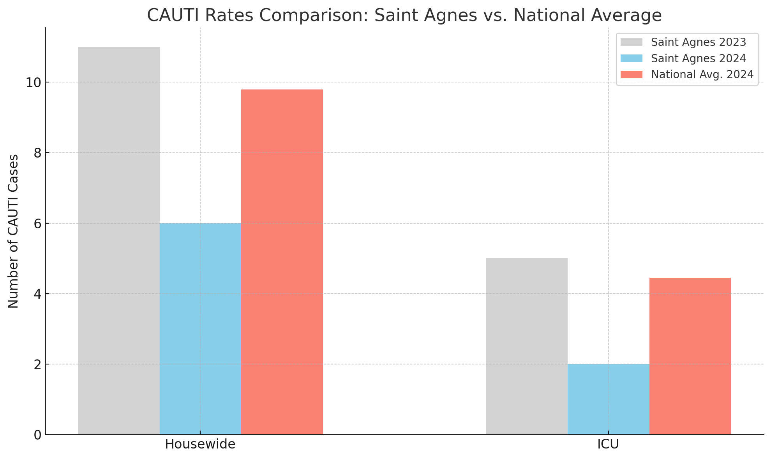
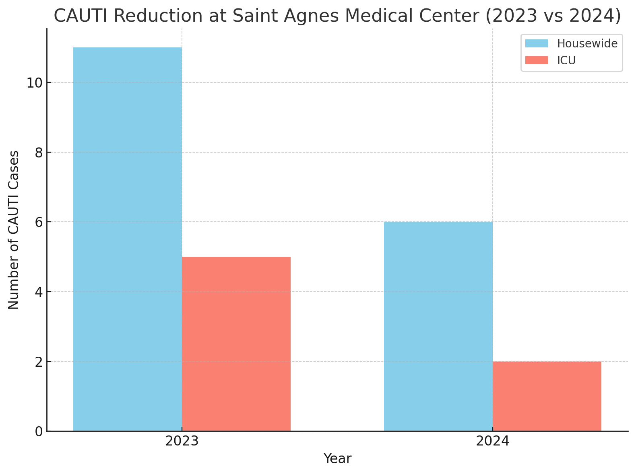
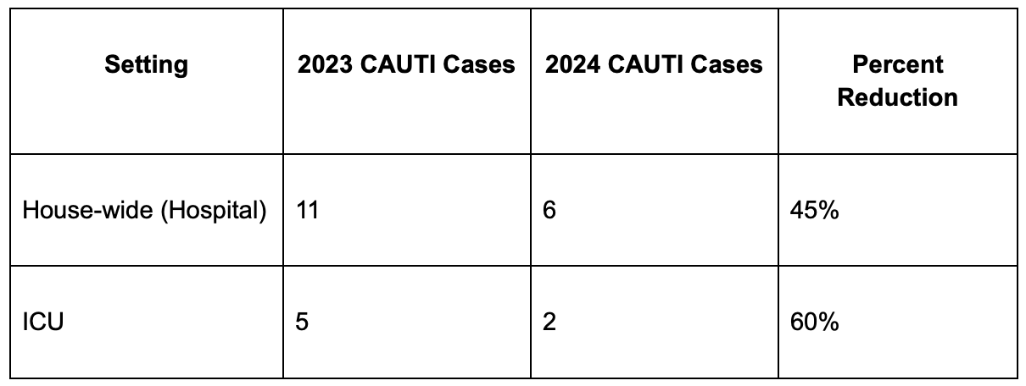

Breaking the CAUTI Cycle: A Multidisciplinary Initiative to Reduce
Catheter-Associated UTIs in Hospital and ICU Settings
Mahmut Unverdi MD, Andrew Clark MD, Hamna Javed MD, Kamalpreet Gill MD, Amritpal Nat MD, Talal Arab MD
Saint Agnes Medical Center, Fresno, CA
Introduction
Catheter-Associated Urinary Tract Infections (CAUTIs) are among the most common healthcare-associated infections nationwide and significantly contribute to patient morbidity, prolonged hospitalization, and increased healthcare costs. This QI project aims to implement evidence-based interventions to reduce CAUTI rates in both the general hospital and the ICU setting. The objective is to reduce CAUTI incidence by 30% over 12 months by promoting appropriate catheter use and timely removal, improving staff adherence to insertion and maintenance bundles, and enhancing surveillance and feedback mechanisms.
Figure 2: CAUTI Rate Reduction seen over 2023 and 2024
Figure 1: Comparison of Hospital and ICU CAUTI Rates with the National Average
Discussion
A comprehensive CAUTI prevention strategy at Saint Agnes Medical Center significantly outperformed national benchmarks, demonstrating the impact of evidence-based interventions. Key elements—such as nurse-driven catheter removal protocols, insertion and maintenance bundles, real-time compliance dashboards, and EHR-based alerts—were instrumental in reducing CAUTI rates [2,3]. These findings align with national recommendations and support prior literature emphasizing that interdisciplinary collaboration and strict adherence to prevention bundles are essential to improving patient safety and reducing healthcare-associated infections [2,4].
Methods
To reduce CAUTI rates, we conducted a baseline assessment reviewing 12-month CAUTI data to identify high-risk units and practice gaps. Interventions included a nurse-driven catheter use protocol requiring justification for insertion and promoting timely removal. An insertion bundle emphasized hand hygiene, aseptic technique, and sterile equipment, while a maintenance bundle focused on daily necessity review, securement, drainage, and perineal care. Monthly staff education and competency validation were implemented. Real-time audit dashboards, unit-level feedback, and staff recognition supported compliance was implemented and discussed in daily interdisciplinary team rounds in the intensive care unit. EHR-based alerts prompted catheter reviews and auto-expiry were implemented to reinforce best practices and standardization.
Table 1: CAUTI Rates in the whole hospital and ICU over 2023 and 2024
Results
The implementation of a CAUTI prevention initiative from 2023 to 2024 led to a 45% reduction in house-wide CAUTIs (from 11 to 6 cases) and a 60% reduction in ICU CAUTIs (from 5 to 2 cases). In contrast, CDC national data showed only an 11% reduction in CAUTIs among acute care hospitals over a similar period [1]. These results exceed national trends and demonstrate the effectiveness of our targeted, multidisciplinary interventions. Improvements are attributed to standardized catheter use protocols, enhanced staff education, and a reduced catheter utilization ratio. Ongoing efforts are focused on achieving >90% compliance with CAUTI prevention bundles across all units.
References
Centers for Disease Control and Prevention. 2023 National and State Healthcare-Associated Infections Progress Report.https://www.cdc.gov/hai/data/portal/progress-report.html
Saint S, Greene MT, Kowalski CP, et al. Preventing catheter-associated urinary tract infection in the United States: a national comparative study. JAMA Intern Med. 2013;173(10):874-879.
Meddings J, Rogers MA, Krein SL, et al. Reducing unnecessary urinary catheter use and other strategies to prevent CAUTIs: an integrative review. BMJ Qual Saf. 2014;23(4):277–289.
Lo E, Nicolle LE, Coffin SE, et al. Strategies to prevent catheter-associated urinary tract infections in acute care hospitals: 2014 update. Infect Control Hosp Epidemiol. 2014;35(5):464–479.

