Slide 1

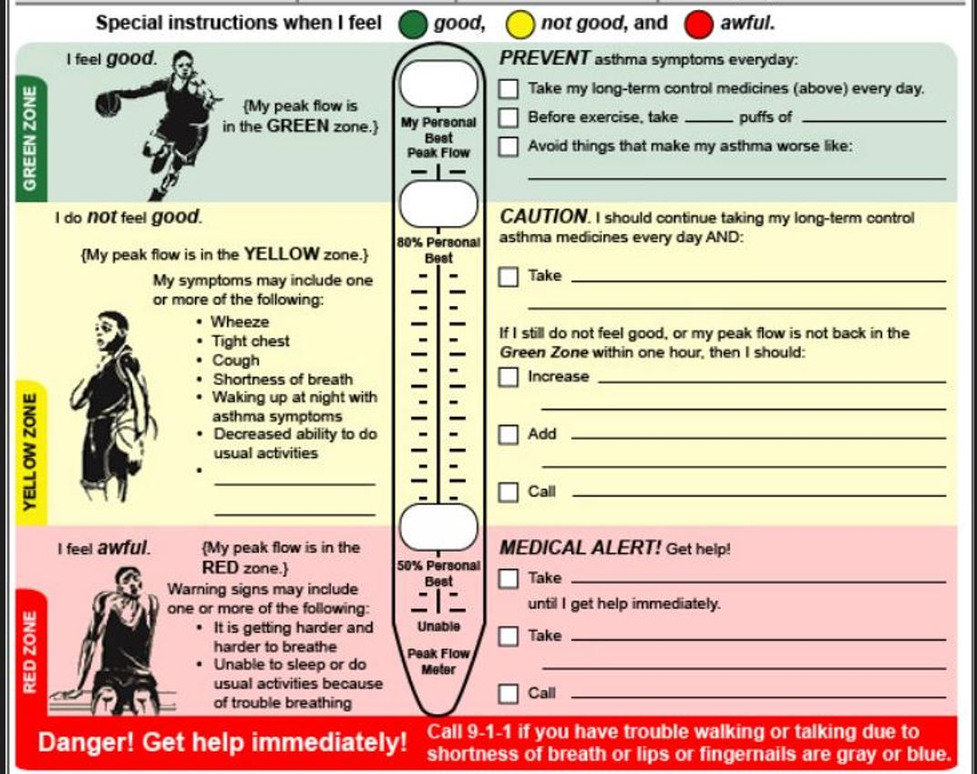
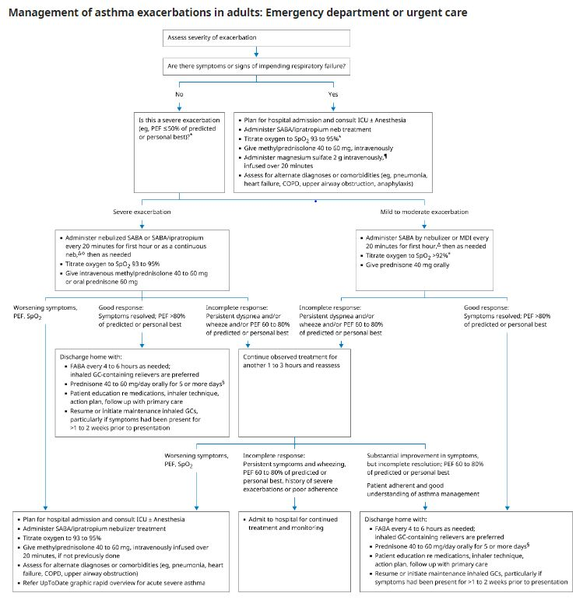
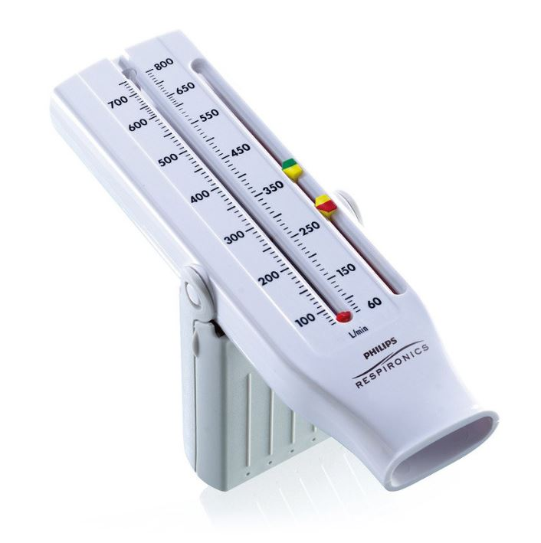

A Quality Improvement Initiative on Guideline-Directed Care,
PEF Monitoring, and Discharge Planning
Moeez Sadiq M.D.
Yussif Muhammed M.D.
Saint Agnes Medical Center, Fresno, CA
Introduction
Results
Asthma exacerbations frequently result in hospital admissions. Early guideline-directed intervention improves outcomes. Care gaps persist in PEF monitoring and discharge planning. This initiative aimed to improve adherence to asthma management guidelines, enhance monitoring, and ensure effective discharge planning with Asthma Action Plans (AAPs).
Our quality improvement initiatives aim to enhance the overall management of hospitalized asthma patients by improving adherence to guideline-based medication therapies, increasing the frequency and accuracy of Peak Expiratory Flow (PEF) documentation throughout the patient’s hospital stay, and ensuring a higher rate of comprehensive Asthma Action Plan (AAP) provision at the time of discharge. Additionally, we will actively monitor key clinical outcomes, including hospital length of stay and 30-day readmission rates, to assess the effectiveness of these interventions and identify opportunities for ongoing refinement in patient care practices
Methods
Discussion
Figure 1:
Intervention Components
Staff Education
Guideline-based training sessions for clinical staff.
Electronic Medical Record (EMR) Optimization
Implementation of standardized asthma order sets.
Peak Expiratory Flow (PEF) Monitoring
Daily nurse-led PEF assessments and documentation.
Discharge Action Plans
Standardized Asthma Action Plan (AAP) forms with structured teach-back education.
Process Measures
Percentage of patients receiving guideline-recommended medications.
Percentage of patients with daily PEF documentation.
Identification of inconsistent application of evidence-based treatments.
Assessment of underutilized PEF monitoring.
Evaluation of AAP provision rates at discharge.
Outcome Measures
Average hospital length of stay.
30-day hospital readmission rates.
Percentage of patients discharged with an AAP.
Balancing Measures
Impact on staff workload and workflow.
Patient satisfaction scores and feedback.
Anticipated improvements include enhanced process adherence and better patient outcomes through the implementation of targeted interventions. Key challenges will be proactively addressed by incorporating simplified, actionable alerts within the clinical workflow, establishing nurse-led monitoring systems to ensure real-time oversight, and fostering ongoing leadership engagement to maintain team motivation and accountability. To support long-term sustainability, these initiatives will be reinforced by integrating processes into the electronic medical record (EMR) system, conducting monthly performance tracking, and performing quarterly protocol reviews and updates to ensure continued alignment with best practice standards
References
Figure 2:
https://www.uptodate.com/contents/image?csi=736dd886-1b64-4626-997c-4db03269ab18&source=contentShare&imageKey=PULM%2F111835
https://www.uptodate.com/contents/acute-exacerbations-of-asthma-in-adults-emergency-department-and-inpatient-management?csi=ba15e796-6b28-4e16-9f14-c2ff8ff5a0c6&source=contentShare
https://www.uptodate.com/contents/peak-expiratory-flow-monitoring-in-asthma?csi=13cf802a-5cfc-44ff-958b-69253b53ad09&source=contentShare
http://pmc.ncbi.nlm.nih.gov/articles/PMC11055252/
Aim Statement
Our goals include achieving a 95% adherence rate to guideline-directed medical treatment protocols for asthma management, ensuring that 90% of patients have their Peak Expiratory Flow (PEF) measurements documented on a daily basis during their hospital stay, and providing 85% of patients with a comprehensive, individualized Asthma Action Plan at the time of discharge to support optimal outpatient care and reduce the risk of future exacerbation

