Slide 1

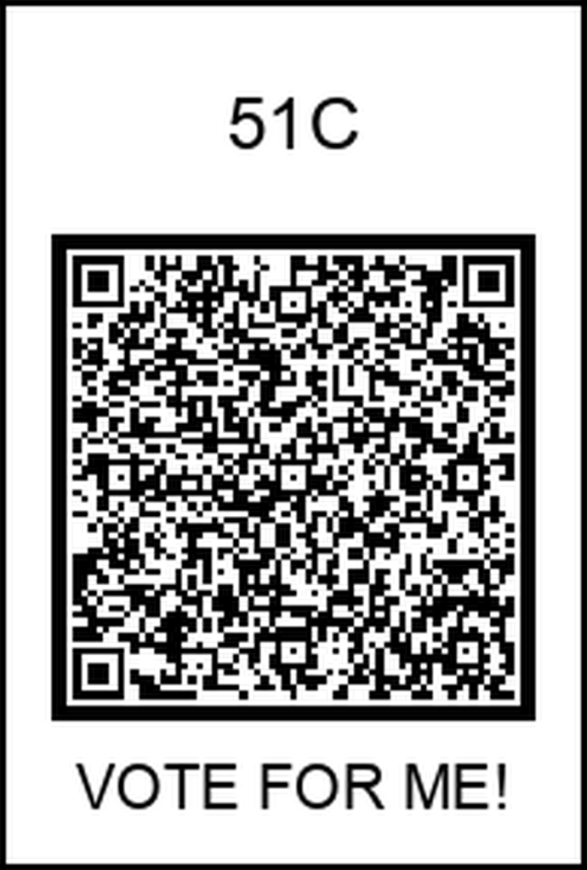
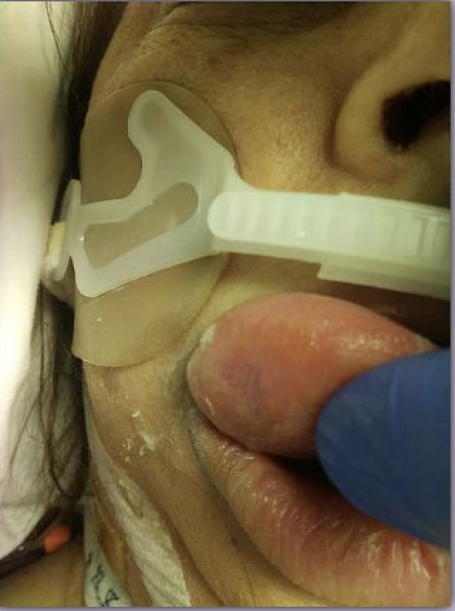
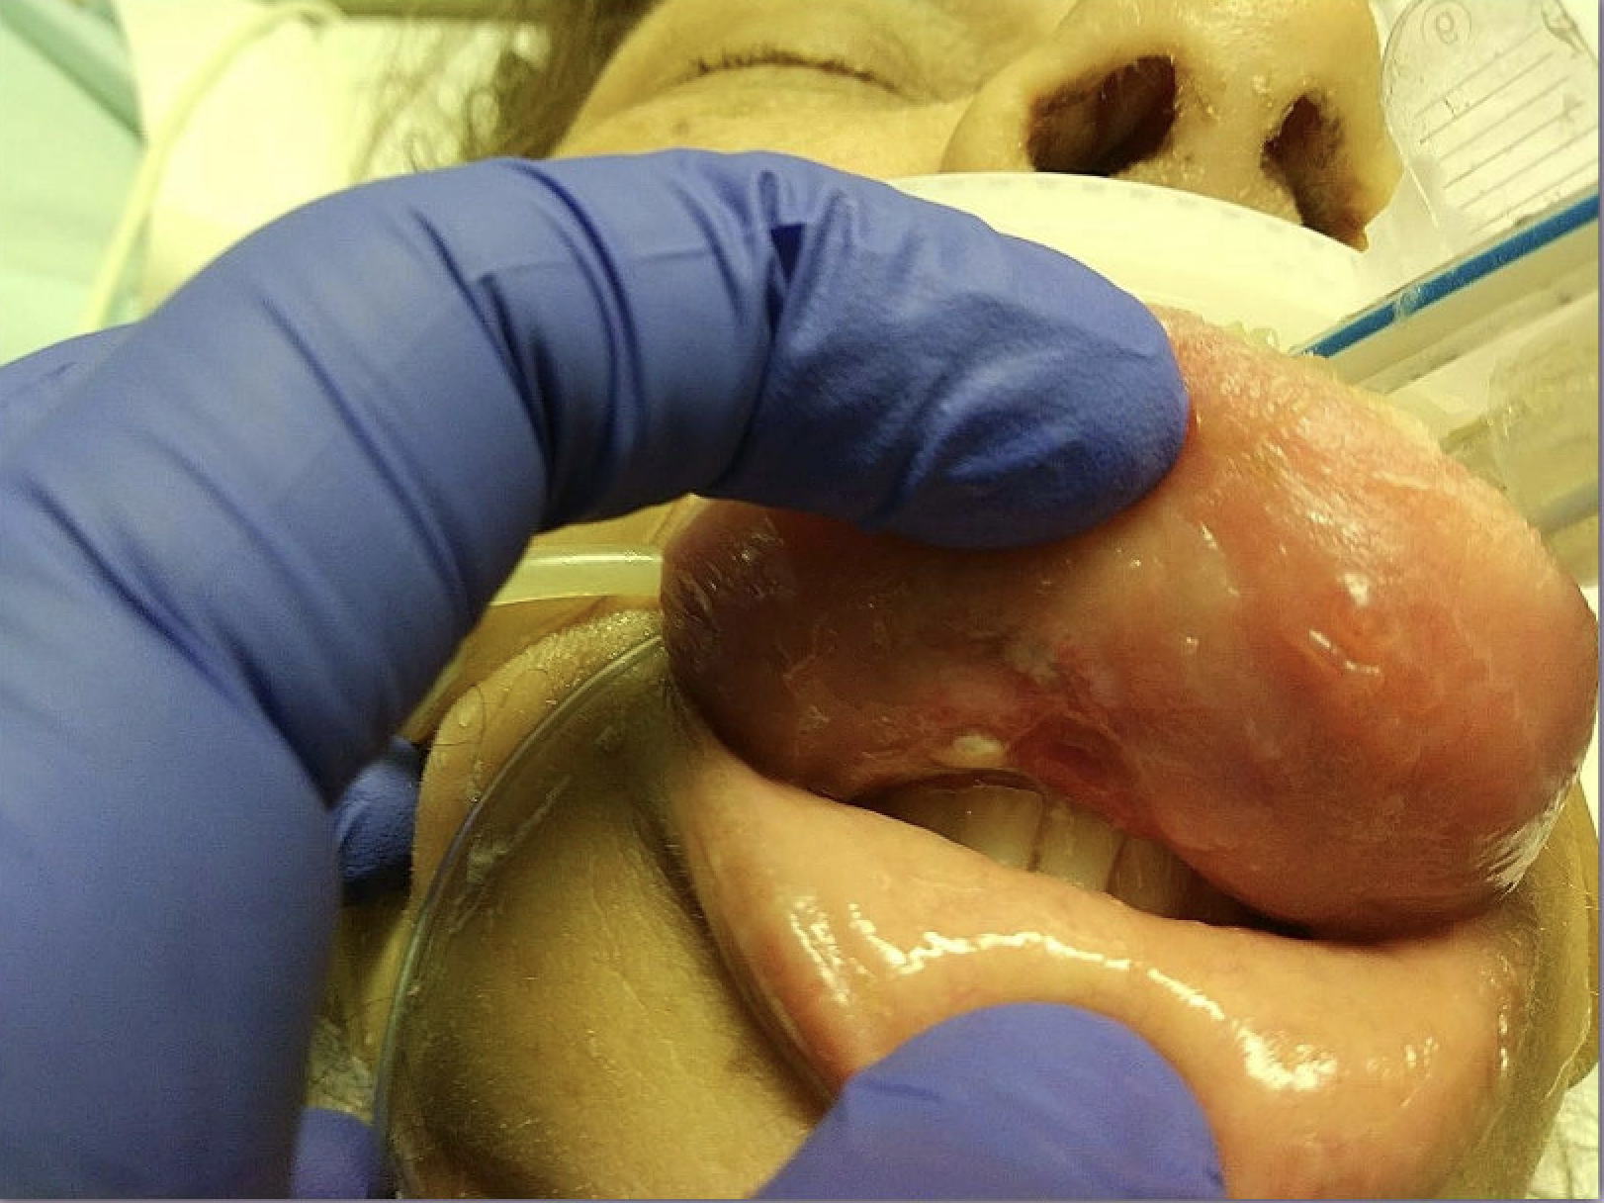

Severe Macroglossia In Myxedema Coma:
A ‘Tongue-Tied’ Emergency
Kamalpreet Gill MD, Rukhsar Nadeem MD, Moeez Sadiq MD, Shiva Hadadinapour MD,
Nicholas Reyes MD, Saqib Rashid MD, Amritpal Nat MD, Sukhampal Sidhu MD, Shahab Dian MD
Internal Medicine Residency, Saint Agnes Medical Center, Fresno, CA
Introduction
Discussion
Severe macroglossia is a rare but notable complication of hypothyroidism, particularly in the context of myxedema coma being the primary etiology. While hypothyroidism is a common endocrine disorder, the development of significant tongue swelling as part of its clinical presentation remains poorly documented and often under- recognized. Macroglossia can present with a variety of challenges, from airway obstruction to difficulty with speech and swallowing, and its association with myxedema coma is even rarer. The incidence of this complication is not well-established in the literature, leading to a gap in awareness and potential delays in diagnosis.
Macroglossia is a rare and poorly documented finding in myxedema, with no well-established cases identifying it as the primary cause. While hypothyroidism can lead to tissue swelling from mucopolysaccharide deposition, there is limited information on effective treatments beyond normalizing thyroid function—or, in severe cases, partial glossectomy. One such case reported a wedge glossectomy due to persistent macroglossia despite normalized thyroid levels. In our patient, similar interventions like corticosteroids provided little benefit, and although thyroid function normalized early, macroglossia took weeks to improve. This highlights that time remains the most critical factor in recovery, even with appropriate medical management. These findings suggest that, when clinically appropriate, allowing sufficient time for thyroid hormone therapy to take full effect may help avoid the need for invasive interventions.
Case Presentation
A 55-year-old female with a past medical history of chronic kidney disease
stage III, hyperlipidemia, hypertension, hypothyroidism, and cannabis use presented to the emergency department 11/29/24 with altered mental status and lethargy with suspected overdose versus hypothyroid related symptoms, as her urine drug screen was positive for methamphetamine. Upon admission, she was found to be disheveled and lethargic, with significantly elevated TSH (117), and enlargement of the neck and tongue. The patient was admitted to general medicine, but intensive care unit was consulted shortly after due to worsening tongue enlargement and concern for airway obstruction. The Patient was intubated, and broad-spectrum antibiotics (vancomycin and Zosyn) were initiated. A submandibular mass and macroglossia were noted, raising concern for thyroiditis, abscess formation or thyroid hematoma. She was managed with stress dose steroids, IV levothyroxine, and antibiotics. Despite improvement in thyroid function and some clinical stability, she continued to have significant swelling. The patient received two trials of stress-dose steroids throughout hospitalization, administered weeks apart, at the recommendation of the ENT specialist consulted. Additionally, the tongue was wrapped in gauze to relieve pressure from the teeth and reduce inflammation; however, there was no significant improvement in the swelling, and the patient subsequently developed adrenal insufficiency, confirmed by a low morning cortisol and abnormal ACTH stimulation test managed by endocrinology. CT maxillofacial, CT head, and CT soft tissue of the neck with contrast were all obtained to evaluate for any underlying etiology contributing to the macroglossia and neck enlargement but was unremarkable. Despite all these interventions, the tongue swelling persisted without improvement, ultimately necessitating tracheostomy and PEG tube placement by day 12 and 14, respectively. Her thyroid function remained under close management with ongoing levothyroxine and hydrocortisone adjustments. Throughout her stay, she demonstrated slow but steady improvement of her swelling, and she was ultimately de-cannulated on 01/02/25. By 01/03/25, the patient was stable enough for transfer to the medical floor and ultimately discharged
Figure 1
References
1. Elshimy, G., Chippa, V., & Correa, R. (2023, August 14). Myxedema. StatPearls -
NCBI
Bookshelf. https://www.ncbi.nlm.nih.gov/books/NBK545193/#:~:text=Disrupted
%20homeostatic%20mechanisms%20in%20hypothyroid,%5B11%5D
2. Gish, D. S., Loynd, R. T., Melnick, S., & Nazir, S. (2016). Myxoedema coma: a
forgotten presentation of extreme hypothyroidism. BMJ Case Reports,
bcr2016216225. https://doi.org/10.1136/bcr-2016-216225
3. Melville, J. C., Menegotto, K. D., Woernley, T. C., Maida, B. D., & Alava, I.
(2017). Unusual case of a massive macroglossia secondary to myxedema: A case
report and literature review. Journal of Oral and Maxillofacial Surgery, 76(1),
119–127. https://doi.org/10.1016/j.joms.2017.06.033
Figure 2

