Slide 1


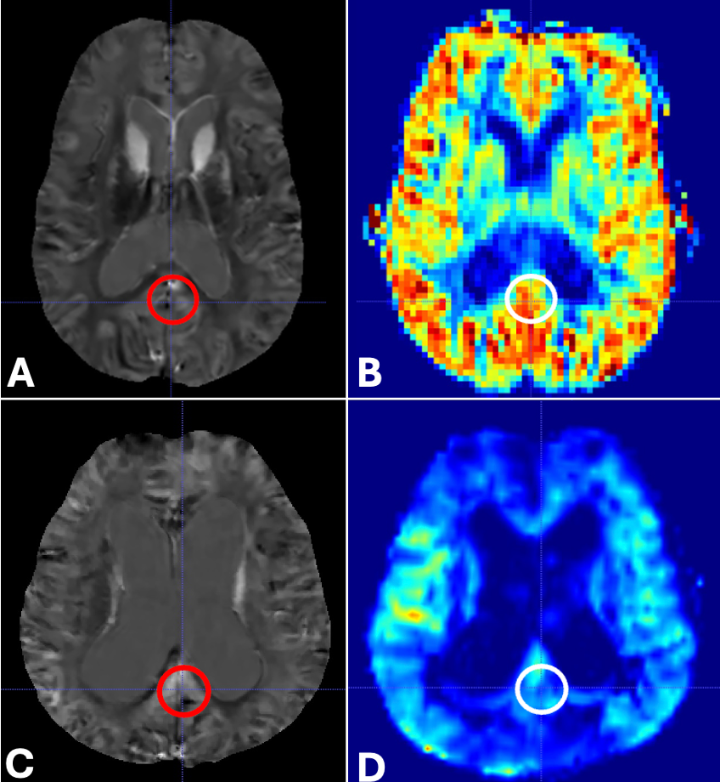
Quantitative susceptibility mapping (QSM) correlates with cerebral blood flow (CBF) in temporal and parietal regions, possibly reflecting Alzheimer’s Disease (AD) pathology
Kevin Lee¹, Jonathan P. Dyke¹, Yi Wang¹, Gloria C. Chiang¹
¹Weill Cornell Medicine, New York, NY
Purpose
Results
Prior studies have found that brain iron increases with age and Alzheimer’s disease (AD). It has been proposed that amyloid and hyperphosphorylated tau, two pathological hallmarks of AD, can promote iron deposition in the brain. ASL-MR has also been studied as a biomarker of AD, with reduced cerebral blood flow correlating with cerebral hypometabolism in AD. The pathology underlying CBF abnormalities in AD can be attributed to amyloid buildup in vessel walls and capillary stasis. However, whether these processes are related is unclear. We sought to determine whether QSM, as a noninvasive measure of brain iron, is associated with an AD-pattern of decreased cerebral blood flow.
78 subjects (34 amyloid PET-negative cognitively normal individuals, 15 amyloid PET-positive cognitively normal individuals, 10 amyloid PET-negative MCI, 11 MCI, 8 AD) with a mean age of 69±9 (range 52-85; male:female 34:44) were included. Cerebral blood flow was negatively associated with QSM values in the posterior cingulate (p=0.001), isthmus cingulate (p=0.02), and superior temporal regions (p=0.037). QSM was not significantly associated with CBF in other brain regions (p>0.05).
Materials and Methods
Conclusion
All subjects underwent a 3T standardized MRI protocol. 3D T1 MPRAGE and CBF maps were coregistered to QSM-MRI using the SPM12 software package in MATLAB. FreeSurfer was used to segment temporoparietal brain regions on both the QSM and CBF maps. Regression analysis was utilized to investigate the associations between QSM and CBF.
Higher QSM values, suggestive of increased brain iron, in the temporal and parietal regions, are associated with decreased blood flow, possibly reflecting greater underlying AD pathology. Future work will assess how QSM and CBF relate to underlying amyloid and tau pathology on PET.
(A) Quantitative susceptibility mapping (QSM)-MRI of Patient A demonstrating no significant QSM hyperintensity in the isthmus cingulate, indicating no significant iron deposition (red oval). (B) Cerebral blood flow (CBF) map showing normal preserved CBF in this same region and throughout the brain (white oval). (C) QSM-MRI of Patient B showing QSM hyperintensity in the isthmus cingulate, indicating increased iron deposition (red oval). (D) CBF map showing decreased CBF in this same region (white oval).
Acknowledgements
Thank you to Dr. Van Putten and the Transitional Year Program for allowing me to partake in a research elective to conduct this research with my mentors at Weill Cornell and present our findings.
Add your information, graphs and images to this section.

