Slide 1

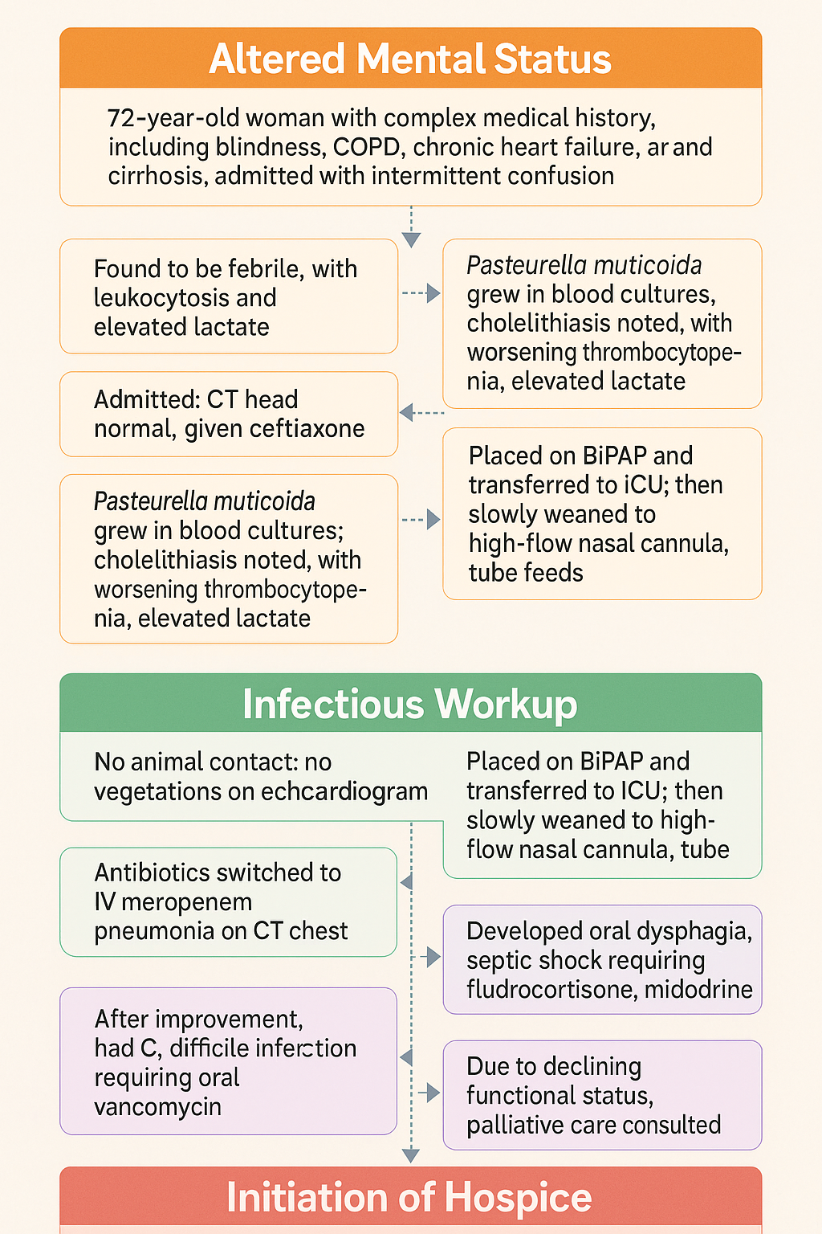

“No Pets, No Problem? Think Again—Pasteurella Bacteremia in a Pet-Free Patient
Aftab Arif MD, Ayesha Shahzad MD, Mahwish Sheikh MD, Hamna Javed MD, Roshan Bakht MD
Saint Agnes Medical Center, Fresno, CA
Introduction
Discussion
Pasteurella multocida is a Gram-negative coccobacillus commonly associated with animal bites, particularly from cats and dogs. Infections without direct animal exposure are exceedingly rare, especially in immunocompromised individuals. We present a case of P. multocida bacteremia in an elderly patient with multiple comorbidities and no recent animal contact, highlighting the diagnostic challenges and management complexities of opportunistic infections in high-risk populations.
This case illustrates a rare presentation of Pasteurella multocida bacteremia in the absence of documented animal exposure. Although commonly linked to animal bites, P. multocida can be part of the oropharyngeal flora and may cause invasive infections in immunocompromised hosts. This patient’s cirrhosis likely contributed to immune dysfunction, increasing susceptibility to atypical pathogens.The diagnostic challenge was compounded by the absence of classic risk factors and the presence of overlapping symptoms from her chronic comorbidities. This case underscores the importance of broadening the differential diagnosis in critically ill patients, especially those with cirrhosis and other immunocompromising conditions.
Case presentation
A 72-year-old female with a history of blindness (due to glaucoma), deafness, COPD with emphysema, cirrhosis, chronic diastolic heart failure with pacemaker, hypertension, insomnia, depression, overactive bladder, and remote breast cancer (with normal tumor markers) was admitted for altered mental status. Her caregiver reported intermittent confusion over several days.
On presentation, the patient was febrile with leukocytosis (WBC 13.8 ×10⁹/L) and elevated lactate (4.3 mmol/L), consistent with sepsis and metabolic acidosis. CT head was unremarkable. She received empiric ceftriaxone and was admitted for further evaluation. Antibiotic therapy was escalated to cefepime due to persistent leukocytosis and rising lactate.
Despite therapy, the patient developed thrombocytopenia (platelets: 17,000/μL) and worsening leukocytosis. Abdominal ultrasound revealed cholelithiasis with a positive Murphy’s sign and coarsened hepatic echotexture, suggestive of chronic liver disease. However, HIDA scan showed no evidence of acute cholecystitis. Blood cultures obtained in the ED grew Pasteurella multocida in all vials. The infectious disease team was consulted.
A thorough history revealed no recent animal contact. The patient had not owned pets for over three years, and her caregiver confirmed no exposure to animals. Dermatologic examination was unremarkable. Due to persistent symptoms, antibiotics were switched to IV meropenem, later supplemented with IV levofloxacin due to concern for pulmonary involvement after chest CT revealed left upper lobe ground-glass opacities.
Conclusion
Pasteurella multocida should be considered in immunocompromised patients presenting with sepsis, even in the absence of known animal exposure. Early recognition, appropriate antimicrobial therapy, and a multidisciplinary approach are critical in managing such complex cases. Despite aggressive treatment, this patient’s outcome was limited by her baseline functional status and multisystem decline, underscoring the need for timely goals-of-care discussions in similar scenarios.
Figure 1: Timeline of the patients hospitalization
References
An echocardiogram ruled out endocarditis, and bone marrow biopsy showed normocellular marrow without evidence of malignancy.The patient’s condition deteriorated, requiring ICU transfer for respiratory support with BiPAP, eventually transitioning to high-flow nasal cannula. Nutritional support included TPN and later tube feeds due to oral dysphagia. Although her pulmonary findings and leukocytosis improved, she developed Clostridioides difficile infection secondary to prolonged antibiotic use, managed with oral vancomycin.
Subsequently, the patient developed septic shock requiring vasopressor support (midodrine and fludrocortisone) and showed signs of protein-calorie malnutrition. Given her poor prognosis and continued decline, a goals-of-care discussion was held, and hospice care was initiated.
Ho, D. L., & M. D. (2020). Pasteurella multocida: An overview of its clinical significance and treatment options. Journal of Clinical Microbiology, 58(12), e01930-20.
Thompson, A. J., & W. G. (2018). Sepsis and bacteremia caused by Pasteurella multocida: A review of clinical outcomes and treatment strategies. Infectious Disease Reports, 10(4), 7545.

