Slide 1

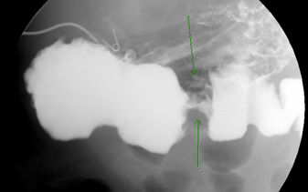
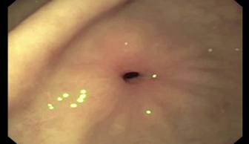
Idiopathic Adult Hypertrophic Pyloric Stenosis:
Known but rare cause in adults
Ajaypreet Singh MD, Atinderpal Singh MD, Muhamad Oum MD, Kamalpreet Gill MD, Mehdi Hakimipour MD
Abstract
Case Report
Conclusion
Hypertrophic pyloric stenosis is widely recognized as a disease in infants, with clinical manifestation appearing between 3 and 5 weeks of age. However, an adult form has been well-established since the 19th century but with only approximately 300 cases documented worldwide. This
case is about a 59-year-old Hispanic male patient who was admitted due to intractable nausea and vomiting with abdominal pain, decreased appetite, and unintentional weight loss.
This 59-year-old Hispanic male with an unremarkable medical history presented to the emergency department complaining of persistent nausea and vomiting for almost a year, which intensified over the past 2 months. The patient has no apparent predisposing factors related to the digestive tract. Initially, a nuclear medicine gastric study was attempted but the patient could not tolerate it due to vomiting. Subsequently, the patient then underwent an esophagogastroduodenoscopy (EGD), revealing a benign but severe stenosis at the pylorus, as shown in Figure 2. A tissue biopsy taken during this EGD showed signs of chronic gastritis but was negative for metaplasia, dysplasia, or neoplasia. Balloon dilation of the pylorus up to 9mm was performed, but there was continued stenosis at the duodenal bulb. Despite the procedure, the patient still experienced some minimal nausea with liquids. An upper gastrointestinal (UGI) series showed persistent edematous thickening and significant narrowing of the pylorus channel, even after balloon dilation as noted in Figure 1. The patient was discharged with a plan for surgery follow-up. However, the patient returned to the emergency department (ED) before his follow-up appointment with continuous nausea and vomiting, mostly with solids. During this second hospital stay, the patient underwent a Laparoscopic Antrectomy with Roux Y Anastomosis and Bilateral Truncal Vagotomy. One month, post-operatively, the patient has tolerated both solids and liquids.
Unlike its more common infantile counterpart, adult hypertrophic pyloric stenosis (AHPS) often presents diagnostic challenges due to its rarity and nonspecific symptoms such as postprandial nausea, vomiting, and abdominal pain. The etiology of AHPS remains largely idiopathic, though associations with peptic ulcer disease and certain inflammatory conditions have been noted. Diagnosis typically involves endoscopy and barium studies, and treatment often requires surgical intervention, such as pyloromyotomy or pyloroplasty.
Methodology
Figure 1: UGI series showing stenosis
Figure 2: EGD showing stenosis

