Slide 1

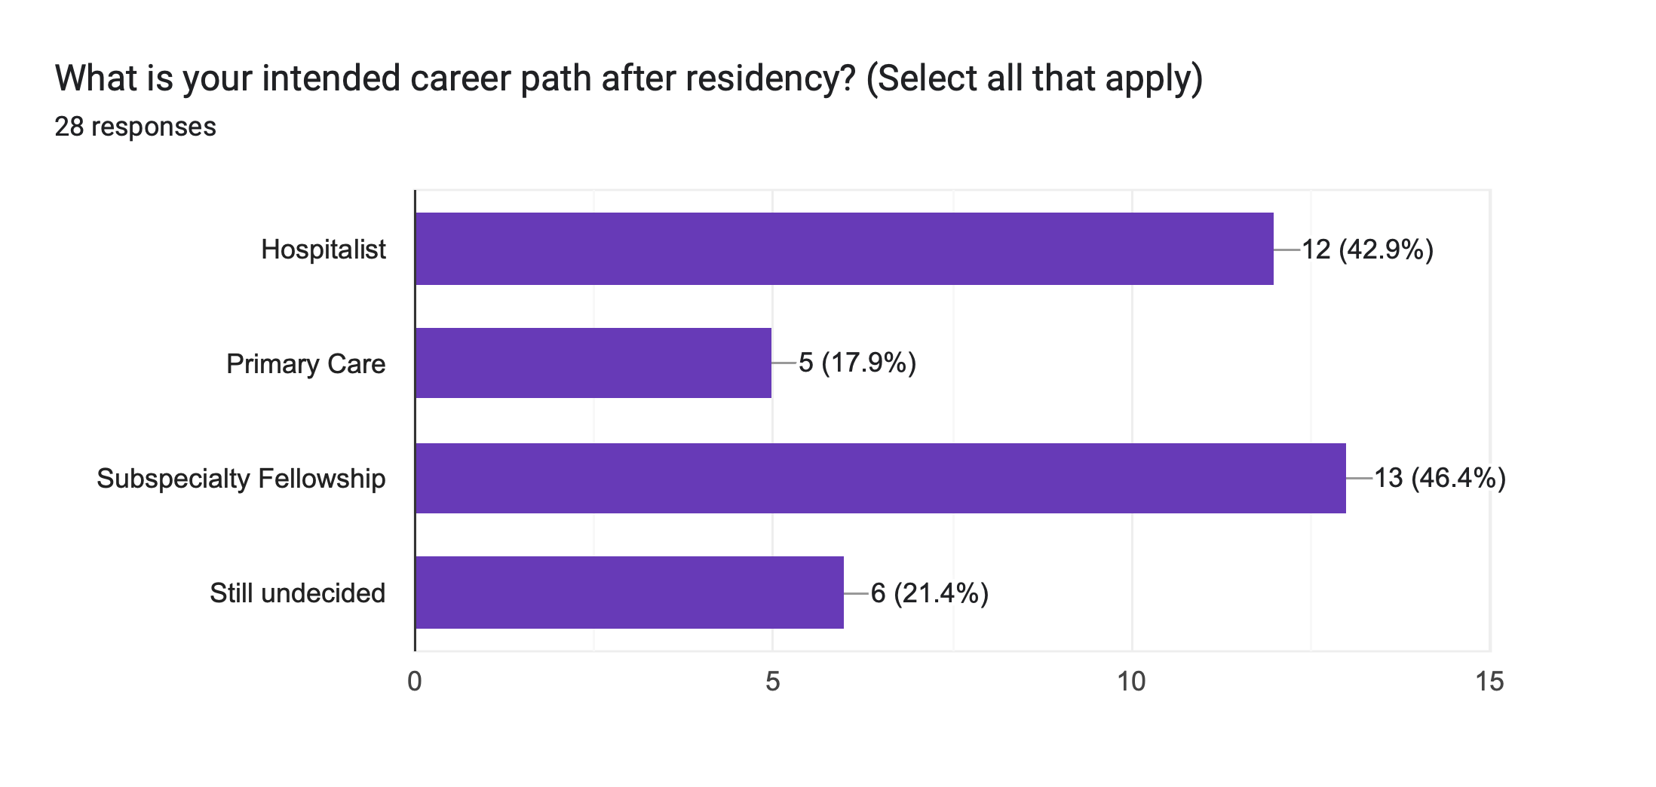
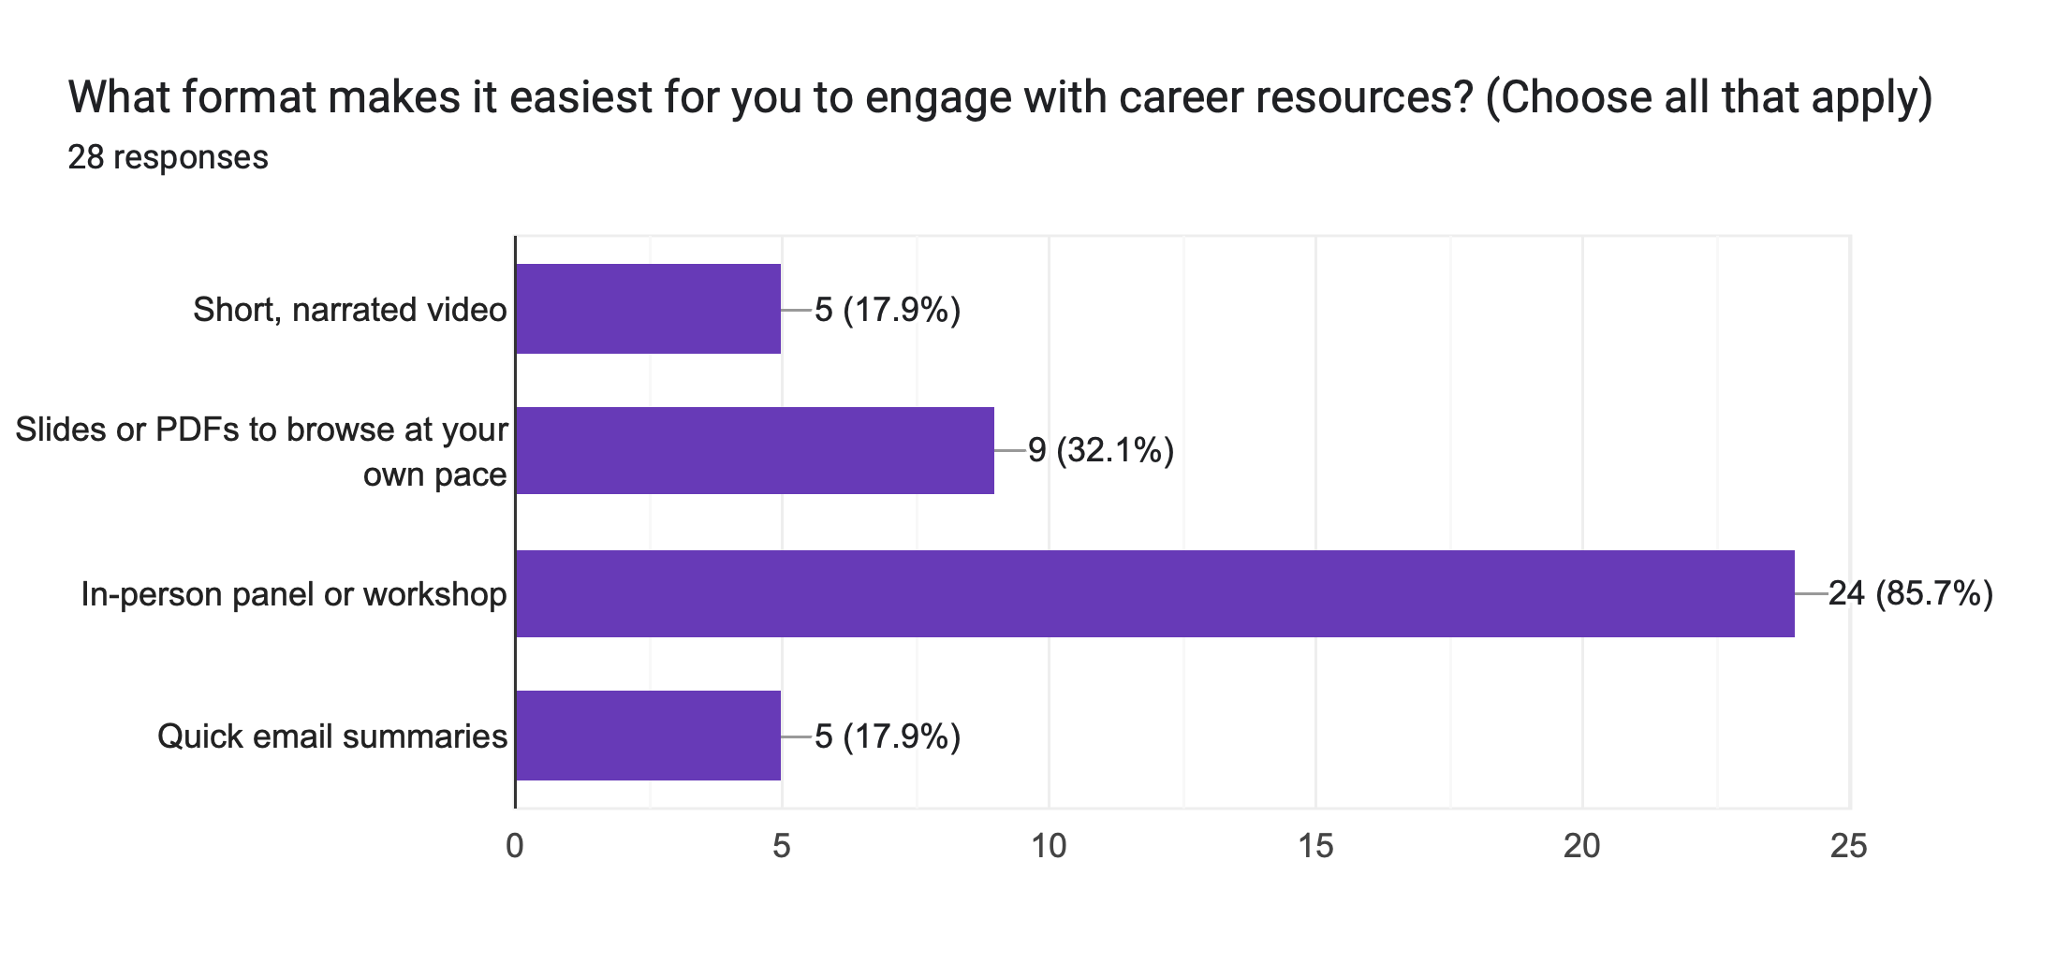
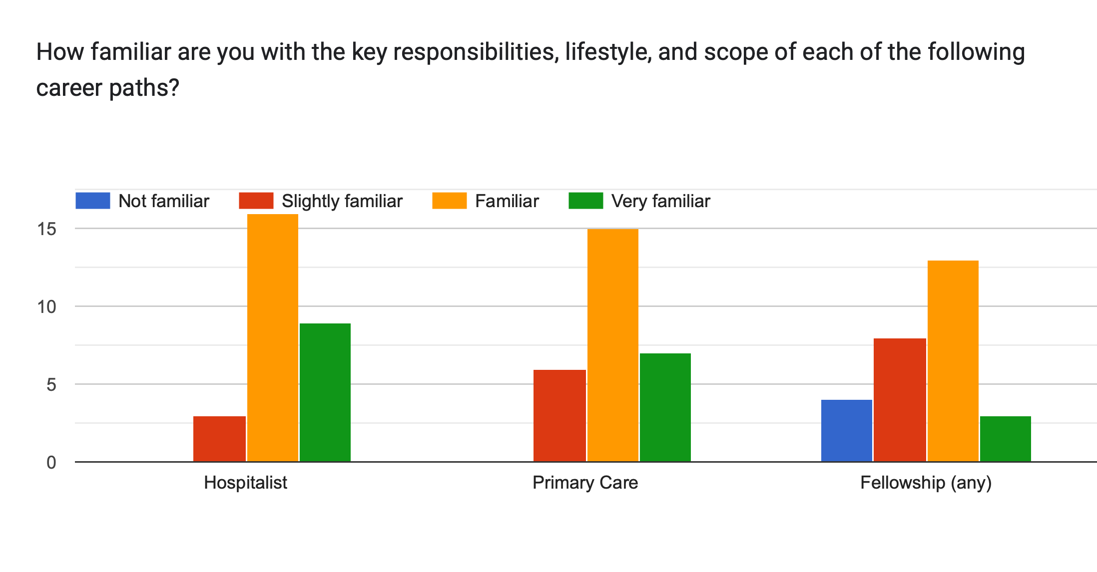
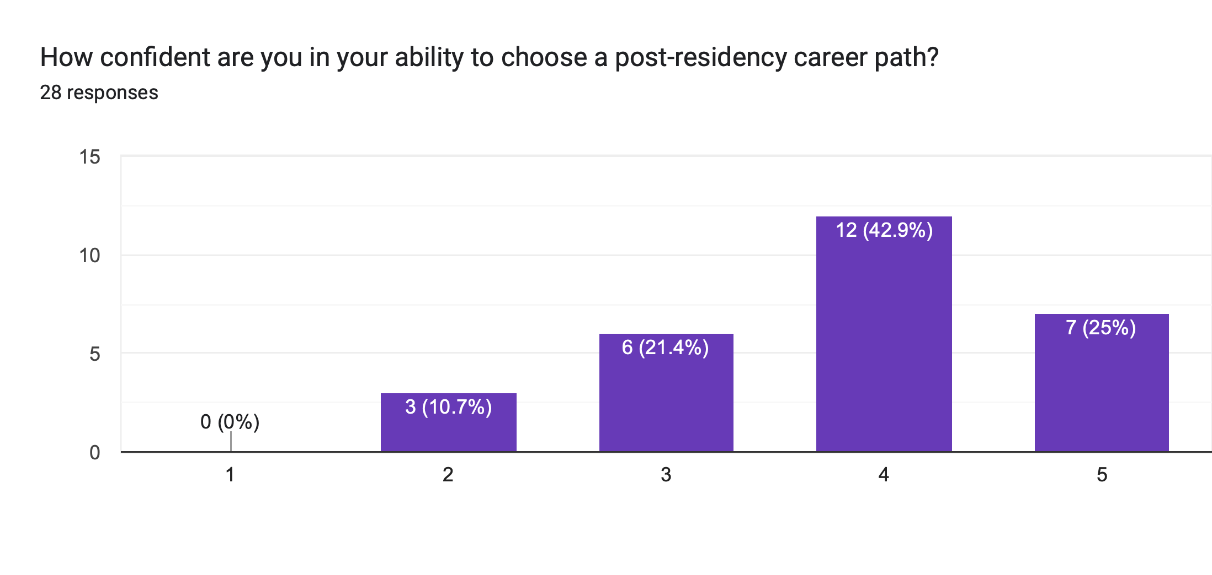
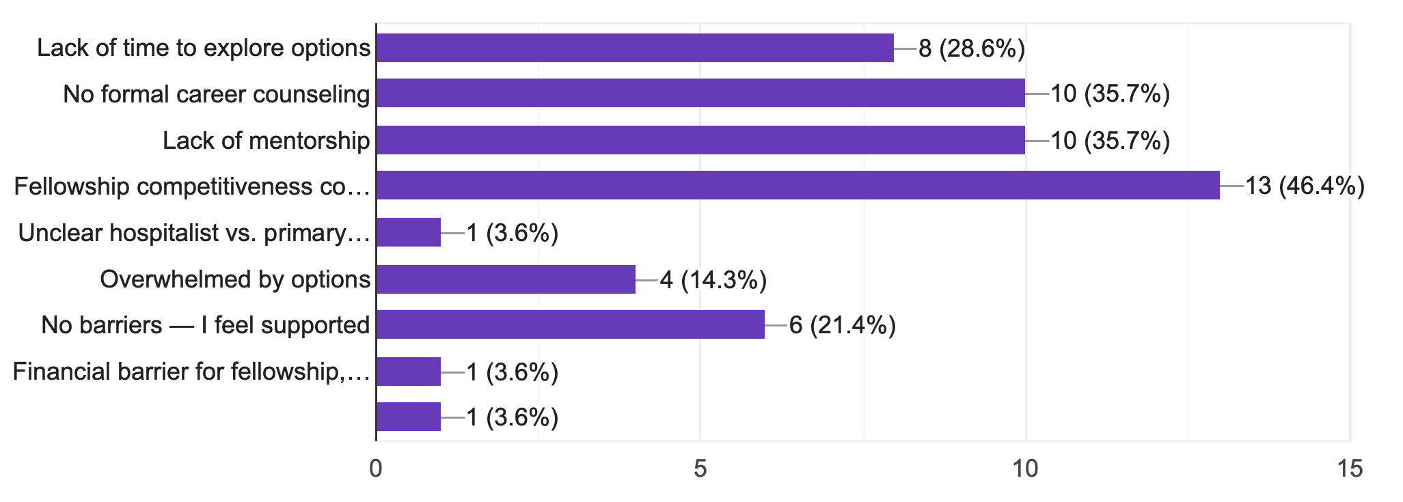
Quality Improvement Project: Enhancing Career Pathway Guidance for Internal Medicine Residents
Yazan Haroun, MD; Advisor: Anupama Poliyedath, MD
Graduate Medical Education Internal Medicine - Saint Agnes Medical Center, Fresno CA
Background
Results
Results
Career planning is a critical part of Internal Medicine residency, yet many residents report limited structured exposure to key post-residency options like hospitalist medicine, primary care, and subspecialty fellowship.
Time constraints, inconsistent mentorship, and lack of formal guidance often contribute to decision fatigue and uncertainty.
Literature supports the value of targeted career counseling in improving satisfaction and confidence, yet most programs still rely on informal or late-stage advising. [1] [2]
Figure 1: Intended career path after residency.
Figure 5: Residents’ preference on suggested formats for career resources.
Discussion
Figure 2: Residents’ familiarity with key responsibilities, lifestyle, and scope of career pathways.
Survey findings highlighted critical gaps in exposure, confidence, and support regarding career planning. While interest in hospitalist and fellowship paths was high, many reported limited exposure to fellowship-prep experiences or outpatient primary care. Only a small proportion felt very confident in making post-residency decisions, and nearly half lacked a dedicated mentor to guide them.
Residents preferred video formats, short presentations, and interactive experiences as career guidance resources, and emphasized the importance of addressing both professional and personal goals.
In response, a slide-based educational resource covering Hospitalist, Primary Care, and Fellowship tracks was created. The project demonstrates the value of resident-informed guidance and sets the stage for future feedback and expansion.
Objectives
Assess resident exposure, confidence, and support across major career tracks.
Identify key barriers to informed career decision-making.
Develop a resident-informed educational resource tailored to their needs.
Prepare for future implementation and evaluation of its impact.
Figure 3: Residents’ confidence in ability to choose a post-residency career path.
Methodolgy
PLAN
Identified gaps in career guidance and designed an anonymous needs assessment survey
DO
Distributed a 19-question survey to IM residents; received 28 responses
STUDY
Analyzed data on confidence, exposure, barriers, and preferred formats
ACT
Developed a slide-based resource covering all 3tracks; preparing for rollout and feedback
Future Considerations
Not Confident
Slightly
Confident
Somewhat
Confident
Fairly
Confident
Very
Confident
Deploy the resource and collect feedback
Expand content and consider adding live panels or mentorship components.
Explore integration into intern orientation or formal residency curriculum.
Figure 4: Possible barriers for post-residency career path planning.
References
Ramanan, R. A., Taylor, W. C., Davis, R. B., & Phillips, R. S. (2006). Mentoring matters. Mentoring and career preparation in internal medicine residency training. Journal of general internal medicine, 21(4), 340–345. https://doi.org/10.1111/j.1525-1497.2006.00346.x
DeCastro, R., Griffith, K. A., Ubel, P. A., Stewart, A., & Jagsi, R. (2014). Mentoring and the career satisfaction of male and female academic medical faculty. Academic medicine : journal of the Association of American Medical Colleges, 89(2), 301–311. https://doi.org/10.1097/ACM.0000000000000109

