Slide 1

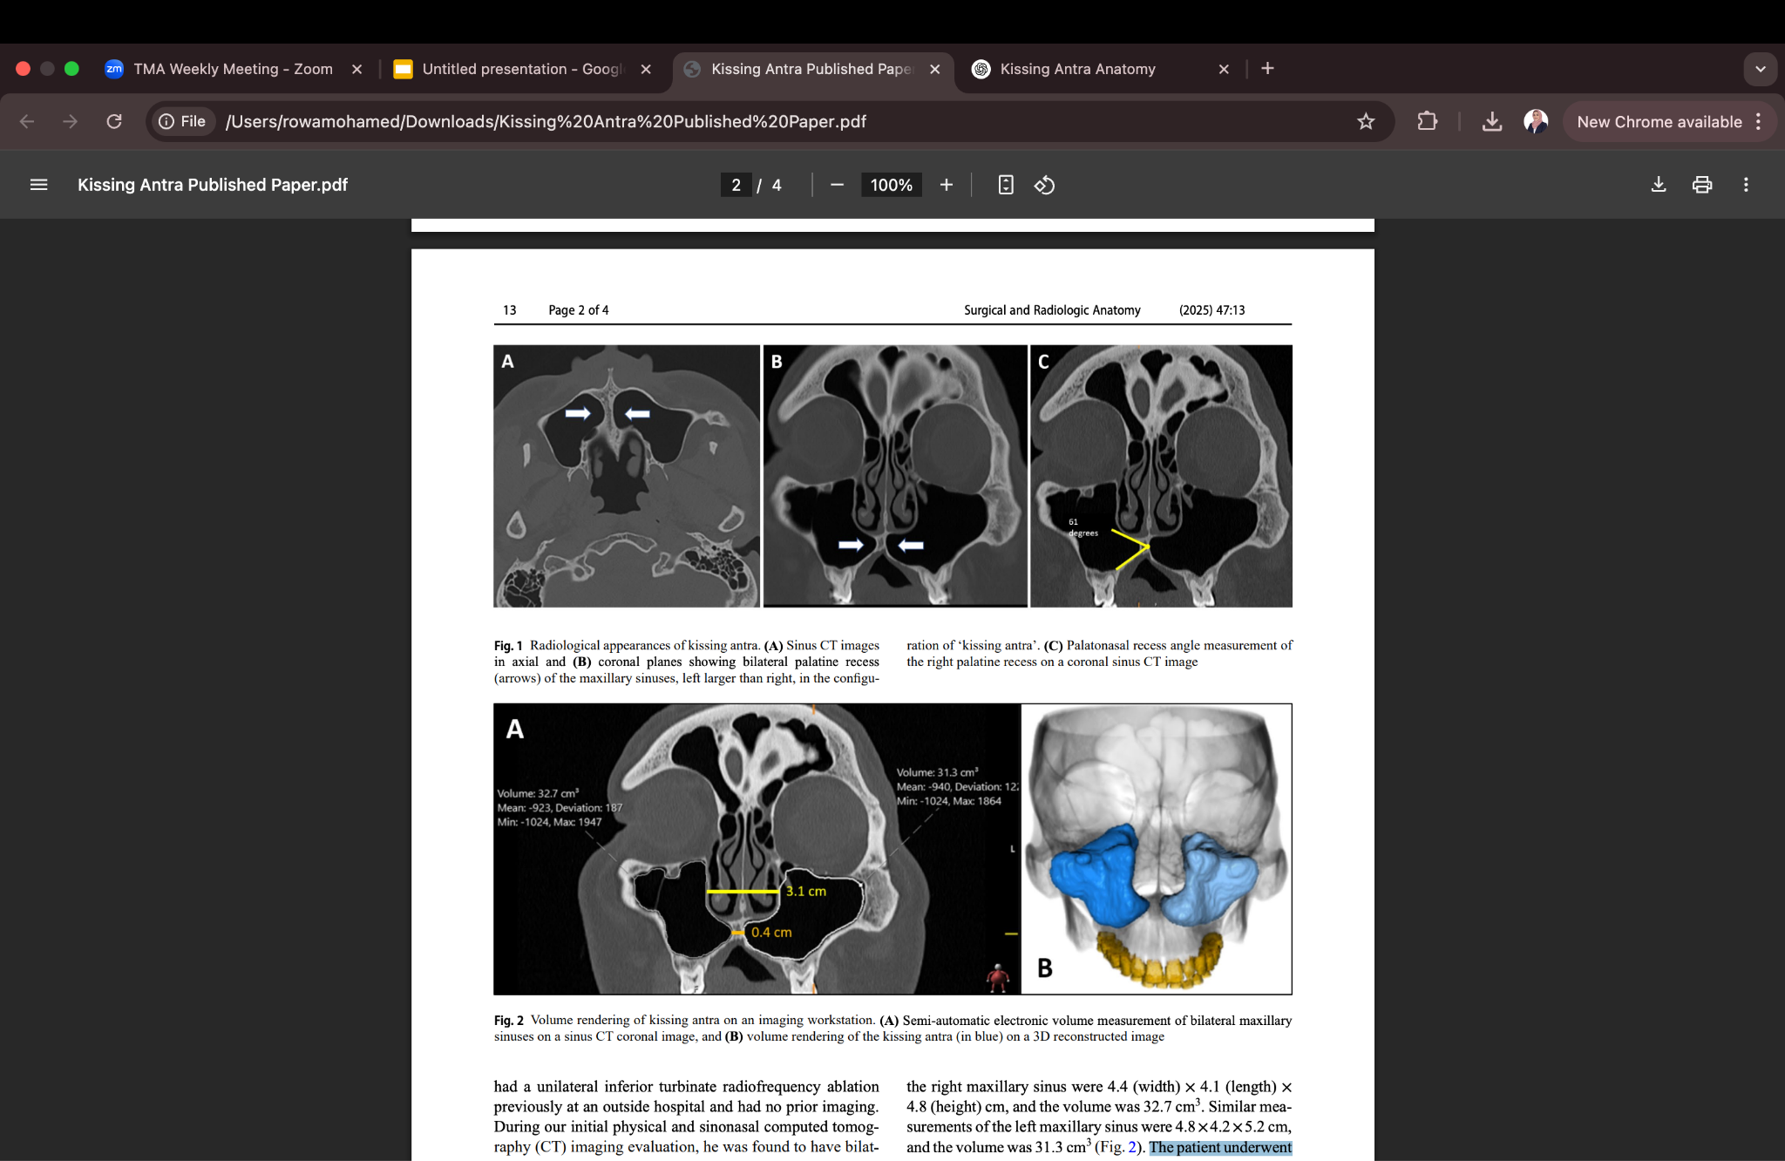
Rare Kissing Antra of the Maxillary Sinuses: Clinical Implications
Rowa A. Mohamed¹ Mohamed S. Muneer² Tarik F. Massoud²
1.Saint Agnes Medical Center, Fresno, CA
2.Division of Neuroimaging and Neurointervention, Department of Radiology, Stanford University School of Medicine, Palo Alto, CA
Introduction
Discussion
The maxillary antra, the largest paranasal sinuses, have several anatomical recesses, including the medially extending palatine recess. We report a rare variant where bilateral palatine recesses meet at the midline—we coin the term “kissing antra.” in analogy to the term “kissing carotids”
This case report highlights a rare anatomical variant called kissing antra, where bilateral palatine recesses of the maxillary sinuses meet at the midline. While palatine recesses are seen bilaterally, this specific variant is extremely rare, with an incidence of only 0.0038%. The condition may be congenital, linked to early fetal development of the maxilla and palate. Clinically, kissing antra can be mistaken for pathological lesions on imaging, complicate sinus drainage, and pose challenges during sinus surgeries such as augmentation. Awareness of this variant is important for accurate diagnosis and surgical planning.
Methods
Figure 1: Radiological appearances of kissing antra. (A) Sinus CT images in axial and (B) coronal planes showing bilateral palatine recess (arrows) of the maxillary sinuses, left larger than right, in the configuration of ‘kissing antra’. (C) Palatonasal recess angle measurement of the right palatine recess on a coronal sinus CT image
A 40-year-old male with recurrent acute rhinosinusitis presented to our center for clinical management. A computed tomography scan revealed the presence of an incidental anatomical variant of bilateral maxillary sinuses for which we coin the term “kissing antra”. The patient reported that he had repeated sinonasal symptoms since childhood. The patient underwent bilateral inferior turbinate submucosal resections, right concha bullosa resection, right septal reduction, and bilateral vestibular body reduction. Despite improvement in breathing, the patient continued to be symptomatic, requiring further functional endoscopic sinus surgery including bilateral maxillary antrostomies, bilateral total ethmoidectomies, and bilateral frontal sinusotomy.
References
1. De Oliveira AG, Silveira ODS, Francio LA, De Andrade Marigo Grandinetti H, Manzi FR (2012) Anatomic variations of paranasal sinuses—clinical case report. Surg Radiol Anat 35:535–538. https://doi.org/10.1007/s00276-012-1060-6
2. Earwaker J (1993) Anatomic variants in sinonasal CT. Radiographics 13 https://doi.org/10.1148/radiographics.13.2 .8460226
3. Nelke KH, Pawlak W, Morawska-Kochman M, Guziński M (2014) Unique canal communicating between both maxillary sinuses through the palatine recess with hypertrophy of sinuses. Br J Oral Maxillofac Surg 52:764–766. https://doi.org/10.1016/j. bjoms.2014.06.002
4. Omami G (2013) Palatine recess of maxillary sinus masquerading as radiolucent lesion: Case report. Libyan Dent J 3:14815171. https://doi.org/10.5542/LDJ.v3i0
Figure 2:Volume rendering of kissing antra on an imaging workstation. (A) Semi-automatic electronic volume measurement of bilateral maxillary sinuses on a sinus CT coronal image, and (B) volume rendering of the kissing antra (in blue) on a 3D reconstructed image

