Slide 1

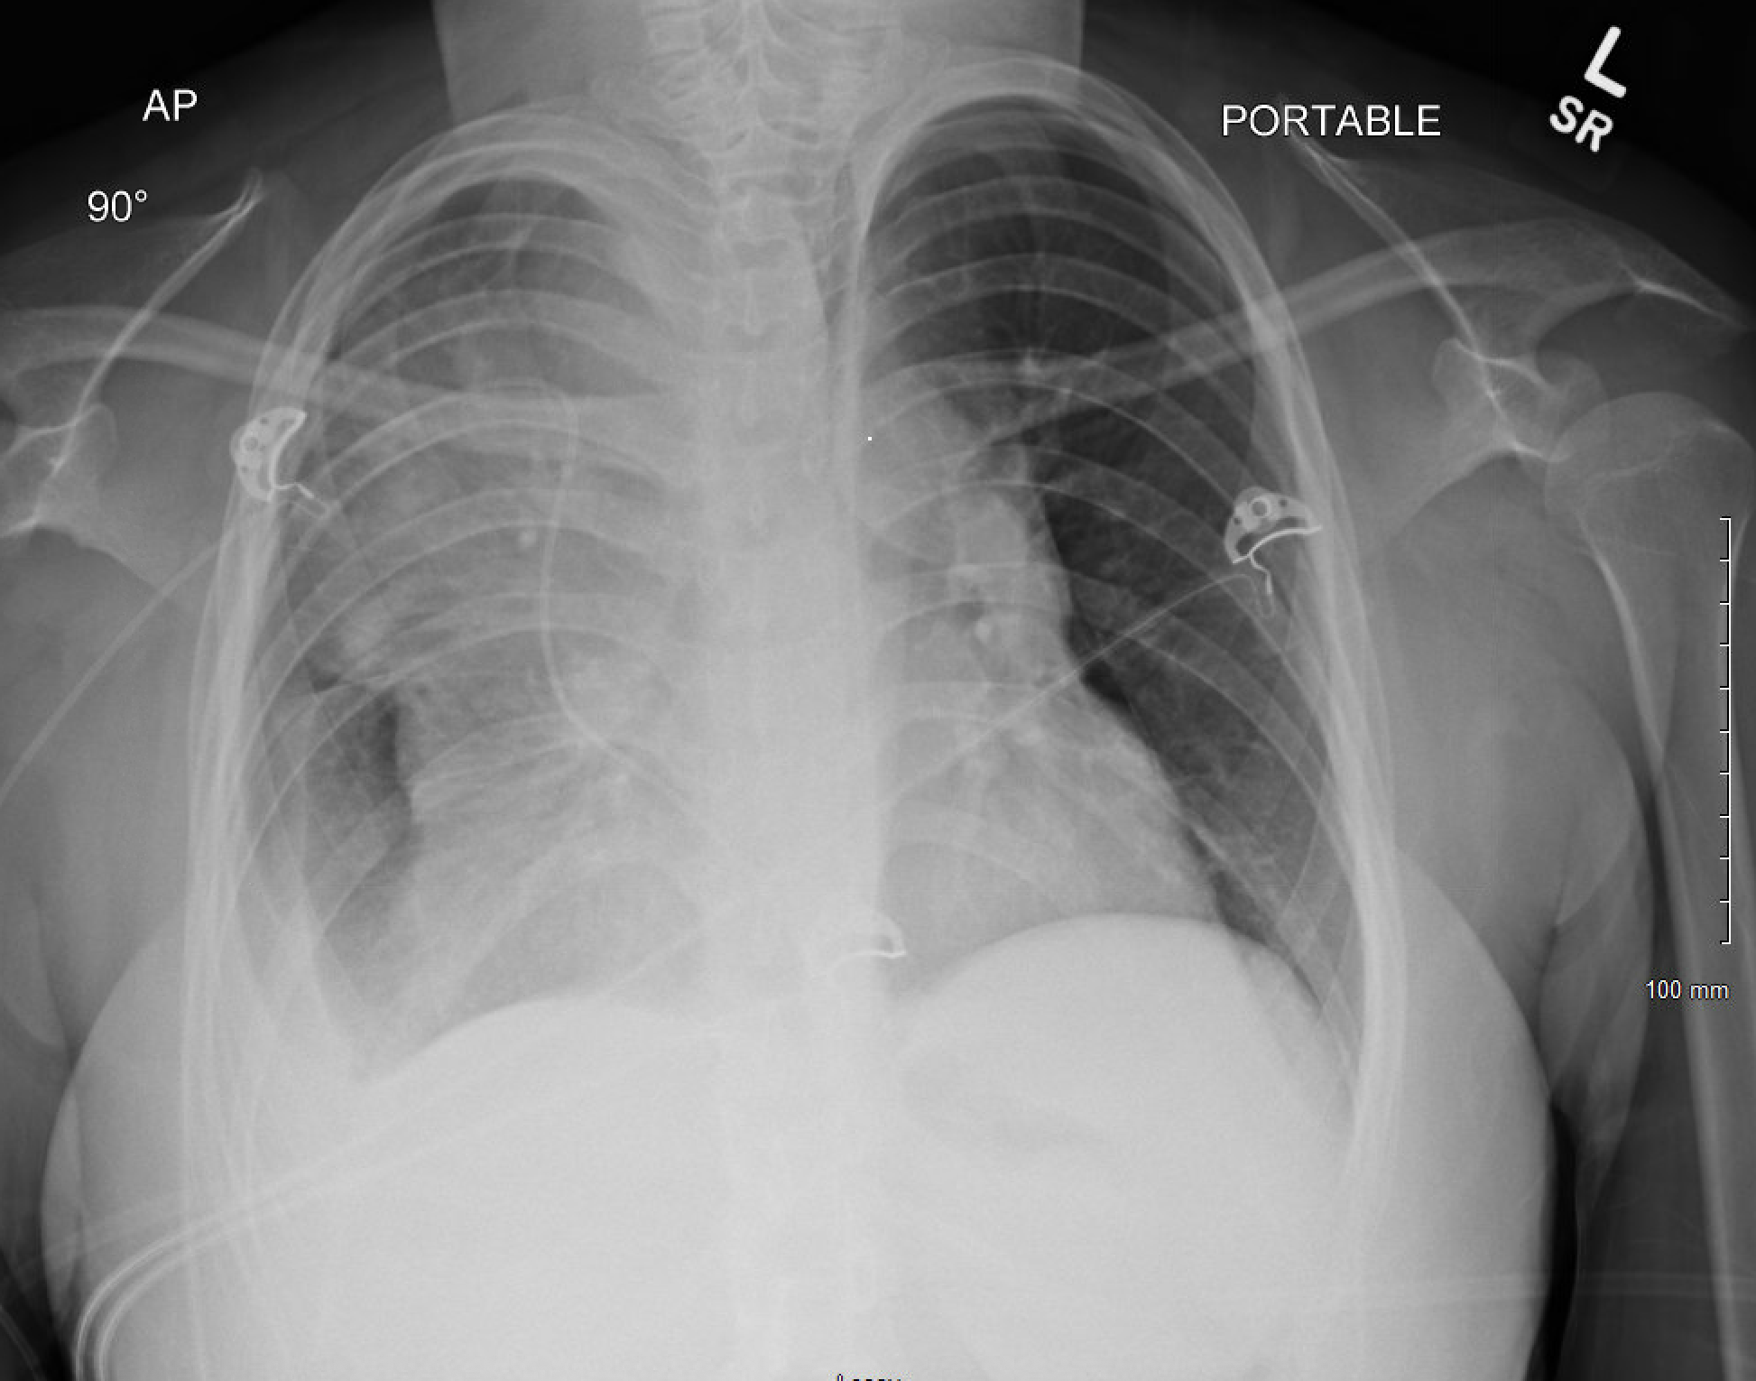
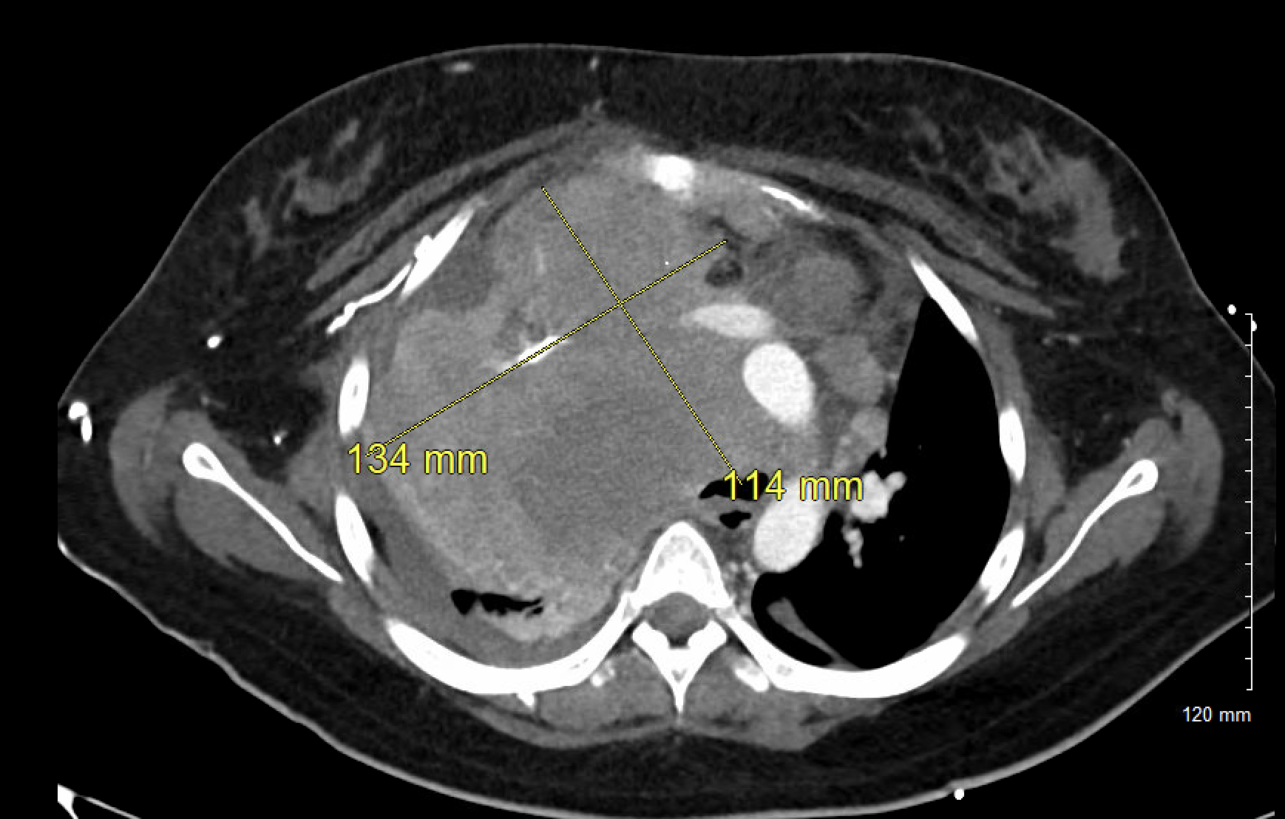
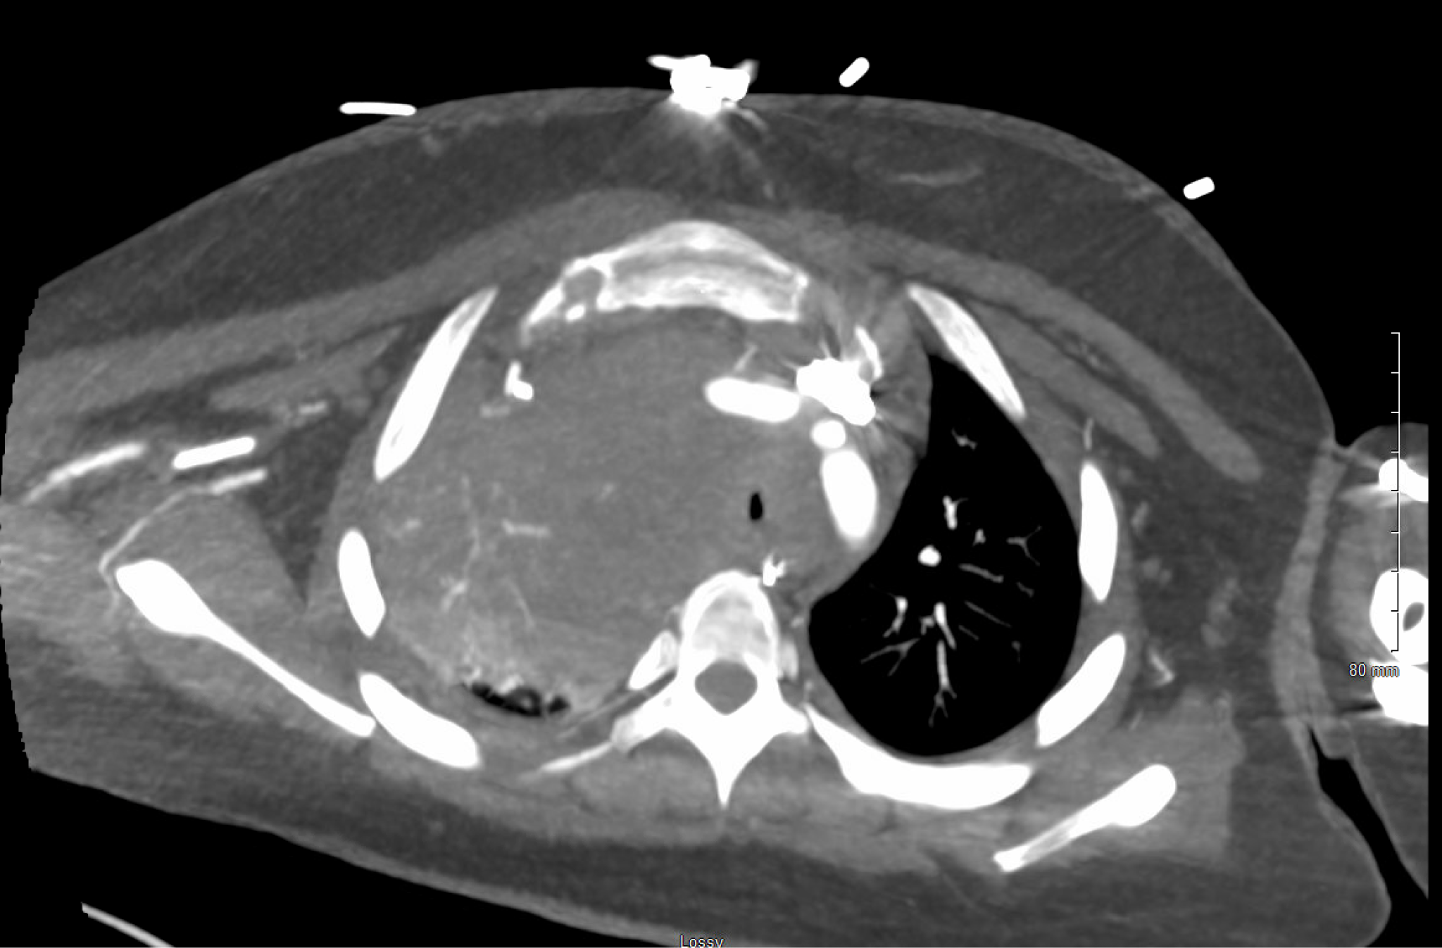
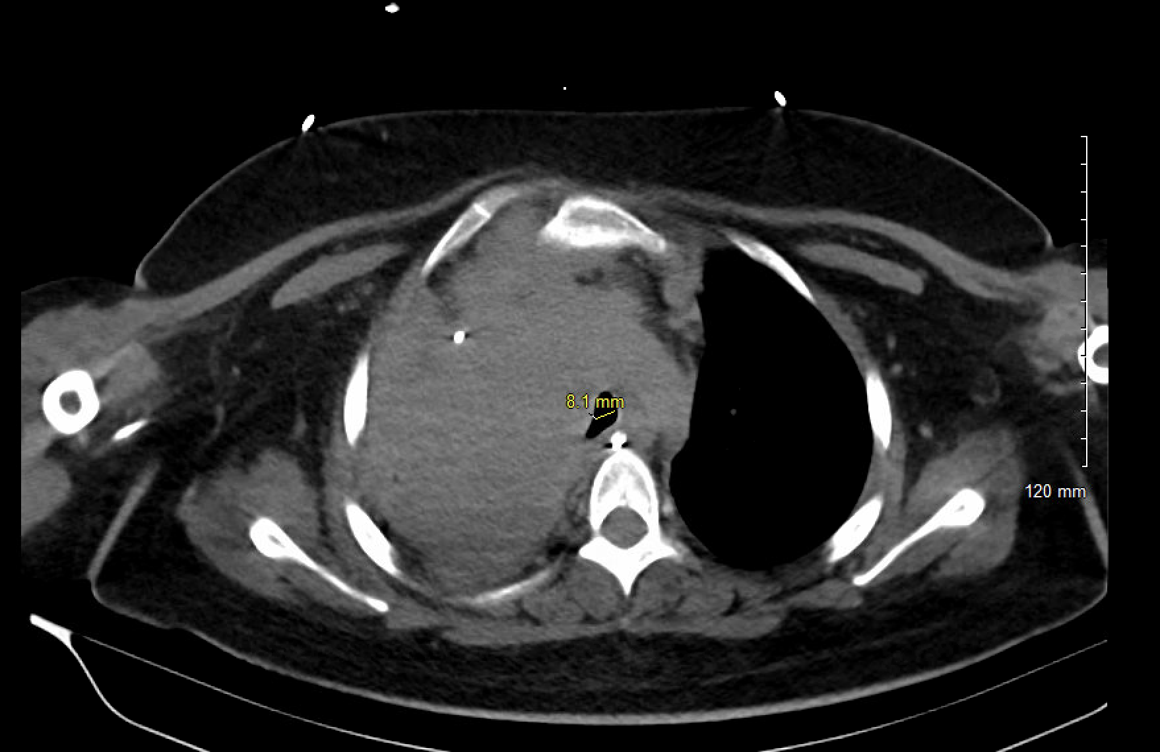

The Great Compression: Airway Crisis In Case Of Bulky Hodgkin Lymphoma
Mahwish Sheikh MD, Ayesha Shahzad MD, Hamna Javed MD,
Pankaj Bharati MD, Saqib Rashid MD
Saint Agnes Medical Center, Fresno, CA
Introduction
Figure 1
Figure 2
Discussion
Hodgkin lymphoma is a lymphoid malignancy that primarily affects adolescents and young adults and typically carries a favorable prognosis due to the success of combination chemotherapy regimens such as ABVD (Adriamycin, Bleomycin, Vinblastine, Dacarbazine) [1]. However, bulky mediastinal disease can result in acute complications, including airway compression that may progress to respiratory failure and necessitate emergent intervention [2]. In such cases, high-dose corticosteroids are often employed to achieve rapid tumor reduction and stabilize the patient prior to further chemotherapy [3]. This case highlights the importance of prompt imaging, multidisciplinary coordination, and individualized management in addressing oncologic emergencies.
This case illustrates a rare but critical complication of Hodgkin lymphoma: acute airway obstruction due to a bulky mediastinal mass. Although mediastinal involvement is common in nodular sclerosing Hodgkin lymphoma, progression to respiratory failure requiring mechanical ventilation is uncommon [2]. In this case, urgent imaging enabled the identification of severe airway and vascular compromise, guiding immediate intervention. High-dose corticosteroids were essential in achieving rapid tumor debulking—a well-established strategy in compressive lymphomas to relieve symptoms and stabilize the airway [1]. Early intervention avoided the need for stent placement, which carries potential procedural and long-term complications.
Case Presentation
An 18-year-old female with a recent diagnosis of grade 2 nodular sclerosing Hodgkin lymphoma presented to the emergency department with progressive shortness of breath, nonproductive cough, and a sensation of air trapping over the past two days. She had received her first cycle of ABVD chemotherapy during a recent inpatient admission but was discharged early due to insurance limitations. She denied fevers, chills, chest pain, abdominal discomfort, gastrointestinal or urinary symptoms.In the ED, she appeared in acute respiratory distress with tachypnea. Laboratory evaluation revealed microcytic anemia, and a chest X-ray demonstrated a right anterior mediastinal mass (Figure 1). Her respiratory status deteriorated rapidly with the onset of stridor and loss of consciousness, prompting emergent intubation. A CT angiogram of the chest revealed a large heterogeneous anterior mediastinal and hilar mass (16.8 x 11.7 x 17.5 cm) extending into the lower neck. The mass caused significant compression of vascular structures, narrowing of the right main pulmonary artery and both mainstem bronchi (right > left), and a small left apical pneumothorax. No pulmonary embolism was detected (Figures 2, 3).She was admitted to the ICU and placed on pressure-regulated volume control ventilation (FiO₂ 30%, RR 16, TV 400 mL, PEEP 5). Interventional pulmonology recommended initiating high-dose corticosteroids with repeat imaging in five days.
Figure 3
Figure 4
Conclusion
This case underscores the importance of early recognition of airway compromise in patients with bulky mediastinal Hodgkin lymphoma. Prompt initiation of corticosteroids served as an effective temporizing measure, allowing the patient to resume definitive oncologic therapy. Coordinated, multidisciplinary management remains critical in optimizing outcomes for patients facing life-threatening complications of hematologic malignancies [3].
References
Shanbhag, S., & Ambinder, R. F. (2018). Hodgkin lymphoma: A review and update on recent progress. CA: A Cancer Journal for Clinicians, 68(2), 116–132. https://doi.org/10.3322/caac.21438
Mauz-Körholz, C., Metzger, M. L., Kelly, K. M., et al. (2015). Pediatric Hodgkin lymphoma. Journal of Clinical Oncology, 33(27), 2975–2985. https://doi.org/10.1200/JCO.2015.62.6671
Crombie, J. L., & LaCasce, A. S. (2019). Mediastinal lymphomas: Diagnosis and management. Journal of the National Comprehensive Cancer Network, 17(10), 1190–1197. https://doi.org/10.6004/jnccn.2019.7350
Case Presentation cont.
A stent was considered but deferred due to risks associated with metal airway stents in young patients.During her ICU stay, a large right pleural effusion was identified and drained. The pleural fluid was transudative with negative cytology. On repeat CT imaging at day five, airway patency had improved, and she was successfully extubated to room air (Figure 4). She continued receiving chemotherapy and corticosteroids, resulting in significant clinical improvement. The patient was discharged in stable condition with close outpatient oncology follow-up.

