Slide 1


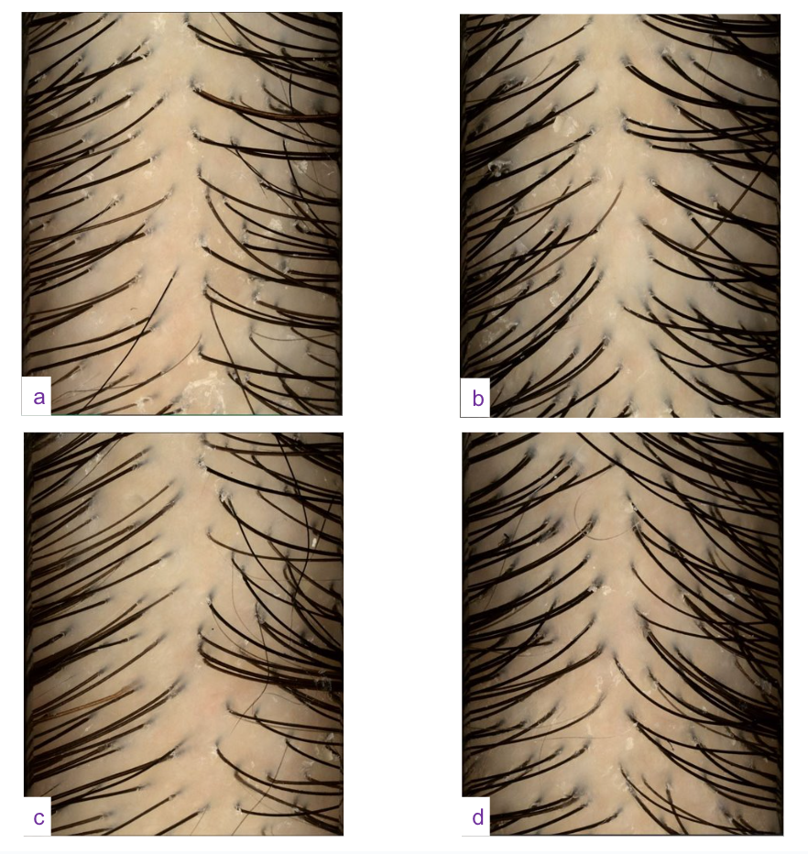

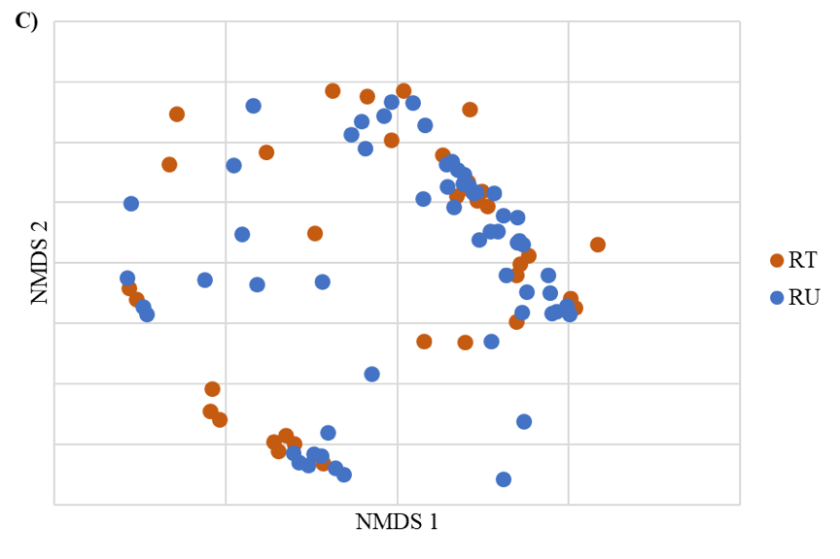
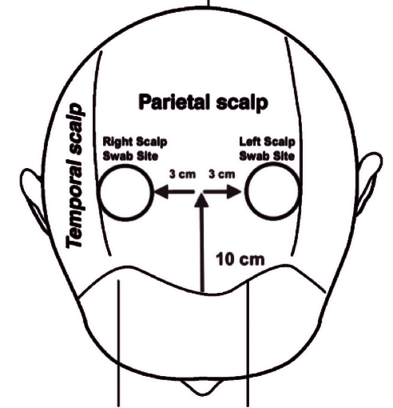
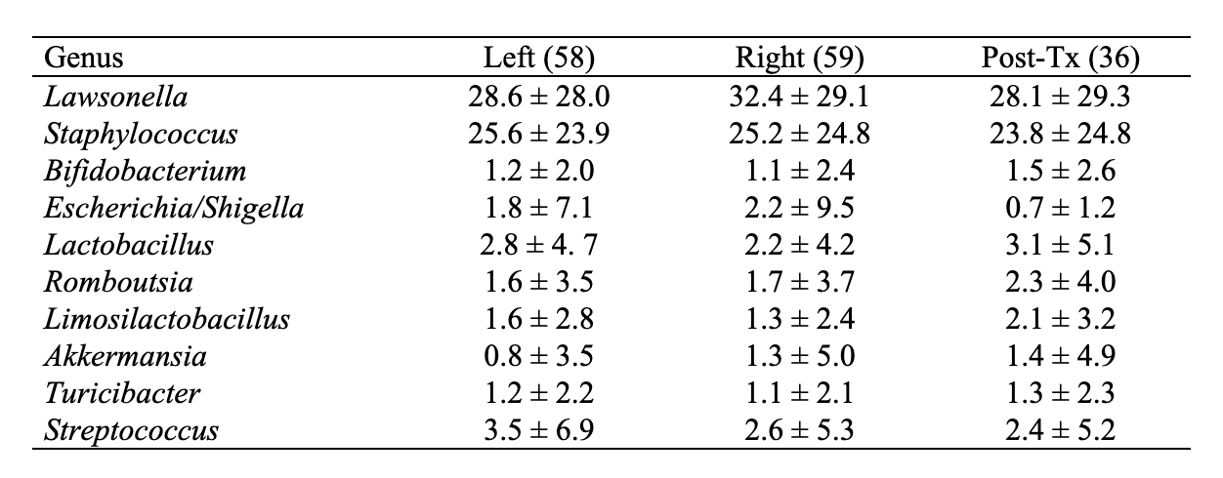

Examining the impact of hydradermabrasion on scalp health and the scalp microbiome: a prospective cohort study
Nathalie Y. Ly, MD^{1,2}, Kim T. Nguyen, BS^{1,4}, Aneesh Syal⁵, BS, Sophia Fruechte, DO^{1,3}, Briana Paiewonsky, MD¹,
Maria K. Hordinsky, MD¹, Christopher Staley, PhD⁵, Neil Sadick, MD⁶, Suleima Arruda, MD⁶, Ronda S. Farah MD^{1,7}
¹University of Minnesota, Department of Dermatology, Minneapolis, MN, ²Saint Agnes Medical Center, Fresno, CA, ³University of North Dakota, Fargo, ND, ⁴University of Nebraska, Omaha, NE, ⁵University of Minnesota, Division of Basic and Translational Research, Department of Surgery, Minneapolis, MN, ⁶Sadick Dermatology, New York, NY, ⁷Minneapolis Veterans Affairs Health Care System, Minneapolis, MN
INTRODUCTION
RESULTS
RESULTS (CONTINUED)
Cicatricial (scarring) alopecia is caused by the destruction of hair follicles.¹
Proposed explanations for the development of cicatricial alopecia include immune-mediated factors, such as a dysbiotic scalp.^{1,2}
Cleansing technologies, such as hydradermabrasion, are commonly marketed to reduce inflammation and improve scalp health.³
We do not have a clear understanding of how these cleansing devices affect the scalp microbiome in scalp diseases.
N = 154 scalp swabs
Differences in community composition were noted among individual patient samples (ANOSIM R=0.52, p<0.001).
When comparing right scalps pre- and post-hydradermabrasion, no significant differences in microbiome composition were observed (ANOSIM R=0.02, p=0.181; Figure 2).
Similarly, the relative abundance of predominant taxa did not show significant variation between treatment groups.
On healthy scalps, Lawsonella and Staphylococcus emerged as the two most abundant genera (Kruskal-Wallis p>0.05; Table 1).
Figure 3. Patient’s right (a) and left (b) scalp before hydradermabrasion treatment on the right scalp. Patient’s right (c) and left (d) scalp after hydradermabrasion at follow-up visit. Decreased loose and perifollicular scale on right.
CONCLUSIONS
Our findings suggest that mechanical intervention does not significantly alter the scalp microbiome.
Our study also establishes a baseline for a healthy scalp microbiome and is a foundation for future microbiome studies.
OBJECTIVES
RESULTS (CONTINUED)
Our objectives are to elucidate the effect of mechanical cleansing on the scalp microbiome, and to characterize the microbiome of healthy patients for future scalp disease research.
REFERENCES
METHODS
1. Eisenstein M. The skin microbiome and its relationship with the human body explained. Nature. 2020;588(7838):S210-S211. doi:10.1038/d41586-020-03524-6
2. Pinto D, Calabrese FM, De Angelis M, Celano G, Giuliani G, Rinaldi F. Lichen planopilaris: The first biopsy layer microbiota inspection. PLoS One. 2022;17(7):e0269933. Published 2022 Jul 18. doi:10.1371/journal.pone.0269933
3. https://www.venusconcept.com/en-au/venus-glow.htm
METHODS
Figure 2. Non-metric multidimensional scaling (NMDS) plots of Bray-Curtis dissimilarities of microbiome composition, colored by right swabs pre- (RU/right untreated) and post-(RT/right treated) hydradermabrasion.
Prospective cohort study
Healthy adults
Split-scalp study: Hydradermabrasion (Venus GlowTM) on the right scalp, with no intervention on the left
1st visit: Baseline + treatment
2nd visit: Post-treatment (5-7 days after)
3rd visit: Follow-up (7 days after 2nd visit)
Collected at each visit:
Scalp swabs (Figure 1)
AI trichoscopy images
Table 1. Distribution of predominant genera (mean ± standard deviation) among all samples, with sample sizes in parentheses.
Figure 1. Scalp swabs were taken 10 cm from the nasal bridge and 3 cm from the midline
ACKNOWLEDGEMENTS
This research was supported in part by the Department of Dermatology at the University of Minnesota and the American Academy of Dermatology.

