Slide 1

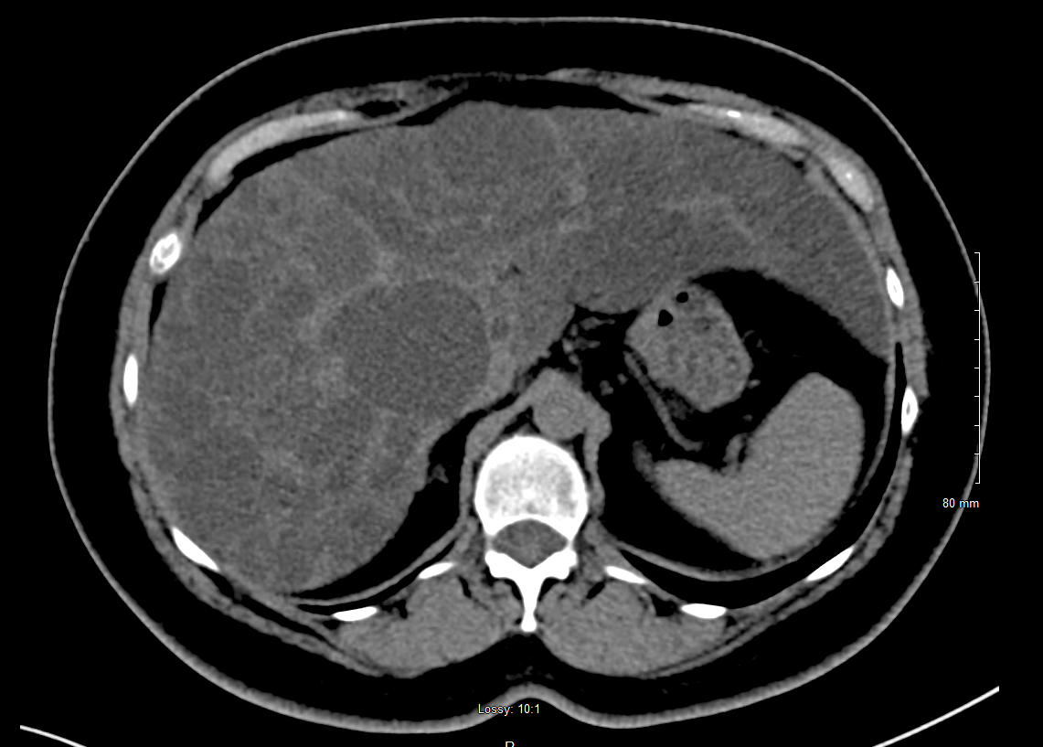
Autosomal Dominant Polycystic Liver Disease
Jennifer Xu, DO, Phillip Kim, MD
Saint Agnes Medical Center, Fresno, CA
Abstract
Case
Discussion
Autosomal dominant polycystic liver disease (ADPLD) is a genetic condition associated with PRKCSH and SEC6 loss of function mutations which result in progressive growth of liver cysts. ADPLD can cause symptoms secondary to hepatomegaly or hepatic venous outflow tract obstruction but rarely affects liver function. This case follows a patient with imaging showing interval growth in size and number of liver cysts over the past decade who was newly diagnosed with ADPLD on genetic testing. Decision to treat is based on monitoring of cyst growth and symptoms. Treatments are targeted towards symptomatic patients and current options include octreotide, cyst aspiration and sclerosis, and liver resection and transplant.
59-year-old female with history of incidental liver cysts initially noted about 20 years ago without previous workup presented to establish care. Patient had CT chest in January 2024 for lung cancer screening which showed interval progression of lesions noted throughout the liver. She denied abdominal pain or distention. Recent labs showed liver function tests within normal limit. She had no known family history of cystic disease and no personal history of kidney cysts. CT abdomen in October 2024 showed innumerable low-density non-enhancing cysts throughout the liver markedly increased in number and size compared to CT from 2007; new hepatomegaly measuring 22.1 cm. Ultrasound showed largest cyst in right lobe measured 6.6 cm in diameter. Patient agreed to testing for PRKCSH and SEC63 genes. Results confirmed the presence of a pathogenic variant c.374_375del (p.Glu125Valfs*21) in PRKCSH. After discussion of these results, patient’s daughter also decided to undergo genetic testing to evaluate for disease risk. Patient was referred to UCSF Hepatology Clinic with plan to evaluate for liver fibrosis with fibroscan, repeat imaging in 6 months to monitor progression, and consider treatment if she has rapid growth in size or number of hepatic cysts.
.
Patients with ADPLD may develop symptoms related to hepatomegaly or hepatic venous outflow tract obstruction. Complications such as cyst hemorrhage, rupture, or infection are less common in ADPLD compared to ADPKD.² Since only about 5% of patients with polycystic liver develop significant symptoms, current recommendations indicate treatment for symptomatic patients with the goal to reduce liver volume. The only currently available pharmacotherapy is somatostatin analogs (octreotide) though other targets are being explored in preclinical and clinical trials. Somatostatin analogs have been shown to be effective in reducing total liver volume in early-stage patients, though more benefits have been shown in patients <45 years old as the medication targets rapid cyst proliferation due to estrogen.^{1,5} For patients with dominant cyst >5cm, aspiration with sclerotherapy may reduce symptom severity, however this approach is limited in practice as most patients have multiple cysts.^{2,3} For patients with few large cysts, laparoscopic fenestration can treat multiple cysts in single intervention, but there is mixed evidence for the benefit of this treatment.^{1,2,3} Hepatic resection is effective in reducing liver volume however is associated with significant morbidity and mortality and may result in post-procedure abdominal adhesions that interfere with liver transplant if needed.²
Introduction
ADPLD is a genetic condition affecting 1/100,000 individuals characterized by progressive growth of cysts throughout the liver. The number and volume of cysts in ADPLD are typically greater than in autosomal dominant polycystic kidney disease (ADPKD) in which kidney cysts are the primary feature and extrarenal manifestation of liver cysts are common.¹ Although most patients remain asymptomatic, about 5% of ADPLD patients may develop symptoms from hepatomegaly or location of cysts, including abdominal pain, early satiety, postprandial fullness, nausea and vomiting, followed by weight loss, dyspnea, and in rare cases jaundice or portal hypertension.^{1,2,3} Liver function is generally not affected. Diagnosis is based on family history, clinical symptoms, and radiological evidence with US or CT showing presence of more than 20 hepatic cysts without kidney cysts in individuals without family history.²
Conclusion
Existing treatments for ADPLD have shown benefit in reducing symptom severity however these treatments are limited in clinical applications. In this case study, the patient is not the optimal candidate for octreotide given her age, postmenopausal status, and mild symptoms. The goal of routine monitoring is to prevent the development of symptoms requiring invasive interventions such as liver resection or transplant. Genetic testing also provides the opportunity to screen family members for early identification of disease risk. Although current guidelines recommend initiating treatment only in symptomatic patients, new research including identification of the genetic basis of ADPLD may lead to treatments that target early stages of the disease.
Pathophysiology
ADPLD is associated with several identified genes including mutations in PRKCSH in about 20% of cases and mutations in SEC6 in about 15% of cases. The PRKSCH gene encodes the beta-subunit of glucosidase II which functions in glycoprotein processing. Although ADPLD is autosomal dominant, patients with the germline mutation are thought to develop hepatic cystogenesis through a second somatic mutation causing the loss of heterozygosity.^{2,4} Loss of function in the PRKSCH gene product leads to proliferation of biliary epithelium and connective tissues.
References
1. Masyuk TV, Masyuk AI, LaRusso NF. Therapeutic Targets in Polycystic Liver Disease. Current drug targets. 2017;18(8):950-957. doi:https://doi.org/10.2174/1389450116666150427161743
2. Norcia LF, Watanabe EM, Hamamoto Filho PT, et al. Polycystic Liver Disease: Pathophysiology, Diagnosis and Treatment. Hepatic Medicine: Evidence and Research. 2022; 14:135-161. doi:https://doi.org/10.2147/hmer.s377530
3. Duijzer R, Barten T, Staring C, Drenth J, Gevers T. Treatment of Polycystic Liver Disease: Impact on Patient-reported Symptom Severity and Health-related Quality of Life. J Clin Gastroenterol. 2022;56(9):731-739.
4. Banales JM. Somatic second-hit mutations leads to polycystic liver diseases. World Journal of Gastroenterology. 2013;19(1):141. doi:https://doi.org/10.3748/wjg.v19.i1.141
5. Suwabe T, Barrera FJ, Rodriguez-Gutierrez R, Ubara Y, Hogan MC. Somatostatin analog therapy effectiveness on the progression of polycystic kidney and liver disease: A systematic review and metaanalysis of randomized clinical trials. PLoS ONE. 2021;16(9). doi:https://doi.org/10.1371/journal.pone.0257606
.
CT abdomen pelvis wo and w contrast. Interval increase in size and number of innumerable liver cysts consistent with history of polycystic liver disease. Hepatomegaly measures up to 22.1 cm in craniocaudal dimension.

