Slide 1
VUID Toolbox
Phil Shinn
Phil.Shinn@Gmail.com
646 736 2377

Slide 2
Outline
Who am I?
What is the VUID Toolbox?
Why is it useful?
Where do you get it?

Slide 3
Who Am I?
PhD Linguistics, Thesis in acoustics
Designed and built a bunch of speech recognition apps
7 years Speech Systems Inc
7 years Citibank
4 years various consulting gigs
3 years HeyAnita
2 years Countrywide Financial
5 years Genesys
3 years MorganStanley
Started http://tech.groups.yahoo.com/group/vuids/
On board of http://www.avixd.org/

Slide 4
What is the VUID Toolbox?
A Methodology and Open source code including Custom Visio Templates, Microsoft Visual Basic Macros, and Python code
A wire-frame environment for designing speech applications
The code was written by Phil Shinn and Matt Shomphe, and placed into the public domain in 2007
Our goal was to make life easier by helping to set up a uniform standard markup language for VUI designs.
Since then, a number of organizations have adopted the toolkit for their own use.
The code is free, as in free beer, under the GPL licsnse.
If you would like support, or would like to schedule a training session, please contact me, or Matt.

Slide 5
Requirements
Microsoft XP or Windows 7
Visio 2003 or 2007 or 2010 Professional
VUIStencil.vss and other tools distributed with this package.
Python 2.4 (or better): Download & install this from www.python.org.
Win32 Python extensions: Download & install this from: http://sourceforge.net/projects/pywin32/ (or find links from http://www.python.org/download/download_windows.html). NB – You must install Python before installing the Python Win32 extensions.
The code – can be downloaded from https://sites.google.com/site/ivrdesigngroup/vuid-toolkit

Slide 6
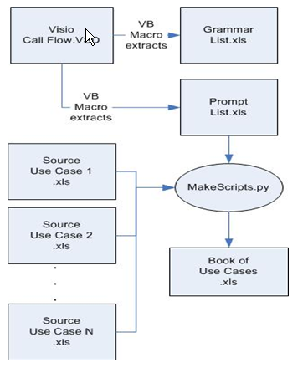
How it hangs together

Slide 7
Why is it useful? Users
Business Owners
  Can understand use cases/scripts easier than call flows
Project Managers
  Track progress on pages completed
QA
  Keeps test scripts in synch with call flow
Developers
  Puts all doc in one place
VUIDs
  Makes your life way easier
Recording Studio
  Puts prompts in context

Slide 8
Custom Visio Templates
Prompt
Grammar
Computation
Database
Start
Stop
Subroutine
  Goto
  Gosub
Labeled arcs
Decision States
External apps

Slide 9
Demo Custom Stencils
Build a call flow with the custom stencils

Slide 10
Demo Extraction Macros
Show pass to excel to save a prompt list
To save a grammar list

Slide 11
Demo Test Case Design
Create test case source file
Demonstrate use of stencil overlays

Slide 12
Extra Stuff
Tools -> Options -> Advanced
  Check ‘run in developer mode’
Right click on an object and inspect the shape sheet
Demo how to create your own custom stencil – see the directory named CustomStencils
Tools -> Macros -> Visual Basic Editor
  Check out the pass-to-excel code

Slide 13
Where do you get it?
https://sites.google.com/site/ivrdesigngroup/vuid-toolkit
Phil.shinn@gmail.com

