Slide 1



Slide 2



Slide 3
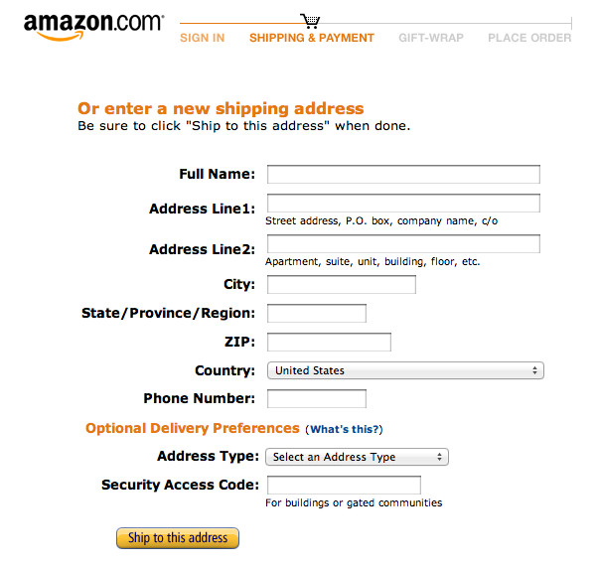
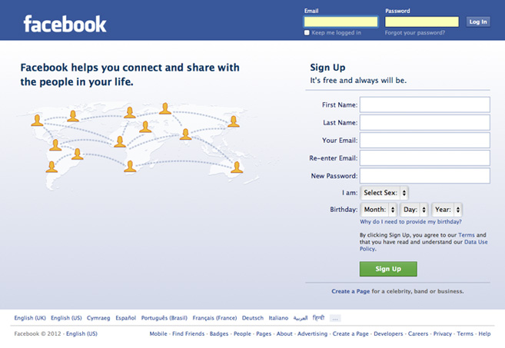
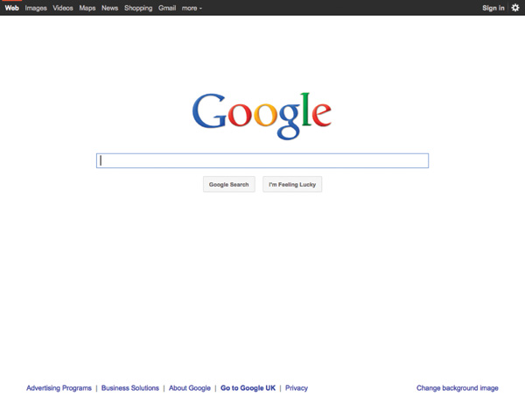
WHY FORMS?
Notes:
Explain: Mostly, when you need to collect data from a user you need a form
Click: Google search form
Click: Facebook login form
Click: Amazon shipping form

Slide 4
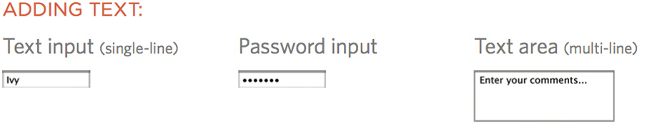
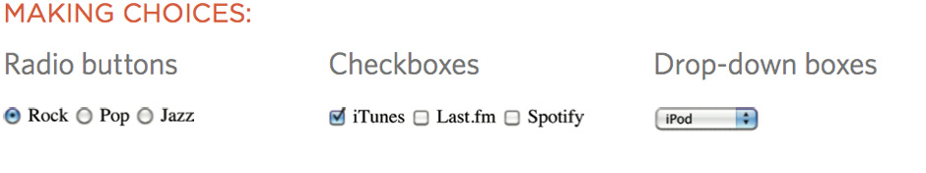
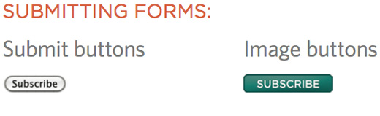
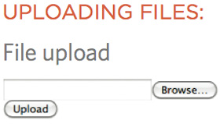
FORM CONTROLS
Notes:
Explain: how there are different types of form control
You need to choose the right type of control to get the information you need
Click: ways to provide text
Click: ways to make choices between fixed options
Click: ways to submit information
Click: how to upload files

Slide 5
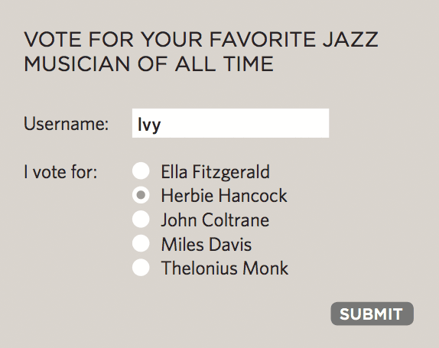
HOW FORMS WORK
1: User fills in form and presses button to submit info to server
Notes:
Explain: Each form control has a name and a value which is sent to the server.

Slide 6
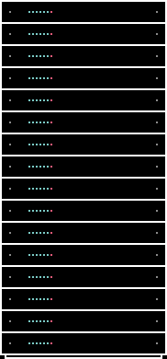
HOW FORMS WORK
2: Name of each form control sent with value user entered
Notes:
Explain: This is how server knows what info relates to each question.

Slide 7
HOW FORMS WORK
3: Server processes information using programming language
Notes:
Explain: How servers process information using programming language

Slide 8
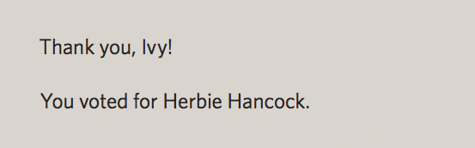
HOW FORMS WORK
4: Server creates new page to send back to the browser based
on info received
Notes:
Explain: The server returns a page to the user based on the information supplied in the form. Note that this will largely contain HTML & CSS. (It's not just a hand-coded page, it is based on templates.)

Slide 9
NAME & VALUE PAIRS
username=Ivy
Notes:
Explain: how the server needs to know what the user entered / chose for each different form element
To do this, each form element must have a name
The value is what the user enters / the value associated with the choice made

Slide 10
NAME & VALUE PAIRS
NAME
username=Ivy
Notes:
Explain: how the server needs to know what the user entered / chose for each different form element
To do this, each form element must have a name
The value is what the user enters / the value associated with the choice made

Slide 11
NAME & VALUE PAIRS
NAME
username=Ivy
VALUE
Notes:
Explain: how the server needs to know what the user entered / chose for each different form element
To do this, each form element must have a name
The value is what the user enters / the value associated with the choice made

Slide 12
FORM STRUCTURE
<form
action="http://example.com/join.php"
method="get">
This is where the form controls
will appear.
</form>

Slide 13
FORM STRUCTURE
<form
action="http://example.com/join.php"
method="get">
This is where the form controls
will appear.
</form>
Notes:
Explain: The action attribute shows the page the form is sent to.

Slide 14
FORM STRUCTURE
<form
action="http://example.com/join.php"
method="get">
This is where the form controls
will appear.
</form>
Notes:
Explain: Describe the difference between the get and post methods.

Slide 15
TEXT INPUT
<form
action="http://example.com/join.php">
<input type="text" name="username"
size="15" maxlength="30" />
</form>
Notes:
Explain: Several different form controls are created with the <input> element.

Slide 16
TEXT INPUT
<form
action="http://example.com/join.php">
<input type="text" name="username"
size="15" maxlength="30" />
</form>
Notes:
Explain: The type attribute is used to indicate which type of control you want.

Slide 17
TEXT INPUT
<form
action="http://example.com/join.php">
<input type="text" name="username"
size="15" maxlength="30" />
</form>
Notes:
Explain: The name attribute is used to tell the server which form element this is.

Slide 18
TEXT INPUT
<form
action="http://example.com/join.php">
<input type="text" name="username"
size="15" maxlength="30" />
</form>
Notes:
Explain: The size attribute is used to specify the size of the control. (This can also be specified using CSS.) The size given does not restrict the user from adding additional characters however it can help indicate how long an entry is expected to be. For example, collecting parts of a date (2 characters) compared to an email address.

Slide 19
TEXT INPUT
<form
action="http://example.com/join.php">
<input type="text" name="username"
size="15" maxlength="30" />
</form>
Notes:
Explain: This attribute is used to limit the number of characters a user can enter.

Slide 20


Slide 21
PASSWORD
<p>Username:
<input type="text" name="username"
size="15" maxlength="30" />
</p>
<p>Password:
<input type="password" name="password"
size="15" maxlength="30" />
</p>

Slide 22
PASSWORD
<p>Username:
<input type="text" name="username"
size="15" maxlength="30" />
</p>
<p>Password:
<input type="password" name="password"
size="15" maxlength="30" />
</p>
Notes:
Explain: The password attribute does not mean what is entered is secure. It just stops people from being able to read the characters when looking over the shoulder of the user entering them.

Slide 23
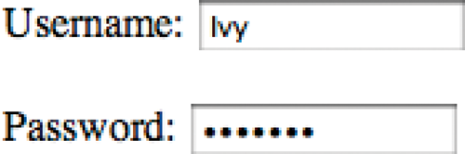

Slide 24
TEXTAREA
<p>What did you think of this gig?</p>
<textarea name="comments"
cols="20" rows="4">
Enter your comments...
<textarea/>

Slide 25
TEXTAREA
<p>What did you think of this gig?</p>
<textarea name="comments"
cols="20" rows="4">
Enter your comments...
<textarea/>

Slide 26
TEXTAREA
<p>What did you think of this gig?</p>
<textarea name="comments"
cols="20" rows="4">
Enter your comments...
<textarea/>
Notes:
Explain: The cols attribute sets the width of the <textarea>.

Slide 27
TEXTAREA
<p>What did you think of this gig?</p>
<textarea name="comments"
cols="20" rows="4">
Enter your comments...
<textarea/>
Notes:
Explain: The rows attribute sets the number of rows the <textarea> spans.

Slide 28
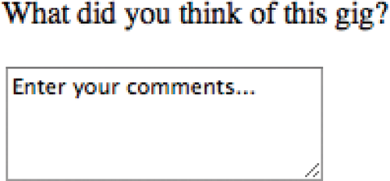

Slide 29
RADIO BUTTON
<p>Your favorite genre:<br />
<input type="radio" name="genre"
value="rock" checked="checked" /> Rock
<input type="radio" name="genre"
value="pop" /> Pop
<input type="radio" name="genre"
value="jazz" /> Jazz
</p>

Slide 30
RADIO BUTTON
<p>Your favorite genre:<br />
<input type="radio" name="genre"
value="rock" checked="checked" /> Rock
<input type="radio" name="genre"
value="pop" /> Pop
<input type="radio" name="genre"
value="jazz" /> Jazz
</p>
Notes:
Explain: Radio buttons allow you to pick one of several options. This example shows three options.

Slide 31
RADIO BUTTON
<p>Your favorite genre:<br />
<input type="radio" name="genre"
value="rock" checked="checked" /> Rock
<input type="radio" name="genre"
value="pop" /> Pop
<input type="radio" name="genre"
value="jazz" /> Jazz
</p>
Notes:
Explain: Note that the name is the same for all radio buttons in the group of options.

Slide 32
RADIO BUTTON
<p>Your favorite genre:<br />
<input type="radio" name="genre"
value="rock" checked="checked" /> Rock
<input type="radio" name="genre"
value="pop" /> Pop
<input type="radio" name="genre"
value="jazz" /> Jazz
</p>
Notes:
Explain: Note that these are different for each option (to indicate which option the user selected).

Slide 33
RADIO BUTTON
<p>Your favorite genre:<br />
<input type="radio" name="genre"
value="rock" checked="checked" /> Rock
<input type="radio" name="genre"
value="pop" /> Pop
<input type="radio" name="genre"
value="jazz" /> Jazz
</p>
Notes:
Explain: Once an option chosen, there is no way to deselect it.

Slide 34


Slide 35
CHECKBOX
<p>Your favorite music service:<br />
<input type="checkbox" name="service"
value="iTunes"
checked="checked" /> iTunes
<input type="checkbox" name="service"
value="Last.fm" /> Last.fm
<input type="checkbox" name="service"
value="Spotify" /> Spotify
</p>

Slide 36
CHECKBOX
<p>Your favorite music service:<br />
<input type="checkbox" name="service"
value="iTunes"
checked="checked" /> iTunes
<input type="checkbox" name="service"
value="Last.fm" /> Last.fm
<input type="checkbox" name="service"
value="Spotify" /> Spotify
</p>
Notes:
Explain: Checkboxes allow users to select more than one option.

Slide 37
CHECKBOX
<p>Your favorite music service:<br />
<input type="checkbox" name="service"
value="iTunes"
checked="checked" /> iTunes
<input type="checkbox" name="service"
value="Last.fm" /> Last.fm
<input type="checkbox" name="service"
value="Spotify" /> Spotify
</p>
Notes:
Explain: Note how these names are the same for each checkbox.

Slide 38
CHECKBOX
<p>Your favorite music service:<br />
<input type="checkbox" name="service"
value="iTunes"
checked="checked" /> iTunes
<input type="checkbox" name="service"
value="Last.fm" /> Last.fm
<input type="checkbox" name="service"
value="Spotify" /> Spotify
</p>
Notes:
Explain: Note how these are different for each option (so the server knows which option the user selected).

Slide 39
CHECKBOX
<p>Your favorite music service:<br />
<input type="checkbox" name="service"
value="iTunes"
checked="checked" /> iTunes
<input type="checkbox" name="service"
value="Last.fm" /> Last.fm
<input type="checkbox" name="service"
value="Spotify" /> Spotify
</p>

Slide 40


Slide 41
DROP DOWN LIST BOX
<select name="devices">
<option value="iPod"
selected="selected">iPod</option>
<option value="radio">Radio</option>
<option value="PC">Computer</option>
</select>
Notes:
Explain: Drop down list (or "select") boxes allows the user to pick one from several options. They are useful when there are long lists (e.g. a country selector) and not enough space to show each option.

Slide 42
DROP DOWN LIST BOX
<select name="devices">
<option value="iPod"
selected="selected">iPod</option>
<option value="radio">Radio</option>
<option value="PC">Computer</option>
</select>

Slide 43
DROP DOWN LIST BOX
<select name="devices">
<option value="iPod"
selected="selected">iPod</option>
<option value="radio">Radio</option>
<option value="PC">Computer</option>
</select>

Slide 44
DROP DOWN LIST BOX
<select name="devices">
<option value="iPod"
selected="selected">iPod</option>
<option value="radio">Radio</option>
<option value="PC">Computer</option>
</select>

Slide 45
DROP DOWN LIST BOX
<select name="devices">
<option value="iPod"
selected="selected">iPod</option>
<option value="radio">Radio</option>
<option value="PC">Computer</option>
</select>
Notes:
Explain: These attributes indicate the selected choice/s.

Slide 46
DROP DOWN LIST BOX
<select name="devices">
<option value="iPod"
selected="selected">iPod</option>
<option value="radio">Radio</option>
<option value="PC">Computer</option>
</select>
Notes:
Explain: The selected attribute makes an option automatically checked upon page load.

Slide 47
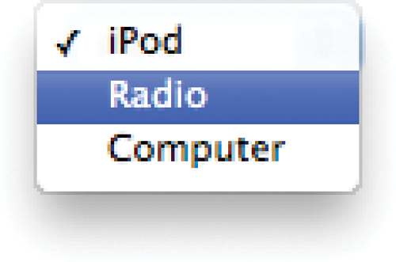

Slide 48
MULTIPLE SELECT BOX
<select name="devices" size="4">
<option value="guitar"
selected="selected">Guitar</option>
<option value="drums">Drums</option>
<option value="keys"
selected="selected">Keyboard</option>
<option value="bass">Bass</option>
</select>

Slide 49
MULTIPLE SELECT BOX
<select name="devices" size="4">
<option value="guitar"
selected="selected">Guitar</option>
<option value="drums">Drums</option>
<option value="keys"
selected="selected">Keyboard</option>
<option value="bass">Bass</option>
</select>
Notes:
Explain: The size attribute is used to define the number of options shown in view.

Slide 50
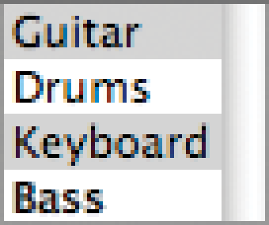

Slide 51
FILE INPUT BOX
<form action="http://eg.com/upload.php"
method="post">
<p>Upload your song in MP3 format:</p>
<input type="file" name="user-song" />
<input type="submit" value="upload" />
</form>

Slide 52
FILE INPUT BOX
<form action="http://eg.com/upload.php"
method="post">
<p>Upload your song in MP3 format:</p>
<input type="file" name="user-song" />
<input type="submit" value="upload" />
</form>

Slide 53
FILE INPUT BOX
<form action="http://eg.com/upload.php"
method="post">
<p>Upload your song in MP3 format:</p>
<input type="file" name="user-song" />
<input type="submit" value="upload" />
</form>

Slide 54
FILE INPUT BOX
<form action="http://eg.com/upload.php"
method="post">
<p>Upload your song in MP3 format:</p>
<input type="file" name="user-song" />
<input type="submit" value="upload" />
</form>
Notes:
Explain: The method must be post for uploads.

Slide 55
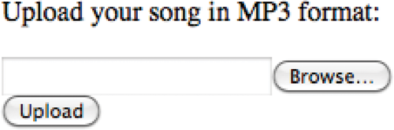

Slide 56
SUBMIT BUTTON
<form action="http://eg.com/email.php">
<p>Subscribe to our email list:</p>
<input type="text" name="email" />
<input type="submit"
value="Subscribe" />
</form>

Slide 57
SUBMIT BUTTON
<form action="http://eg.com/email.php">
<p>Subscribe to our email list:</p>
<input type="text" name="email" />
<input type="submit"
value="Subscribe" />
</form>

Slide 58
SUBMIT BUTTON
<form action="http://eg.com/email.php">
<p>Subscribe to our email list:</p>
<input type="text" name="email" />
<input type="submit"
value="Subscribe" />
</form>
Notes:
Explain: The value is what appears on the button. (It is important to specify this.)

Slide 59
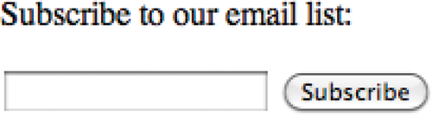

Slide 60
IMAGE BUTTON
<form action="http://eg.com/email.php">
<p>Subscribe to our email list:</p>
<input type="text" name="email" />
<input type="image"
src="images/subscribe.jpg"
width="100" height="20" />
</form>

Slide 61
IMAGE BUTTON
<form action="http://eg.com/email.php">
<p>Subscribe to our email list:</p>
<input type="text" name="email" />
<input type="image"
src="images/subscribe.jpg"
width="100" height="20" />
</form>

Slide 62
IMAGE BUTTON
<form action="http://eg.com/email.php">
<p>Subscribe to our email list:</p>
<input type="text" name="email" />
<input type="image"
src="images/subscribe.jpg"
width="100" height="20" />
</form>

Slide 63
IMAGE BUTTON
<form action="http://eg.com/email.php">
<p>Subscribe to our email list:</p>
<input type="text" name="email" />
<input type="image"
src="images/subscribe.jpg"
width="100" height="20" />
</form>
Notes:
Explain: CSS can also be used to specify the size of buttons.

Slide 64
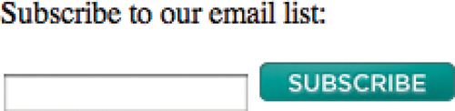

Slide 65
BUTTONS
<form action="http://eg.com/add.php">
<button>
<img src="images/add.gif" alt="add"
width="10" height="20" />
</button>
</form>
Notes:
Explain: This is a good way to combine text and images, too.

Slide 66
BUTTONS
<form action="http://eg.com/add.php">
<button>
<img src="images/add.gif" alt="add"
width="10" height="20" />
</button>
</form>

Slide 67
BUTTONS
<form action="http://eg.com/add.php">
<button>
<img src="images/add.gif" alt="add"
width="10" height="20" />
</button>
</form>

Slide 68


Slide 69
HIDDEN FORM CONTROLS
<form action="http://eg.com/add.php">
<button>
<img src="images/add.gif" alt="add"
width="10" height="20" /></button>
<input type="hidden" name="bookmark"
value="lyrics" />
</form>
Notes:
Explain: Users can see the content of hidden form controls by viewing the source of the page.

Slide 70
HIDDEN FORM CONTROLS
<form action="http://eg.com/add.php">
<button>
<img src="images/add.gif" alt="add"
width="10" height="20" /></button>
<input type="hidden" name="bookmark"
value="lyrics" />
</form>

Slide 71
HIDDEN FORM CONTROLS
<form action="http://eg.com/add.php">
<button>
<img src="images/add.gif" alt="add"
width="10" height="20" /></button>
<input type="hidden" name="bookmark"
value="lyrics" />
</form>

Slide 72
HIDDEN FORM CONTROLS
<form action="http://eg.com/add.php">
<button>
<img src="images/add.gif" alt="add"
width="10" height="20" /></button>
<input type="hidden" name="bookmark"
value="lyrics" />
</form>

Slide 74
LABELLING FORM CONTROLS
<form action="http://eg.com/email.php">
<label>Age:
<input type="text" name="Age" /></label>
Gender:
<input id="female" type="radio"
name="gender" value="f" />
<label for="female">Female</label>
<input id="male" type="radio"
name="gender" value="m" />
<label for="female">Male</label>
</form>

Slide 75
LABELLING FORM CONTROLS
<form action="http://eg.com/email.php">
<label>Age:
<input type="text" name="Age" /></label>
Gender:
<input id="female" type="radio"
name="gender" value="f" />
<label for="female">Female</label>
<input id="male" type="radio"
name="gender" value="m" />
<label for="female">Male</label>
</form>
Notes:
Explain: This is an example of implicit labelling.

Slide 76
LABELLING FORM CONTROLS
<form action="http://eg.com/email.php">
<label>Age:
<input type="text" name="Age" /></label>
Gender:
<input id="female" type="radio"
name="gender" value="f" />
<label for="female">Female</label>
<input id="male" type="radio"
name="gender" value="m" />
<label for="female">Male</label>
</form>
Notes:
Explain: This is an example of explicit labelling.

Slide 77
LABELLING FORM CONTROLS
<form action="http://eg.com/email.php">
<label>Age:
<input type="text" name="Age" /></label>
Gender:
<input id="female" type="radio"
name="gender" value="f" />
<label for="female">Female</label>
<input id="male" type="radio"
name="gender" value="m" />
<label for="female">Male</label>
</form>
Notes:
Explain: The for attribute value corresponds to the id attribute value to explain what the label is referring to.

Slide 78
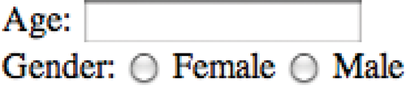

Slide 79
GROUPING FORM ELEMENTS
<fieldset>
<legend>Contact details</legend>
<label>Email:<br />
<input type="text" name="email"></label>
<br />
<label>Mobile:<br />
<input type="text" name="mobile"></label>
<br />
<label>Telephone:<br />
<input type="text" name="tel"></label>
</fieldset>

Slide 80
GROUPING FORM ELEMENTS
<fieldset>
<legend>Contact details</legend>
<label>Email:<br />
<input type="text" name="email"></label>
<br />
<label>Mobile:<br />
<input type="text" name="mobile"></label>
<br />
<label>Telephone:<br />
<input type="text" name="tel"></label>
</fieldset>
Notes:
Explain: Fieldsets are particularly helpful on long forms to group controls.

Slide 81
GROUPING FORM ELEMENTS
<fieldset>
<legend>Contact details</legend>
<label>Email:<br />
<input type="text" name="email"></label>
<br />
<label>Mobile:<br />
<input type="text" name="mobile"></label>
<br />
<label>Telephone:<br />
<input type="text" name="tel"></label>
</fieldset>

Slide 82
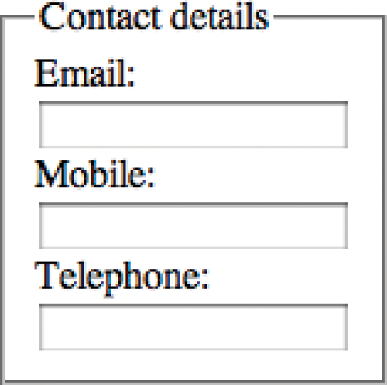

Slide 83
HTML5: FORM VALIDATION
<label for="username">Username:</label>
<input type="text" name="username"
required="required" />
<label for="password">Password:</label>
<input type="password" name="password"
required="required" />
<input type="submit" value="Submit" />
Notes:
Explain: This only works in the latest browsers. (JavaScript is needed to support older browsers.)

Slide 84
HTML5: FORM VALIDATION
<label for="username">Username:</label>
<input type="text" name="username"
required="required" />
<label for="password">Password:</label>
<input type="password" name="password"
required="required" />
<input type="submit" value="Submit" />

Slide 85
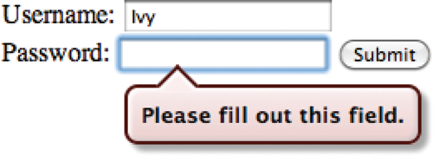

Slide 86
HTML5: DATE INPUT
<label for="date">Departure date:</label>
<input type="date" name="depart"
id="date" />
<input type="submit" value="Submit" />
Notes:
Explain: This only works in the latest browsers. Older browsers show text input and still require JavaScript validation.

Slide 87
HTML5: DATE INPUT
<label for="date">Departure date:</label>
<input type="date" name="depart"
id="date" />
<input type="submit" value="Submit" />

Slide 89
HTML5: EMAIL & URL INPUT
<input type="email" name="email" />
<input type="url" name="website" />
Notes:
Explain: This only works in the latest browsers. Older browsers show text input and still require JavaScript validation. Also note how some touchscreen devices with smaller keypads will automatically show the relevant buttons for this type of control. For example, an email input will show the @ sign.

Slide 90
HTML5: EMAIL & URL INPUT
<input type="email" name="email" />
<input type="url" name="website" />

Slide 91
HTML5: EMAIL & URL INPUT
<input type="email" name="email" />
<input type="url" name="website" />

Slide 92
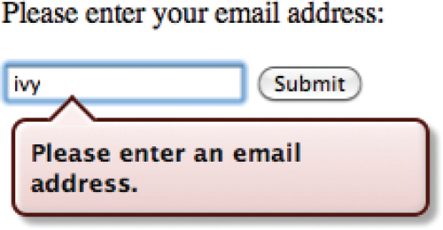
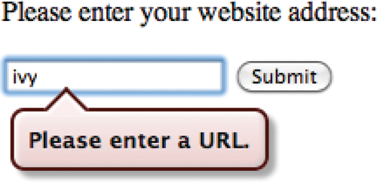

Slide 93
HTML5: SEARCH INPUT
<input type="search" name="search"
placeholder="Enter keyword" />
<input type="submit" value="Search" />
Notes:
Explain: Older browsers show text input. Also note that the Safari browser adds styling.

Slide 94
HTML5: SEARCH INPUT
<input type="search" name="search"
placeholder="Enter keyword" />
<input type="submit" value="Search" />

Slide 95
HTML5: SEARCH INPUT
<input type="search" name="search"
placeholder="Enter keyword" />
<input type="submit" value="Search" />

Slide 96
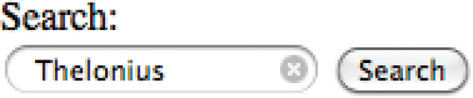

Slide 97
SUMMARY
Whenever you want to collect information from visitors you will need a form, which lives inside a <form> element.
Notes:
Clicks: Load individual bullets

Slide 98
SUMMARY
Information from a form is sent in name/value pairs.
Notes:
Clicks: Load individual bullets

Slide 99
SUMMARY
Each form control is given a name, and the text the user types in or the values of the options they select are sent to the server.
Notes:
Clicks: Load individual bullets

Slide 100
SUMMARY
HTML5 introduces new form elements which make it easier for visitors to
fill in forms.
Notes:
Clicks: Load individual bullets

Slide 101
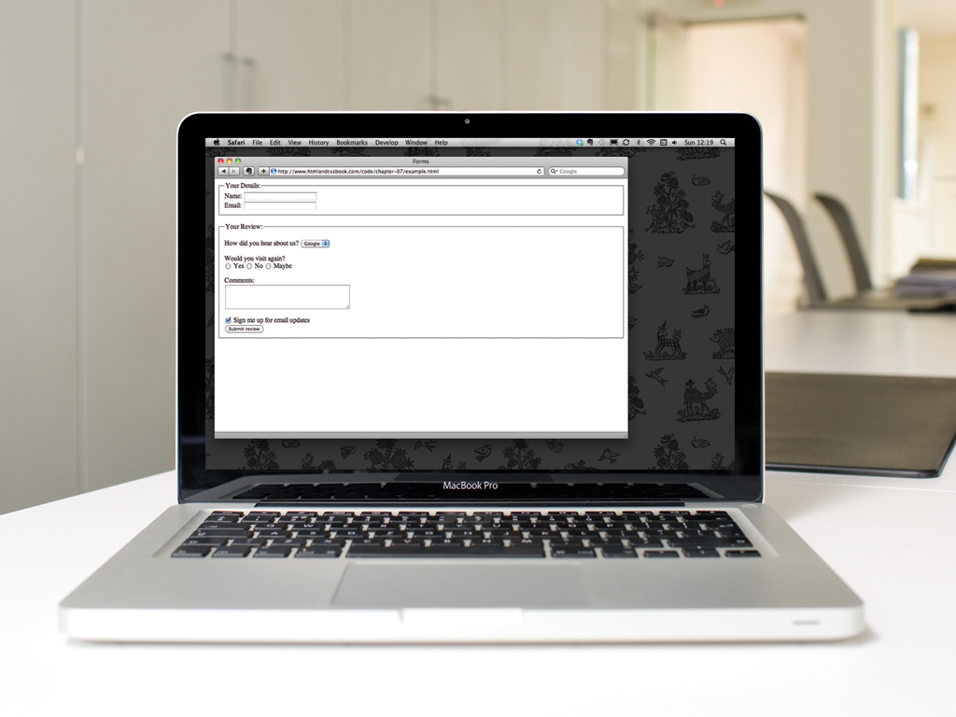

Slide 102


