Slide 1
Fieldwork Processing

Slide 2




Outline
VIDEO CONCATENATION
FRAME EXTRACTION
GEOTAGGING
CLASSIFICATION

Slide 3
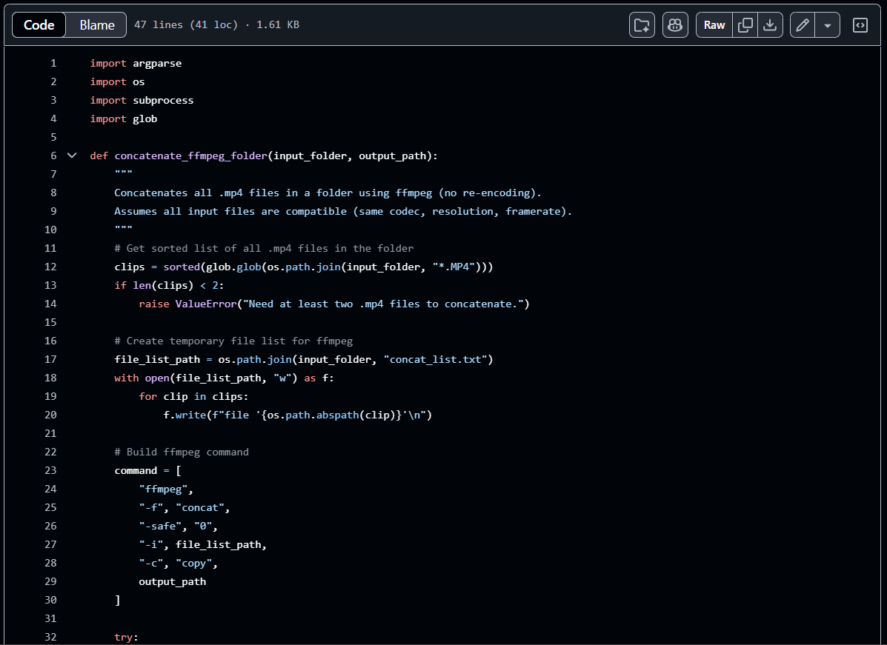

VIDEO
CONCATENATION
Concatenate GoPro Video using python script. GoPro uses this filenaming convention:
GHzzxxxx.mp4 GXzzxxxx.mp4
“H” = AVC encoding
“X” = HEVC encoding
‘xxxx’ = file number
‘zz’ = chapter number

Slide 4
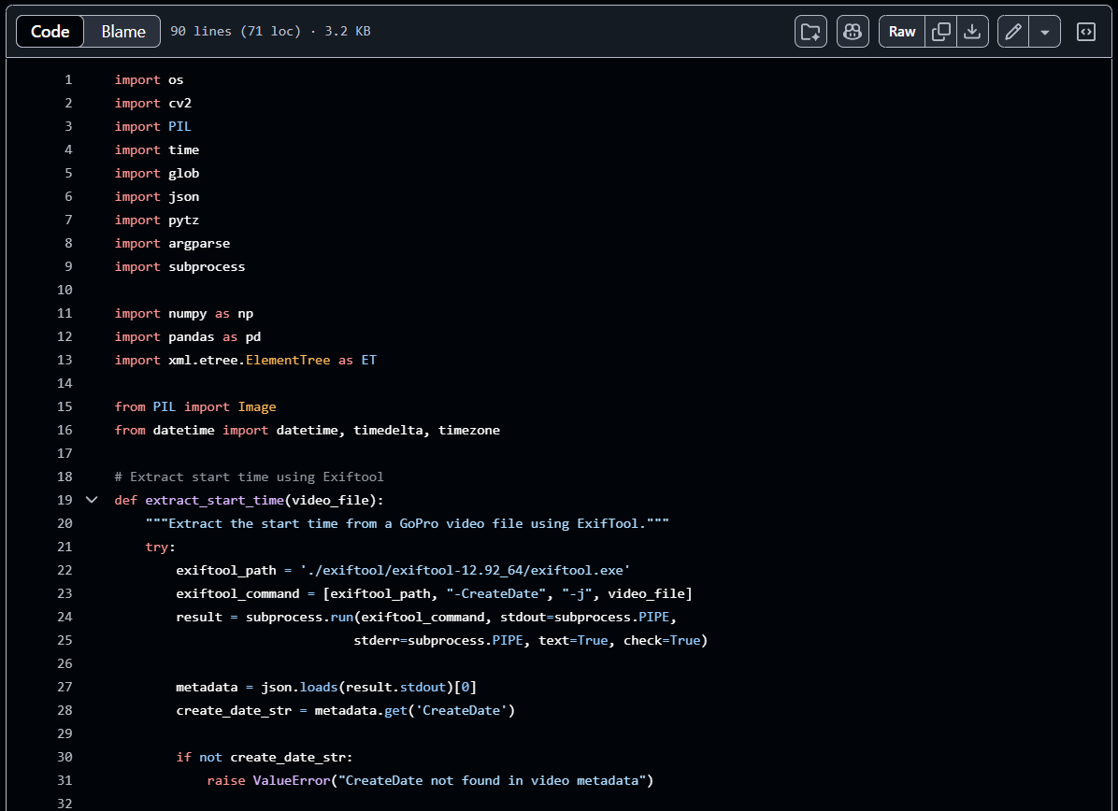
FRAME
EXTRACTION
Frames are then extracted from the concatenated video using python script. The date and time of photos will serve as the filename.

Slide 5
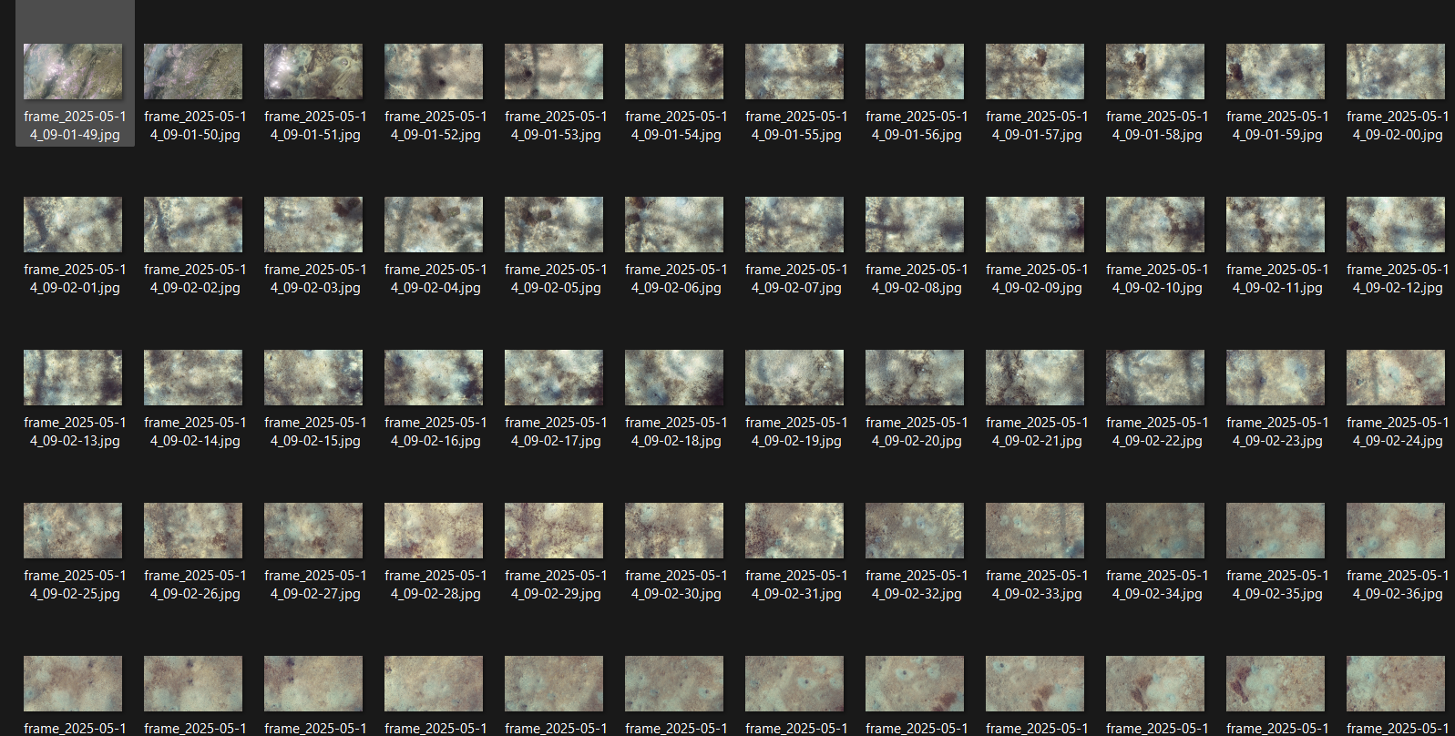
FRAME
EXTRACTION
EXTRACTED FRAMES

Slide 6
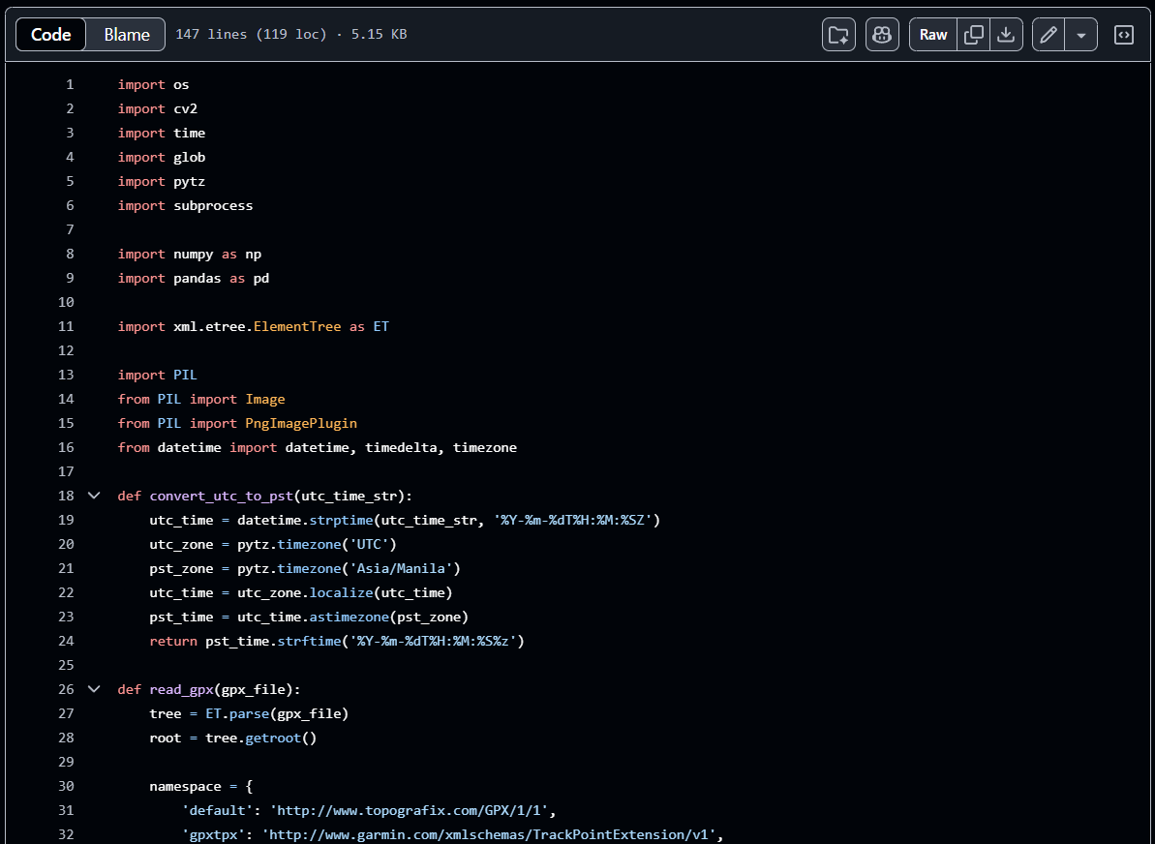
GEOTAGGING
Extracted frames are then geotagged using the bathymetry data from echosounder.

Slide 7

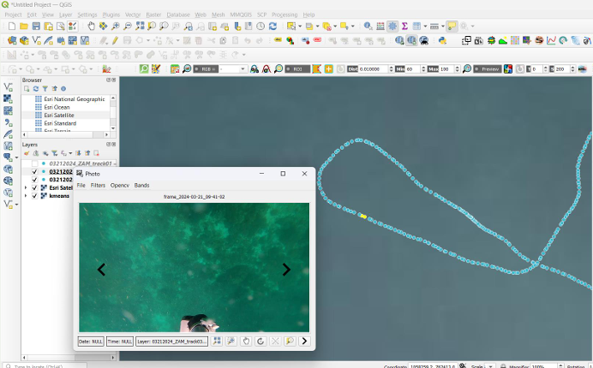
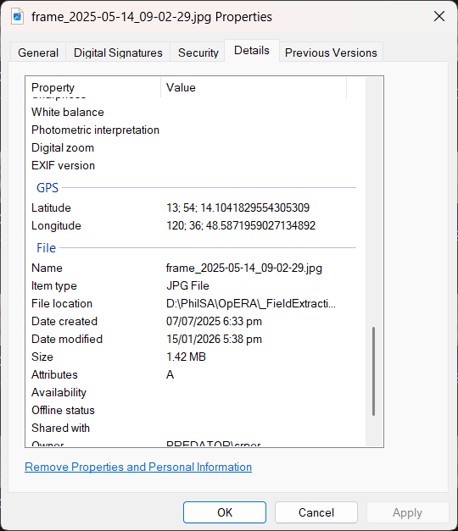
GEOTAGGING

Slide 8
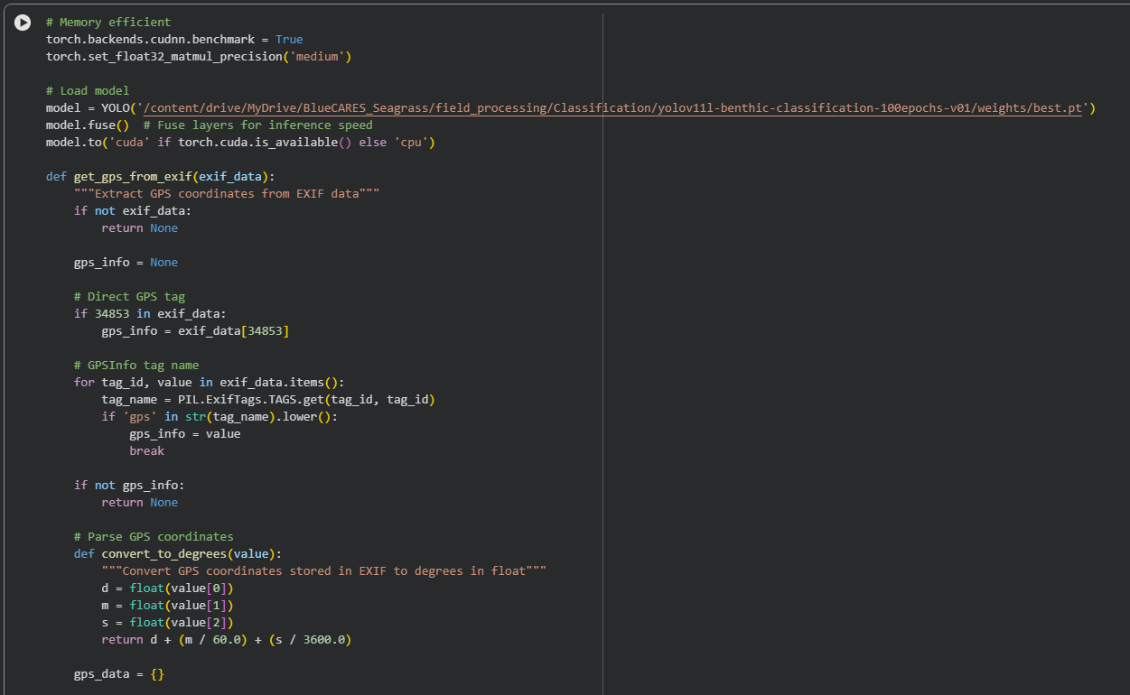
CLASSIFICATION
After geotagging, the images/frames are then classified using YOLO model.

Slide 9
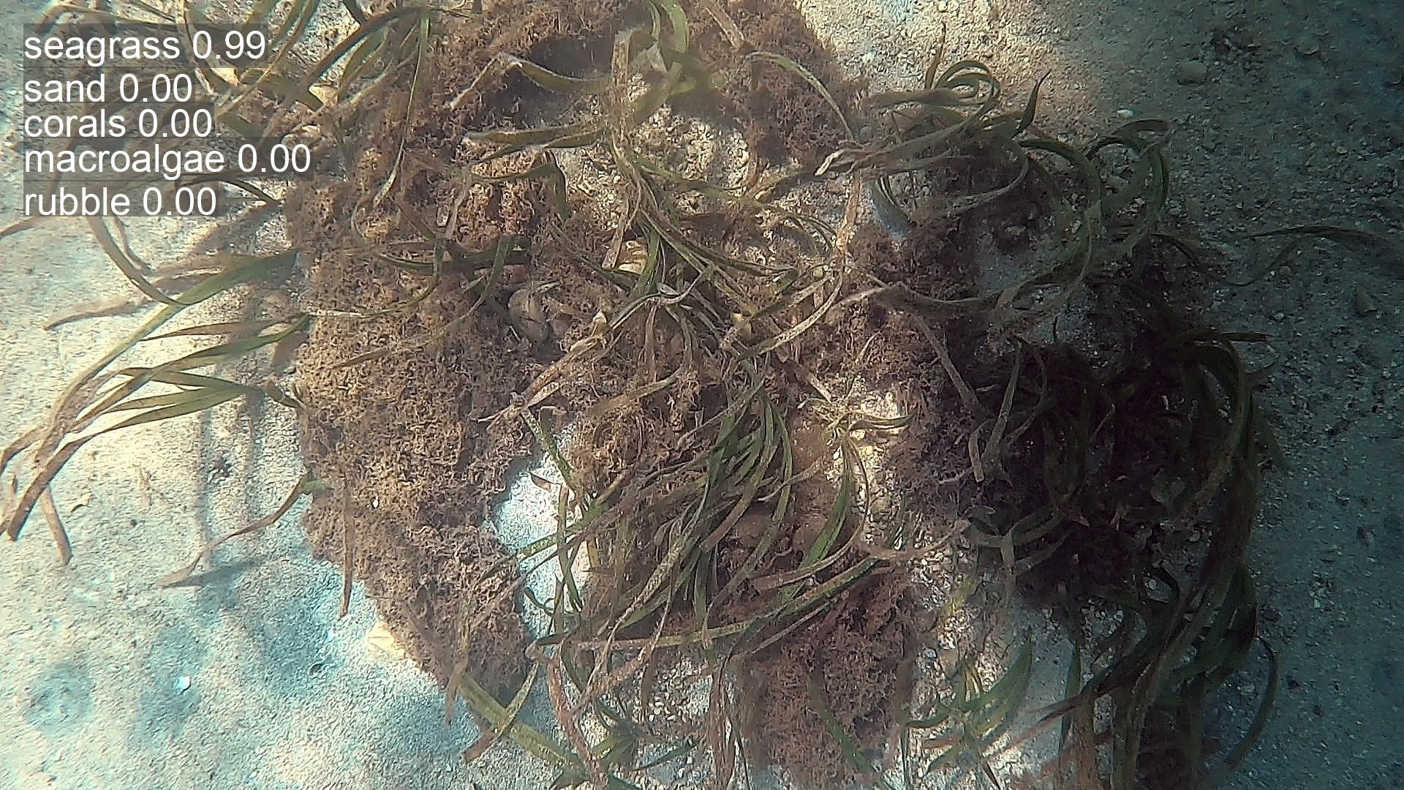
CLASSIFICATION

Slide 10
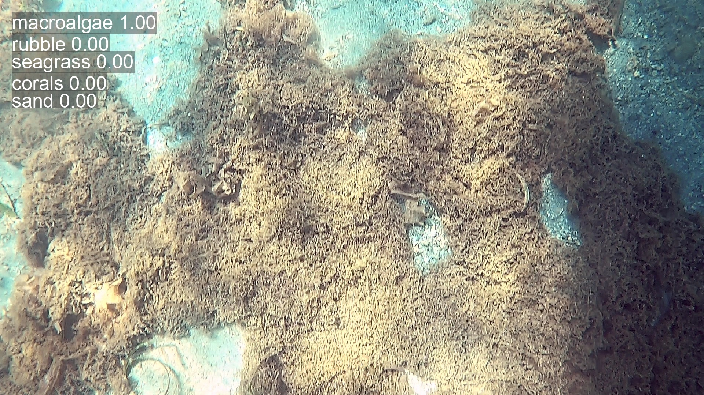
CLASSIFICATION

Slide 11
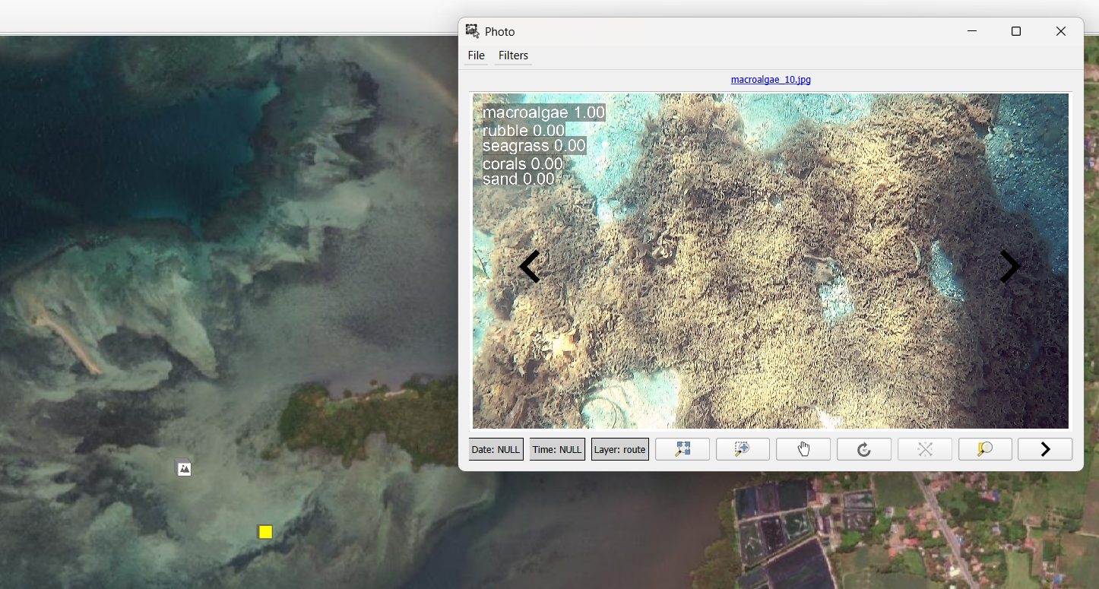
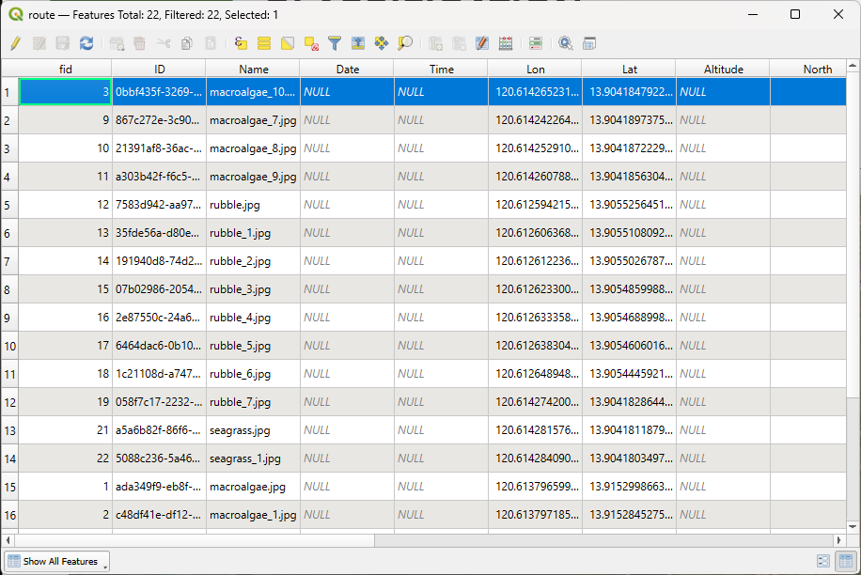
CLASSIFICATION

