Slide 1
Seagrass Cover using Drone Imagery

Slide 2
Outline
SEGMENTATION
DRONE DATASET
MODEL TRAINING
MODEL INFERENCE
GRID GENERATION
PERCENT COVER CALCULATION

Slide 3
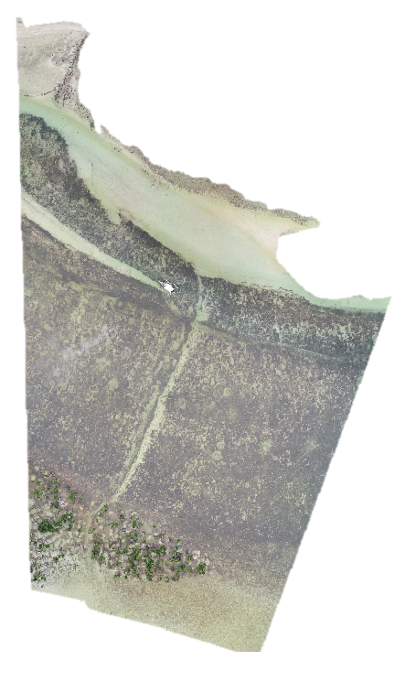
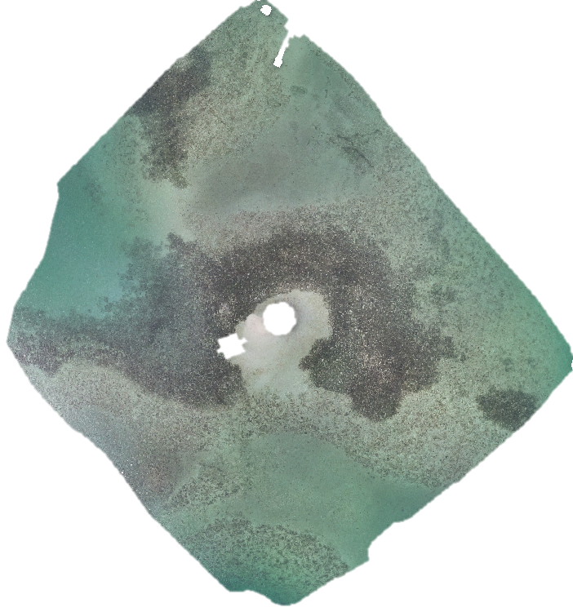
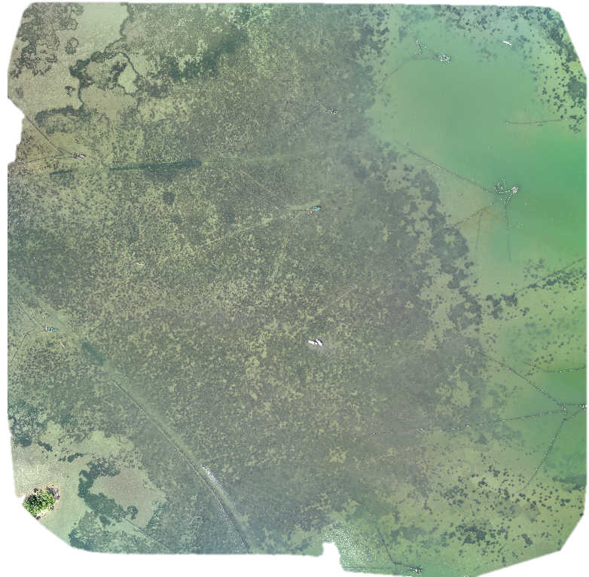
DRONE
DATASET
CEBU
MASINLOC
BOLINAO

Slide 4
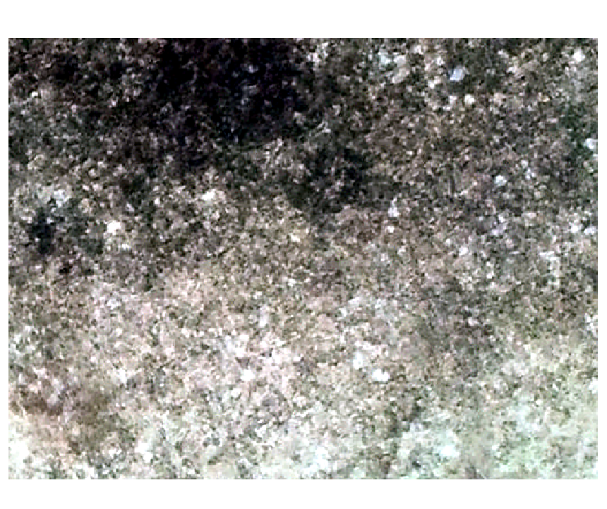
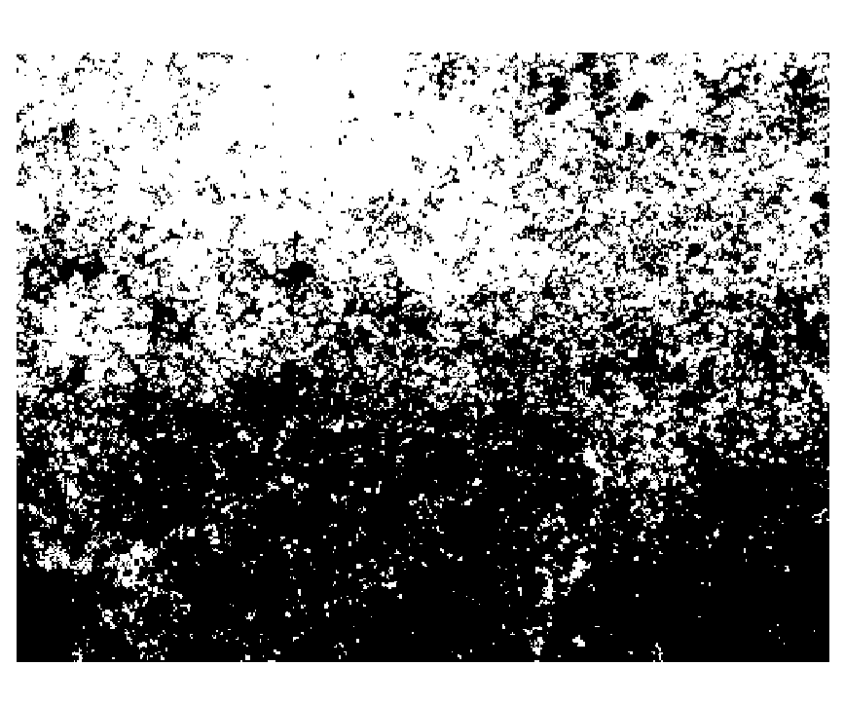
MODEL
TRAINING
IMAGE
PATCHES
Split Training Dataset
Accuracy Metrics
(mIoU)
LinkNET-EFFICIENTNET
Train : 0.75
Test : 0.15
Validation: 10
BINARY CLASSIFICATION

Slide 5
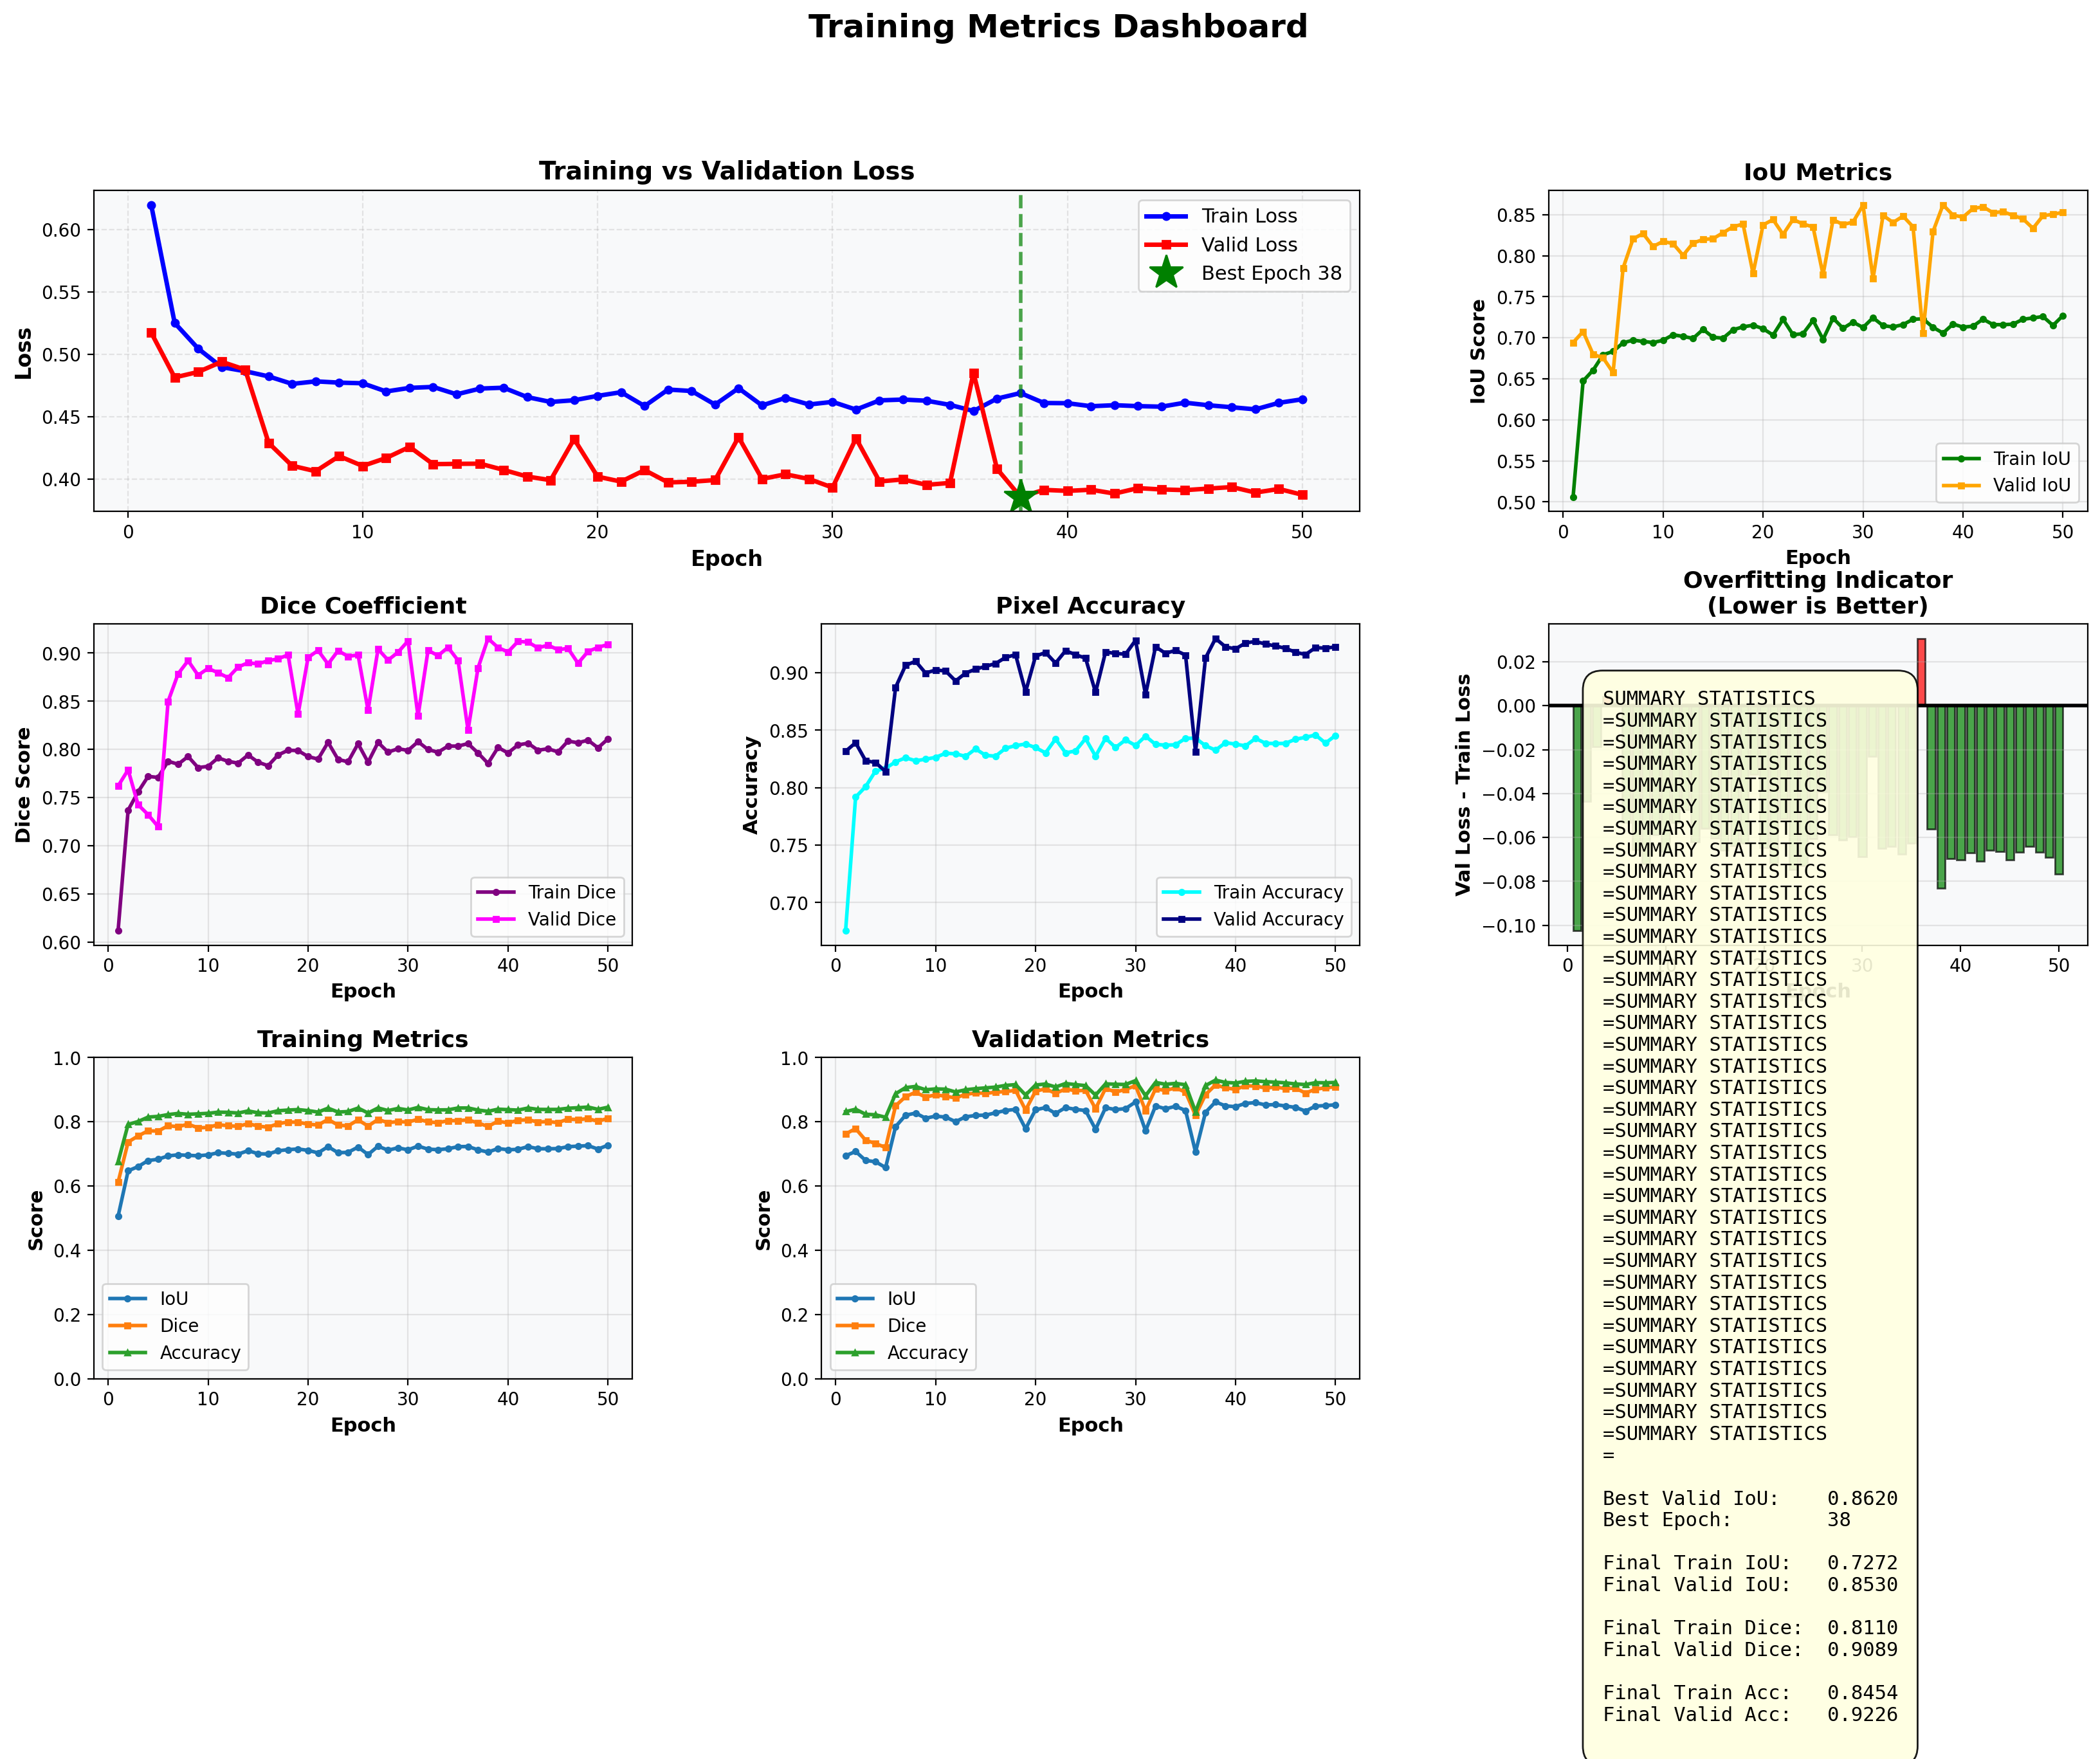
MODEL
TRAINING
METRICS
Best Epoch: 38
IoU : 0.8620
DICE Coef: 0.9150
Pixel Acc: 0.9298

Slide 6
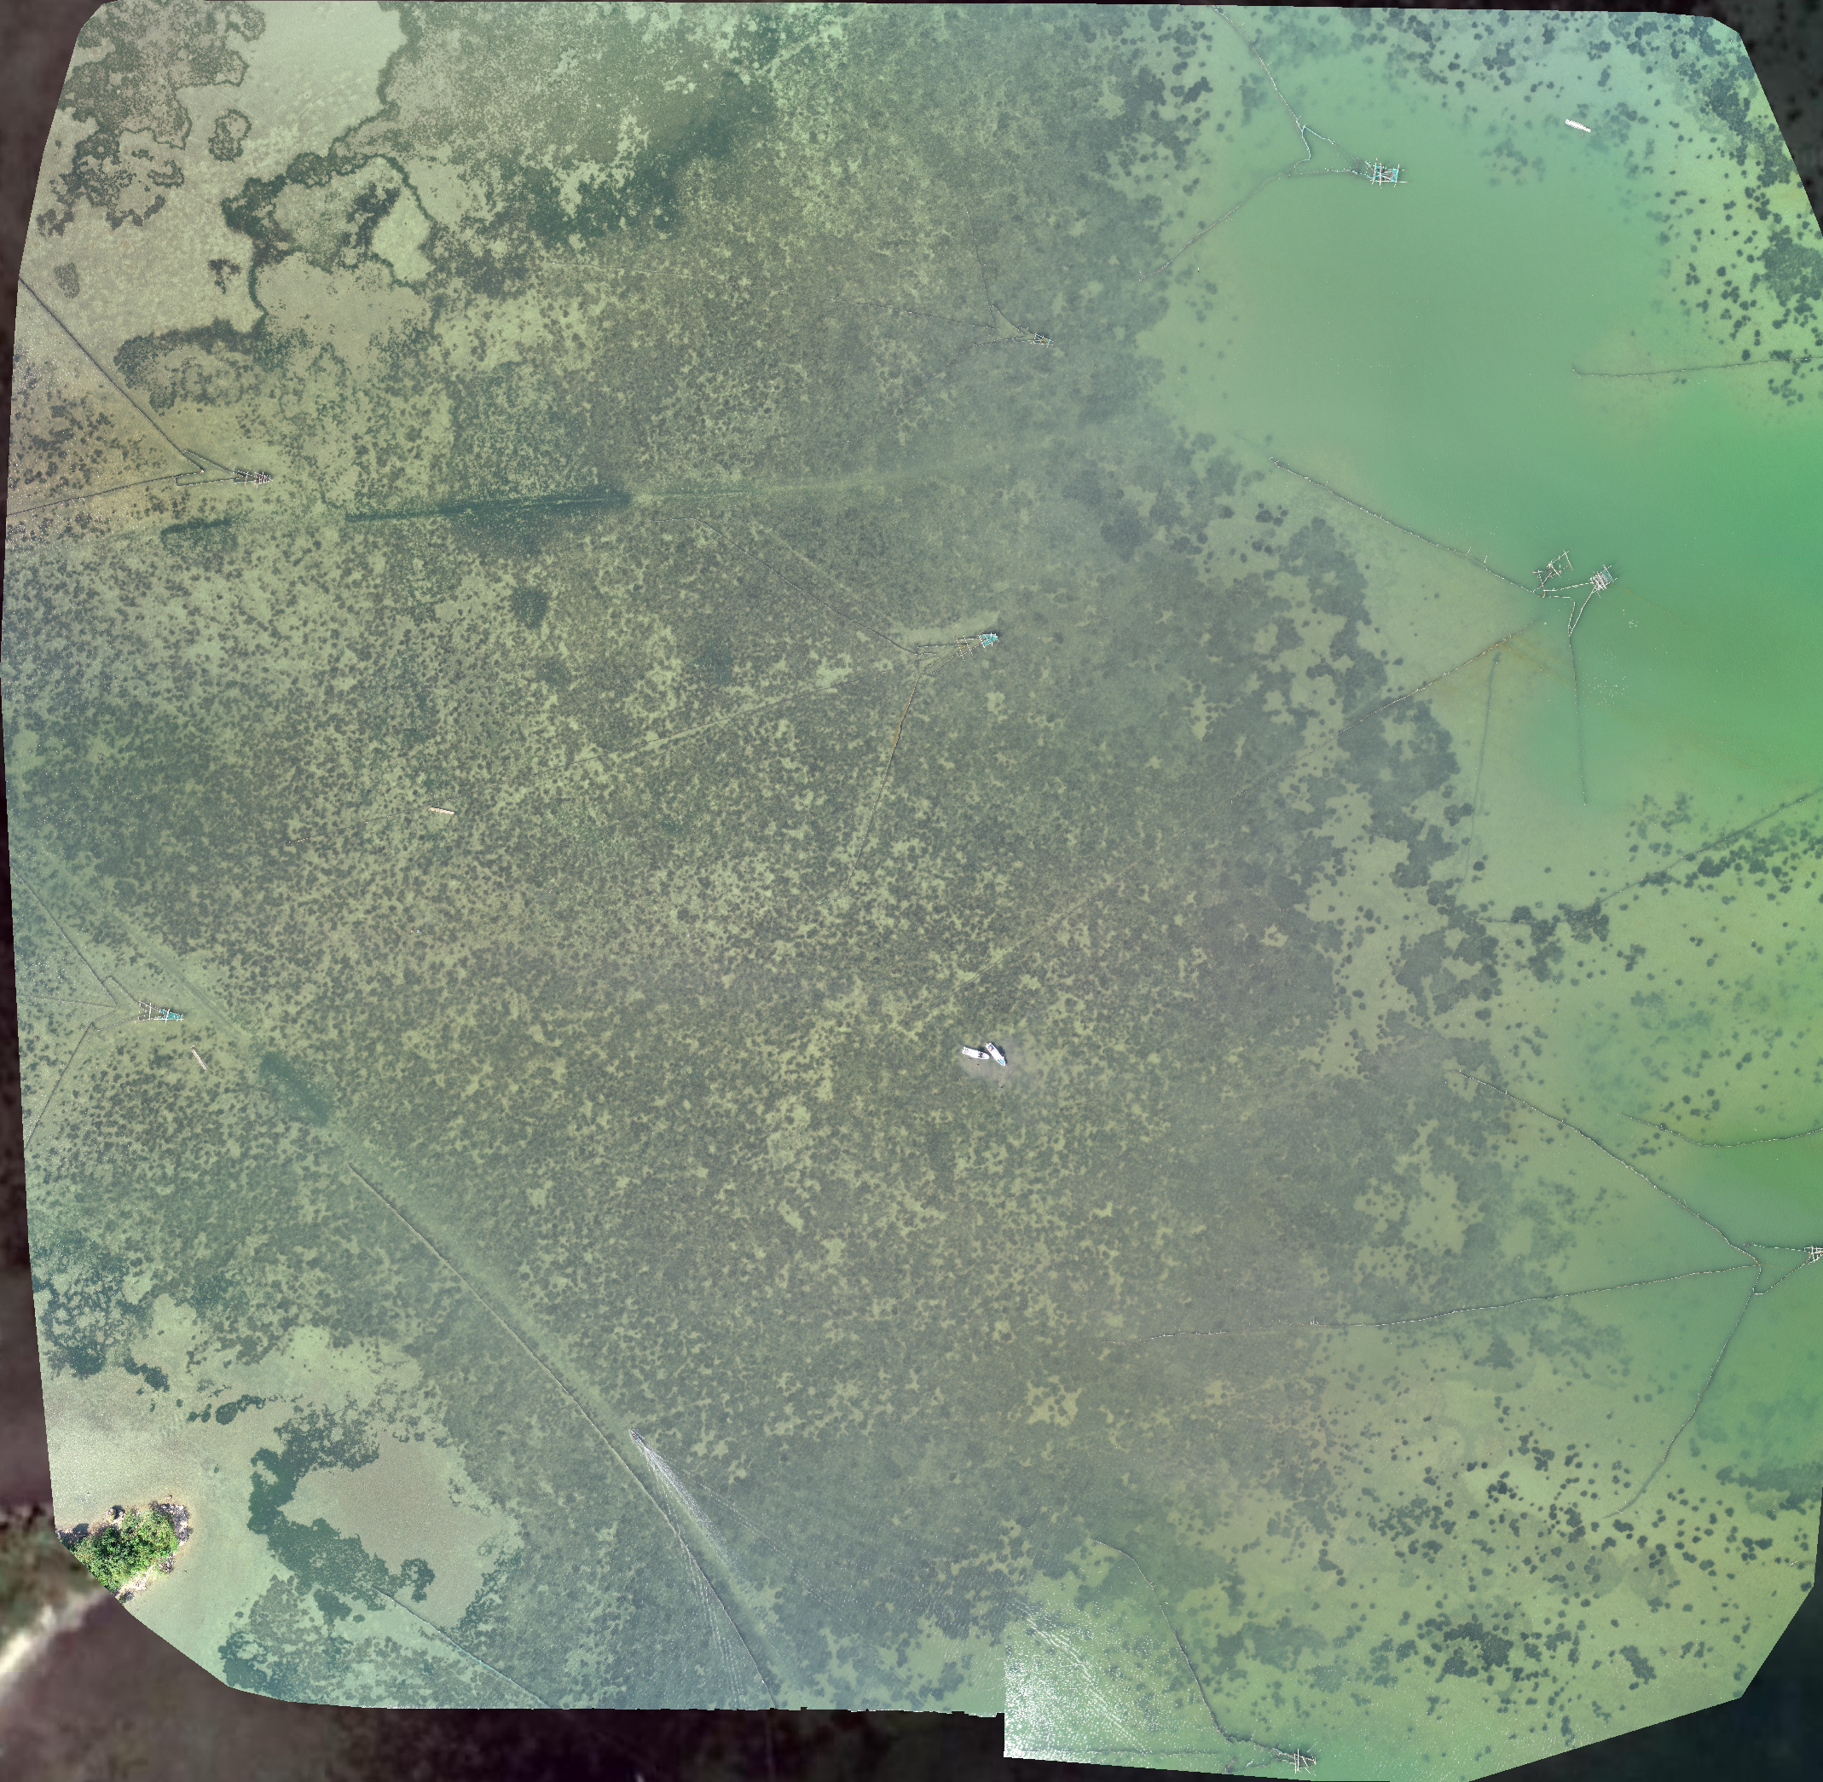
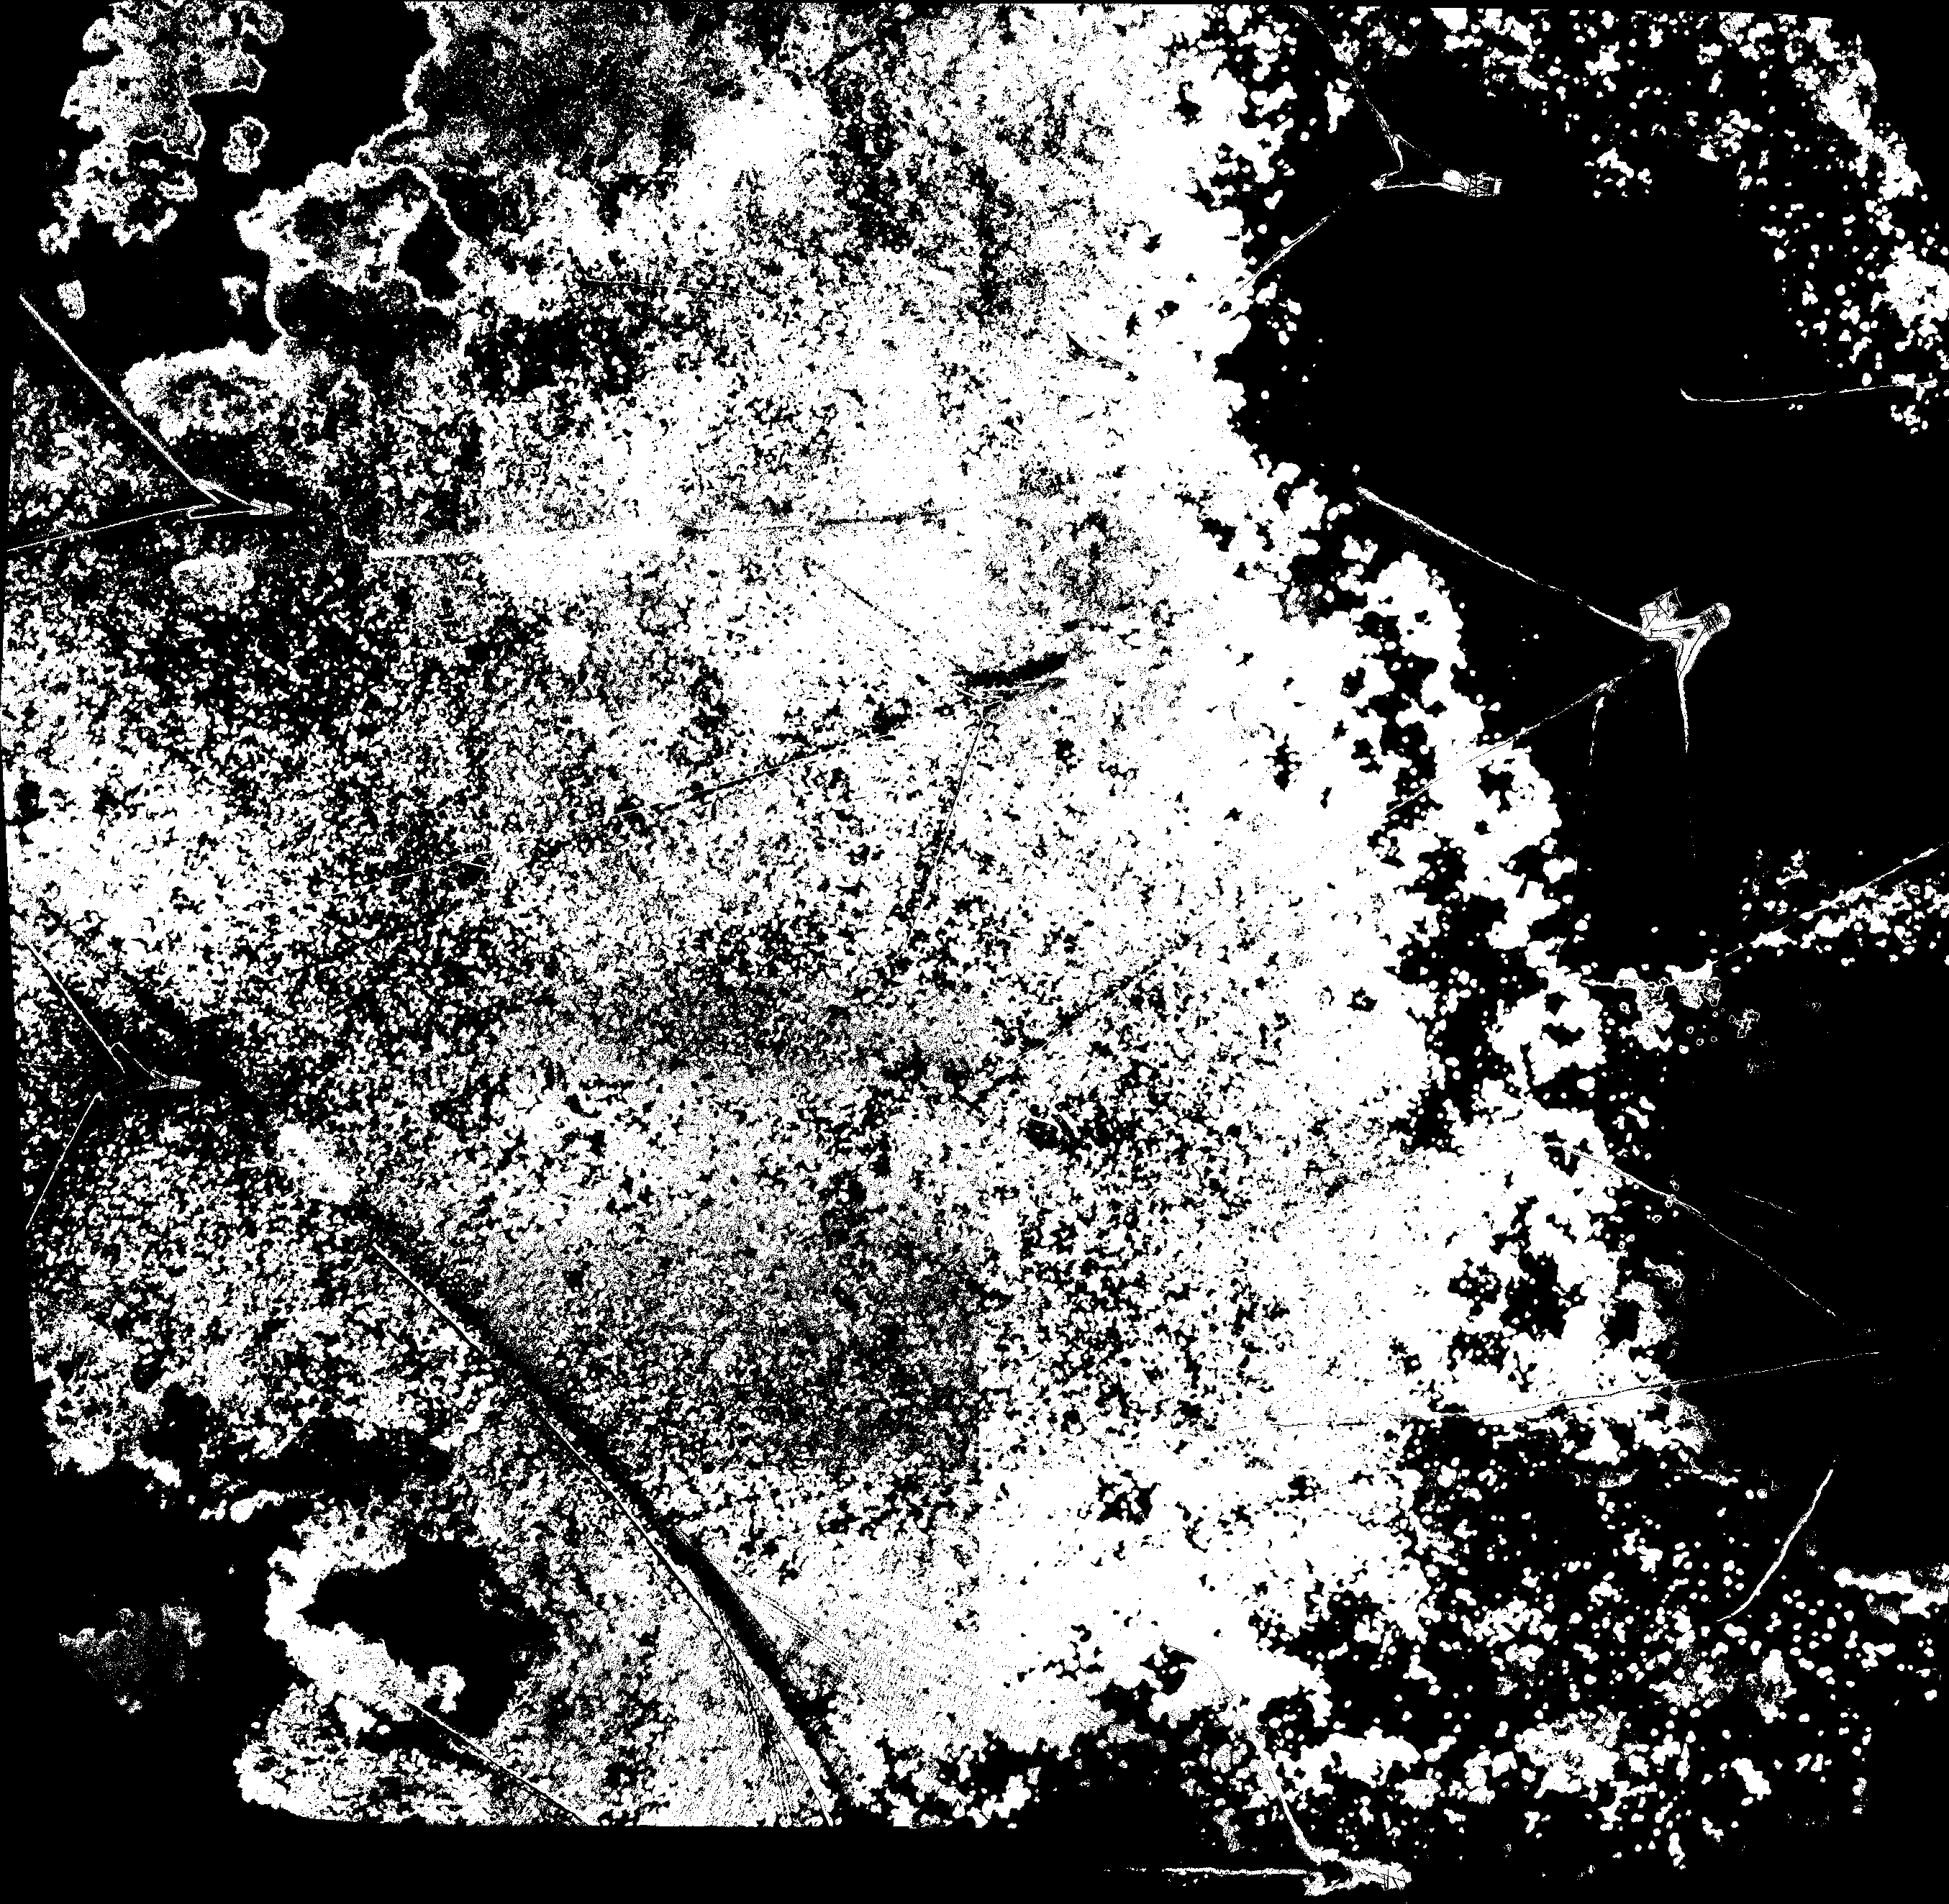
MODEL
INFERENCE
Drone IMAGES
Predict
MODEL

Slide 7
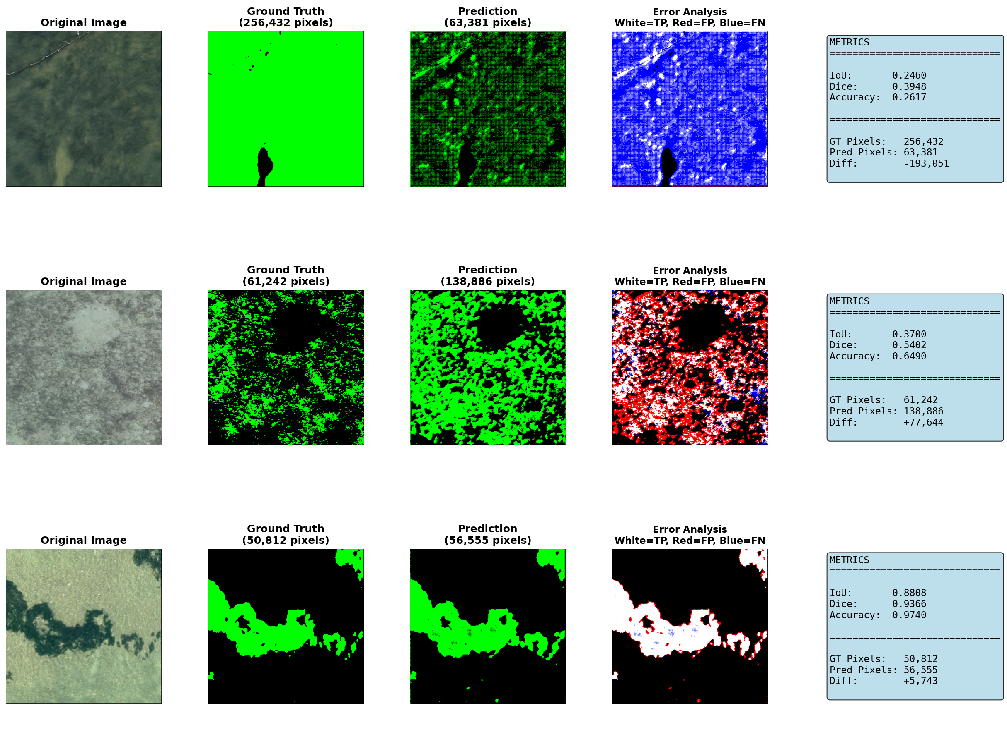
MODEL
INFERENCE

Slide 8
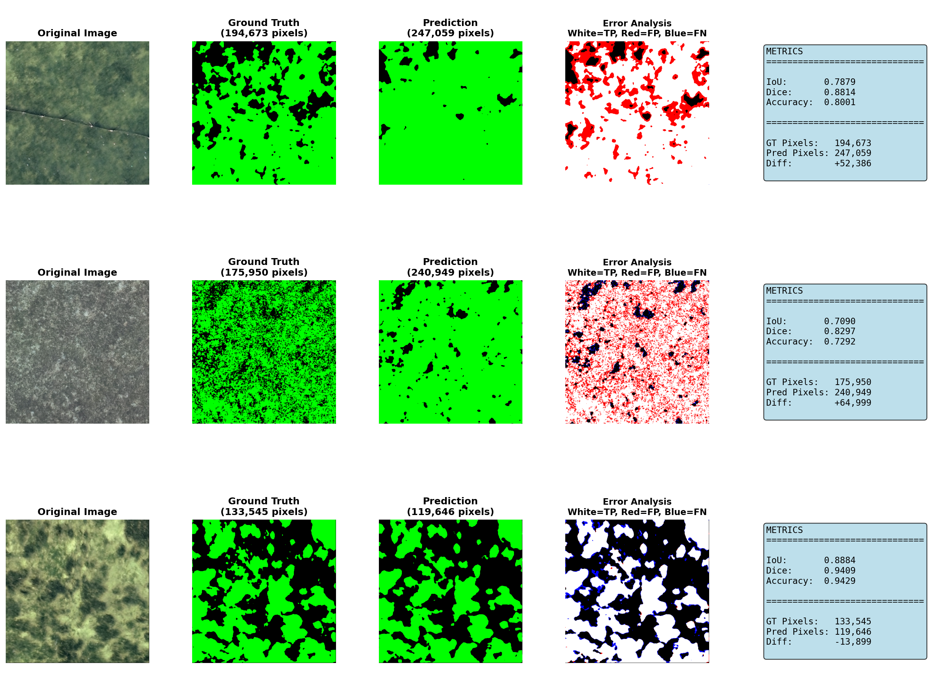
MODEL
INFERENCE

Slide 9
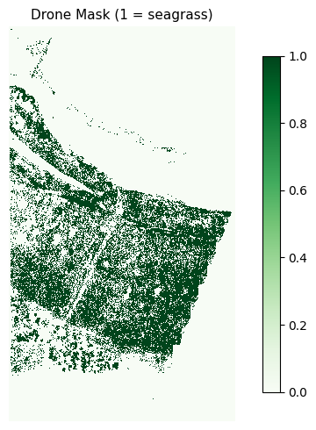
MODEL
INFERENCE

Slide 10
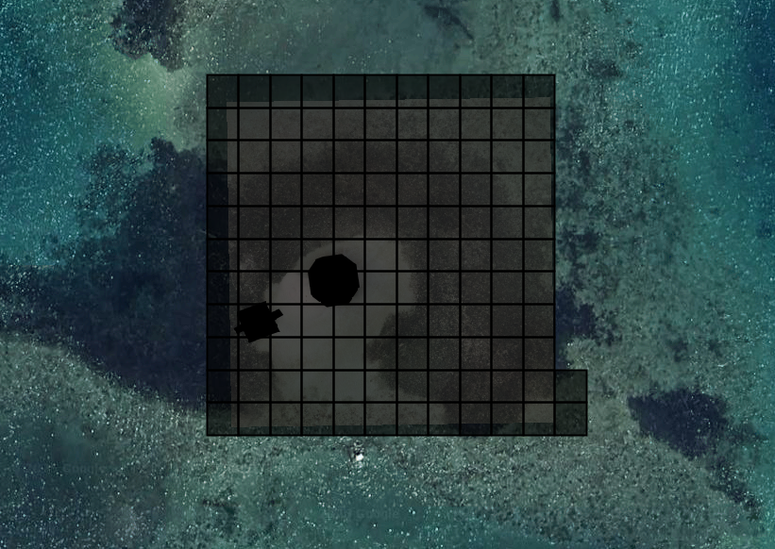
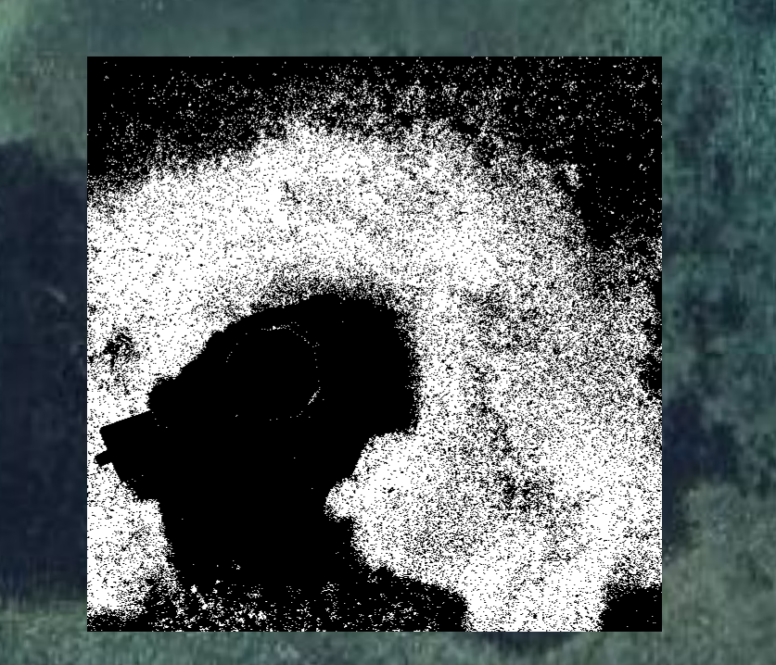
GRID
CREATION
GEE (Create GRID)
DRONE IMAGE
Sentinel-2 Composite

Slide 11
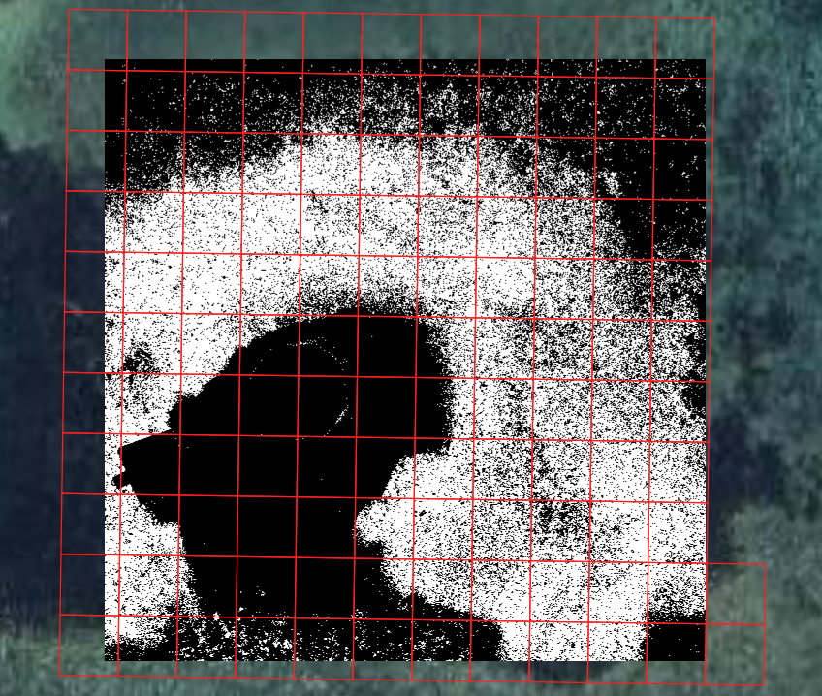
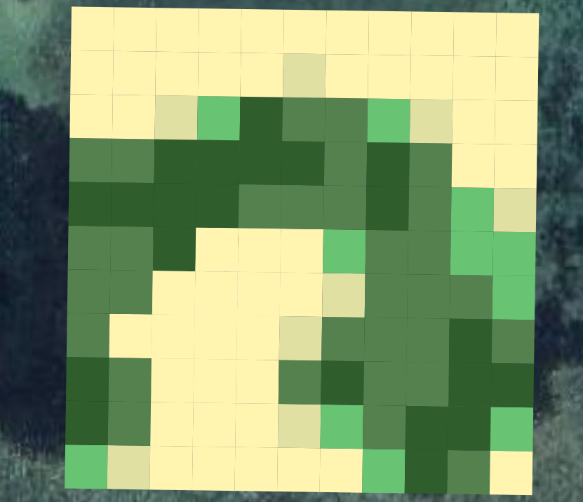
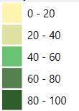

PERCENT COVER
CALCULATION
Calculate Pixel No. [0 & 1]
Calculate Percent Cover

