Slide 1
Paging in 2026
From current carriers to OSS and hobbyist networks

Slide 2
Agenda
Who are we?
What is a pager?
Paging Protocols
TAP/IXO and Motorola AlphaMate
How the Media Gets It Wrong
Providers and Consolidation
Current Support
Security Considerations
Paging in OSS, looking at LBBS
DAPNET – Paging for Radio Amateurs

Slide 3
Who are You?
Mike
Software Engineer
PhilTel (2022-)
Networks of Philly (2018-)
Dialup.world (2021-)
Radio Amateur (2018-)
Naveen
Computer engineer, IT
Telecommunications/software consultant
Communications activist
Projects
  Payphone scanning (2019-)
  PhreakNet (2021-)
  PhilTel (2022-)
  LBBS (2023-)

Slide 4


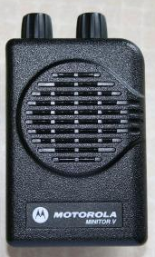
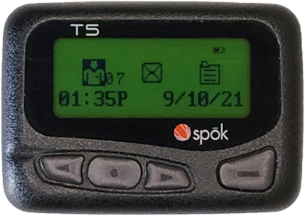
What is a pager?

Slide 5
Common (RF) Paging Protocols
Type | Example | Protocol
Tone-Only | Bellboy | “Three-Reed”
 | Motorola Pageboy Motorola Pageboy II | 2-Tone
Voice | Motorola Minitor
 | Unication G1 | 5/6-Tone
Numeric | Motorola Bravo | POCSAG
Alphanumeric | Apollo 202
 | Sun Telecom T5 | FLEX
Two-Way | Motorola PageWriter 2000 | ReFLEX

Slide 6
How Do Alphanumeric Pages Get Submitted?
(Hint: Not by Telephone!)

Slide 7
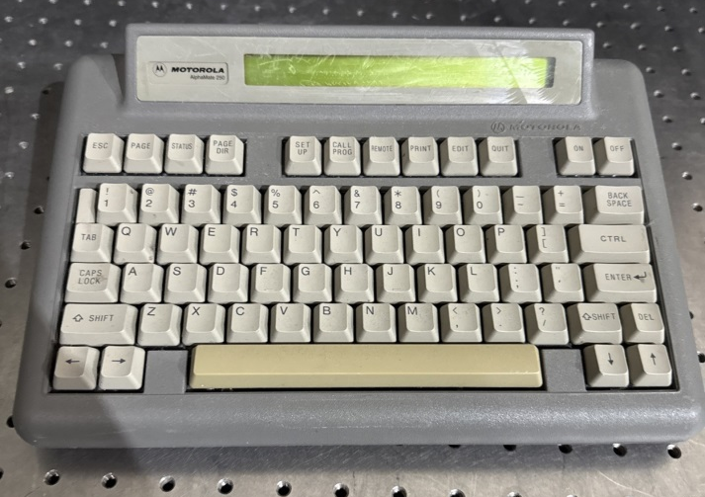
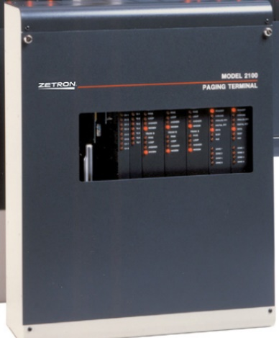
Telocator Alphanumeric Protocol
7E1 300 baud serial/modem protocol
Initially “Motorola Page Entry”
Standardized as TAP/IXO in 1988
Motorola AlphaMate is the most common (physical) TAP client
<CR> <ESC>PG1<CR> <STX>123<CR> ABC<CR> <ETX>17;<CR> <EOT><CR> (Carrier Drop) | (Modem answers) ID= 110 1.8<CR> Welcome<CR> <ACK><CR> 211 Page accepted<CR> <ACK><CR> 115 Goodbye<CR> <ESC><EOT><CR> (Carrier Drop)

Slide 8
Simple Network Paging Protocol
RFC 1861 (Oct. 1995)
SMTP-like, with enhancements specific to paging
Evolution from TAP, designed for IP-based environments
New capabilities for 2WAY paging
Assigned TCP port 444
Most providers only implemented the basic (1-way) paging commands
PAGE 5551212 MESS Your network is hosed SEND QUIT | 220 SNPP Gateway Ready 250 Pager ID Accepted 250 Message OK 250 Message Sent 221 Goodbye

Slide 9

The Media (Almost Always) Gets It Wrong
SPOILER ALERT: excerpt from ending of Columbo S9E2: Columbo Cries Wolf (1990)

Slide 10


Current Paging Ecosystem
Most nationwide paging has consolidated to a couple providers
  Spok – largest “nationwide” provider
    Formed by merged of USA Mobility and Amcom Software in 2014
      USA Mobility <- Arch Wireless + Pagenet
    Serves 2,200 hospitals / over 70 million msg/month
    $139 million in annual revenue
  Different coverage plans – local (state), regional, and “nationwide”
  Two-way paging is rare and less available
Still many regional providers throughout the country
  e.g. Range Paging in Minnesota

Slide 11
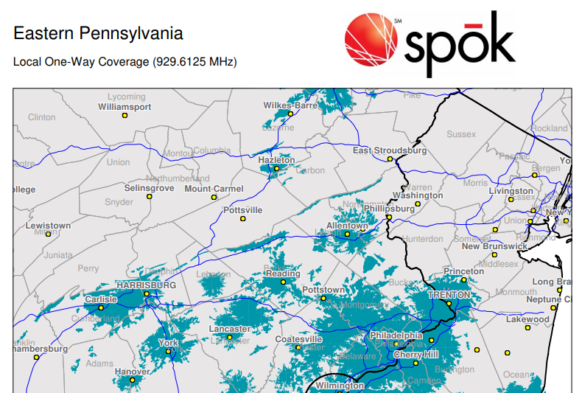
Local Coverage

Slide 12
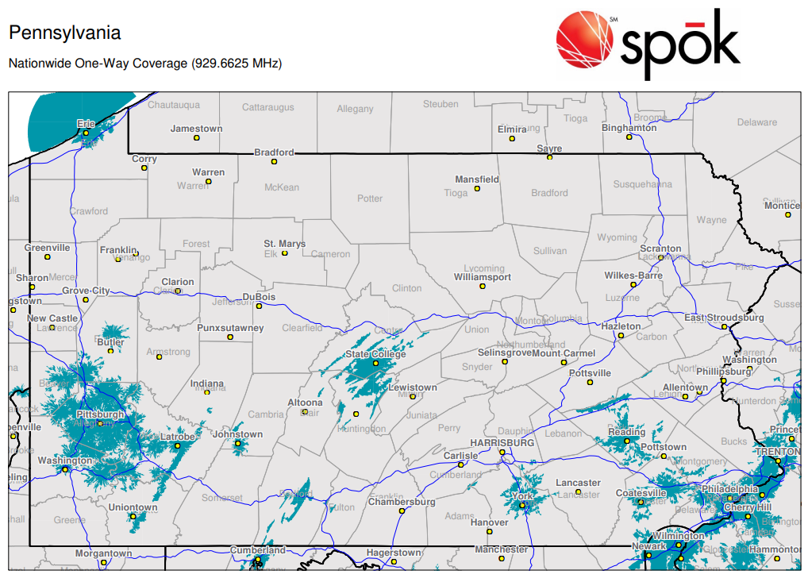
Nationwide Coverage

Slide 13
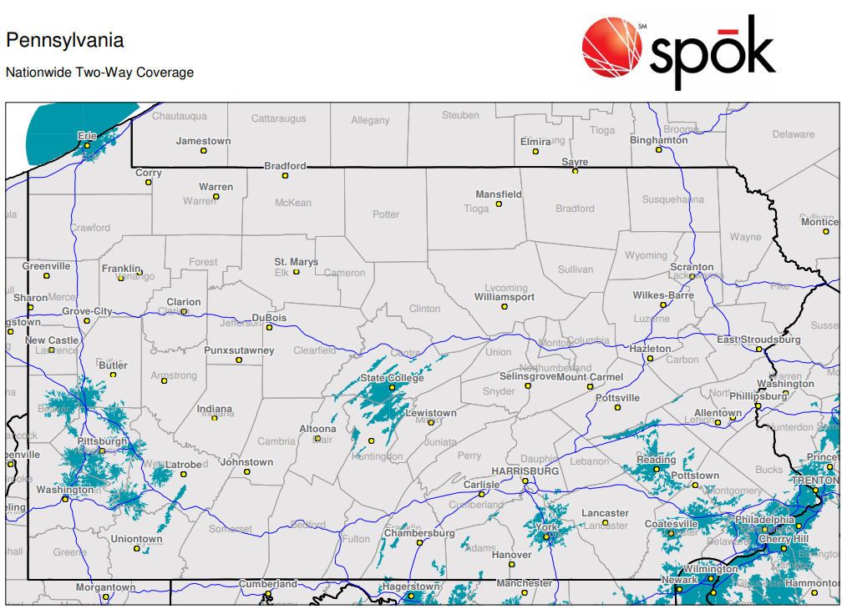
(Nationwide) Two-Way Coverage

Slide 14
Local vs. Nationwide

Slide 15
Current Paging Protocol Support
Most providers accept all paging submission protocols in existence, despite claiming not to support “legacy” methods anymore
Spok accepts:
  Numeric messages by voice at the 10-digit pager number
  Messages by TAP at 1-800-946-4644 (7E1, 300)
  Message by SNPP at snpp.usamobility.net
  Messages by SMTP usamobility.net
  Messages by SMS at the 10-digit pager number
  Messages via online form at https://secure.usamobility.net

Slide 16
Protocol Speed Comparison
Time from protocol-level page acknowledgment to receipt by pager (in sec.)
 | SNPP | SMTP | TAP
Min | 5.23 | 9.23 | 5.86
Mean | 9.46 | 17.05 | 12.37
Median | 8.76 | 15.68 | 10.8
Max | 18.33 | 29.22 | 20.81
Range | 13.1 | 19.99 | 14.95
https://blog.interlinked.us/88/paging-all-pagers-the-many-methods-of-alphanumeric-paging

Slide 17
Security Considerations
Spok supports encrypted paging
  e.g. Sun Telecom T5
  Encrypts payload over RF so only intended pager can decode message
Spok’s security itself is… not the best
  Usually the name and pager number is all that is required to change the coverage area
https://blog.interlinked.us/92/protecting-yourself-from-paging-coverage-attacks

Slide 18
Paging support in LBBS
LBBS = open-source BBS package for Linux that I maintain
Added support for common paging submission methods:
  TAP/IXO
  SNPP (with STARTTLS)
  SMTP
Configurable paging plans to accept pages from one protocol and relay it via another
Can use it to accept pages and relay them to your “real” provider
https://github.com/InterLinked1/lbbs <-- check it out
  mod_paging.conf provides documentation of paging support

Slide 19
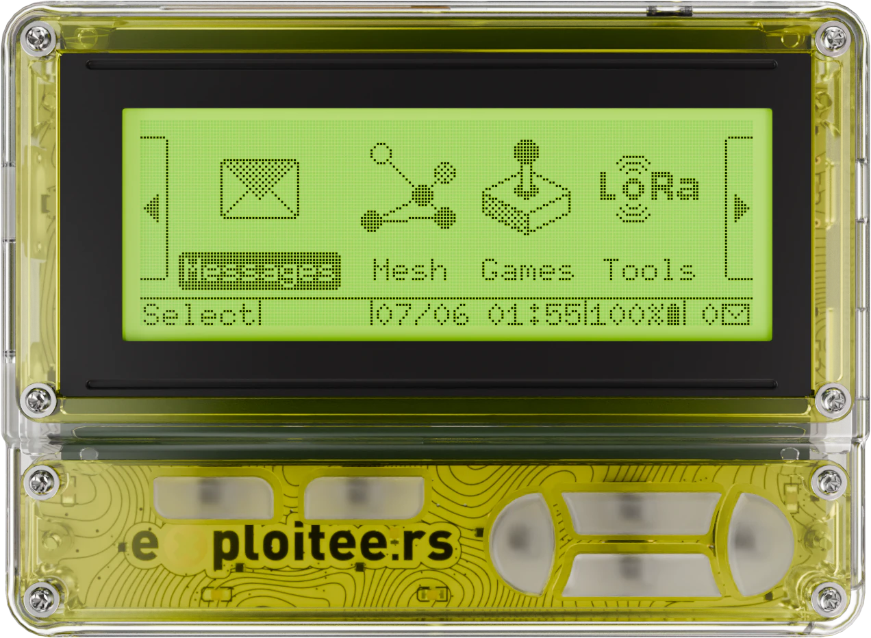
Can we run our own pagers?

Slide 20

What is DAPNET?
Decentralized Amateur Paging Network
  Free, global, ham-radio-operated
Grew out of the early-2000s "FunkrufMaster" project (AX.25/Packet Radio) at RWTH Aachen University
  Modern successor built for the HAMNET/IP era
Uses standard POCSAG protocol
  Same as commercial paging, but legally run by volunteers
  https://hampager.de/

Slide 21
How it's structured
Network of Internet and HAMNET-linked transmitters worldwide
  HAMNET is a cool topic in itself, but out-of-scope for this talk
Each transmitter can cover miles, most just a small area
Recommended frequency: 439.9875 MHz (70cm amateur band)
Not one big tower — a mesh of small, hobbyist-run sites

Slide 22
How to use it
Requires a valid amateur radio license
Messages sent via web portal, Android/iOS apps, or API/integrations
Receive on POCSAG-capable pagers (Skyper, AlphaPOC are popular)
  OR SDR-adjacent tools like Flipper Zero
Get an Account: support.hampager.de → "New DAPNET account with RIC“
  Need a DMR ID (get one at radioid.net) — forms part of your RIC
  Processing takes several days

Slide 23
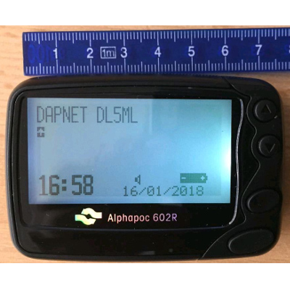

Picking a Pager
AlphaPoc is the most popular
  Their pagers are ~$125, sold from EU, often sold out
Generic versions are $70 on eBay, seller confirms frequency
  Hand-program with your RIC, group RICs if you want
Other pagers are supported, even vintage ones with caveats…

Slide 24
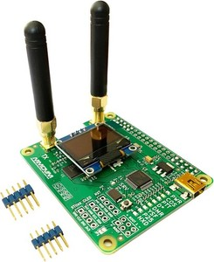
Transmitters
If a transmitter covers your area already, you’re done
  One probably doesn’t, though
Submit a second ticket: "New DAPNET Transmitter“…
Most people use Raspberry Pi + MMDVM modem
  Same hardware many hams already have for DMR hotspots
  Low cost: $30, Low power: 10 milliwatts
  Use unipager (or Pi-Star's built-in DAPNET/POCSAG support)

Slide 25
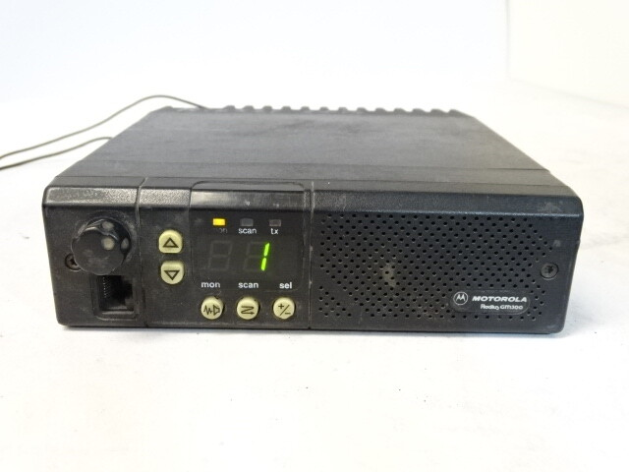
Transmitters
I’m not most people
Let’s use an old Motorola GM300 (MX4XXXXXX3XX)
  https://www.repeater-builder.com/motorola/maxtrac/gm300-info.html
My M44GMC29C3AA is a $30 radio that outputs 40 watts!
Program it with a DOSBox Docker container
  https://github.com/thotypous/gm300-dosbox
  https://bad-radio.solutions/notes_unipager
Will need programming cable(s)!

Slide 26
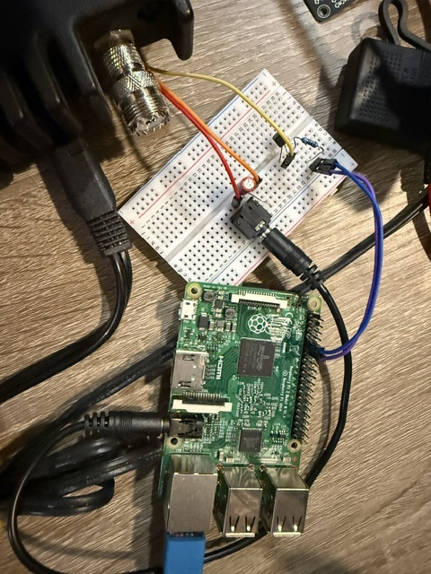
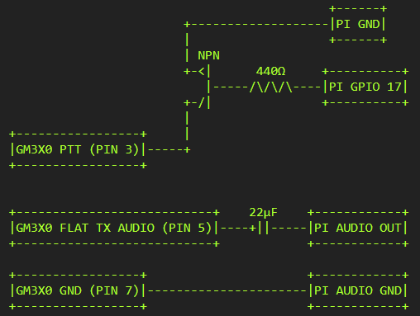
Running unipager
We need a way to run unipager
  Raspberry Pi 2, use the release binary from GitHub
Need audio and PTT trigger, use three inexpensive components

Slide 27
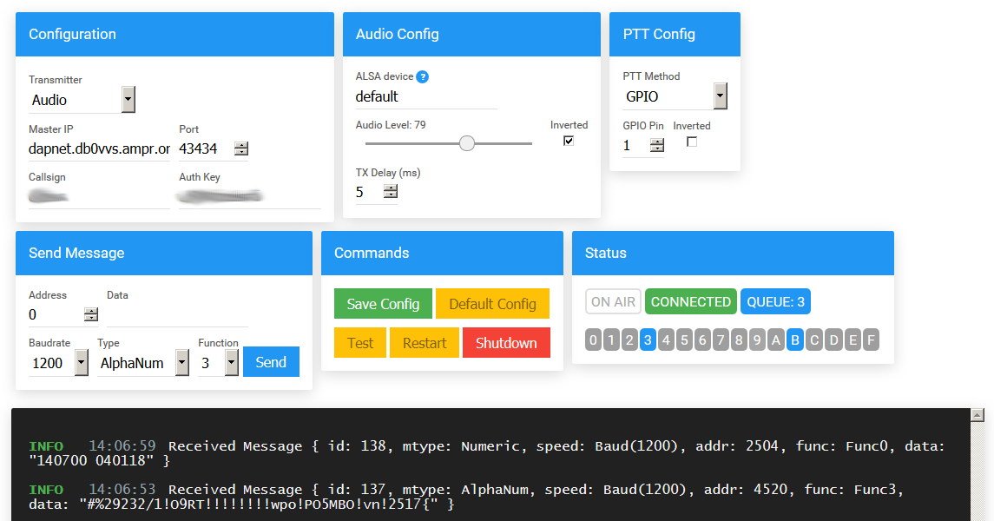
Running unipager
Access unipager’s webui at http://localhost:8073
  Has websocket for mobile apps, cli tool, etc.

Slide 28
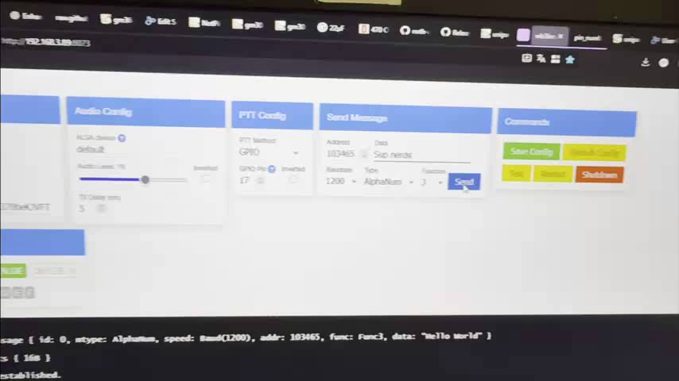
Let’s test it

Slide 29
Questions?
Mike
mike@philtel.org
Famicoman (Libera IRC)
https://famicoman.com
https://github.com/Famicoman
Naveen
interlinked@philtel.org
InterLinked (Libera IRC)
https://interlinked.us
https://github.com/InterLinked1
https://philtel.org/contact/
https://philtel.org/donate/
https://github.com/philtelco/philtel-presentations/

