Slide 1
Freephones - A look at free-to-use payphone projects via PhilTel

Slide 2
Agenda
Who are we?
What’s a payphone?
What happened to them?
What are “freephones”?
What’s PhilTel?
What have we learned?
Future Plans

Slide 3
Who are You?
Mike
Software engineer
Philly 2600 (2012-)
FreePBX/Asterisk user (2012-)
Networks of Philly (2018-)
Dialup.world (2021-)
Naveen
Computer engineer, IT
Telephone collector, phone phreak (2016-)
Asterisk user (2018-)
Payphone inventory (2019-)
PhreakNet (2021-)
Asterisk/DAHDI developer and consultant (2021-)
BBS software developer (2022-)
Environmental activist (2016-)

Slide 4
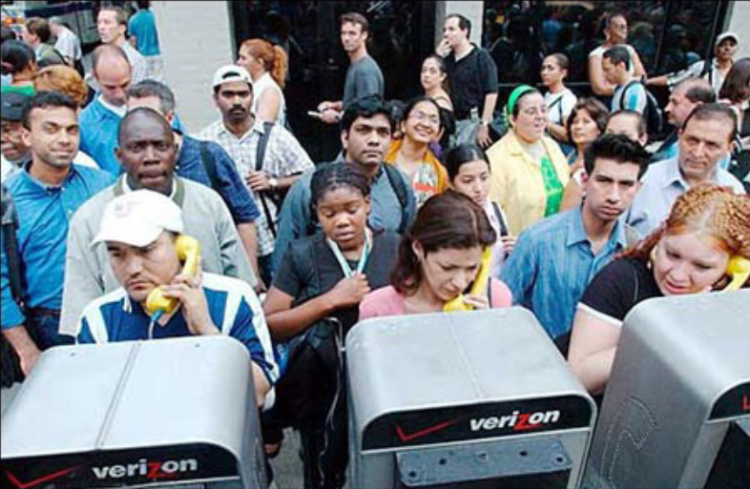
What is a Payphone?

Slide 5
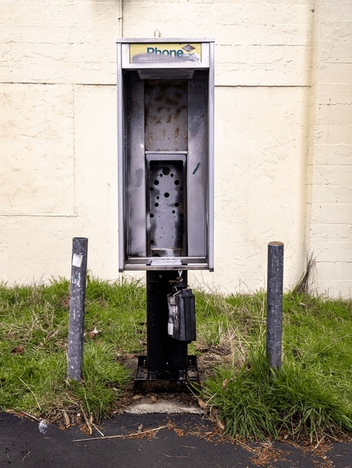
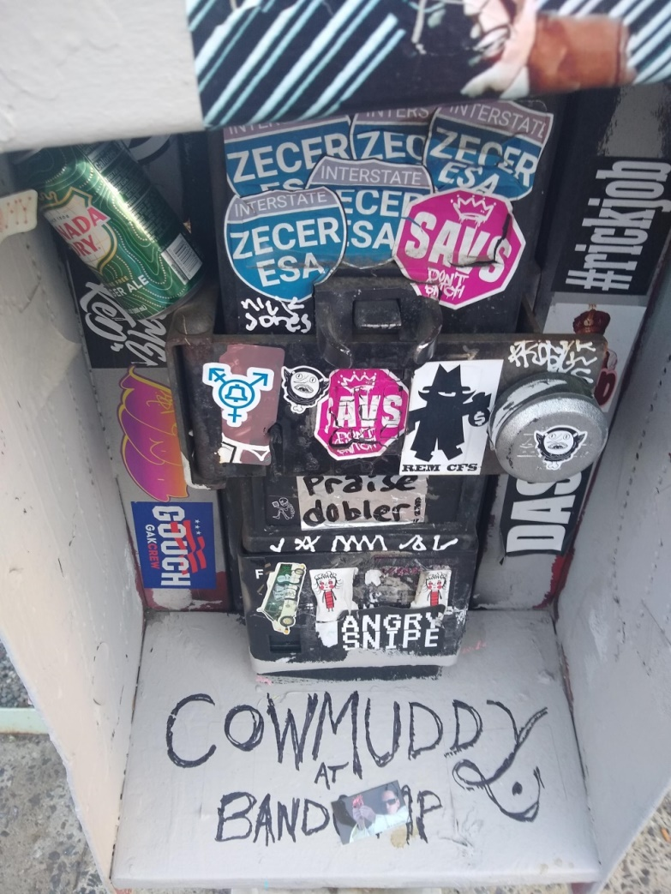
What is a Payphone?

Slide 6
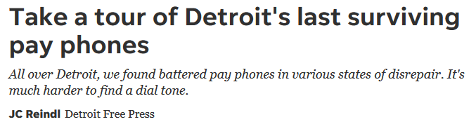
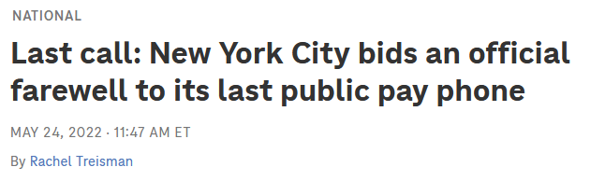
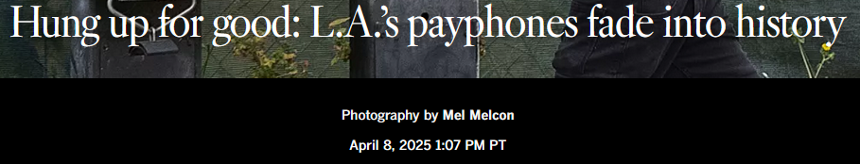
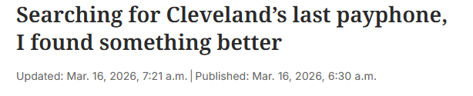
What happened to them?

Slide 7
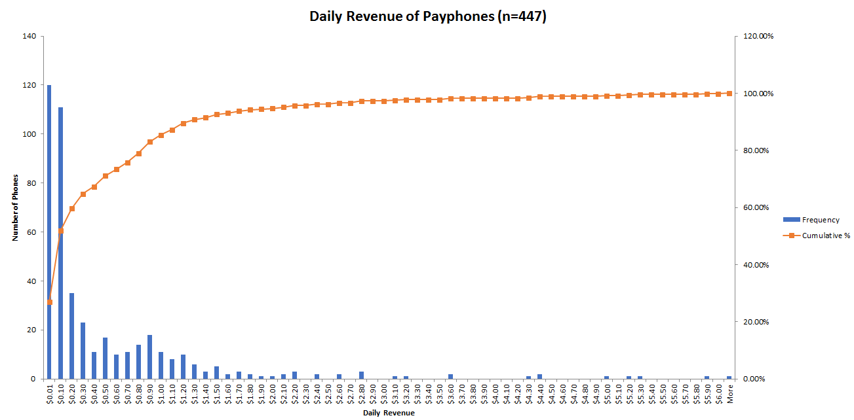
What happened to them?

Slide 8
What happened to them?
98% of adults in the USA have a cell phone (Pew Research)
Philadelphia population as of July 1 2024 is 1,573,916 (census.gov)
78.8% of Philadelphians are 18+ (census.gov)
(1573916*.788)*.02 = ~24,808 Philadelphia adults without a cell phone
Xfinity Mobile Arena max seated capacity: ~21,000

Slide 9
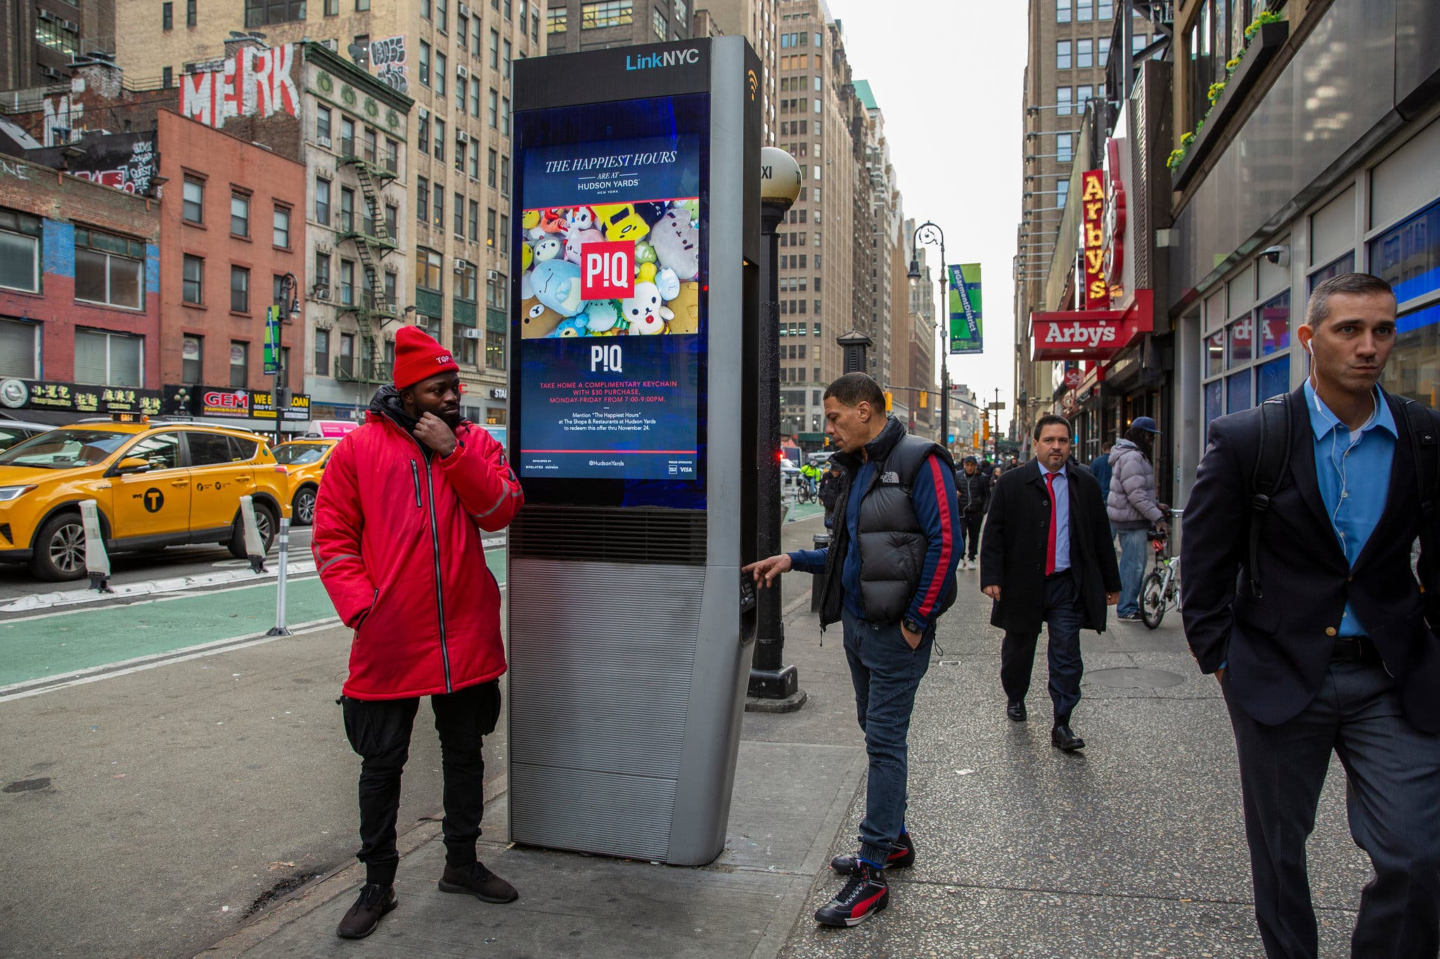
What happened to them?

Slide 10
What are Freephones?
Essentially, payphones but free-to-use
Public-use, courtesy phones
Often older payphones or armored phones because they are rugged, vandal-proof, and weather resistant
Anyone can set up a freephone, you don’t need to be a telephone company
Often utilize VoIP for phone service, off-the-shelf hardware, and open-source software
May have unique services and easter-eggs, including operator services, connection to collectors’ networks, etc.

Slide 11
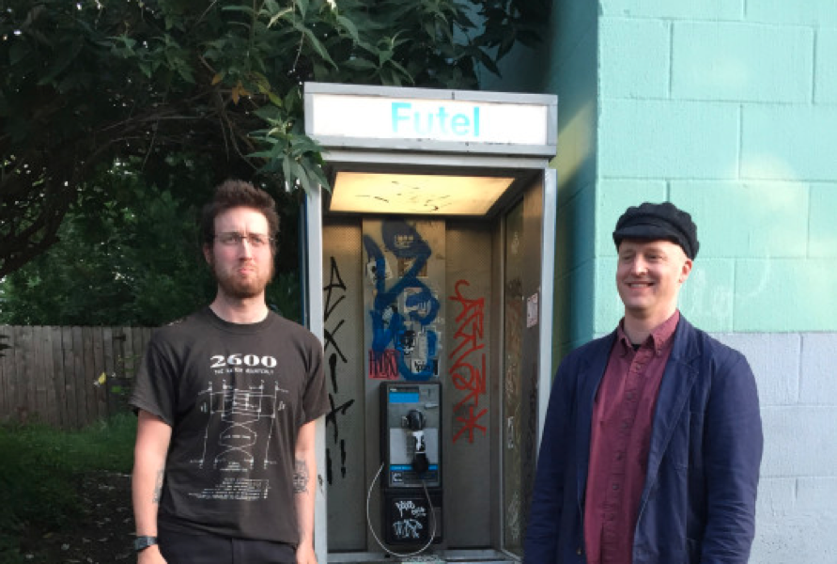
What are Freephones?
The first freephone project is likely Futel, based in Portland Oregon, started in 2014 by Karl Anderson and Elijah St. Clair
Started with one phone in Karl’s front yard, now has 17 phones in 3 states

Slide 12
What are Freephones?
Freephone Projects (that we know of)
  Futel - Portland, OR
  PhilTel – Philadelphia, PA
  RandTel - Central VT
  Good Phone Project – Monroe County, NY
  0Dial – Canada
  OIRCT - France

Slide 13
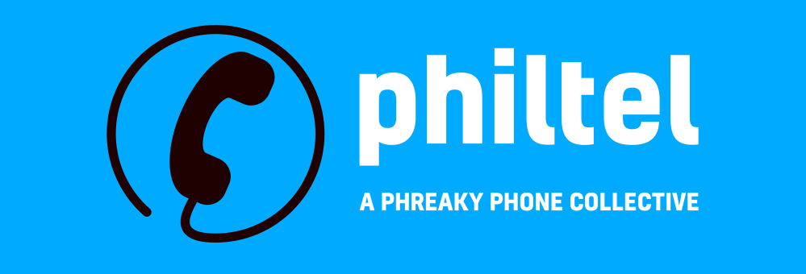
What is PhilTel?
PhilTel is inspired by Futel, but based in Philadelphia
Bring payphones back but make them free-to-use this time because payphones are cool
Use as much discarded and second-hand stuff as we can, build with COTS hardware and open-source software
Large upfront cost (>$300), small recurring cost (<$10/mo)
Benefit people without cell phones, preserve public telephony

Slide 14
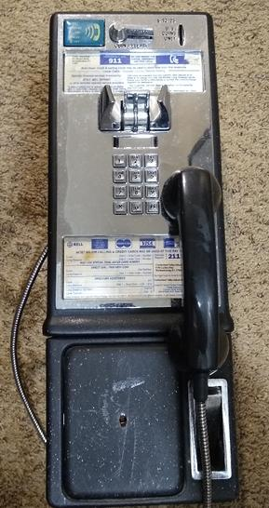
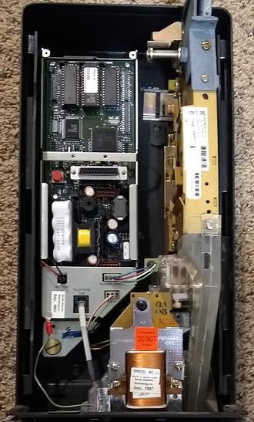
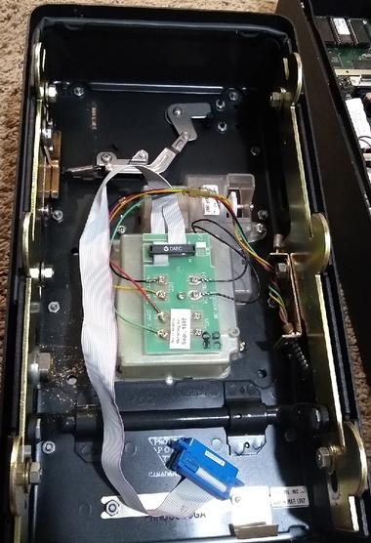
The First Phone

Slide 15
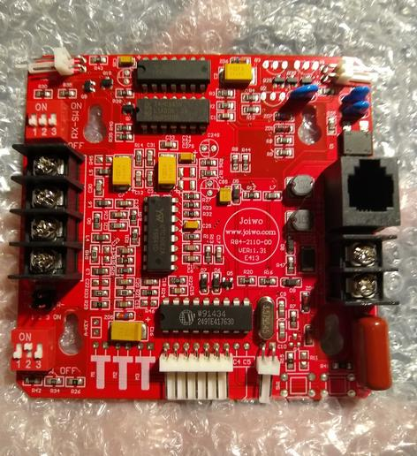
2110V Coinless Board
“Dumb” phone board made for armored phones
Acts as an (almost) drop-in replacement board for most GTE-style payphones
No longer made (but still available)
Good solution if you don’t want to mess with Protel hardware/software

Slide 16
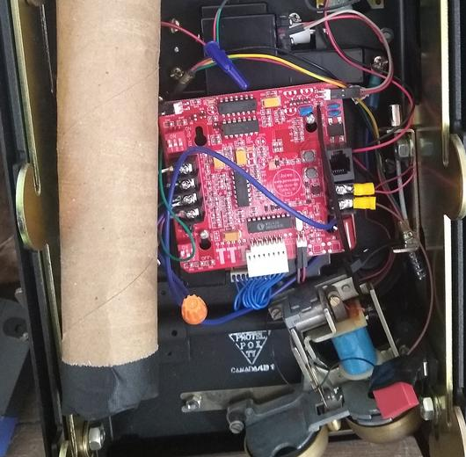
2110V Coinless Board (Continued)

Slide 17
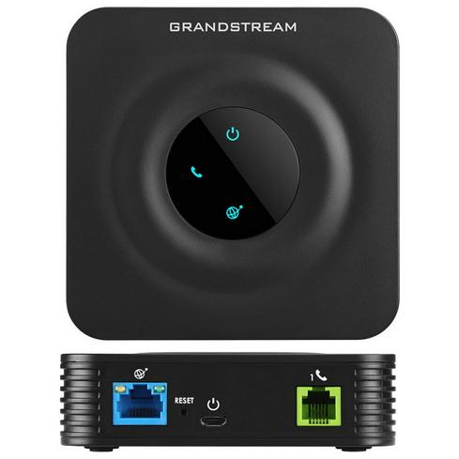
Grandstream HT801 ATA
Analog Telephone Adapter
Allows analog telephones to speak SIP (Session Initiation Protocol)
Registers as a client to our telephone exchange so we can make/take calls
Remotely monitored with GDMS (Grandstream Device Management System) for free!

Slide 18


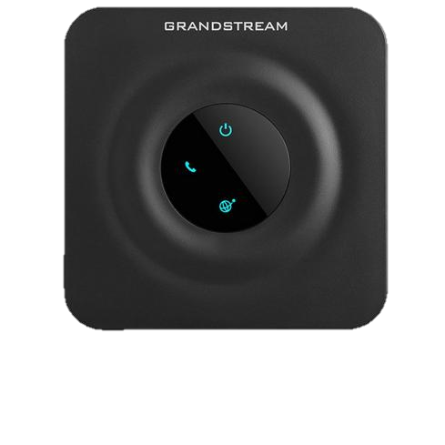
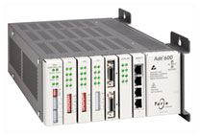
SIP provider
Asterisk
VoIP
SIP/RTP
IAX2
DAHDI
T1

Slide 19
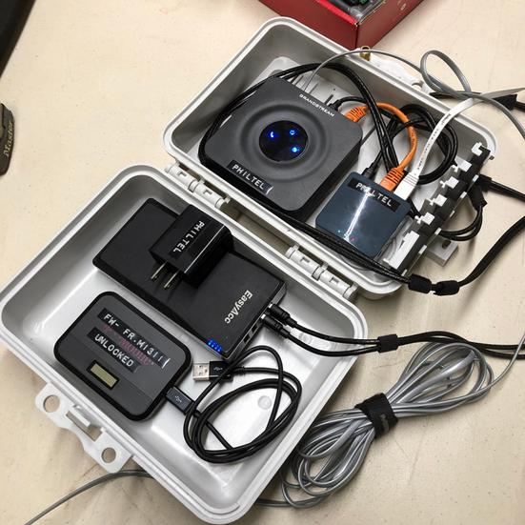
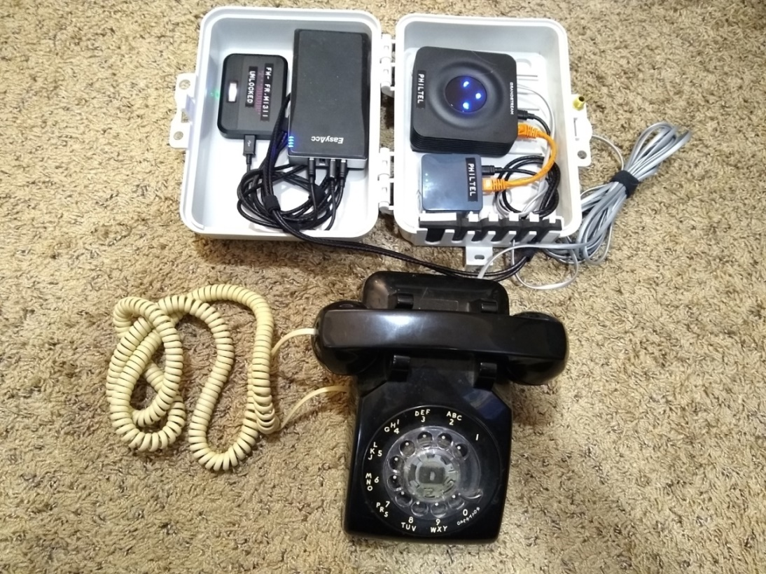
Our Portable Proof of Concept

Slide 20
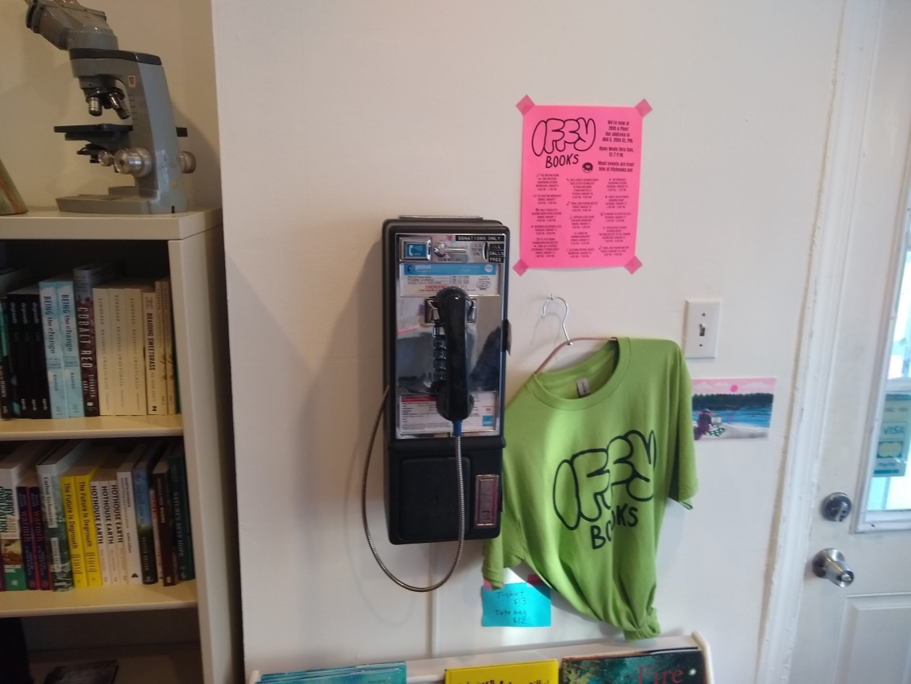
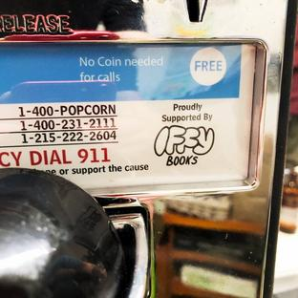
Flagship Phone @ IffyBooks
Initially Installed December 17, 2022, reinstalled several times since.
Had a party, hackers and phreakers showed up

Slide 21
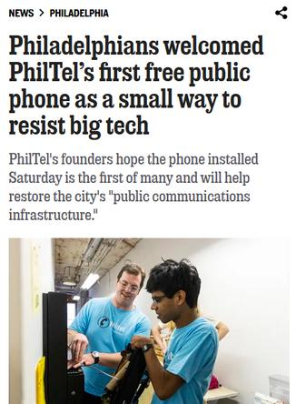

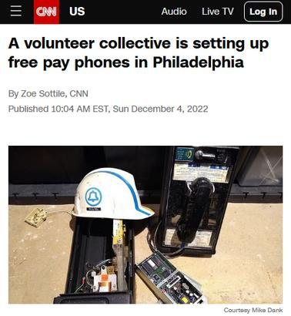
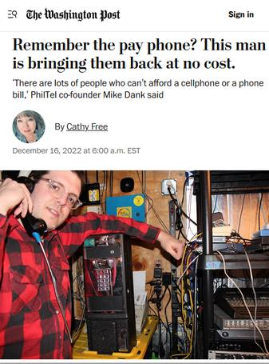


People seemed to like it

Slide 22
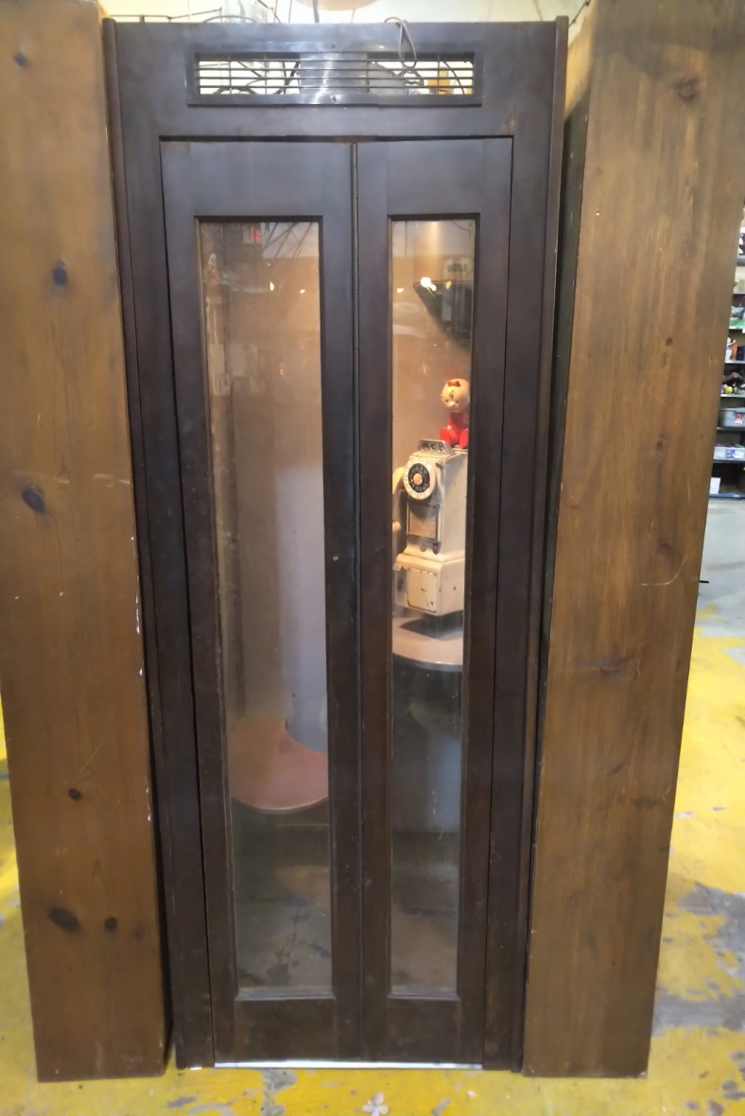
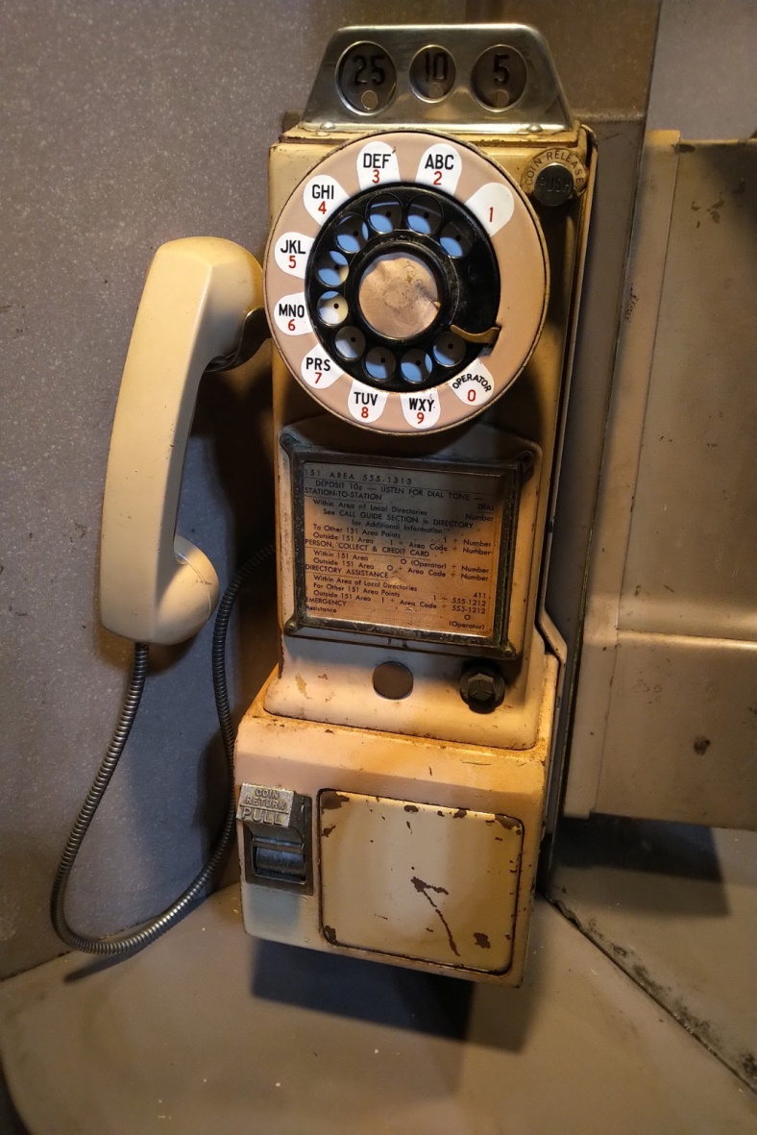
A Second Phone

Slide 23

What Did We Learn?

Slide 24
What Did We Learn?
VPNing the ATA can work, but SIPS/SRTP works better
  ISPs can block or traffic-shape VPN traffic
  VPN means…
    More interoperability challenges
    More latency
    More maintenance (expiring certificates)

Slide 25
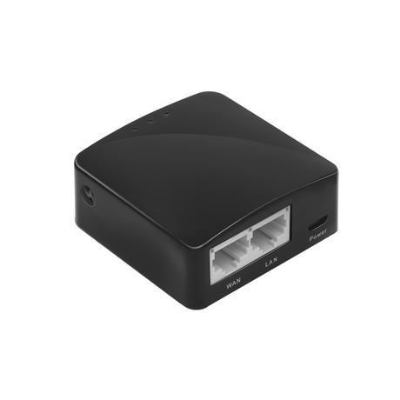
What Did We Learn?
Less hardware is better
  Originally tried to run everything through a small router
  More cost/maintenance when not needed for all installations
  Hardware limitations for WiFi

Slide 26
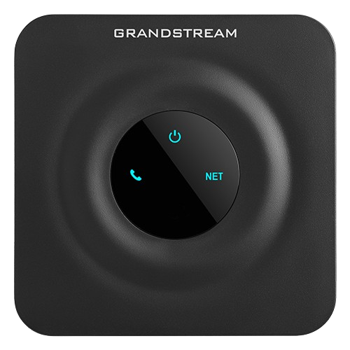
What Did We Learn?
ATAs work until they don’t, and most aren’t great
Grandstream ATAs are still the best we know of
  Plagued with firmware issues for V1s initially
  We have had 2 die on one phone
  One died during a demo
  V2 ATAs have been nothing but trouble

Slide 27
What Did We Learn?
People will try their best to ruin a good thing
  Repeated vandalism on the 2nd phone
  Don’t prank call 911
    Have a demo mode for exhibits
There are good people too!

Slide 28
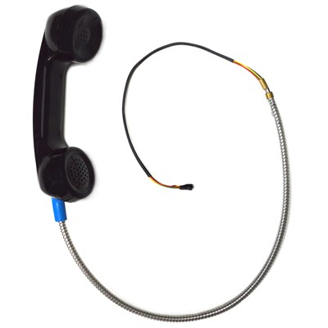
What Did We Learn?
Some parts are often meant to be replaced, not repaired
Don’t spend all your time trying to fix something that doesn’t want to be fixed
  You may not be able to trust it

Slide 29
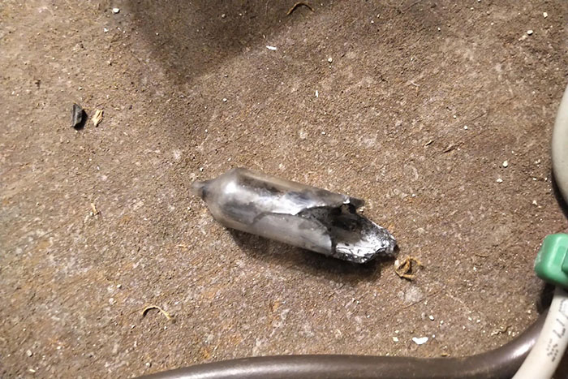
What Did We Learn?
Accidents happen
This is a marathon, not a sprint

Slide 30

What Did We Learn?

Slide 31
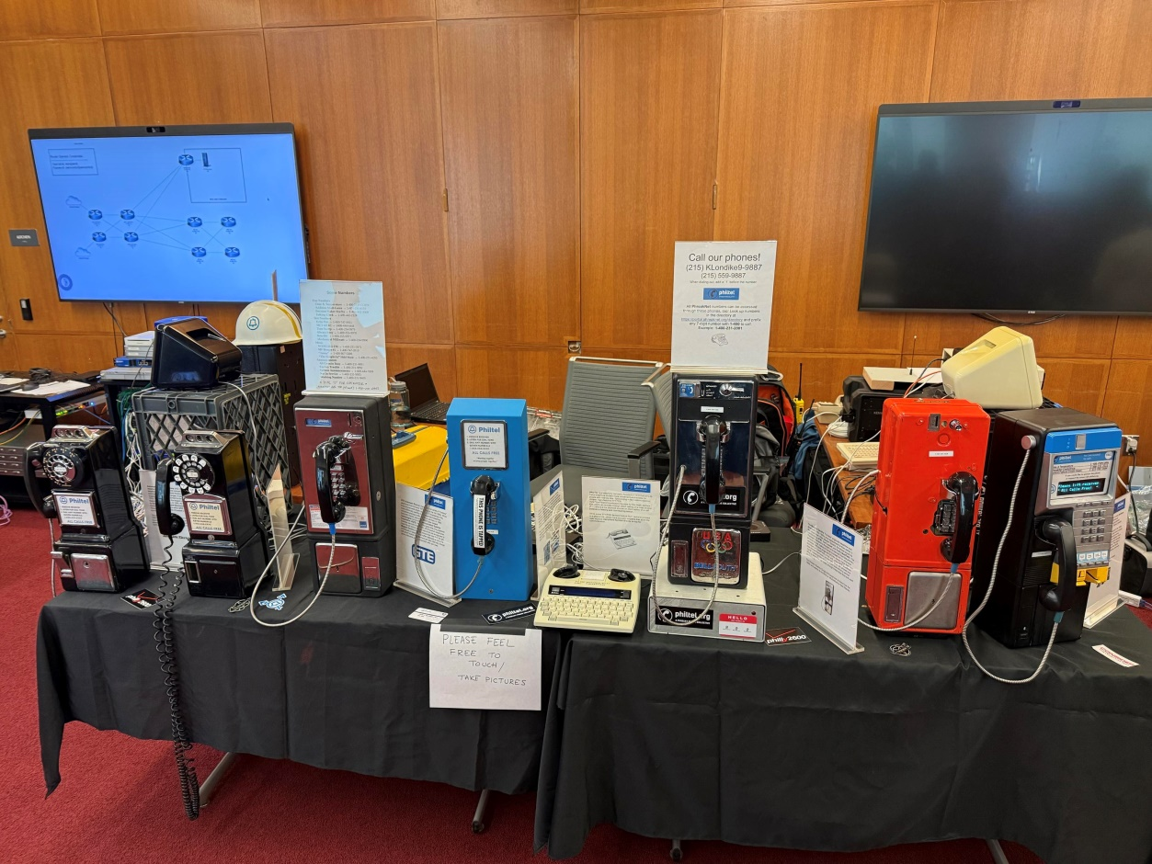
What Did We Learn?
People love to play with and are nostalgic for payphones

Slide 32
What Did We Learn?
Write everything down
  Good documentation shows your work is reproducible (and helps those starting out)
  You’ll use it yourself when you forget in a few months
  We keep a lot of documentation
    https://philtel.org/
    https://github.com/philtelco/philtel-docs
    https://payphone.club/ (work in progress)

Slide 33
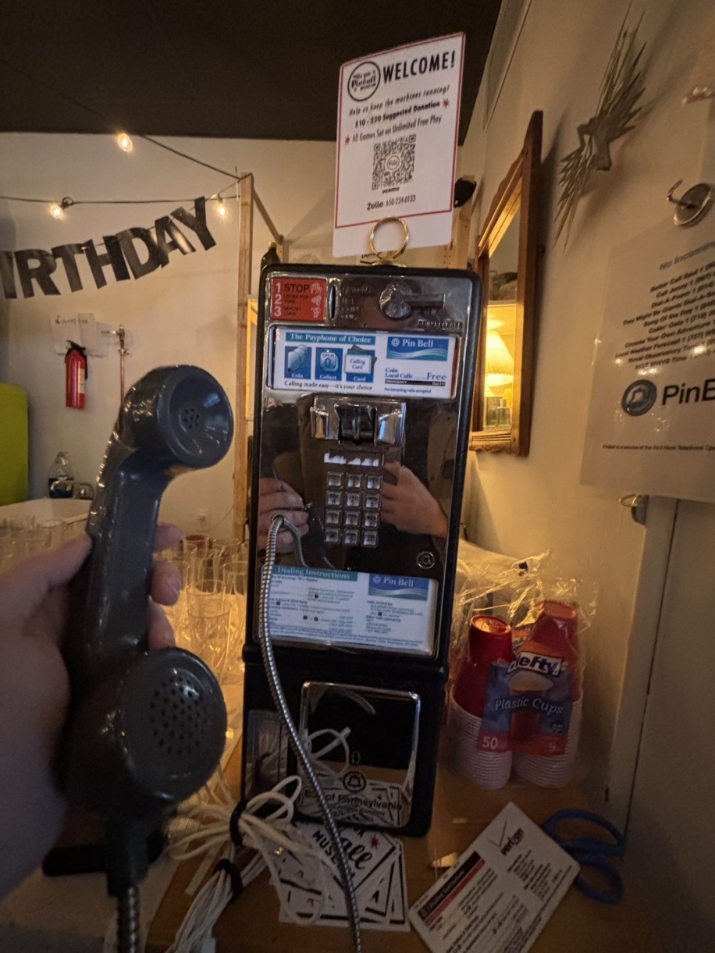
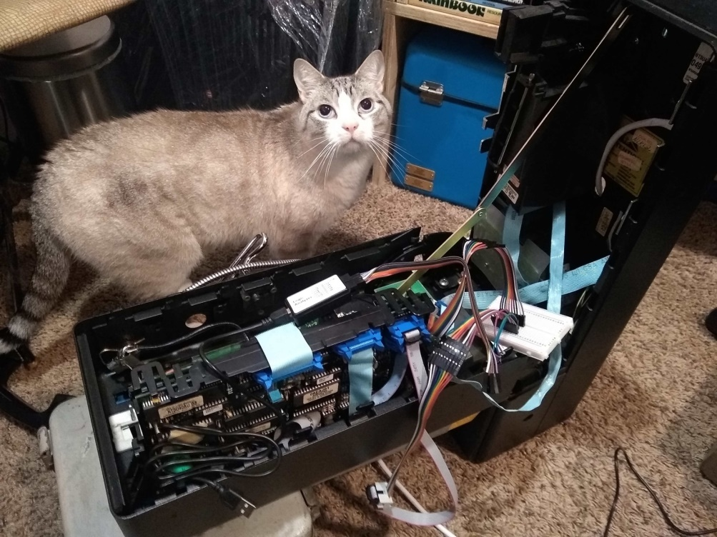
What Did We Learn?
Community is everything

Slide 34
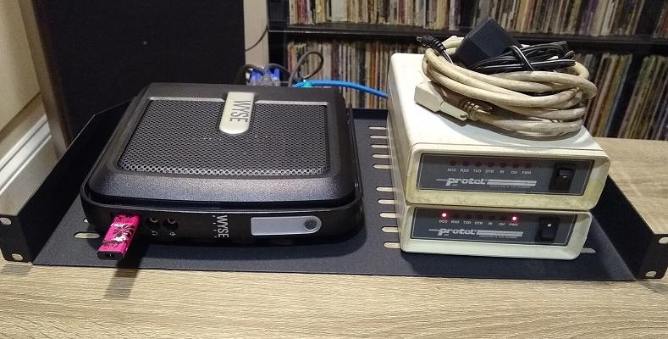
What Did We Learn?
Don’t let someone tell you something is impossible

Slide 35
Questions?
Mike
mike@philtel.org
Famicoman (Libera IRC)
https://famicoman.com
https://github.com/Famicoman
Naveen
interlinked@philtel.org
InterLinked (Libera IRC)
https://interlinked.us
https://github.com/InterLinked1
https://philtel.org/contact/
https://philtel.org/donate/
https://github.com/philtelco/philtel-presentations/

