Slide 1

Modem Madness!
Recent Experiments with Dial-up Modems

Slide 2
Agenda
Who are we?
Previously with Mike and Naveen
Modems? Dial-up?
Dialup World
Other modem offerings?
  NAPLPS-Server, Leitch Clock System Driver, Telecommunications Devices for the Deaf (TDDs)
State of dial-up today
  Dial-up war stories, multilink PPP
Future Efforts

Slide 3
Who are You?
Mike
Software engineer by trade, more excited when he can use a soldering iron
Has been doing weird VoIP stuff for 13 years
Roleplays as a telephone company
Notices every manhole cover he walks past
Naveen
Computer engineer with IT background
Longtime phone phreak
Scans payphones using modems
Created PhreakNet
Asterisk/DAHDI/C developer
BBS sysop
Environmental activist

Slide 4

Previously with Mike and Naveen…
PhilTel is a telephone collective aiming to install free-to-use payphones in the Philadelphia area
Mike created the “Protel Programming Line” so people with Protel payphones can freely call this service to make their payphone work again
Naveen runs NIPCAQ, a system that perpetually calls hundreds of COCOTs for health and usage statistics

Slide 5
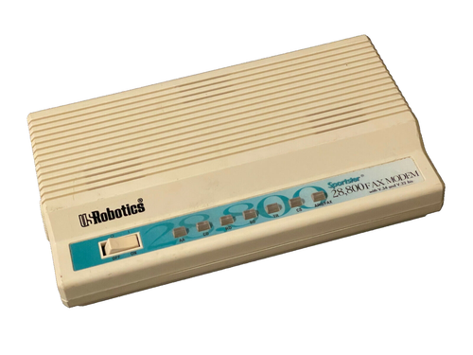
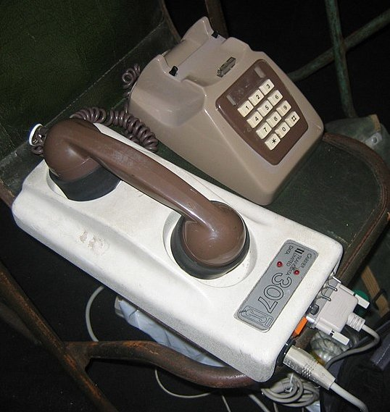
What is a Modem?
Modulator/Demodulator
A computer hardware device that converts data from a digital format into a format suitable for an analog transmission medium such as telephone or radio
They come in many forms

Slide 6
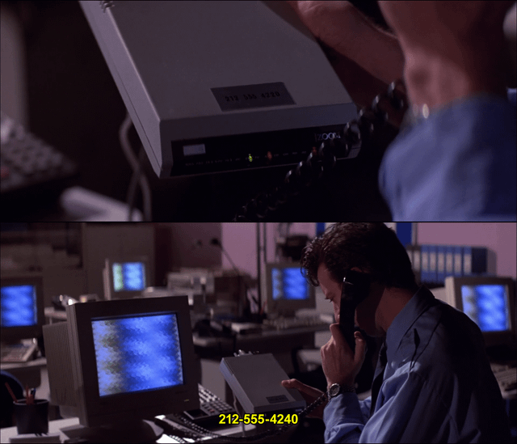
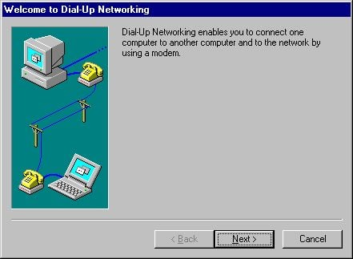
What is a Dial-up?
Transmit computer data over an ordinary switched telephone line that has not been designed for data use
Dial-up is often associated with Internet access, but can describe any way of accessing hardware/systems this way
In the ‘90s, millions of Americans had dial-up Internet access, utilized by 75% of households
Largely surpassed by broadband

Slide 7

What is a Dial-up?
Speeds are measured in bps (bits per second)
  You are probably used to speeds in Mbps or Gbps
Different speeds are usually associated with different standards
  Bell Standards, Bell 101 = 110 bps, Bell 103 = 300 bps, Bell 212A = 1200 bps
  ITU-T Standards, V.34 = 33.6K, V.90/V.92 = 56K

Slide 8
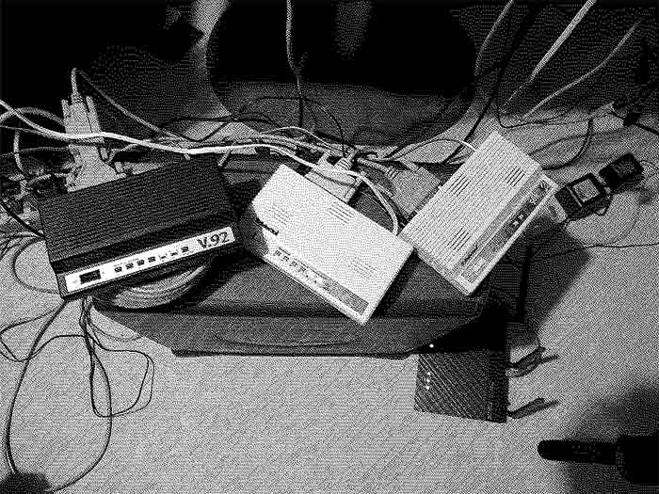
Dialup World
A pretty bad (but functioning) dial-up ISP – http://dialup.world
  Established 2021
  Essentially built on trash
  First iteration leveraged Server 2003 and Remote Access Service

Slide 9
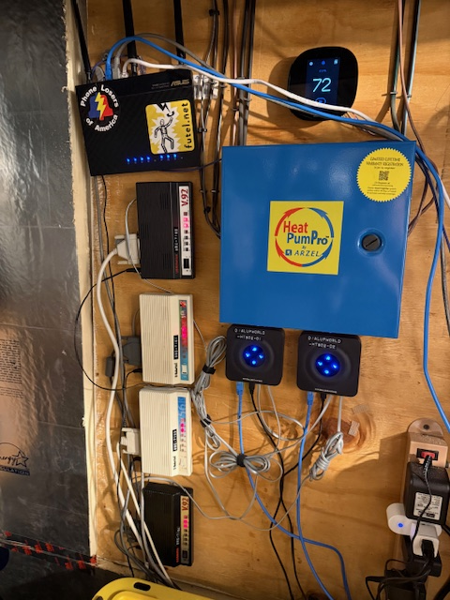
Dialup World
Currently runs on a Le Potato SBC with mgetty/pppd on Armbian
Based on the guide from Doge Microsystems - https://dogemicrosystems.ca/wiki/Dial_up_server
You can call it! 484-820-1337
33.6K speeds! (Limitation with analog-analog communication)
4x Sportster modems
Easter eggs

Slide 10

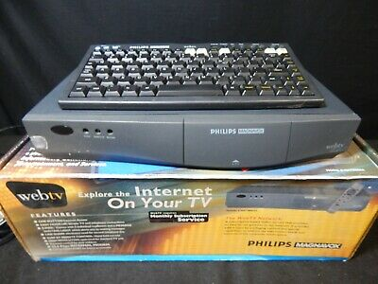
Dialup World
WebTV Compatible
  Connects to WebTV Redialed, an effort to reverse-engineer the original WebTV service - https://webtv.zone/
  Works automagically with your old WebTV

Slide 11
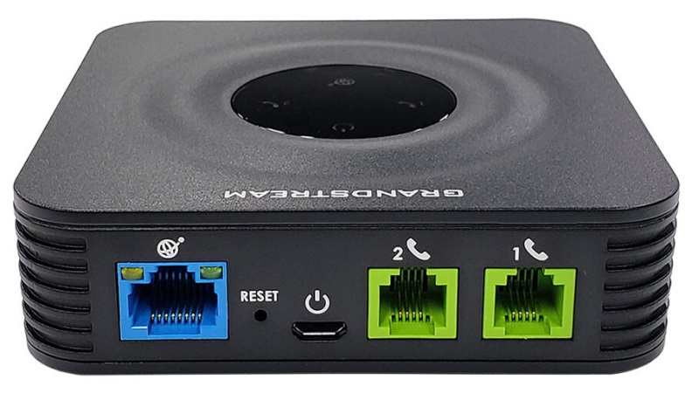

Dialup World
How does it connect to the PSTN?
  VoIP number through Voip.ms
  Grandstream ATAs to an Asterisk switch
You can use a VoIP provider and ATAs for dial-up?!?
  Yes, it works!
  Force ulaw (G.711) codec
  Set fixed jitter buffer, low
  Turn off echo cancellation

Slide 12
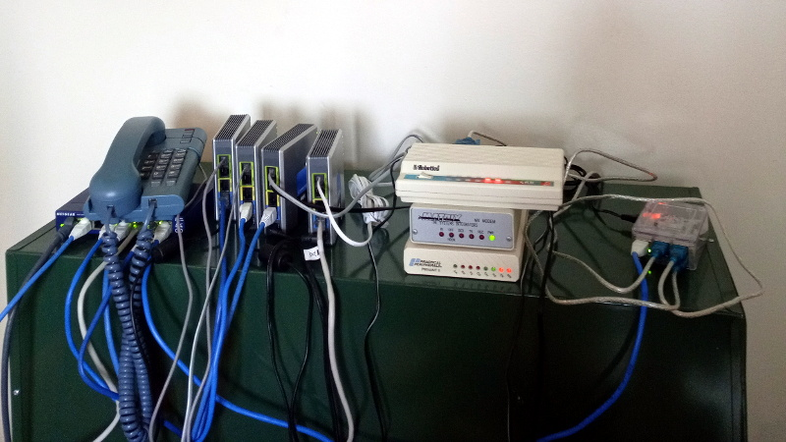
Dialup World
There’s renewed interest in Dial-up and vintage enterprise networking
  @theserialport, @clabretro on YouTube
  DosLab - https://dialin.doslabelectronics.com/
  2600.network - https://2600.network/

Slide 13

What else can we run?

Slide 14
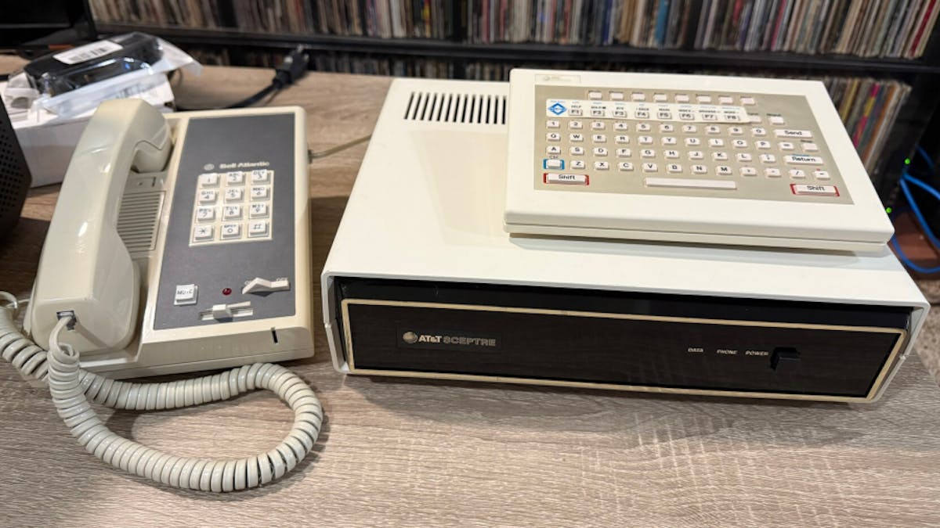
AT&T Sceptre
An 80’s videotex terminal that supports NAPLPS (North American Presentation Layer Protocol Syntax), used for ~3 years
Originated from the Canadian Telidon Service

Slide 15
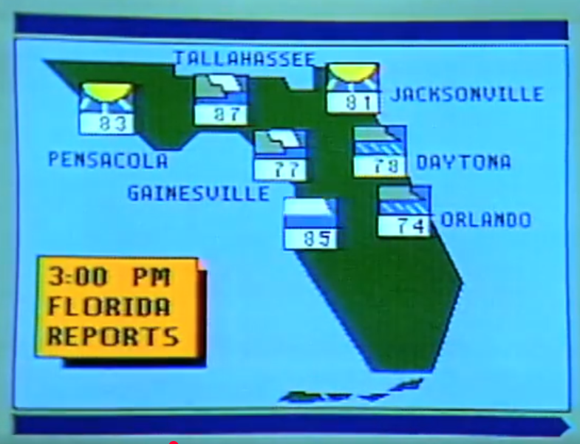
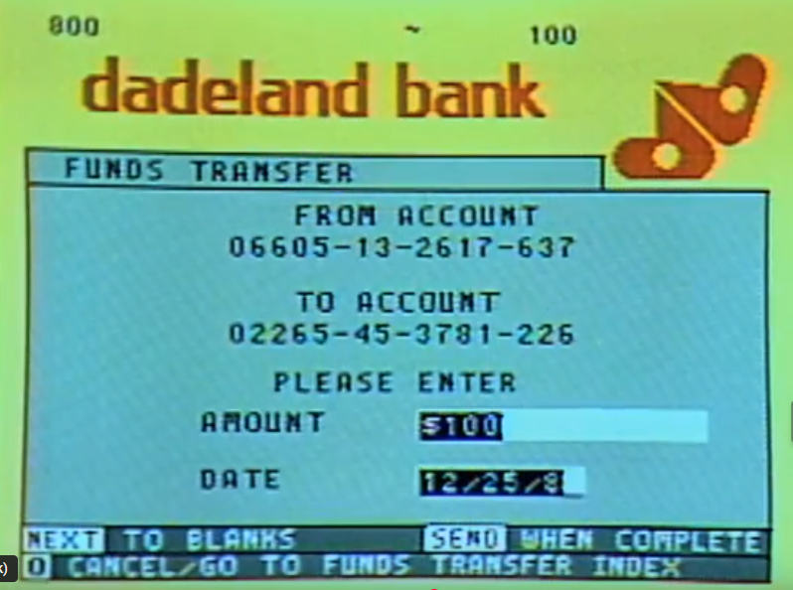
NAPLPS
A vector graphics format, used often as a GUI
NAPLPS services often had a lot of interactivity such as online banking, flight booking, weather reports, and news

Slide 16
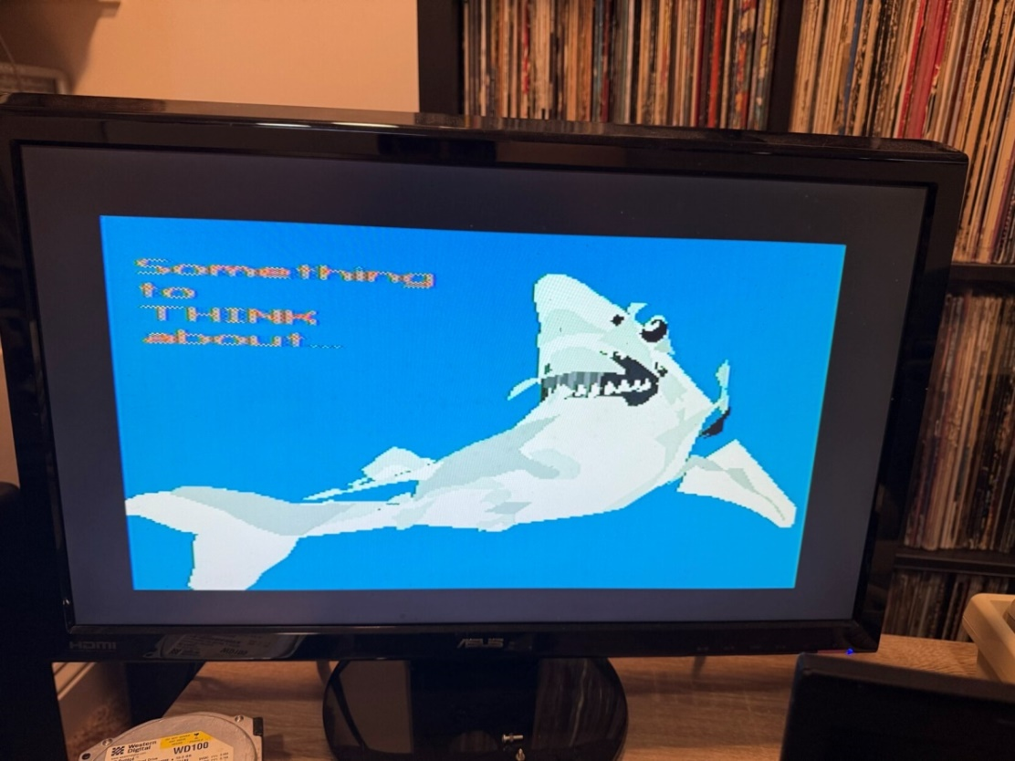
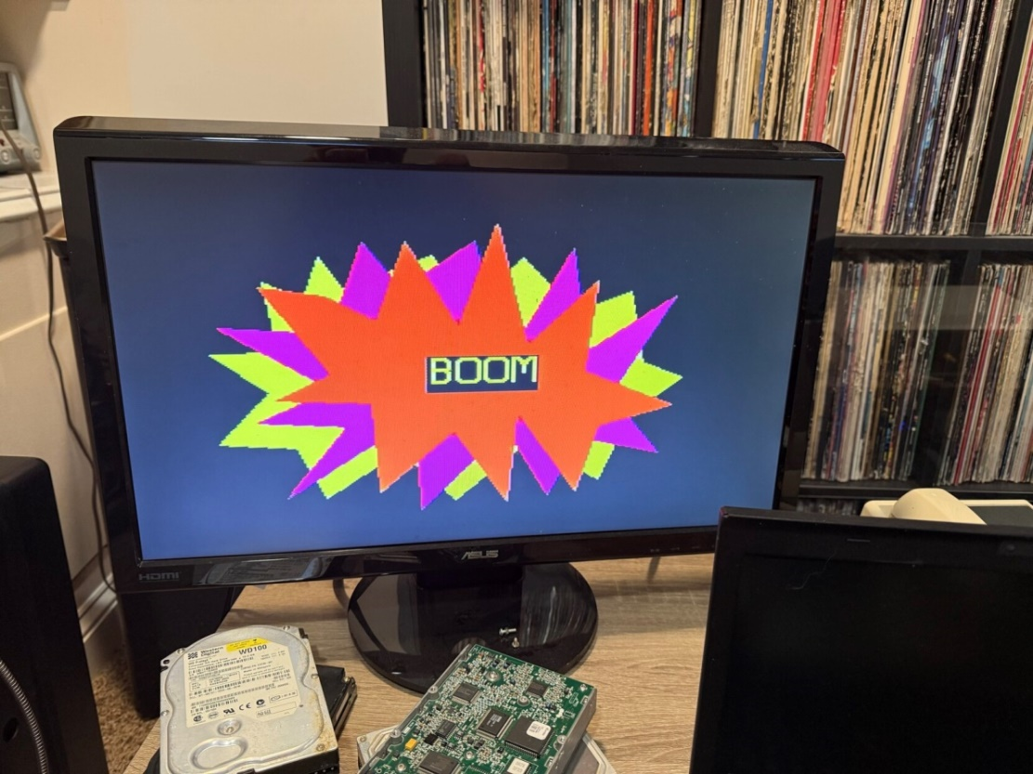
NAPLPS-Server
I wrote a python application that interfaces with a modem to answer incoming calls and send NAPLPS file contents byte-by-byte
The code is OSS - https://github.com/dialup-world/naplps-server
There’s a live demo number: 267-921-1337

Slide 17
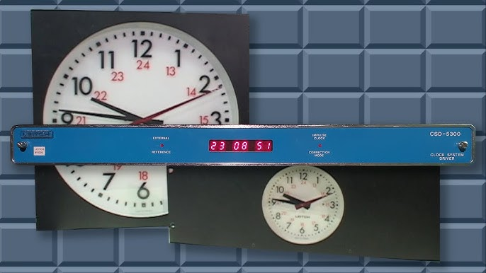
Leitch CSD-5300 - Clock System Driver
1985 device supplying time code for slave clocks, broadcast equipment, etc.
Learned about this via @themaritimegirl on YouTube
The CSD-5300 can call another CSD-5300 via 300 baud modem to set its own time

Slide 18
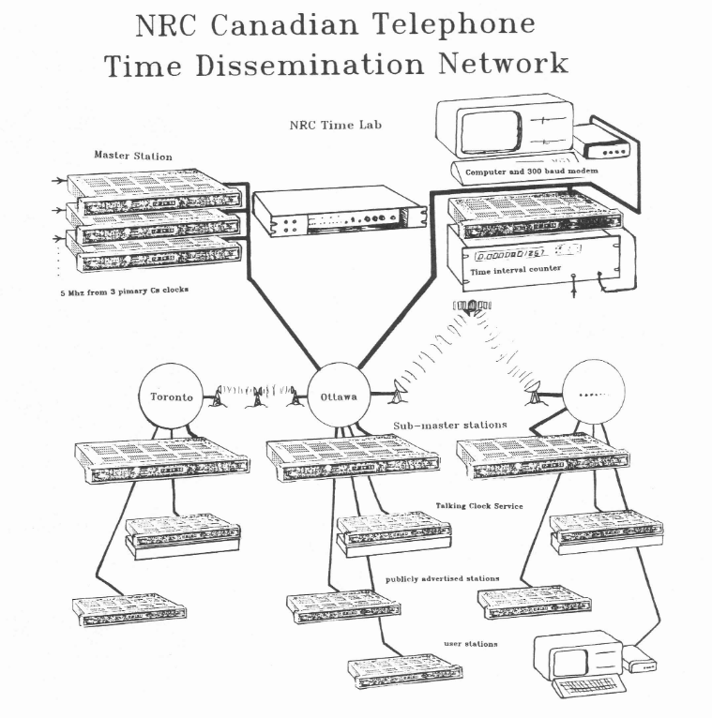
Leitch CSD-5300
The National Research Council of Canada still runs CSD-5300s to call for time
  (613) 745-3900
The NRC proposed a Telephone Time Dissemination Network in the ‘80s that never came to fruition
Different than the NIST’s ACTS
  (303) 494-4774 (CO)
  (808) 335-4721 (HI)

Slide 19
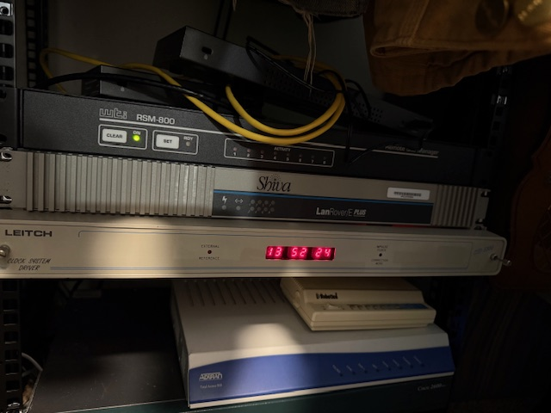
Leitch CSD-5300
My CSD-5300 takes calls, 267-417-TIME (8463)
Other than the NRC, @themaritimegirl and I have the only publicly-accessible CSD-5300s operating
Finally time for a Telephone Time Dissemination Network?

Slide 20
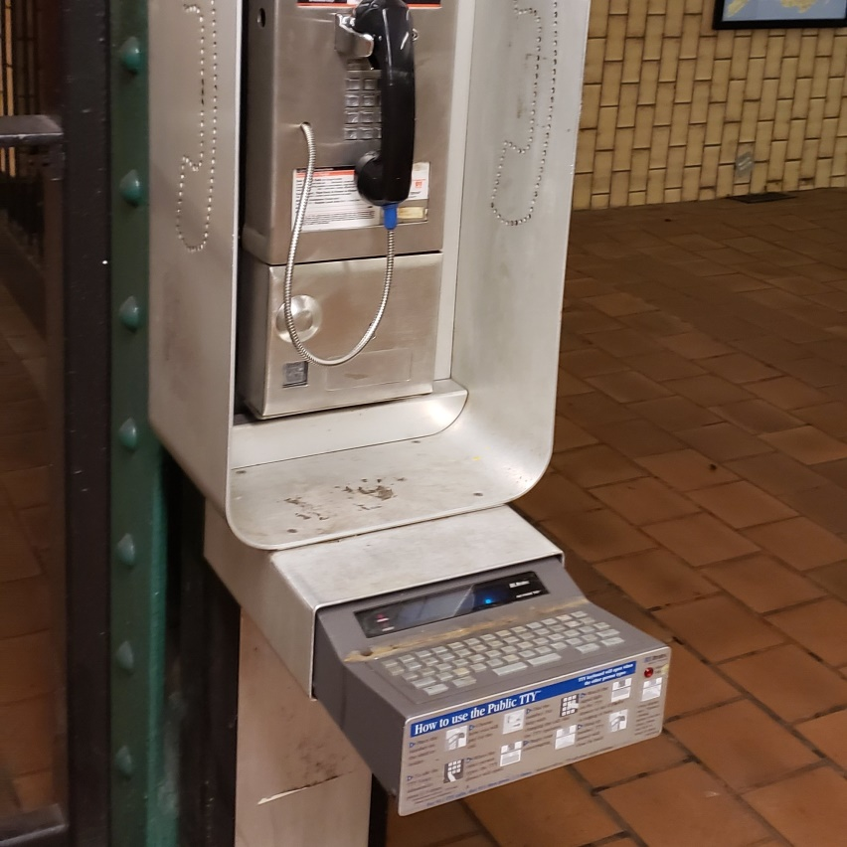
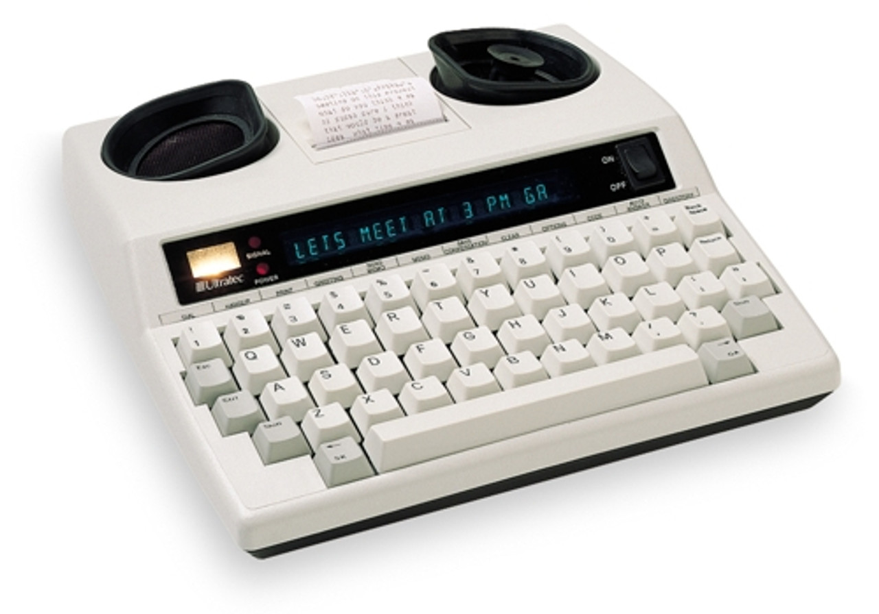
Telecommunications Devices for the Deaf
Electronic device for text communication over a telephone line, that is designed for use by persons with hearing or speech difficulties
Also known as a Teletypewriter (TTY)
Uses baudot code at either 45.45 or 50 baud (just like RTTY)
Have screens, printer, full keyboard

Slide 21
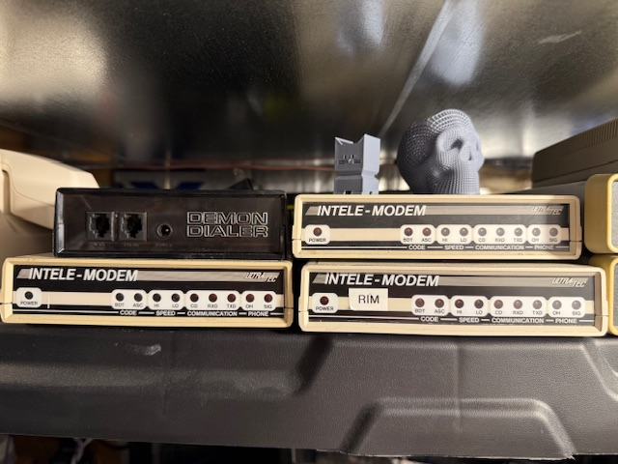
Telecommunications Devices for the Deaf
Baudot-compatible modems do exist!
Pricey/expensive, somewhat hard to find
Not reliable, all of mine have issues

Slide 22
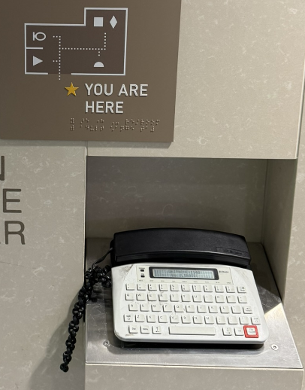
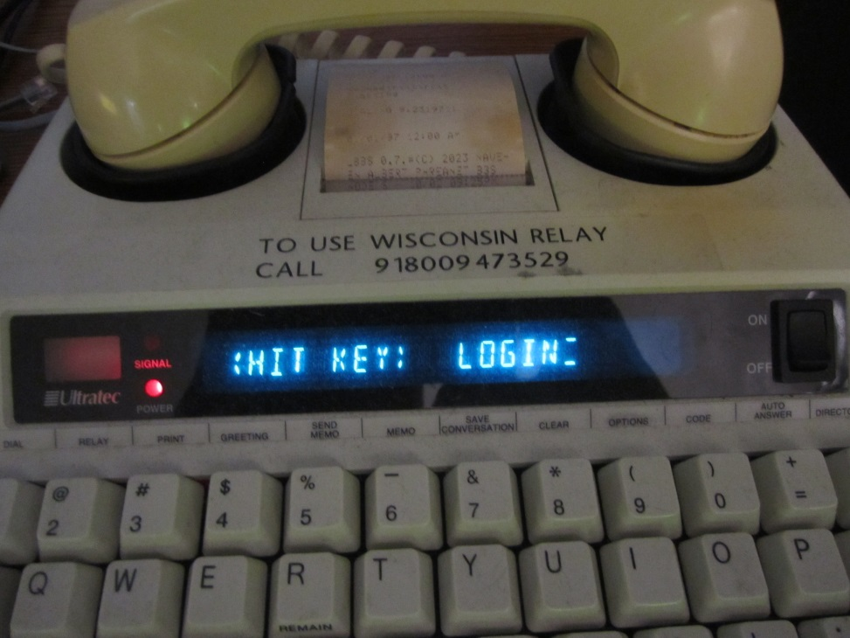
TDDs as Terminals
TDDs are just compact computer terminals!
Common in many airports
Supported by Asterisk Softmodem
(301) 301-1337

Slide 23
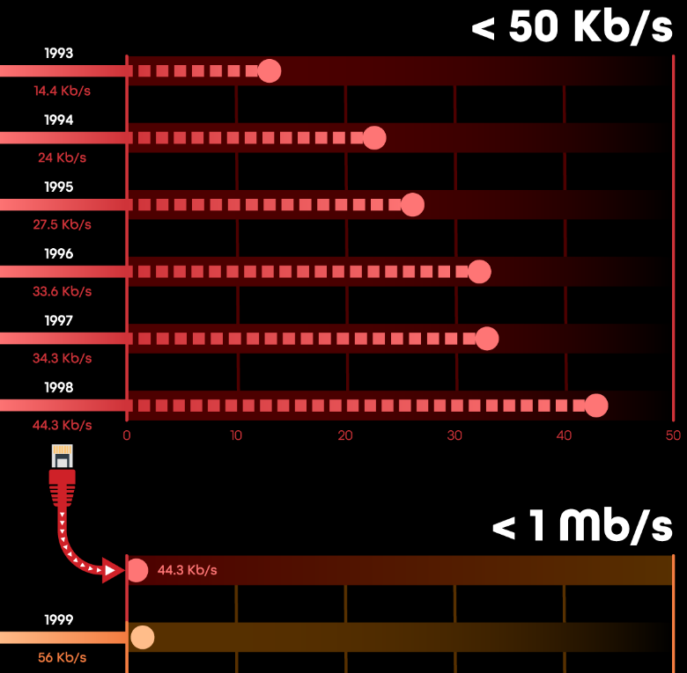
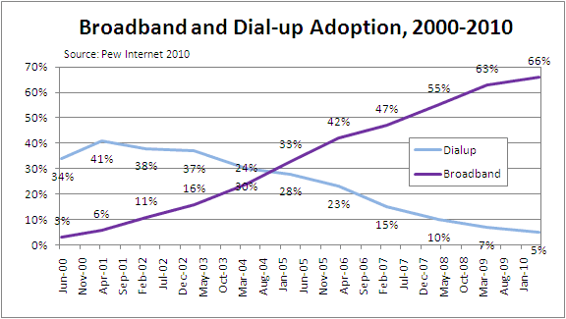
Dial-Up Internet Access
Modem connection to an ISP, as opposed to a “direct dial” link
56k not common until the end of the 90s

Slide 24



Dial-Up… In the 2020s?
Still common in areas unserved by broadband
Sometimes chosen for its cost-effectiveness
Every dial-up ISP resells the same wholesale provider

Slide 25
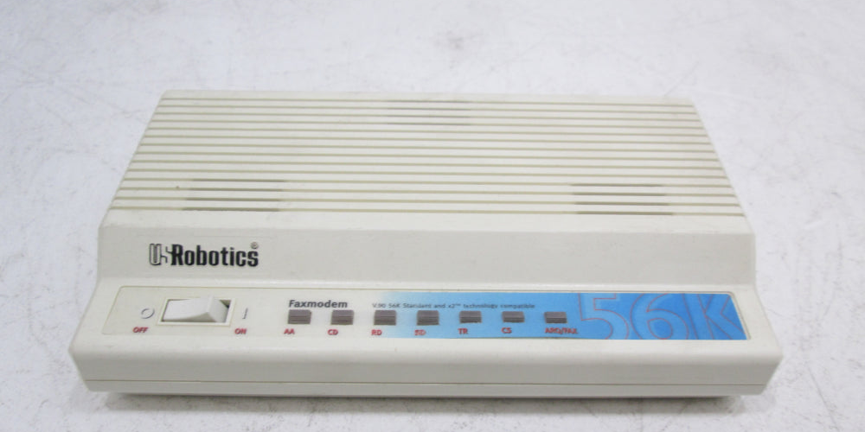
Dial-Up Speeds Today
TONIGHT WE’RE GOING TO PARTY LIKE IT’S 1999

Slide 26
That Darn “33.6k Cliff”
TONIGHT WE’RE GOING TO PARTY LIKE IT’S 1996

Slide 27
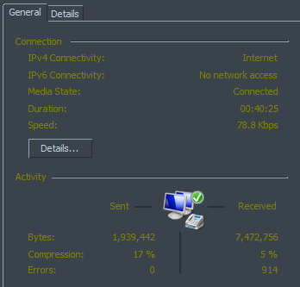
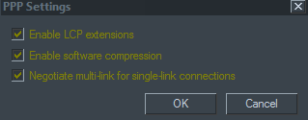
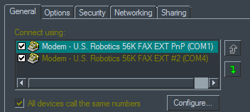
Multilink PPP
Bundles bandwidth from multiple phone lines together
Requires support by the ISP to bundle concurrent sessions
Also called “bonding”

Slide 28
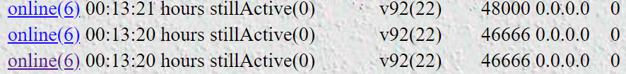
“High-Speed Dial-Up” - A True Story From 2021
One of my users ordered some “extra” phone lines for multilink
8 total POTS line, 7 for dial-up = (up to) ~350 kbps!
324.5 kbps with seven lines connected!
It says I’m getting 349.1 kbps on the PC connection status
It definitely feels faster- literally like high speed dial up It’s great- amazing what is possible - most everything is much more manageable.

Slide 29
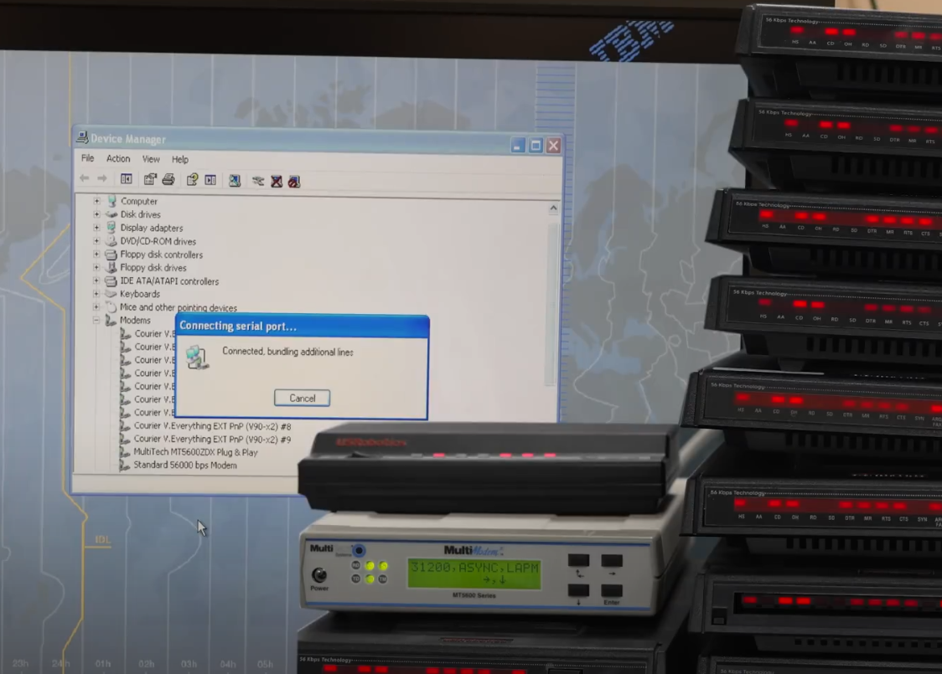
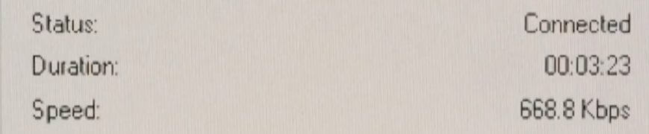
So, how many lines can you bundle?
https://www.youtube.com/@theserialport

Slide 30
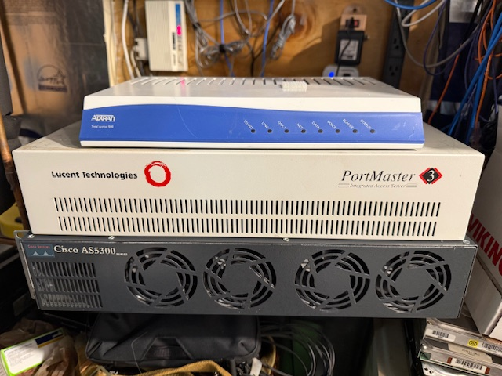
Future Plans
Does 56K work over VoIP? Yes, but it is more difficult
  We can leverage TDM equipment and digital modems
  There are a number of options!
Evaluate dial-up as a primary Internet connection

Slide 31

Questions?
Mike
mike@philtel.org
Famicoman (Libera IRC)
https://famicoman.com
https://github.com/Famicoman
Naveen
interlinked@philtel.org
InterLinked (Libera IRC)
https://interlinked.us
https://github.com/InterLinked1

