Slide 1
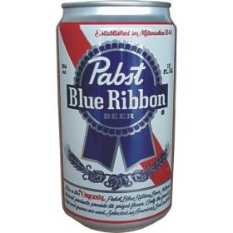
Adventures in Hipster Programming
In which we speak of obscure things like NPR quizzes, Genetic Algorithms and Ocaml
OSBridge 2012
Phil Tomson
@philtor
Notes:
When I tweeted my success, some wag replied: “If that isn't programming hipsterism, I don't know what is”

Slide 2
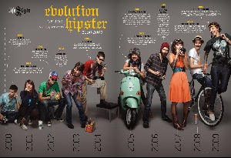
Notes:
Obligatory Hipster slide

Slide 3
Wait, what is “hipsterism” anyway?
If there's a lot of awareness about something, it's probably not “hipster” anymore.

Slide 4
Wait, what is “hipsterism” anyway?
A wise man once said “There's nothing new under the sun”, but there are new ways of combining old things and ideas – that seems to the essence of “hipsterism”.

Slide 5
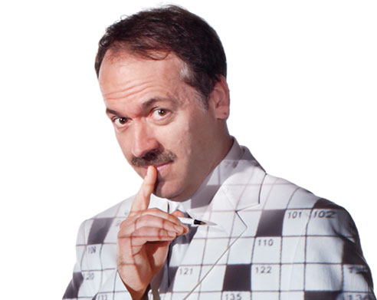
The Puzzle
Given the digits 1 through 9:
The object is to use the following arithmetic operations: addition, subtraction, multiplication and division, in a line from 1 to 9 to get 2012 exactly. The operations should be performed in order from left to right. Digits can be concatenated meaning there is a concatenation operator.

Slide 6
Example for 2018:
12 x 34 x 5 + 67 – 89 = 2018

Slide 7
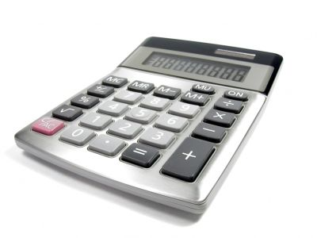
The Operations
Addition
Subtraction
Multiplication
Division
Concatenation of digits

Slide 8
Genetic Algorithms
A search heuristic that mimics natural evolutionary processes
Generates solutions to search & optimization problems using biologically inspired techniques such as inheritance, mutation, selection and crossover.

Slide 9
GA Components
Representation of the chromosome
Fitness function
Population
Method of selecting parents of next generation
Reproduction operators
Mutation

Slide 10

Lots of room for creativity

Slide 11
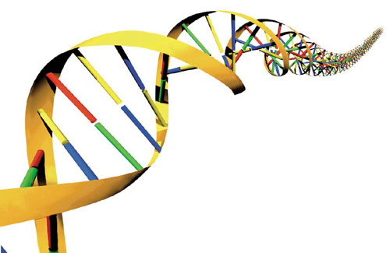
Chromosome representation
Simple string composed of eight operators, for example: “CC+-*/CC”
translates to:
123+4-5*6/789
(actually, in our case we'll use a list of strings)

Slide 12
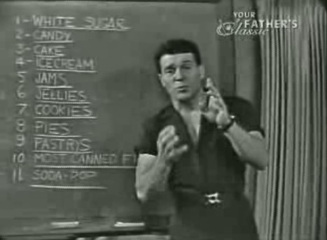
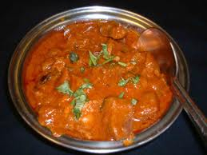
Fitness Function
Difference from 2012 (absolute value)
let target = 2012
let delta t n = abs (t - n)
let delta_target = delta target

Slide 13
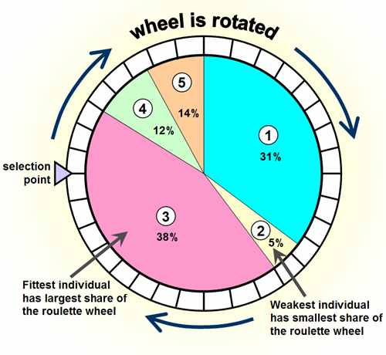
Selection Methods
Tournament
Roulette wheel selection (random proportional)

Slide 14
Tournament selection
tournament_selection n population
parents = []
do {
choose two random members of population
add the member with the highest fitness to parents list
} until parents.size == n
return parents

Slide 15
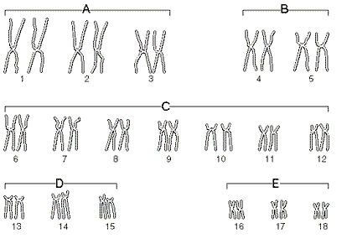
Reproduction operators
Crossover
(Lots of room for creativity)

Slide 16
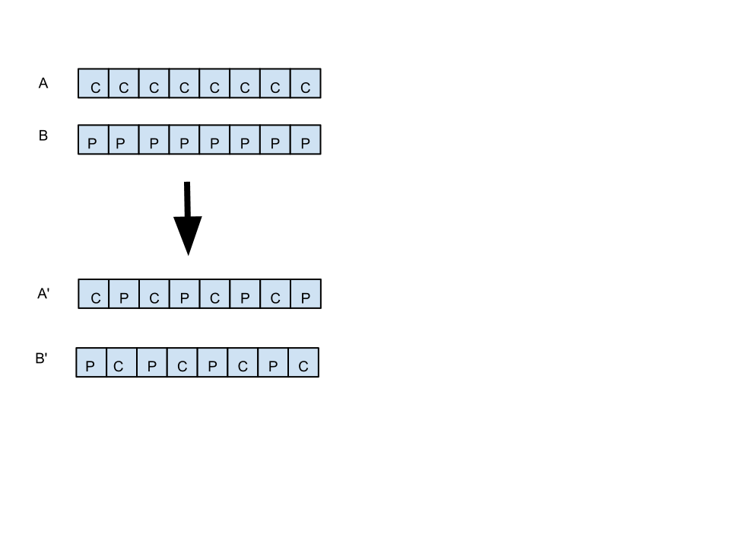
Crossover

Slide 17

A few words about diversity

Slide 18
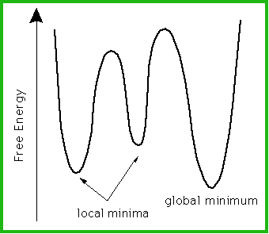
If the population converges too quickly, the GA can get stuck in a local minimum

Slide 19
Keeping our population diverse
population = gen_random_pop( 24 )
run_generations(num_gens) {
while( num_gens > 0 ) {
sort population by distance from target
best = population[0]
if best == target then report and exit
new_parents = tournament_selection( population.size/2,
population )
population = cross parents and choose best of each cross population.push( gen_random_pop( population.size/2 -1))
population.push best // elitism!
num_gens= num_gens - 1
}
report the best individual since target wasn't found
}

Slide 20

Oh, Ocaml, that's what we're writing this in right?
A multi-paradigm (functional, OO, imperative) programming language in the ML family.
Kind of obscure.

Slide 21
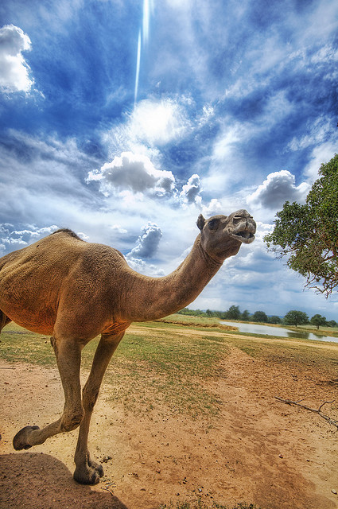
Ocaml features
First class functions & modules
Very nice module system (functors – not to be confused with C++ or Haskell functors – parameterized modules)
Not “pure”, has references
Not lazy by default (laziness optional)

Slide 22

Let's look at some code

Slide 23

Oh, wait: the Epilog
The search space isn't all that big. 5^8= 390625

Slide 24


Slide 25

WWYMWYTD?

Slide 26
Now run the C code...

Slide 27
Write it in C!
(and no fancy-pants GA!)

Slide 28
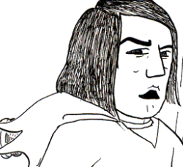
WWWTLSD?

Slide 29
Have fun and learn stuff
Resources:
Ocaml tutorial: http://mirror.ocamlcore.org/ocaml-tutorial.org/
Code in this talk: http://mirror.ocamlcore.org/ocaml-tutorial.org/
GA intro: http://www.obitko.com/tutorials/genetic-algorithms/index.php

