Slide 1
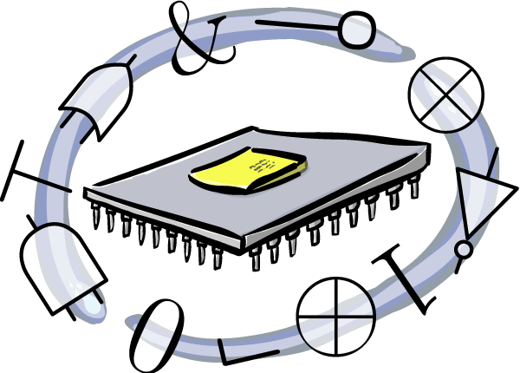
Getting Started with FPGAs and HDLs
Phil Tomson @philtor
OSBridge 2011

Slide 2

From Everest...

Slide 3
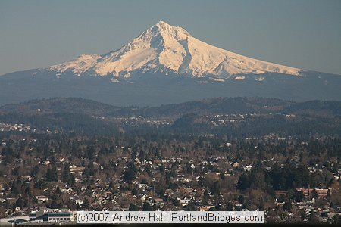
...To Mt. Hood in 45 minutes

Slide 4
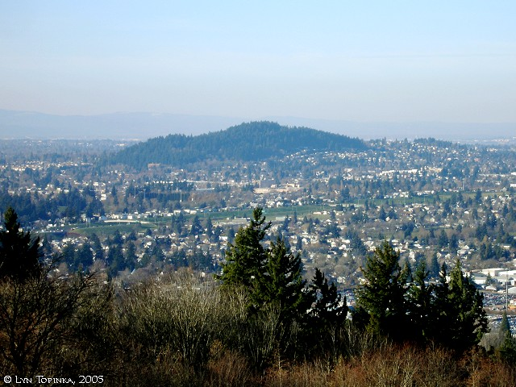
Maybe Mt. Tabor? (we'll see)

Slide 5

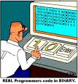


What's an FPGA?
Field
Programmable
Gate
Array

Slide 6

What's an FPGA?
Field
Programmable
Gate
Array

Slide 7

What's an FPGA?
Field
Programmable
Gate
Array

Slide 8
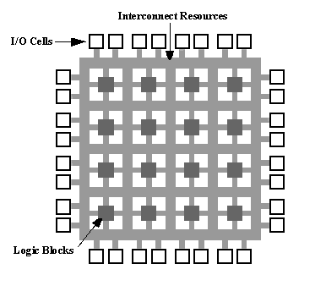
A simplified FPGA

Slide 9
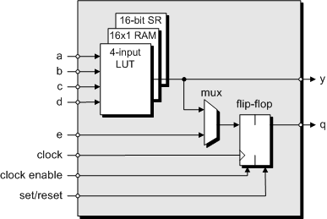
Logic Block
Look up table (LUT). A LUT with 4 inputs can implement (2^2^4)-2 (65534) different functions.
Notes:
A flip flop is a one-bit memory element
A mux is a sort of switch that can sellect between two different inputs.

Slide 10
So why would you want to use an FPGA anyway?
Fast
Affordable (starter kits sell for $99)
Flexible
Notes:
Fast as in capable of doing things you could never do with an arduino, for examle (DSP, FFT, etc)

Slide 11
Yeah, OK, but what would I do with one?
DSP – (Digital Signal Processing) they're fast enough.
Graphic processing
Finite State Machine to control your robot
Custom CPU
High Performance Computing (HPC)
Custom Logic

Slide 12
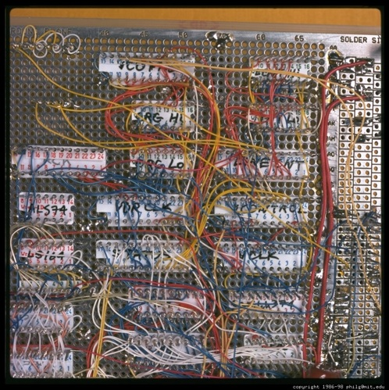
In the past hobbyists would wire-wrap discrete logic chips together...

Slide 13
A word about GPUs since we mentioned “HPC”
Great for vector operations
  But if your problem isn't a vector operation... FPGAs are a lot more flexible.
Fine if you've got a computer handy...
  But they're not really usable “stand alone” whereas FPGAs can be.

Slide 14
Who makes FPGAs?
Altera
Xilinx (we'll focus on these)
Lattice
Actel – antifuse based (can't reprogram)
QuickLogic - “
Tabula (startup – on-the-fly reconfigurability watch these guys)

Slide 15
What's the process for creating an FPGA design?
Describe the design in HDL (Hardware Description Language, such as VHDL or Verilog)
Simulate HDL code using a simulator to ensure it functions “correctly”
Synthesize the HDL code (proprietary tool)
Place and route → bitstream (proprietary tool)
Download bitstream to FPGA (Open source tool! XC3Sprog)
Notes:
Simplify this slide

Slide 16
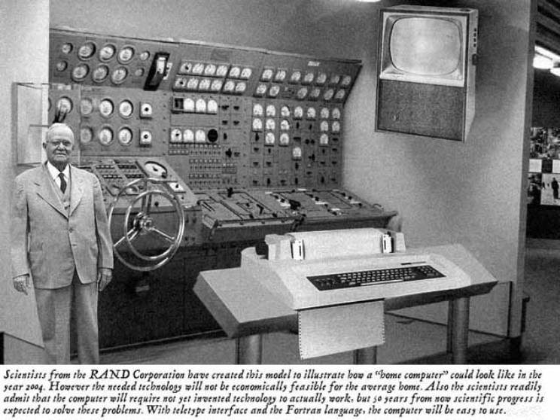
And before you know it...

Slide 17
HDLs?
Hardware Description Languages
Verilog (we will not mention this one again)
VHDL (the preferred one ;-)
  Higher level of the two
  Can define your own types which allows higher levels of abstraction.
  Very strictly typed.
RHDL – Ruby Hardware Description Language. Well, you can't do a lot with it, to be honest, but it's a good way to learn HDL concepts.
Notes:
Can't define new ypes in Verilog
Wishy washy C-like typing

Slide 18
Simulation?
Simulation is where you “debug” your HDL code.
You simulate your HDL description using a simulator like Icarus, GHDL or ModelSim.
Simulation is used to determine if your design works correctly prior to going to the Synthesis step. (not as critical for FPGAs as it was for ASICs, but still a good idea)
Notes:
Analogous to debugger in software

Slide 19
Synthesis?
Synthesis is the process of transforming your textual (HDL) description of your design into low-level building blocks (gates, logic cells) that implement your design in the target device.
Analogous to compilation on the software side.

Slide 20
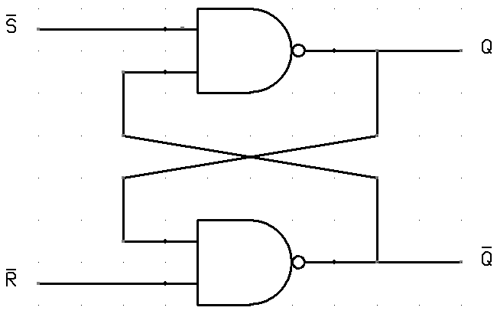
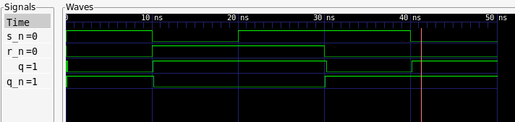
Simulation vs. Synthesis
Behavior
Structure
Do
Be

Slide 21
HDLs are programming languages where everything can happen at the same time.

Slide 22
We're trying to model (or describe) hardware and hardware is highly concurrent.
Notes:
HDLs have aspects of dataflow languages

Slide 23
Think of each gate as a simple little processor

Slide 24
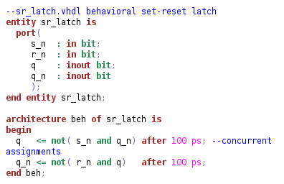

Slide 25
sr_latch simulation waveforms

Slide 26
Wait, so how'd you get that waveform?
By simulation.
But first you have to make a “test bench”
Which is kind of like a unit test.
NOTE: the test bench isn't part of your design, it just exercises your design.
(note to presenter: gvim tb_sr_latch.vhdl )

Slide 27
Using GHDL to simulate
Analyze the sr_latch design:
ghdl -a sr_latch.vhdl
Analyze the testbench:
ghdl -a tb_sr_latch.vhdl
Elaborate the toplevel design:
ghdl -e tb_sr_latch
Run simulation & capture waveforms:
ghdl -r tb_sr_latch --vcd=sr_latch.vcd

Slide 28
Compiling the ca_1d design
ghdl -a --ieee=synopsys -fexplicit kbinterface.vhd
ghdl -a --ieee=synopsys -fexplicit SevenSegment.vhd
ghdl -a kb_tb.vhd
ghdl -e --ieee=synopsys -fexplicit kb_tb
ghdl -r kb_tb --vcd=kb_tb.vcd

Slide 29
Using GTKWave to view the waveforms
Open gtkwave on the vcd file:
gtkwave sr_latch.vcd
You'll have to drag the signals you're interested in over to the “Signals” pane which is to the left of the waveform window.
You'll also need to zoom out a lot before you see anything intersting.
Note to presenter: demonstrate gtkwave

Slide 30
Simulation details
The simulator has a concept of simulation time
The simulation cycle has two phases:
  Signal update phase (sim time is advanced to next transaction time; values of all pending transactions scheduled for this time are applied to their corresponding signals)
  Process execution phase (processes sensitive to events at this time are resumed)
Transactions (like assignments) are scheduled

Slide 31
Simulation vs. Synthesis context
“after 100 ps” means nothing in synthesis, but the simulator does use this information.
Test benches generally aren't synthesizable (file access, TextIO, etc)
Remember, the test bench isn't part of your design, it just tests your design.
Notes:
Simulation: behavior, waveform (pics)
Synthesis: gates and connections

Slide 32
Another example which shows a process and a concurrent assignment.
This example design counts '1's in a serial data stream.

Slide 33
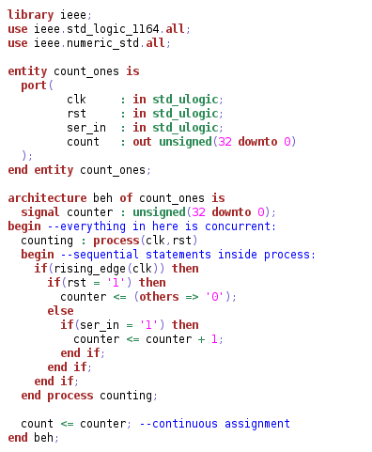

Slide 34
Synthesis tool details
For Xilinx FPGAs use the ISE Design Suite. A free version is available from:
http://www.xilinx.com/support/download/index.htm

Slide 35
Xilinx ISE IDE Quick Overview
Synthesize
Place & Route
Generate bitstream
Download bitstream to FPGA

Slide 36
A word about math
Prefer fixed point to floating point (area concerns)
Division by power-of-2 constant is OK ( n/4 → shift by 2)
  Use a divider core for other divisor values
See VHDL Math Tricks in Resources

Slide 37
Resources
VHDL booK: The Designer's Guide to VHDL by Ashenden
VHDL tutorial:http://www.seas.upenn.edu/~ese201/vhdl/vhdl_primer.html
GHDL: http://ghdl.free.fr
Gtkwave: http://gtkwave.sourceforge.net/
Xilinx ISE Synthesis tool: http://xilinx.com
VHDL math tricks http://www.synthworks.com/papers/vhdl_math_tricks_mapld_2003.pdf
RHDL: http://github.com/philtomson/RHDL
Opal-Kelly FPGA prototyping boards: http://opalkelly.com

Slide 38
More Resources
FPGAs for fun: http://www.fpga4fun.com
http://opencores.org
Newsgroup: comp.arch.fpga
FPGA boards:
http://www.digilentinc.com
Forth Processor in VHDL: http://www.ultratechnology.com/4thvhdl.htm
This presentation: https://github.com/philtomson/fpga_pres
Example code: https://github.com/philtomson/OSBridge_code

Slide 39
Questions?

