Slide 1
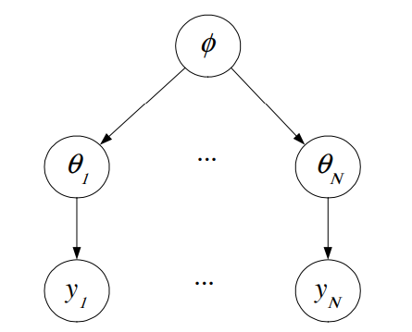
Normal Hierarchical Models
Statistics Foundations
Jorge III Altamirano Astorga
Ángel Rafael Ortega Ramirez

Slide 2
Abstract
The basic idea in a hierarchical model is that when you look at the likelihood function, and decide on the right priors, it may be appropriate to use priors that themselves depend on other parameters not mentioned in the likelihood. These parameters not mentioned in the priors, which themselves may (or may not) depend on new parameters. Eventually the process terminates when we no longer introduce new parameters.
Astrostatistics Program. Cornell University (2006).

Slide 3
Motivation – Introduction
Many stat applications involve hierarchical data, so hierarchical models are more appropriate, as it’s possible to structure some dependence.
Having insufficient parameters, they tend to overfit.
Can be used for “meta-analysis”: used for research in order to understand a relationship between different related experiments.

Slide 4
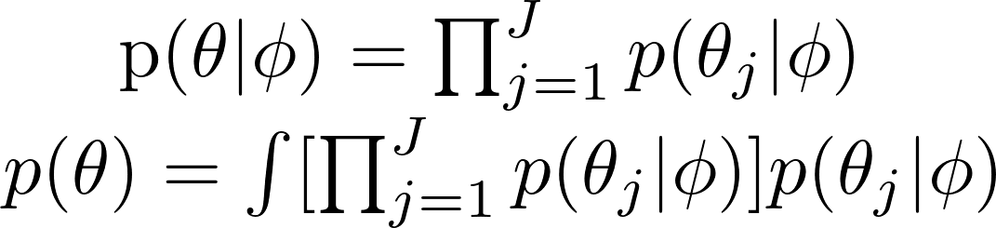
Hierarchical Models
Some authors coin the term Empirical Bayes to the analysis using the data to estimate prior parameters.
Exchangeability: if no information is given to distinguish any of the θj. Then, no order or grouping of the parameters can be made. Ignorance of this info implies exchangeability.

Slide 5
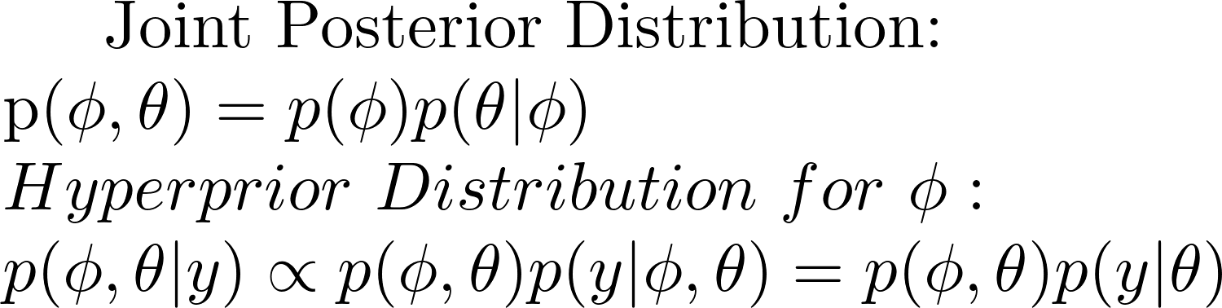
Hierarchical Models
May use a diffuse distribution, if little is known.
Should result in a posterior dist. that is proper.
Should at least constrain the hyper params into a finite region.

Slide 6
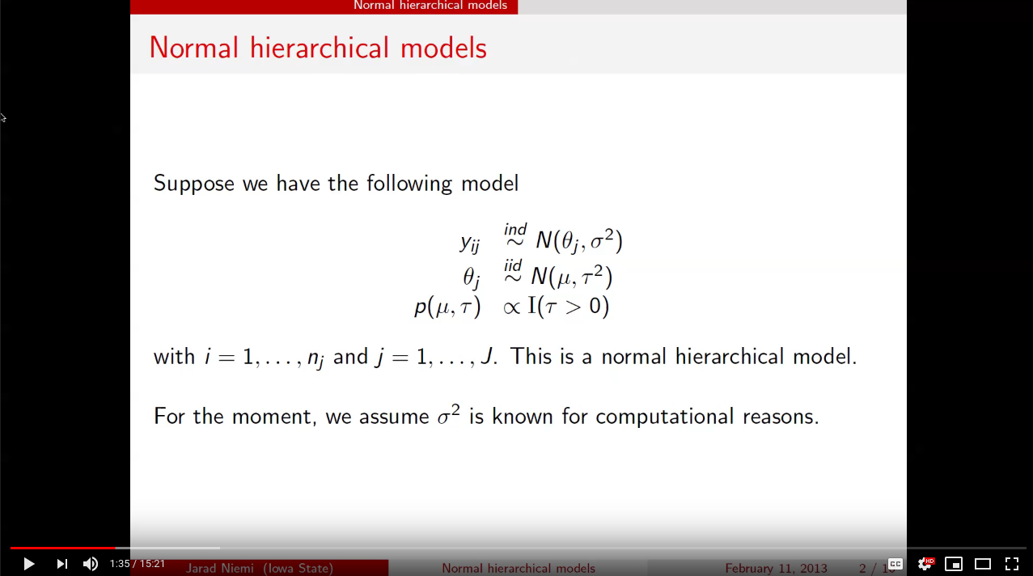
Normal Hierarchical Models

Slide 7
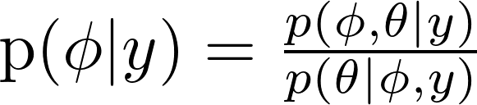
Hierarchical Normal Distributions
The marginal posterior distribution of ɸ can be computed algebraically using the conditional probability formula.
The denominator has a normalizing factor that depends on ɸ and θ: this is the difficult part, as it depends on ɸ, y.
Care must be taken to make sure that the proportionality constant (denominator) is actually a constant.
Many times, a conjugate hierarchical scheme assumes normal sampling and normally distributed latent effects.

Slide 8
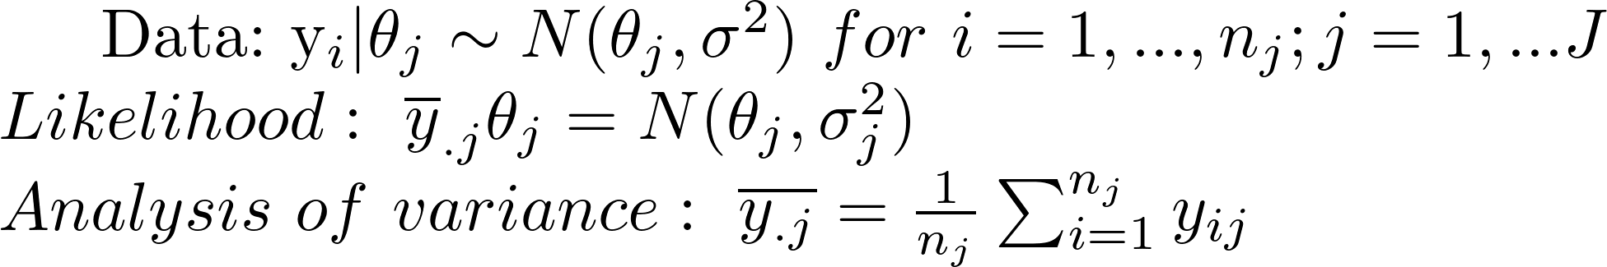
Estimating an Exchangeable Set of Params for a Normal Model
We will show a simple normal hierarchical model: one way normal random effects model.
Different mean for each group or experiment.
Known variance, this assumption can be an adequate approximation at the sampling level.
.

Slide 9
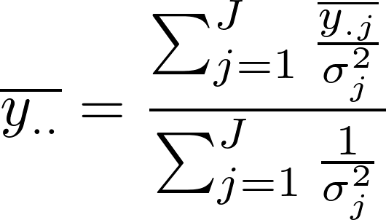
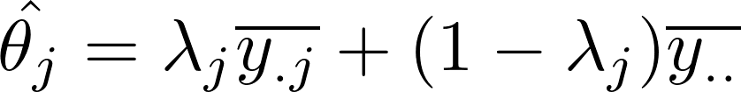
Estimating an Exchangeable Set of Params for a Normal Model
Pooled estimate:
Traditionally, the analysis was to test differences among means. Choosing between the lesser.
Alternatively we can use both: weighted combination:

Slide 10
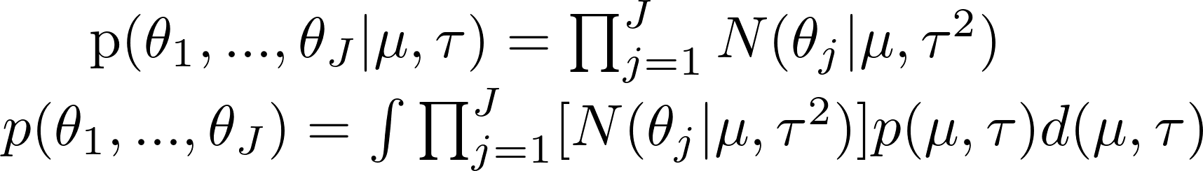
Normal Hierarchical Model
We can assign a noninformative uniform hyperprior distribution to μ, given τ:

Slide 11
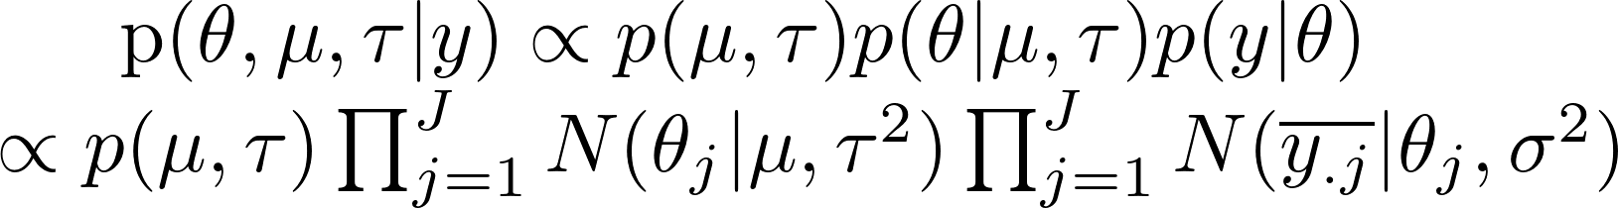
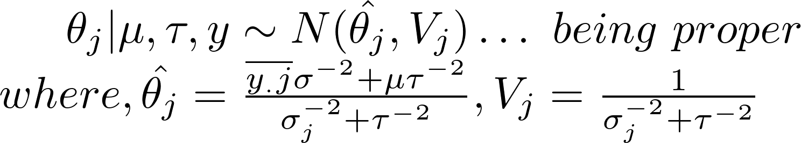
Joint Posterior Distribution
Combining the sampling distribution for the observable y_{ij} we can express:
We can say that θ parameters are independent of the prior distribution, then:

Slide 12
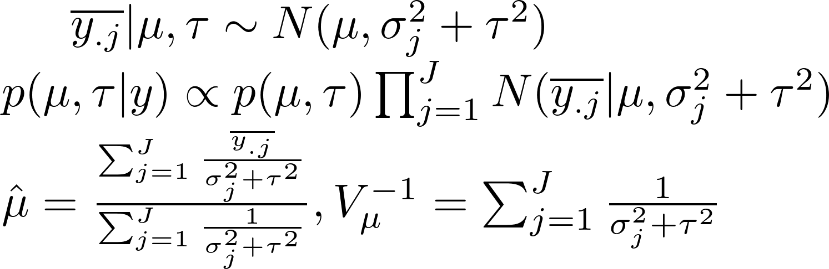
Marginal Posterior Distribution (Hyperparameters)
Prev slide is only a partial solution. As μ and τ are unknown.
In the normal models the marginal likelihood has a simple form (which is not the case in other distributions).

Slide 13
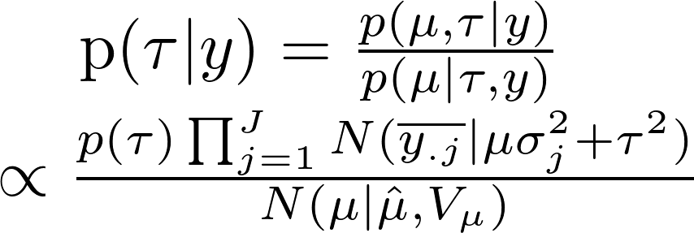
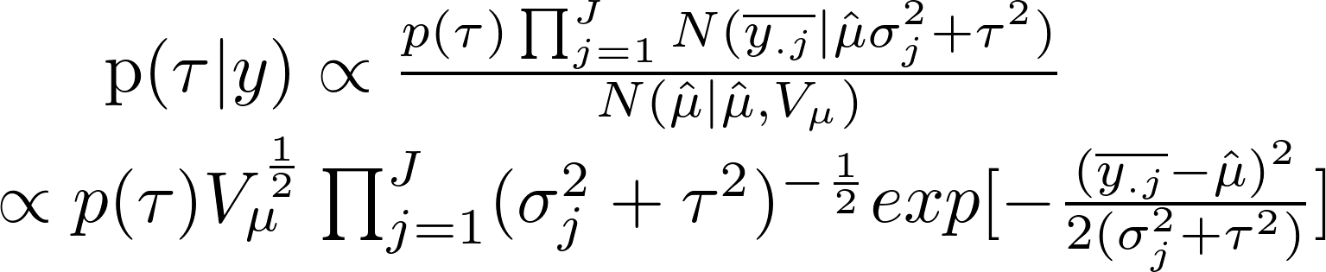
Posterior distribution of τ
We can now get it:
This holds true as
any value of μ, so all the factors of μ must cancel when simplification is done.
If we set μ to hat(µ)

Slide 14


Prior distribution of τ
Prior distribution for τ should be assigned: a diffuse noninf. prior will be used for convenience.
It should be a finite integral:
Other priors can be defined:
  Inverse chi-squared: being a natural choice for variance parameters.

Slide 15

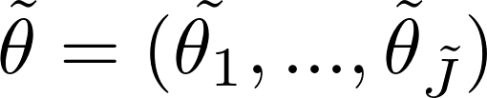


Posterior Predictive Distributions
There are 2 scenarios
  Taking the future data from current batches
  Future data from future batches (y_{new})
    Steps to follow in this scenario:
    (i) Draw (μ, τ) from the posterior, (ii) draw Ĵ new params from the population distribution , (iii) draw ŷ given from the distribution

Slide 16
Example
SAT-Verbal is applied to 8 different schools with a coaching program.
  Variable of interest: score, with values 200-800, mean 500, standard deviation 100

Slide 17
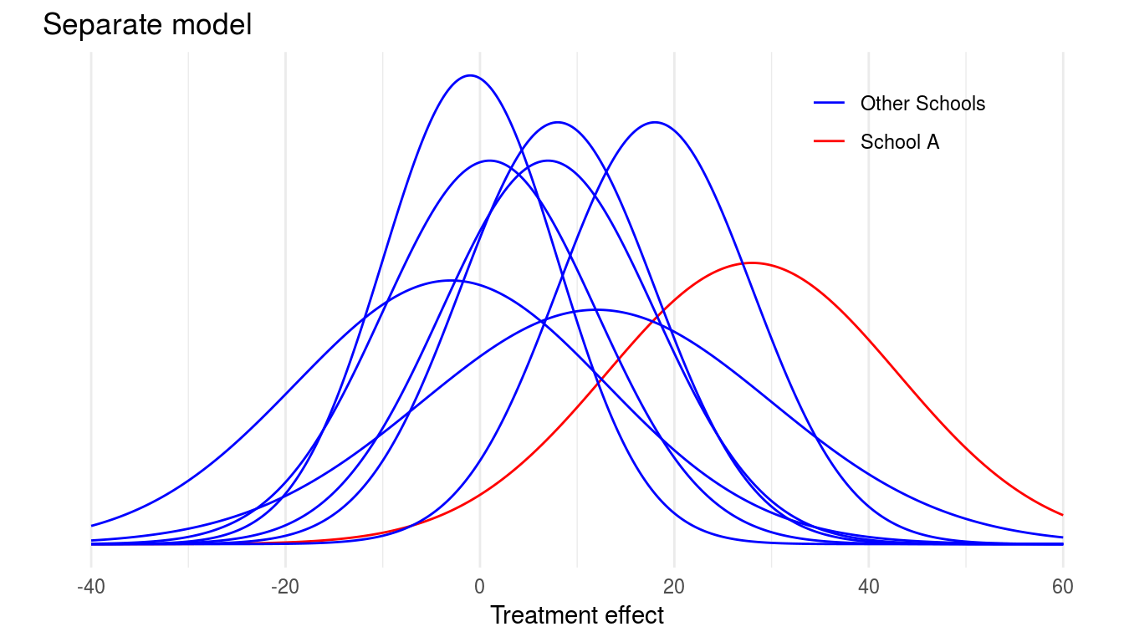
Example
Separate estimates: It’s statistically difficult to distinguish between experiments: yielding 95% posterior intervals overlapping.

Slide 18
Example:
Overlapping in the normal non pooled simple model suggests that we’re estimating the same quantity.
Pooled estimate, in contrast, hypothesize that all experiments have the same effect and produce independent estimates of this common effect.

Slide 19
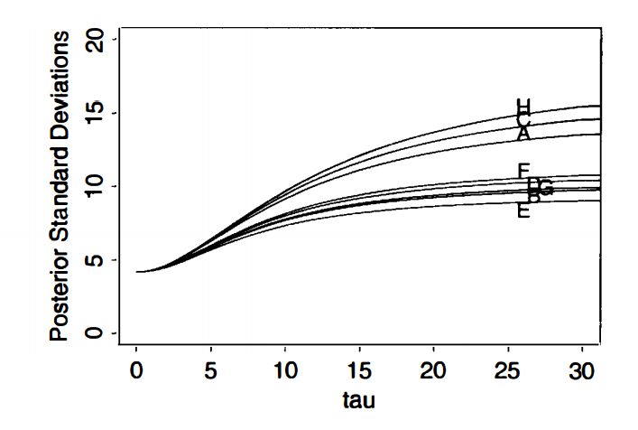
Example
Anyway, the posterior mode of τ is on the boundary of its parameter space.
The same for the joint posterior modal estimate.

Slide 20
Meta-Analysis
It’s increasingly popular to summarize and integrate the findings of research studies.
It’s a method for combining several parallel data sources.
We introduce 0 subscripts for control groups, and 1 in treatment groups.

Slide 21
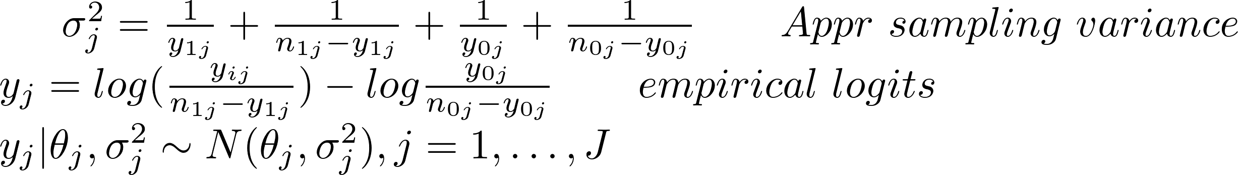
Example: Hierarchical Normal Model
This method has a marginal posterior that peaks at nonzero value, which is plausible.
The Expected value of μ is shrinked, compared with the non-hierarchical model. But the variance is accounted for, as it’s uncertain in the estimation.

Slide 22
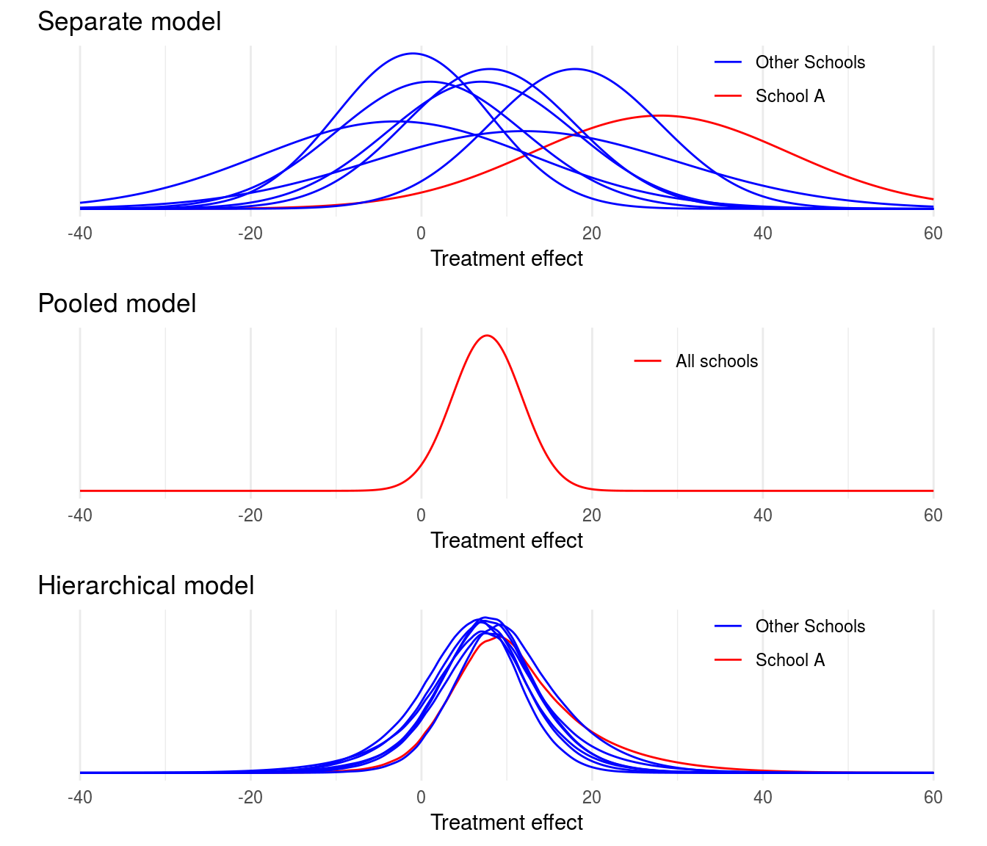

Slide 23
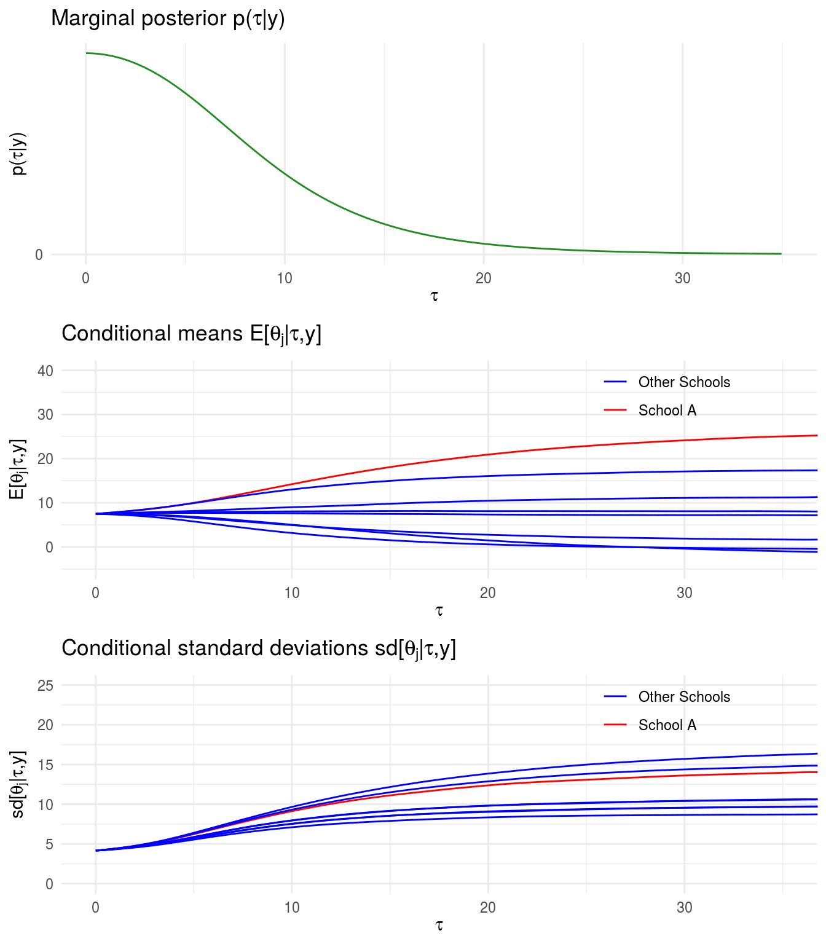

Slide 24
BUGS Example
https://philwebsurfer.github.io/fundstats/

Slide 25
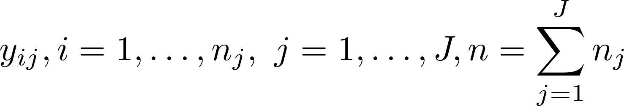
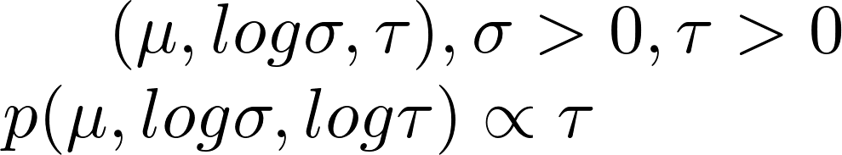
Example 2
Independently normally distributed, for each J groups. With n total number of observations.
Data variance (σ²) is unknown
The group means, we assume, follow a Normal Distribution; with unknown μ, τ²
Prior for

Slide 26
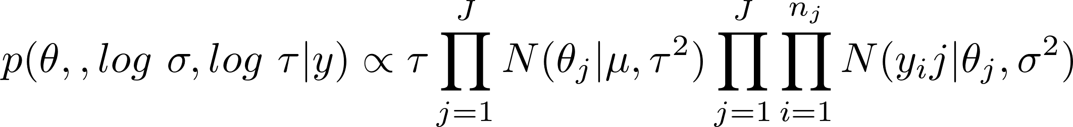
Example 2
If we assign a uniform prior for τ, it will result in an improper posterior.
The joint posterior density of all parameters is:
P 326 – Gelman

Slide 27
References
Carlin, J., Gelman, A., & Stern, H., et al. (2003). Bayesian data analysis. Chapman and Hall/CRC.
Lunn, D., Jackson, C., Best, N., Thomas, A., & Spiegelhalter, D. (2012). The Bugs Book: A Practical Introduction to Bayesian Analysis (1st ed.).
Goldstein, H. (2011). Multilevel statistical models. Oxford: Wiley.
Congdon, P. (2010). Applied Bayesian hierarchical methods. Boca Raton: CRC Press.

