Slide 1
Multiple Linear Regression

Slide 2
Plan
Guiding Example: waterpark
Review of simple (one variable) linear regression
Motivation for multiple variables
Multiple regression equation
Performance vs simple regression
Testing a model on new data
Questions

Slide 3
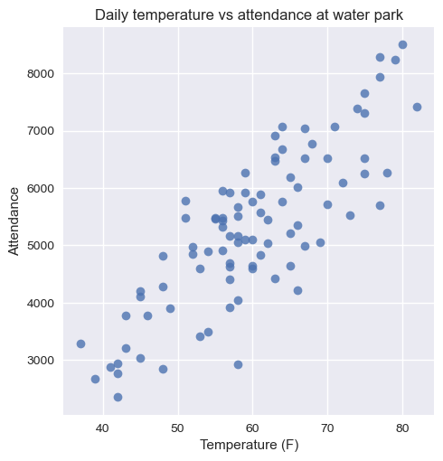
Example: Waterpark
Data on a water park: 90 observations of the temperature on a given day and how many people visited the park that day.
As the manager of this water park, it’s useful to know how many people to expect to attend on a given day!

Slide 4
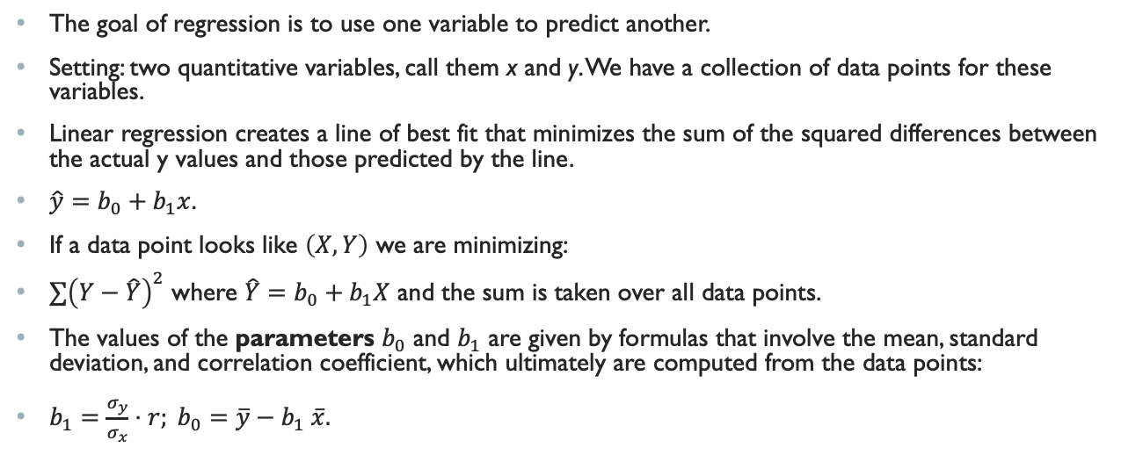
Review of Simple Linear Regression
The goal of regression is to use one variable to predict another.
Setting: two quantitative variables, call them x and y. We have a collection of data points for these variables.
Linear regression creates a line of best fit that minimizes the sum of the squared differences between the actual y values and those predicted by the line.
$\hat{y}=b_{0}+b_{1}x$.
If a data point looks like $\left(X,Y\right)$ we are minimizing:
$∑{\left(Y−\hat{Y}\right)}^{2}$ where $\hat{Y}=b_{0}+b_{1}X$ and the sum is taken over all data points.
The values of the parameters $b_{0}$ and $b_{1}$ are given by formulas that involve the mean, standard deviation, and correlation coefficient, which ultimately are computed from the data points:
$b_{1}=\frac{σ_{y}}{σ_{x}}⋅r; b_{0}=\overline{y}−b_{1} \overline{x}.$

Slide 5
Example: Waterpark
Let’s predict the attendance given the temperature, using simple linear regression.
We proceed in excel, where this can be done in a variety of ways.

Slide 6
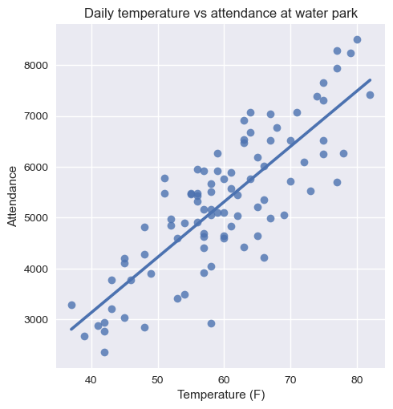
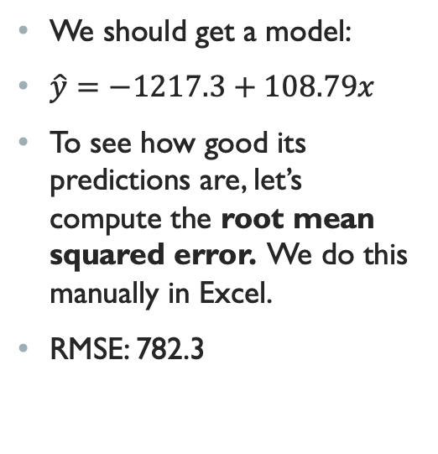
Example: Waterpark
We should get a model:
$\hat{y}=−1217.3+108.79x$
To see how good its predictions are, let’s compute the root mean squared error. We do this manually in Excel.
RMSE: 782.3

Slide 7
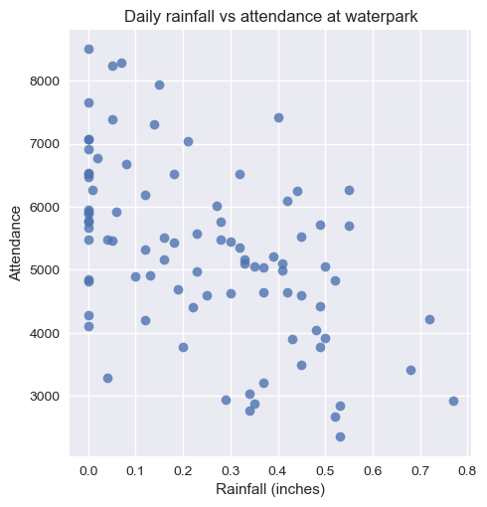
Example: Waterpark
Now we consider a second variable: rainfall. We have data on this also.
We see a downward linear trend, but weaker.
We can compute a model based on this variable.

Slide 8
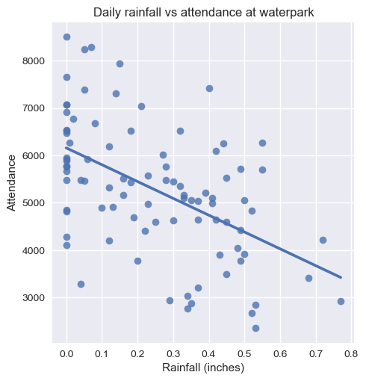
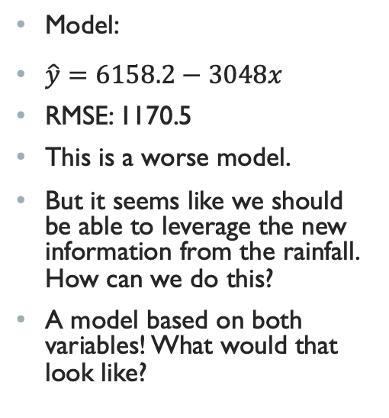
Example: Waterpark
Model:
$\hat{y}=6158.2−3048x$
RMSE: 1170.5
This is a worse model.
But it seems like we should be able to leverage the new information from the rainfall. How can we do this?
A model based on both variables! What would that look like?

Slide 9
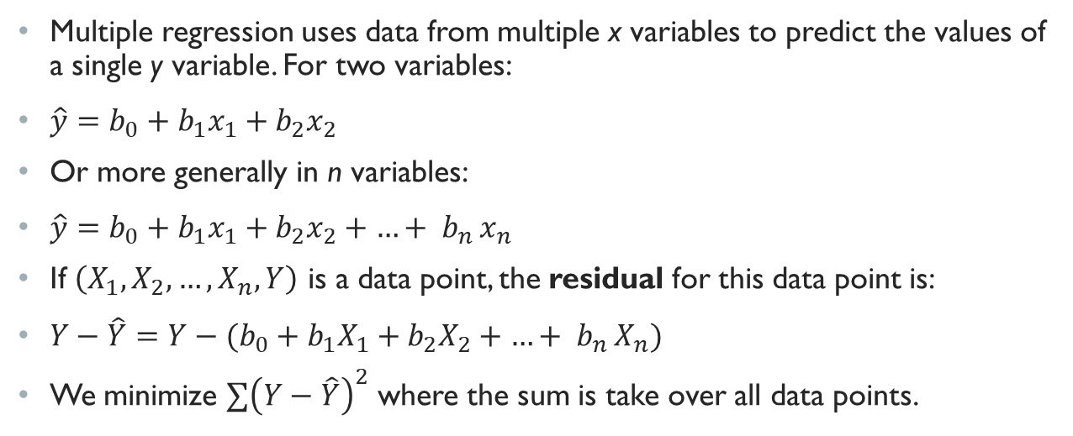
multiple regression
Multiple regression uses data from multiple x variables to predict the values of a single y variable. For two variables:
$\hat{y}=b_{0}+b_{1}x_{1}+b_{2}x_{2}$
Or more generally in n variables:
$\hat{y}=b_{0}+b_{1}x_{1}+b_{2}x_{2}+{…+ b}_{n}x_{n}$
If $\left(X_{1},X_{2},…,X_{n},Y\right)$ is a data point, the residual for this data point is:
$Y−\hat{Y}={Y−(b}_{0}+b_{1}X_{1}+b_{2}X_{2}+{…+ b}_{n}X_{n})$
We minimize $∑{\left(Y−\hat{Y}\right)}^{2}$ where the sum is take over all data points.

Slide 10
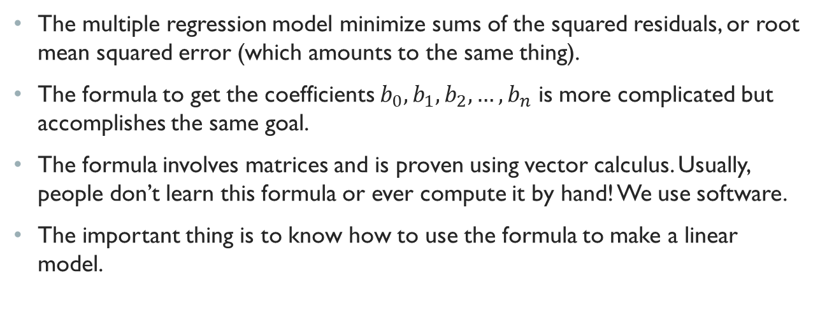
multiple regression
The multiple regression model minimize sums of the squared residuals, or root mean squared error (which amounts to the same thing).
The formula to get the coefficients ${b_{0},b}_{1}, b_{2},…,b_{n}$ is more complicated but accomplishes the same goal.
The formula involves matrices and is proven using vector calculus. Usually, people don’t learn this formula or ever compute it by hand! We use software.
The important thing is to know how to use the formula to make a linear model.

Slide 11
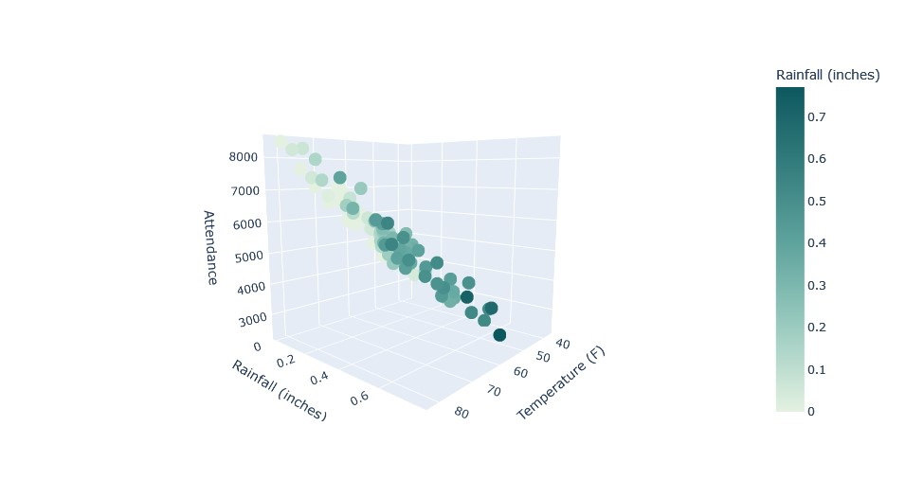

Example: Waterpark
Let’s build a multiple regression model for the waterpark.
We want:
$\hat{Attendance}=b_{0}+b_{1}⋅temp+b_{2}⋅rainfall.$

Slide 12
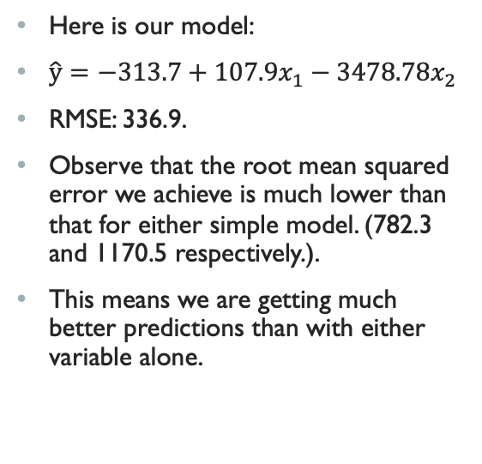
Example: Waterpark
Here is our model:
$\hat{y}=−313.7+107.9x_{1}−3478.78x_{2}$
RMSE: 336.9.
Observe that the root mean squared error we achieve is much lower than that for either simple model. (782.3 and 1170.5 respectively.).
This means we are getting much better predictions than with either variable alone.

Slide 13
Towards machine Learning
We are talking about predictions, but so far we’ve only predicted our existing data.
Multiple regression is the first example of a whole world of study, machine learning, where we try to make predictions about new data based on existing data.
In machine learning, you train your model based on existing data, and then test it on new data (often you test it on existing data also before deploying it in the real world). Let’s try this with our waterpark example with new data: 7 more days of observations (like a one-week forecast).
It’s important to check if the predictions pan out!
There are many other sorts of models out there. In a business analysis context, linear regression is a good first model to try, but for data with other patterns in it, we may get better results with other types of models. (E.G. real world data for our waterpark example might depend on day of the week).
The method is always the same: create predictions, measure how much error there is, and try to minimize that.

