Slide 1
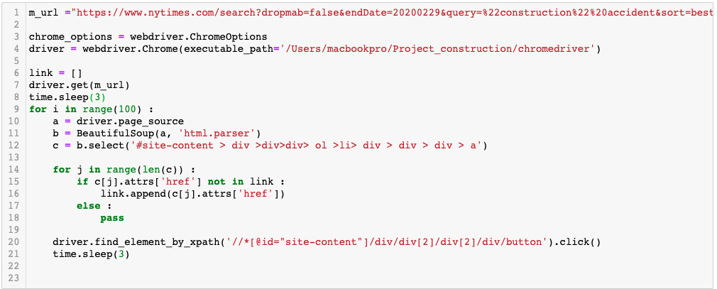
Crawling
Library
- BeautifulSoup, HTMLParser, selenium
Parsing URL of each article and store into list

Slide 2
Word2Vec
Library
- Gensim, Word2Vec
token_sentence - source of data
size - Dimensionality of the word vectors
window – Maximum distance between the current and predicted word within sentence
min_count – Ignores all words with total frequency lower than this
workers – Use this number of workers threads to train the model
sg – 1 for skipgram, otherwise CBOW (CBOW is performed in this study)
iter – Number of iterations(epochs) over the given corpus
Compute cosine similarity between two words

Slide 3
UMAP
Library
- umap, matplotlib
n_neighbors - Size of the local neighborhood, when n_neighbors increase it means UMAP manages to see more of the overall structure of data
min_dist – Controls how tightly UMAP is allowed to pack points together
n_components - Determine the dimensionality of the reduced dimension space
verbose – controls verbosity of logging

Slide 4
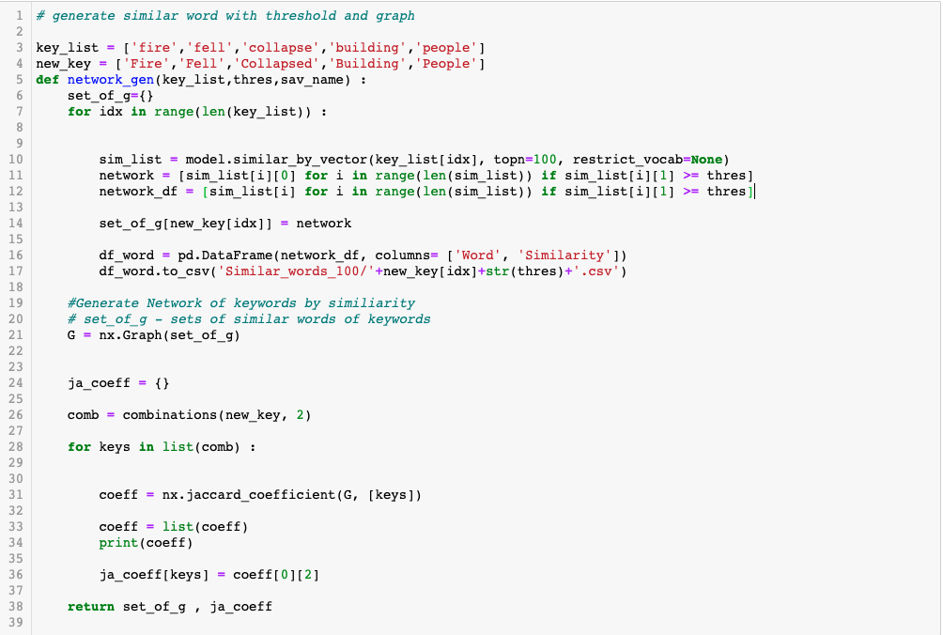
Network Analysis
Library
- networkx
Generate graph
Get jaccard coefficient

