Slide 1

US Trade Balance Overview
Understanding America's Position in Global Trade
Economic Analysis Division
January 2025

Slide 2
02
Executive Summary
01
02
Persistent Trade Deficit
Services Surplus Offset
The US has maintained a trade deficit since 1975, reaching $773 billion in 2023, driven by strong domestic demand and global supply chains.
While goods trade shows significant deficit, services trade maintains a $280 billion surplus, partially offsetting the overall imbalance.
03
04
China Remains Top Partner
Policy Landscape Evolving
China, Mexico, and Canada are the largest trading partners, with recent policy shifts reshaping bilateral trade dynamics.
Tariffs, trade agreements, and supply‑chain restructuring are reshaping US trade patterns with significant economic implications.

Slide 3
03
Agenda
1
Key Concepts & Definitions
2
Measurement & Data Sources
3
Historical Trends
4
Current State Analysis
5
Trade Composition by Category
6
Major Trading Partners
7
Drivers & Determinants
8
Economic Impacts & Policy
9
Outlook & Scenarios
10
Conclusions & Recommendations

Slide 4









04
Key Concepts & Definitions
Trade Balance
Surplus vs. Deficit
Goods vs. Services
The difference between the value of a nation's exports and imports over a specific period.
Surplus: Exports exceed imports. Deficit: Imports exceed exports. US has run deficits since 1975.
Goods: Physical products. Services: Intangible offerings like finance, consulting, and tourism.
Current Account
Bilateral Balance
Trade-to-GDP Ratio
Broader measure including trade balance, net income from abroad, and net transfers.
Trade balance with a specific country. Can vary significantly across partners.
Measures trade openness. US ratio is ~24%, lower than many developed economies.

Slide 5

05
Measurement & Data Sources
Primary Data Sources
Key Metrics & Frequency
BEA
Bureau of Economic Analysis
Monthly and quarterly trade statistics, GDP impact analysis
Monthly
Goods & Services
CENSUS
U.S. Census Bureau
Detailed goods trade by commodity and partner country
Quarterly
Current Account
IMF
International Monetary Fund
Full Revisions
Global comparisons, Balance of Payments data
Annual
WTO
World Trade Organization
Trade policy monitoring, dispute resolution data
Data typically released 35-45 days after reference period

Slide 6
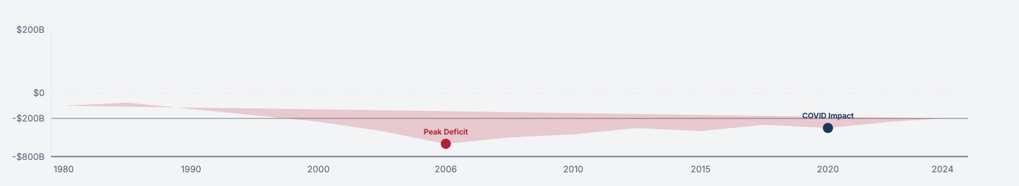
06
Historical Trends
$773B
1975
$918B
3.7%
2023 Trade Deficit
Last Annual Surplus
Peak Deficit (2006)
Trade as % of GDP
▼ 18.7% from 2022
50 years of deficits
Pre‑Financial Crisis
Deficit contribution
US Trade Balance Over Time (Billions USD)

Slide 7
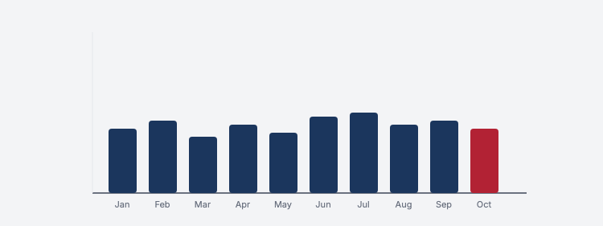

07
Current State (2024)
Latest Figures
Monthly Trend (2024)
-$773B
-$1.06T
Total Trade Balance
Goods Deficit
+$280B
$5.1T
Services Surplus
Total Trade Volume
Goods deficit narrowed 10 % in 2024 while services surplus expanded 8 %

Slide 8



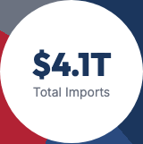
08
Composition by Category
Exports Breakdown
Imports Breakdown
Capital Goods
Consumer Goods
36% • $1.08T
39% • $1.6T
Services
Capital Goods
19% • $570B
17% • $697B
Consumer Goods
Industrial Supplies
22% • $660B
28% • $1.15T
Other
Other
23% • $690B
16% • $656B

Slide 9
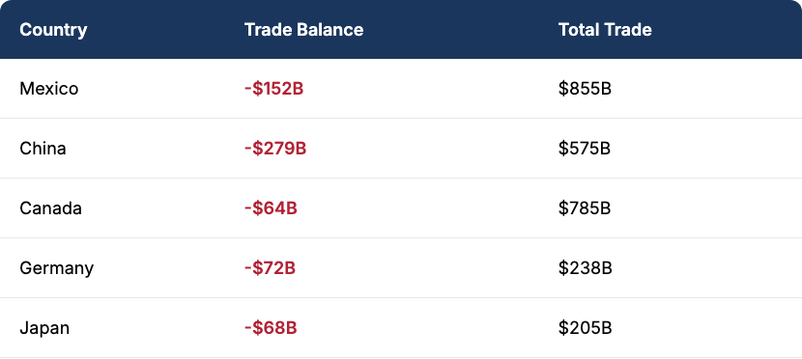


09
Major Trading Partners
Top 10 Trading Partners (2024)
Regional Distribution
Insert Trade Partner Map Here
Asia
Americas
Europe

Slide 10
10
Drivers & Determinants
Exchange Rates
Domestic Demand
Energy Markets
Stronger USD makes exports more expensive and imports cheaper, widening the deficit.
Strong US consumer spending drives import growth, especially in consumer goods.
US energy independence has reduced oil imports, partially offsetting goods deficit.
Trade Policy
Supply Chains
Competitiveness
Tariffs, quotas, and trade agreements directly impact bilateral trade flows.
Global value chains and offshoring have integrated US production with foreign markets.
Productivity, innovation, and cost structure affect US export competitiveness globally.

Slide 11








11
Economic Impacts & Policy Responses
GDP Impact
Employment
Inflation
Investment
Trade deficit subtracts from GDP growth; net exports component typically negative
Mixed effects: manufacturing jobs lost, but export sectors and services gain employment
Imports help contain inflation; tariffs can increase consumer prices
Foreign capital inflows finance deficit, supporting investment and asset prices
Key Policy Tools
Recent Policy Actions
Tariffs on specific goods or countries
Section 301 tariffs on China ($300 B+ goods)
Free trade agreements (USMCA, CPTPP)
USMCA implementation (2020)
Currency intervention & monetary policy
CHIPS Act & supply‑chain initiatives
Export promotion programs

Slide 12
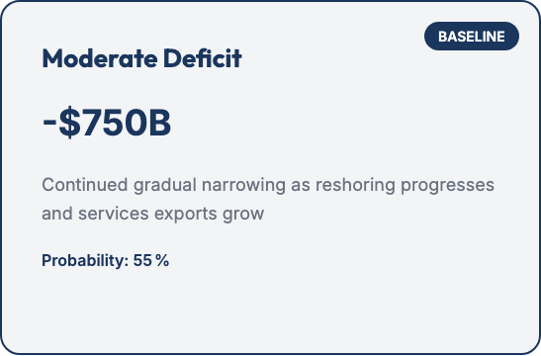
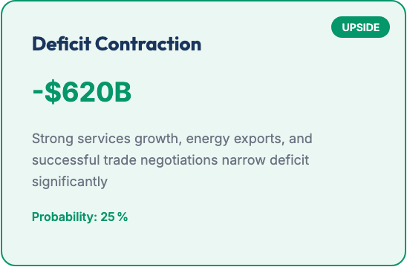
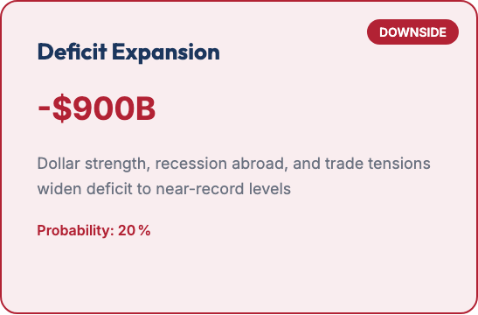
12
Outlook, Risks & Scenarios
2.1%
1.5%
$85B
Projected Export Growth
Projected Import Growth
Annual Deficit Reduction

Slide 13

13
Conclusion & Recommendations
Key Takeaways
Strategic Recommendations
The US trade deficit is structural, driven by consumption patterns and global supply chains
Policymakers: Focus on competitiveness, workforce development, and targeted trade agreements rather than broad protectionism.
Services trade surplus partially offsets goods deficit, representing a competitive advantage
Businesses: Diversify supply chains, leverage services export opportunities, and monitor policy developments for strategic planning.
Trade policy alone cannot eliminate the deficit without broader economic adjustments
Investors: Consider sector‑specific impacts of trade policies, currency movements, and supply‑chain shifts in portfolio decisions.
Supply‑chain diversification and reshoring will gradually reshape trade patterns

Slide 14
14
Sources & Appendix
Primary Data Sources
Methodology Notes
Additional Resources
Data current as of January 2025. All figures in nominal US dollars unless otherwise specified.

