Slide 1
AutoHS
BIDS App for automated hippocampal sclerosis screening from T1w MRI
BIDS anat/T1w → per-subject HS report (PDF + JSON), BIDS-compliant derivatives
Step 1
Segment
FreeSurfer or FastSurfer — cortical parcellation + subcortical aseg
Step 2
Extract volumes
Left- and right-hippocampus mm³ from FreeSurfer aseg
Step 3
Asymmetry index
AI = (L − R) / (L + R) — direction and magnitude of hippocampal asymmetry
Step 4
Classify
Compare AI against published HS thresholds (IDEAS-derived, per-side)
Step 5
Report
PDF + JSON, BIDS derivative layout, ready for review or dashboard
MIT-licensed BIDS App · runs Docker or Apptainer · single T1w per subject
1

Slide 2
Defaults
Threshold-based classifier, no model to train, no reference cohort required at inference
Topic
Default
Why
Segmentation
FastSurfer (default) or FreeSurfer 7.4.1
Deep-learning speed with recon-all option
Volume source
aseg — Left-/Right-Hippocampus (labels 17, 53)
Robust, well-validated in vivo hippocampus
Asymmetry index
AI = (L − R) / (L + R)
Standard laterality index, dimensionless
Laterality threshold
±0.05
Reports Left/Right/Symmetric for the AI report
HS thresholds
Left HS: AI < -0.0708 · Right HS: AI > 0.0469
Derived on IDEAS cohort — validated on epilepsy surgical patients
Output
report.json + report.pdf + summary.txt
Machine-readable metrics plus a clinical PDF
One knob per user: --fastsurfer (default) or --freesurfer
2

Slide 3
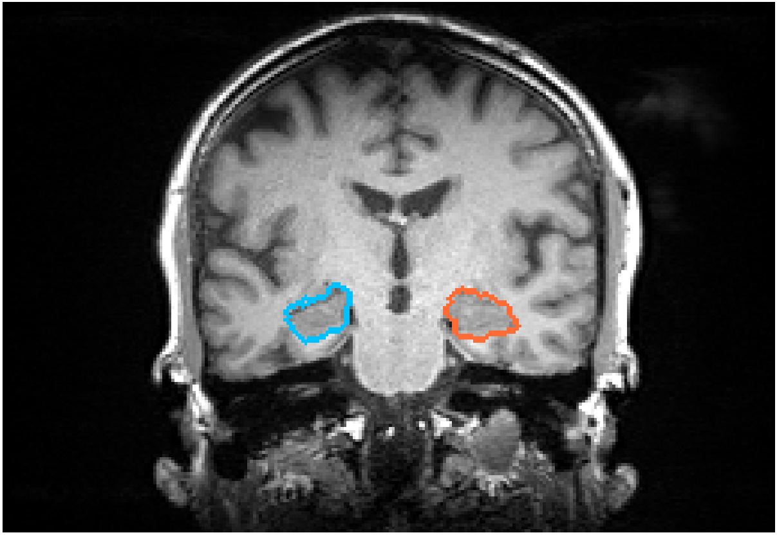
Sample subject — sub-001, IDEAS BIDS release
T1w with left (red) and right (blue) hippocampus overlays · AutoHS auto-classified as No HS
5212 mm³
left hippocampus
5550 mm³
right hippocampus
AI = -0.031
laterality: Symmetric
Balanced (No HS)
HS classification
Coronal T1w slice through the largest hippocampal cross-section; overlay from aparc+aseg.mgz
|AI|=0.031 is inside both HS thresholds (L=0.071, R=0.047) — subject flagged as balanced/no HS
3

