Slide 1
DKT Connectome
BIDS App for lesion-aware structural connectomics
BIDS dwi/ + anat/T1w (optional fmap/, lesion mask) → dkt_connectome.csv, 78 x 78
Step 1
QSIPrep
Motion, eddy, distortion correction, T1w–DWI alignment
Step 1.5
Inpaint
Fill lesion on T1w before reconstruction
Step 2
Recon
FreeSurfer or FastSurfer surfaces + DKT labels
Step 3
QSIRecon
SS3T-CSD fibre orientations, ACT-HSVS tractography
Step 4
Connectome
Warp labels to tractography grid, count streamlines
Step 4.5
Disconnectome
Quantify connectivity lost to the lesion
Step 5
Node strength
Graph metrics and ENIGMA-style clinical report
Greyed steps are optional — they run only when their inputs exist
1

Slide 2
Defaults
Snakemake engine · ./run locally · submit.sh on HPC · overridable per cohort
Topic
Default
Why
Parcellation
DKT, 78 nodes
Available from both recon tools
Tractography
ACT-HSVS
Anatomical priors from surfaces
Edge weight
Streamline counts
Simple, widely reported
Distortion
Measured fieldmap
Explicit --syn or --no-sdc otherwise
Lesion
Auto-detected
From BIDS lesion mask sidecar
Study-agnostic — any BIDS DWI + T1w cohort runs
2

Slide 3
Optional steps
Each is a separate concern, skipped by default unless its input is present
Step 1.5
Step 4.5
Step 5
Inpainting
Disconnectome
Node strength
Recon tools assume healthy anatomy
How much connectivity the lesion cut
Per-region strength and asymmetry
Diffusion model fills the cavity on T1w
Excise voxels or drop streamlines
ENIGMA figures and report.pdf
Auto when a lesion mask exists
Opt-in with --disconnection
Runs once a connectome exists
Diffusion data left untouched
Primary connectome unchanged
Separate container and repo
Optional does not mean secondary — these carry the lesion-aware claims
3

Slide 4
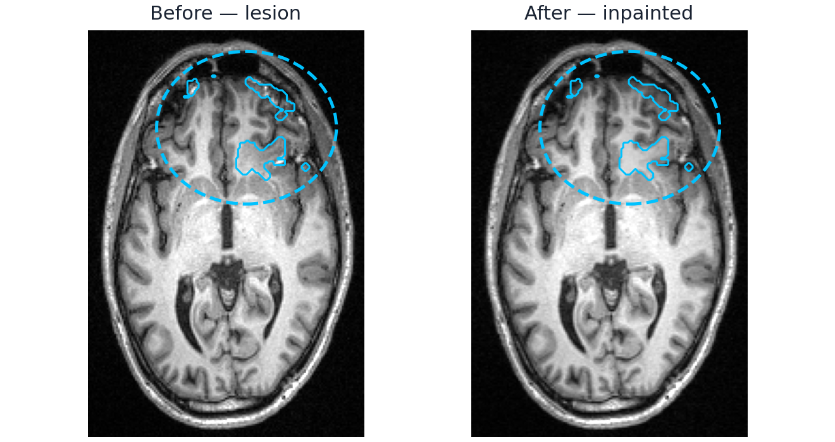
TBI participant — lesion handling
Manual mask, right frontal · neuroLIT inpainting before reconstruction
18.2 mL
lesion (core + oedema)
71%
of lesion in right hemisphere
r = 0.996
T1w intact outside lesion
78 x 78
DKT nodes, none empty
Step 1.5 — axial T1w, lesion outlined and ringed in blue
Inpainting rewrites only the masked voxels — recon then runs on near-normal anatomy
4

Slide 5
TBI participant — node strength where the lesion lands
DKT regions ranked by lesion load, with the node strength and asymmetry of each
Region
Lesion L
Lesion R
L strength
R strength
Str AI
Vol AI
Lateral orbitofrontal
9.8%
21.8%
116,411
113,107
+0.014
−0.014
Middle temporal
—
8.0%
250,161
275,536
−0.048
+0.043
Pars orbitalis
—
5.8%
61,889
62,103
−0.002
−0.025
Insula
—
5.1%
109,650
109,316
+0.002
+0.008
Pars triangularis
—
4.9%
91,530
135,264
−0.193
−0.111
Superior temporal
—
4.2%
232,350
262,319
−0.061
+0.014
Lesion load = share of the region's voxels inside the mask. The lesion touches 16 of the 78 DKT regions; these are the six largest.
Strength = streamlines on all edges touching the node. AI = (L − R)/(L + R), so a negative value means the right side is stronger.
The most damaged region is hit on both sides, so its AI stays near zero — asymmetry on its own is not a lesion detector.
Edge level is where the lesion shows: 1,062 of 2,897 edges weakened, 2 lost entirely, 2.9% of streamline weight
5

Slide 6
Links
Documentation, code, and upstream engines
Resource
Where
Documentation
dkt-connectome.readthedocs.io
Pipeline code
github.com/phindagijimana/dkt_connectome
Node strength
github.com/phindagijimana/dwi-AI
Inpainting model
github.com/Deep-MI/lit
Upstream engines
qsiprep.readthedocs.io · qsirecon.readthedocs.io
Contact
phindagiji@gmail.com
6

