Slide 1

What is gender-based violence?
Sexual and gender-based violence (SGBV) refers to any act that is perpetrated against a person's will and is based on gender norms and unequal power relationships. It includes physical, emotional or psychological and sexual violence, and denial of resources or access to services.

Slide 2

What causes gender-based violence?
Justifications for violence frequently are on based gender norms – that is, social norms about the proper roles and responsibilities of men and women. These cultural and social norms socialize males to be aggressive, powerful, unemotional, and controlling, and contribute to a social acceptance of men as dominant.

Slide 3

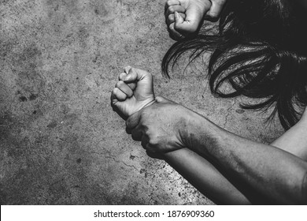
What are effects of gender based violence?
The consequences for victims include undermined confidence, physical disabilities, stigma and shame. Sexual violence also puts women at increased

Slide 4

How can we avoid violence?
Settle arguments with words, not fists or weapons. Don't stand around and form an audience.
Learn safe routes for walking in the neighborhood, and know good places to seek help. Trust your feelings, and if there's a sense of danger, get away fast.
Report any crimes or suspicious actions to the police, school authorities, and parents. Be willing to testify if needed.
Don't open the door to anyone you and your parents don't know and trust.
Never go anywhere with someone you and your parents don't know and trust.

Slide 5

REFERENCES
What is gender-based violence?
What are effects of gender based violence?
What are the forms of gender violence
What are effects of gender based violence?
What are the effects of violence on the family?
Why should we prevent violence?
How can we avoid violence?

