Slide 1



UberDashboardInProgress
View in Power BI
Last data refresh:
9/6/2025 9:02:29 PM UTC
Downloaded at:
9/6/2025 9:06:36 PM UTC

Slide 2
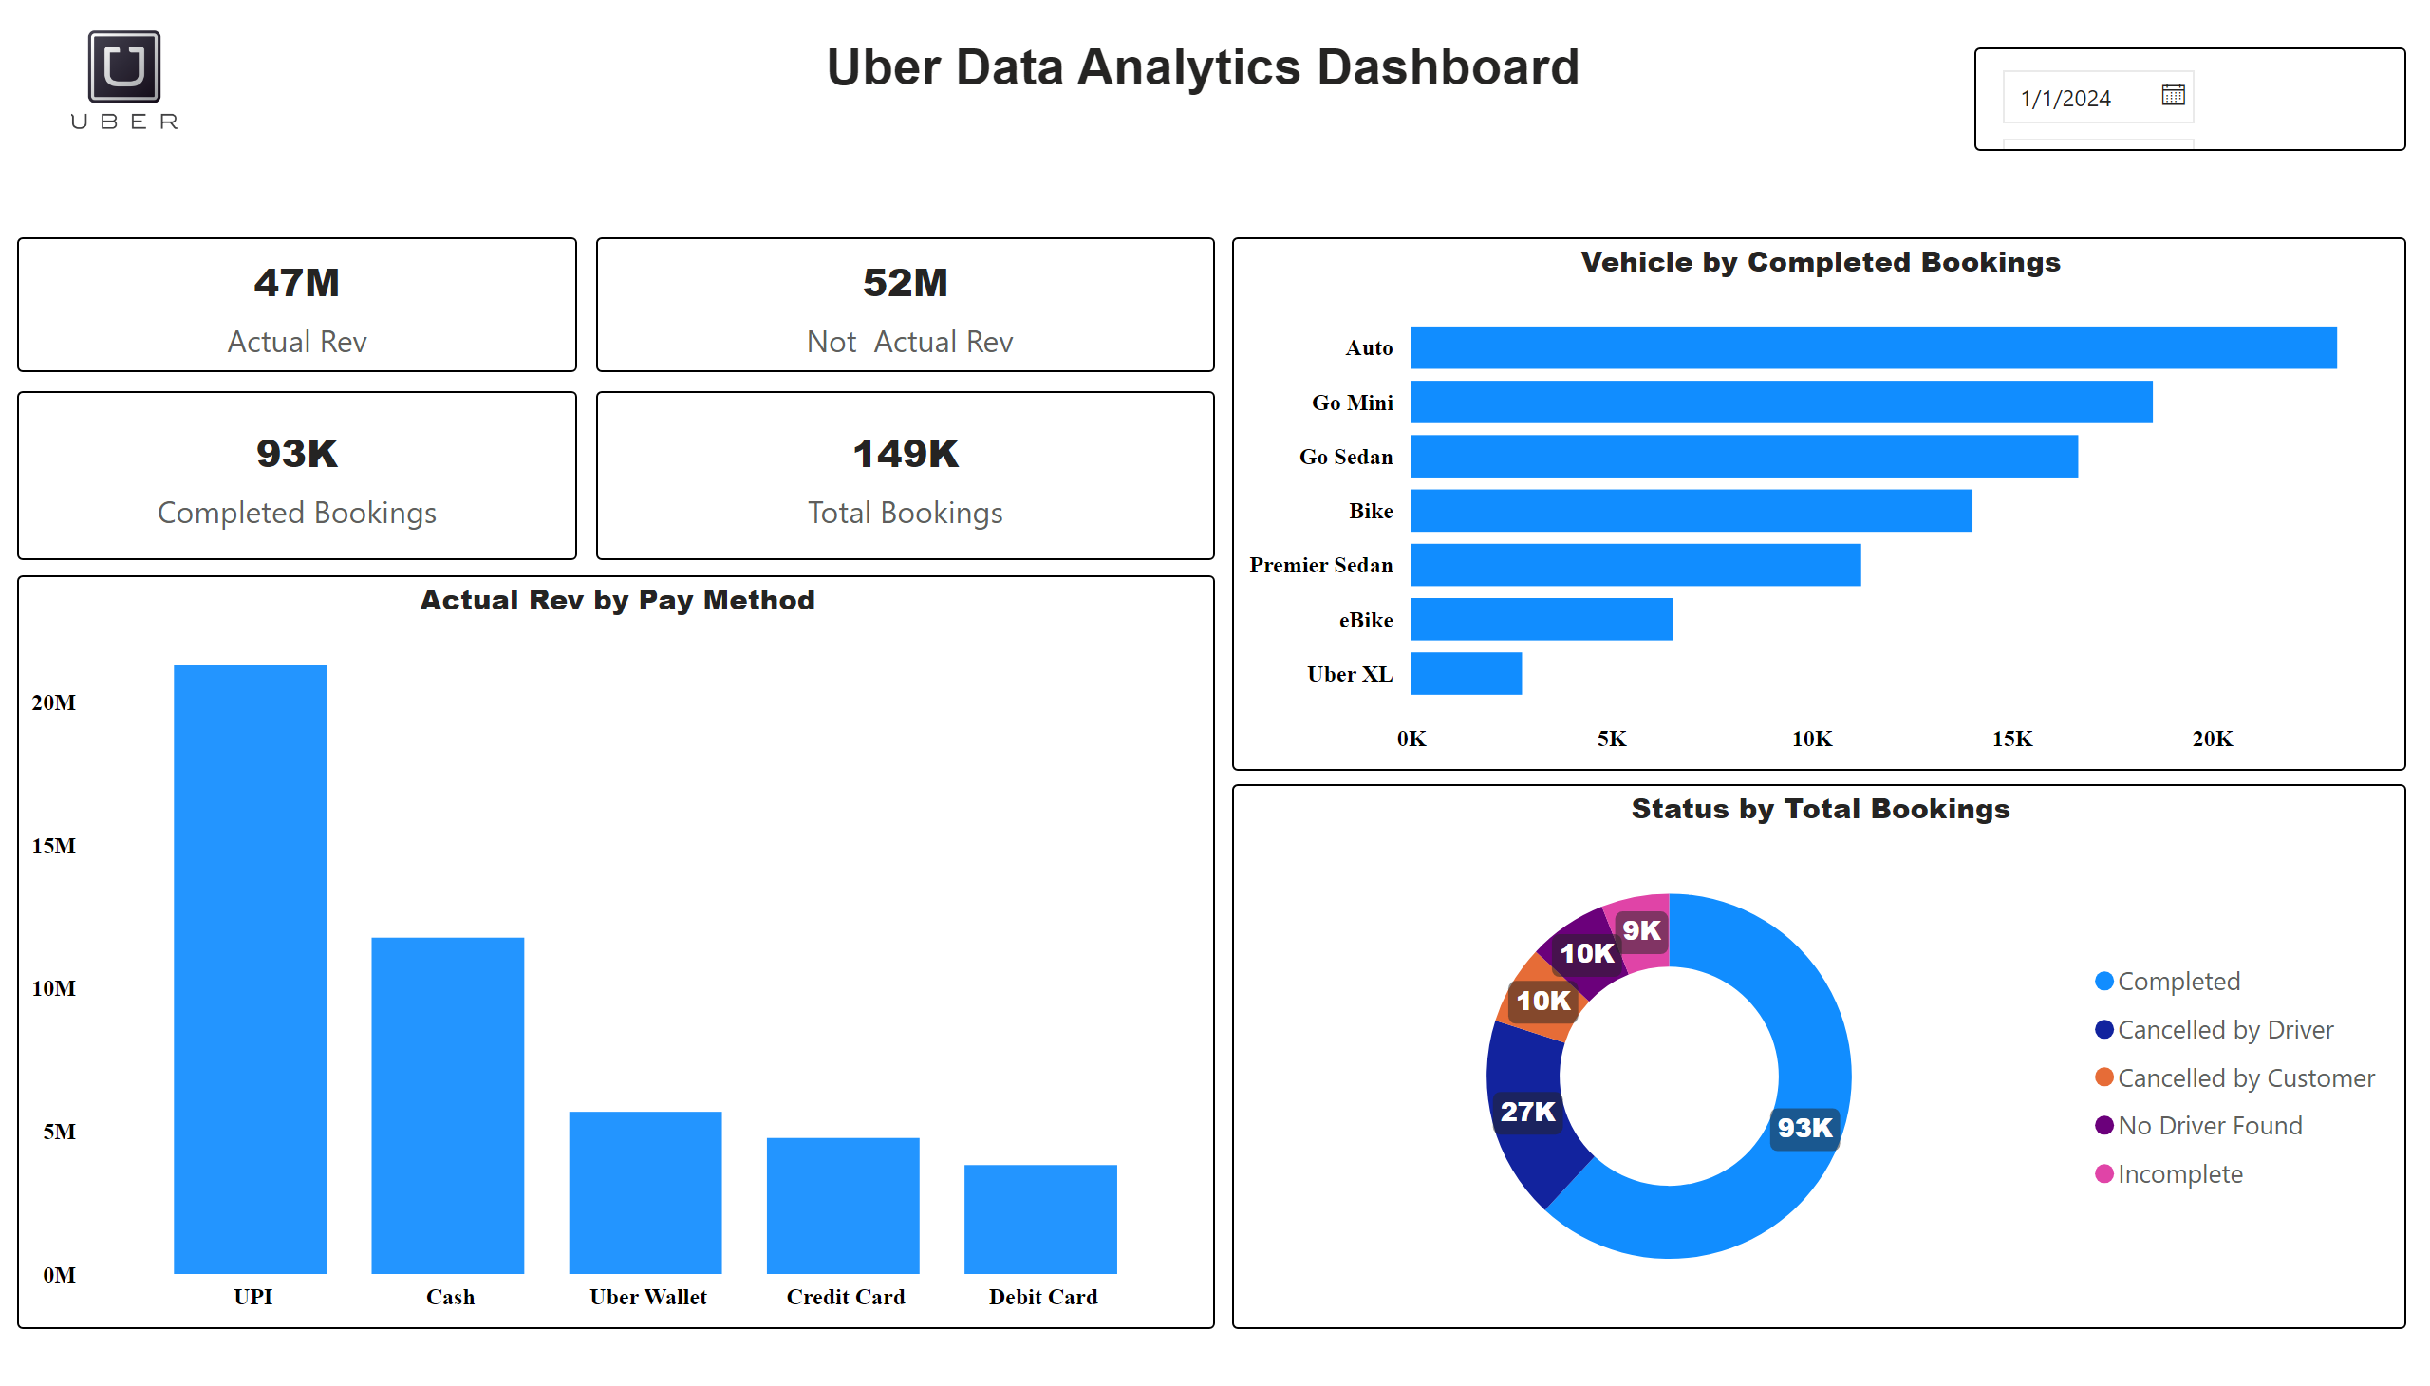
Overview
Notes:
Actual Rev by Pay Method
No alt text provided
Status by Pay Method
No alt text provided
Status by Pay Method
No alt text provided
Status by Pay Method
No alt text provided
Status by Total Bookings
No alt text provided
textbox
No alt text provided
Vehicle by Completed Bookings
No alt text provided
Status by Pay Method
No alt text provided
Status by Pay Method
No alt text provided
image
No alt text provided

