Slide 1
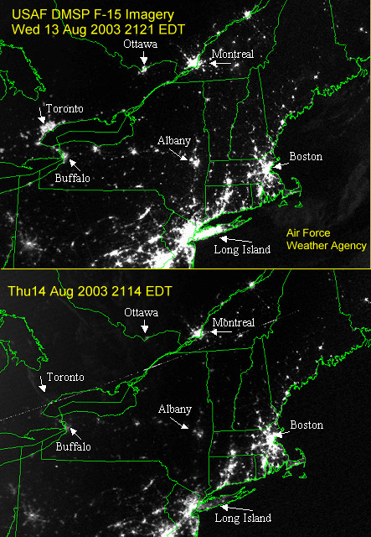
Quantification of the Impact of Renewable Penetration Levels on Power Grid Stability
LIBBY KIRBY
Notes:
Figure : http://epod.usra.edu/blog/2003/08/big-blackout-of-2003.html

Slide 2
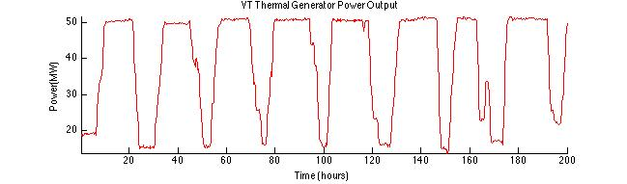
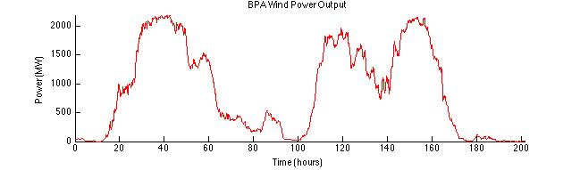
Renewables
Notes:
While renewables are considered beneficial, wind (and most renewables) is (are) variable, especially compared to the output of thermal units, which are human-controlled (i.e. they are approximately constant if we want them to be)
Variability affects system stability
Net load is the difference between load and renewable generation – as it is increasingly variable, frequency swings occur more often and larger, and thermal generators must ramp up and down more to compensate – the more quickly they are forced to ramp, the more likely instability occurs – BETTER EXPLANATION?

Slide 3
Solution to Variability - NOTDONE
Reserves – Back-up generation to be dispatched when a load-generation mismatch occurs
Regulation: Shortest term, quickly dispatchable back-up, used to maintain frequency
Frequency Control
Primary Frequency Response – frequency immediately responds to a change in load (near-instantaneous time scale) - droop
Secondary Frequency Response – Automatic Generation Control
Area Control Error (corrected by AGC)
Notes:
Distinguish between primary and secondary frequency response – maybe its own slide? Jdoes kundar have a picture?
Primary vs secondary – AGC, governor control (see NERC glossary under frequency regulation), ACE, Primary frequency control under ERCOT on nerc gloss
Primary frequency – use cruise control analogy
Currently, 1% but the expectation is (has already been shown, is generally agreed upon…) that this will need to increase as wind increases. However, the specific amount is unknown
Replace with picture!!
Talk about full time scale sets - day ahead (forecast load), 15minute, etc

Slide 4
Problem Statement
Quantify the amount of regulation needed to maintain stability for varying wind penetration levels.
Identify how this quantity is influenced by
Dispatch time
Consolidation of balancing area
Amount of inertia
Notes:
Explain each additional parameter
How will we alter inertia?
Talk about why additional parameters matter – cost of regulation

Slide 5
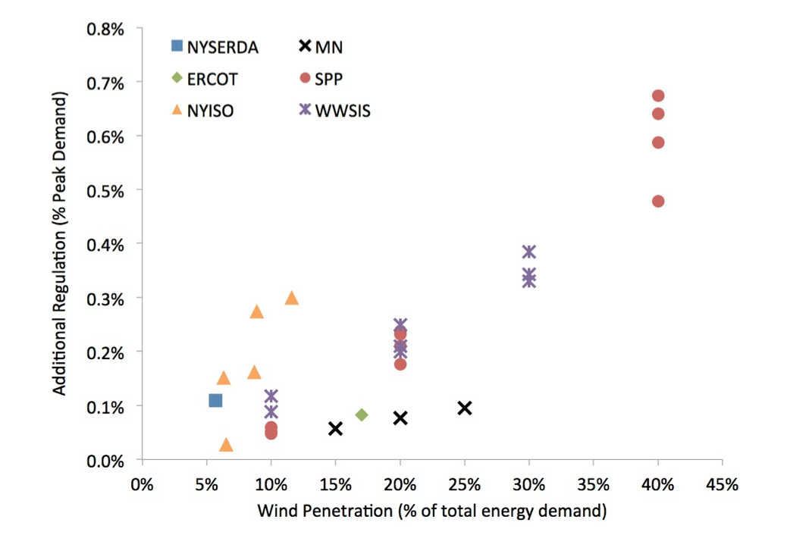
Literature…NOTDONE
Current Wind Studies
Few penetration levels considered
Lack of Dynamic Models
Statistics
Inertia
Notes:
More lit (look for papers Friday)
Slide for a) industry studies, b) academic studies (eto, mccalley, o’malley)
Make this sound like a pretty story

Slide 6
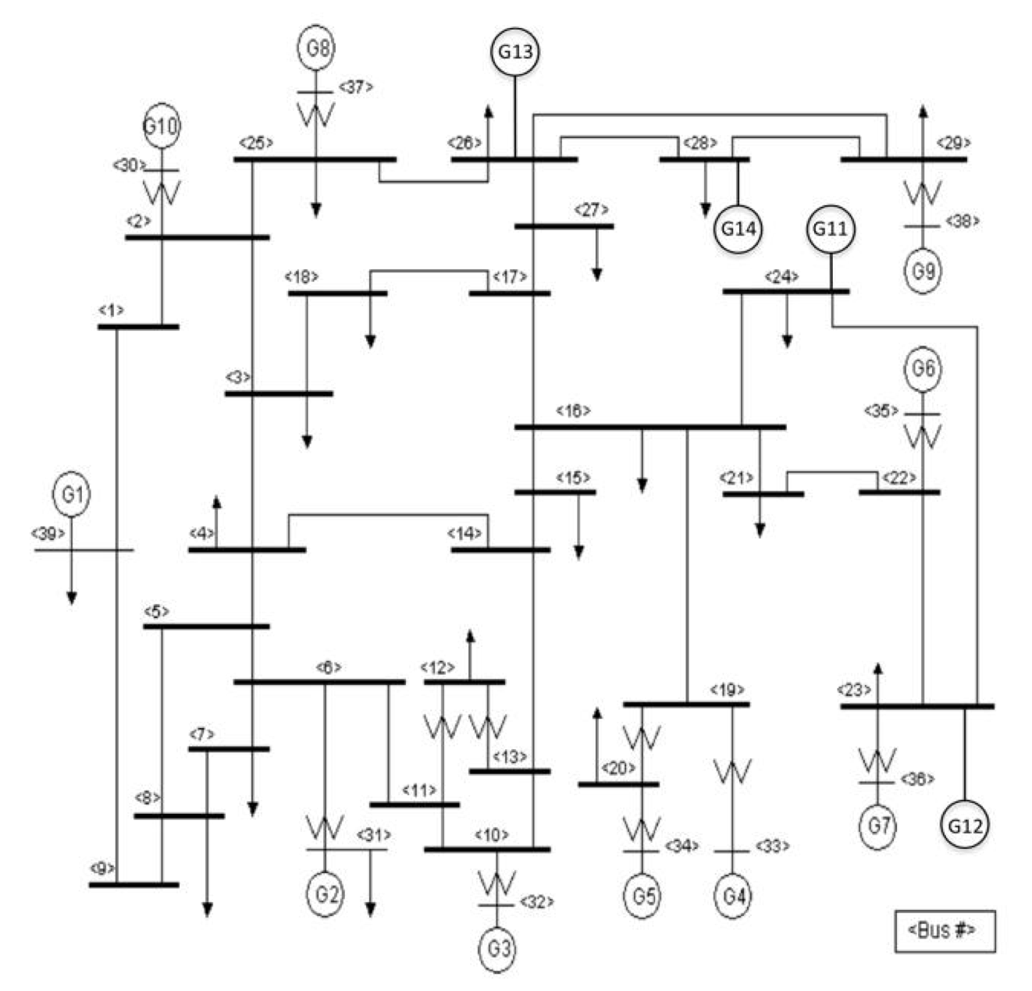
Current Model
Power System
2 Areas
39 Buses Per Area
Wind generators added at buses 23, 24, 26, 28
designates a wind generator
Notes:
Make sure they know wwe’re adding wind into a non-wind model (each gets it’s own profile from real wind farm (2second)

Slide 7
Current Model cntd.
Simulation Program
Economic Dispatch (E.D.)
Linear optimization of generation to minimize cost
Numerical Integration
Stability Check
Input Power System
. . .
Check Stability
E.D.
E.D.
E.D.
E.D.
Notes:
Show base cases?
Picture as time line?

Slide 8
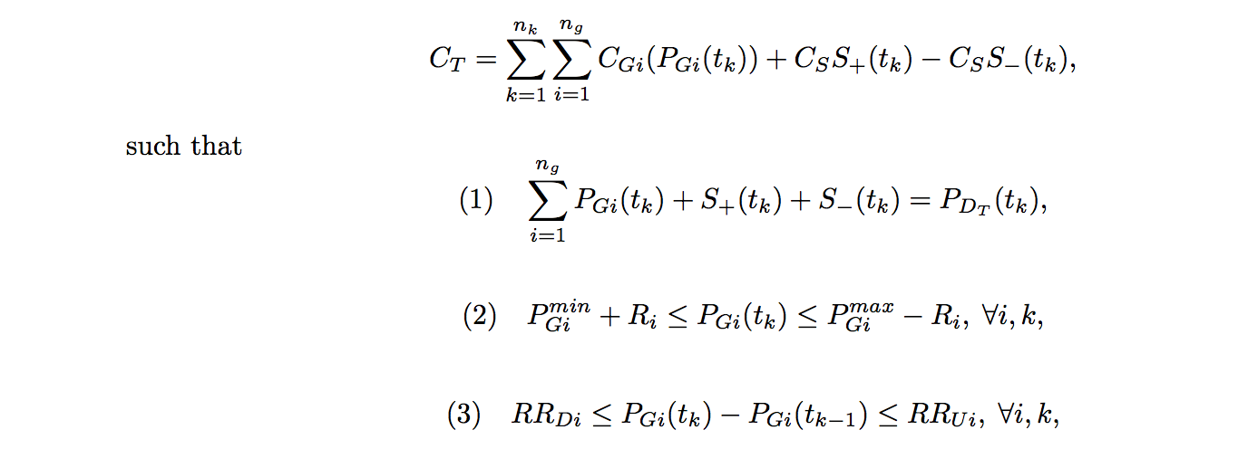
Current Model cntd. NOTDONE
Economic Dispatch
Notes:
Include pointing bubbles to each eqn, with baby explanations

Slide 9
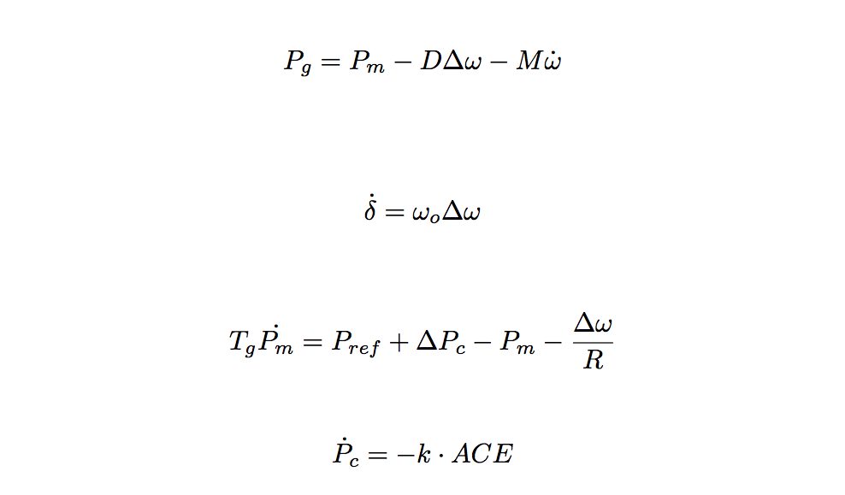
Current Model cntd. NOTDONE
Numerical Integration
Notes:
Trap method

Slide 10
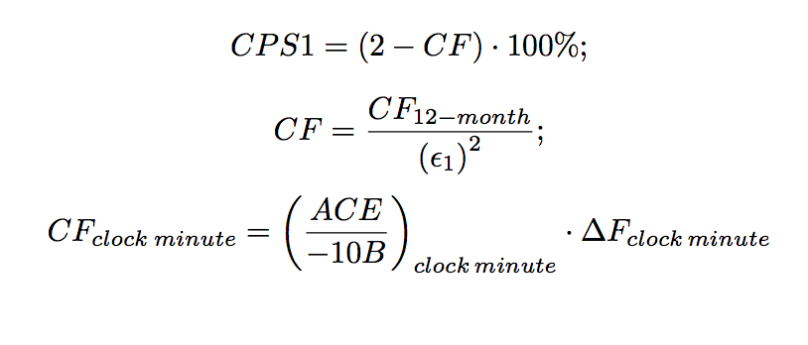
Current Model cntd.
Stability Check
Notes:
SEND OUT PAPER

Slide 11
Thesis Experiments
Increase regulation percentage from 1% until stability is achieved for a given wind percentage
Increase wind penetration percentages and repeat the above
Determine the functional relationship between wind percentage and required regulation percentage
Decrease dispatch time & measure improvements in stability
Consolidate balancing areas & measure improvements in stability
Vary system inertia and measure changes in stability
Notes:
Explain wind penetration?
Additional params – for each wind penetration level one before?
Any combinations?
Compare to simpler heuristics for regulation – 3stdev, 95%tile,
SPP system’s heuristic?
Regultion vs CPS score plot?
Animate bullets

Slide 12
Thesis Experiments cntd. NOTDONE
Notes:
The picture hines and I discussed
Put in slides of prelimnary results (ED (by gen type?), step response for numerical integration),

