Slide 1
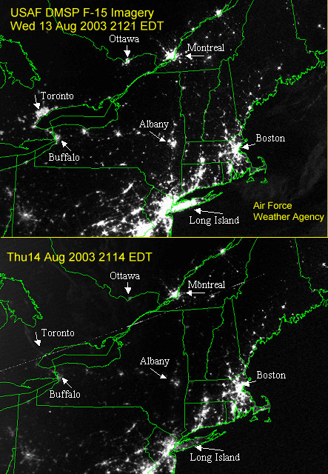
Quantification of the Impact of Renewable Penetration Levels on Power Grid Stability
LIBBY KIRBY
Notes:
Figure : http://epod.usra.edu/blog/2003/08/big-blackout-of-2003.html

Slide 2
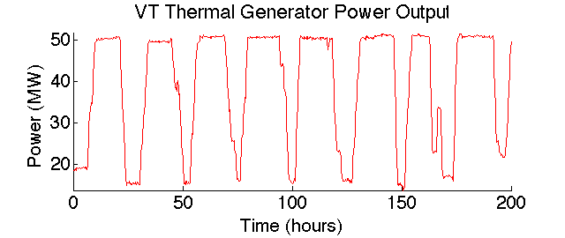
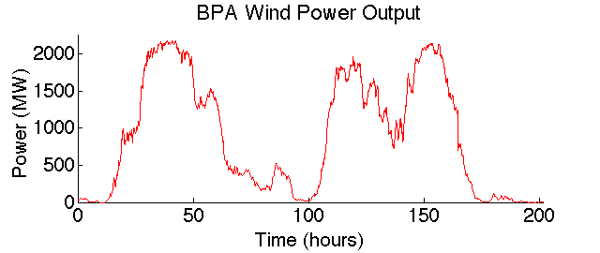
Renewables
Notes:
Renewables beneficial – environment, peak oil, distributed
BUT variable on multiple time scales – day to day, hour to hour, even second to second in comparison with their (well controlled) thermal counter parts (PICTURE)
You cn imagine second to second, when the wind is blowing you down the street and then just stops
While all are problematic in some sense, second to second is specifically detrimental for stability concerns
Equilibrium of the system – imagine other generators having to pick up the slack for the drop in wind at a given moment
To change their output, they must change their speed – changing too quickly/often can throw the whole thing off
Imagine your car needing to go from 0 to 60 in 1 second, and then having to drop back to 20 1 second after – limitations!
Matters more as wind increases (LATER?)

Slide 3
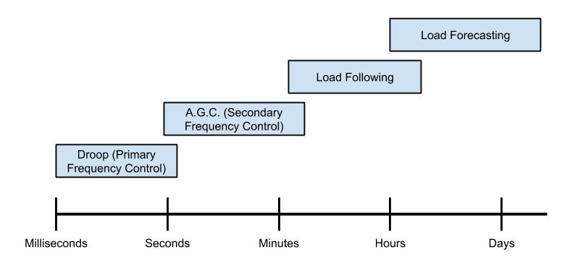
Solution to Variability
Notes:
Primary vs secondary – AGC, governor control (see NERC glossary under frequency regulation), ACE, Primary frequency control under ERCOT on nerc gloss
Primary frequency – use cruise control analogy
Currently, 1% but the expectation is (has already been shown, is generally agreed upon…) that this will need to increase as wind increases. However, the specific amount is unknown
Reserves – Back-up generation to be dispatched when a load-generation mismatch occurs
Regulation: Shortest term, quickly dispatchable back-up, used to maintain frequency
Frequency Control
Primary Frequency Response – frequency immediately responds to a change in load (near-instantaneous time scale) - droop
Secondary Frequency Response – Automatic Generation Control
Area Control Error (corrected by AGC)
We focus on frequency control (though the other 2 are taken care of) because we focus on stability, and so we focus on short time scale changes of wind

Slide 4
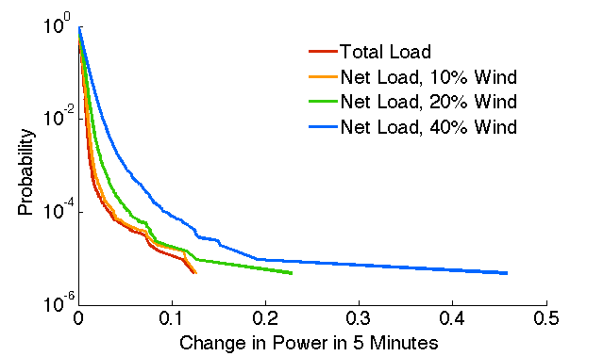
Increased Variability?
Probability (Step Change ≥ X)
1/week
Fraction of Plant Size, X
Notes:
Yaxis – pick one and say 1/time chunk

Slide 5
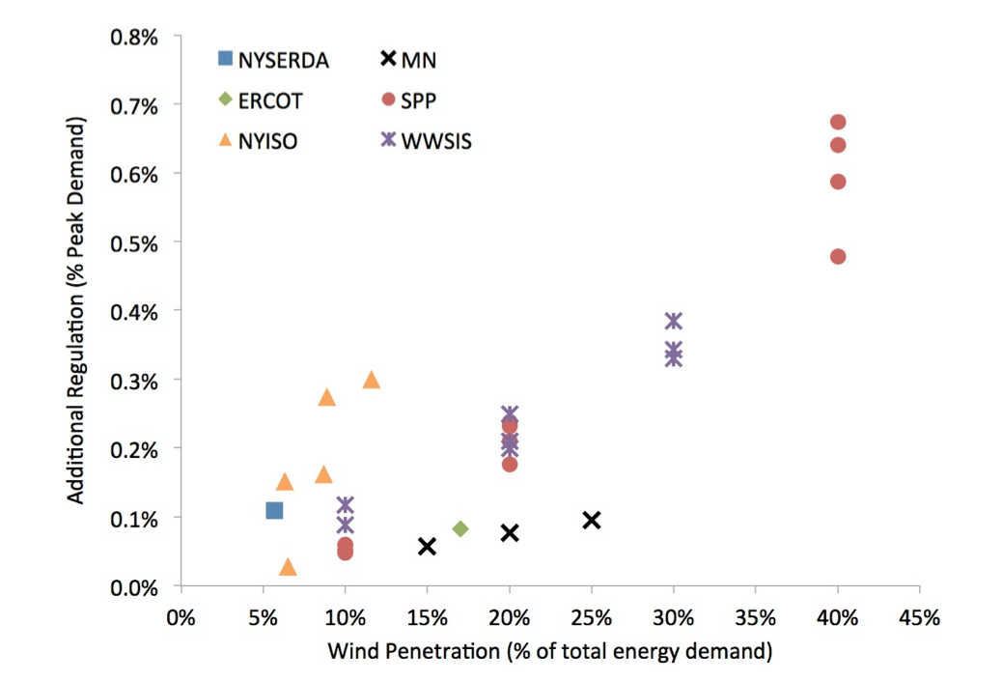
Literature
Current Wind Studies
Few penetration levels considered (Dowds, 2014)
Lack of Dynamic Models (Holttinen, 2013; Kema, 2010)
Statistics
Inertia (Apt, 2009; O’Malley 2009)
Notes:
More lit (look for papers Friday)
Slide for a) industry studies, b) academic studies (eto, mccalley, o’malley)
Holttinen/Omalley: “Dynamic simulations and flexibility assessment are necessary especially when studying higher penetration levels of wind power.” in Steps to a complete wind int study”

Slide 6
Problem Statement
Quantify the amount of regulation needed to maintain stability for varying wind penetration levels.
Identify how this quantity is influenced by
Dispatch time
Consolidation of balancing area
Amount of inertia
Notes:
Explain each additional parameter
How will we alter inertia?
Talk about why additional parameters matter – cost of regulation

Slide 7
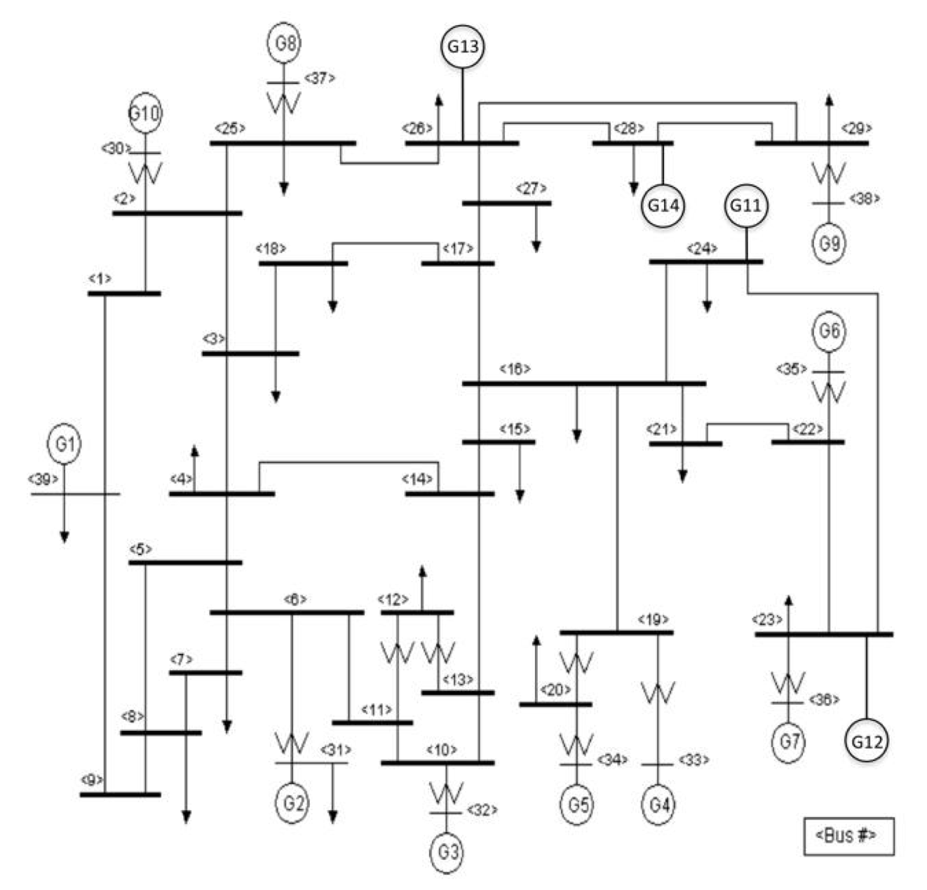
Current Model
Power System
2 Areas
39 Buses Per Area
Wind generators added at buses 23, 24, 26, 28
designates a wind generator
Notes:
Make sure they know wwe’re adding wind into a non-wind model (each gets it’s own profile from real wind farm (2second)

Slide 8
Current Model
Simulation Program
Economic Dispatch (E.D.)
Linear optimization of generation to minimize cost
Numerical Integration
Performance Check
Input Power System
. . .
Check Performance
E.D.
E.D.
E.D.
E.D.
Notes:
Show base cases?
Picture as time line?

Slide 9
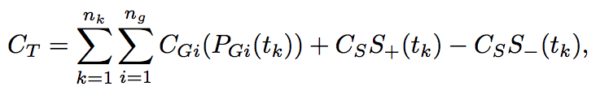




Economic Dispatch
Time Horizon Cost Function
Load-Generation Equilibrium
Generation Limits and Regulation Scheduling
Generator Ramping Limits

Slide 10
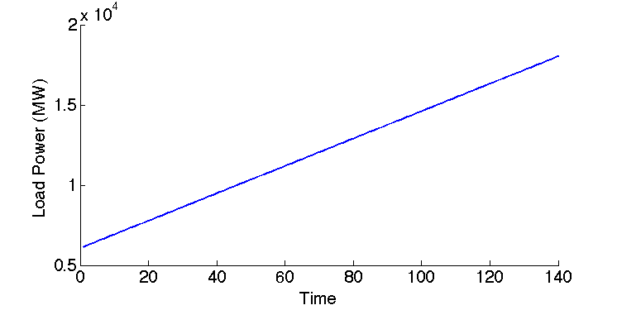
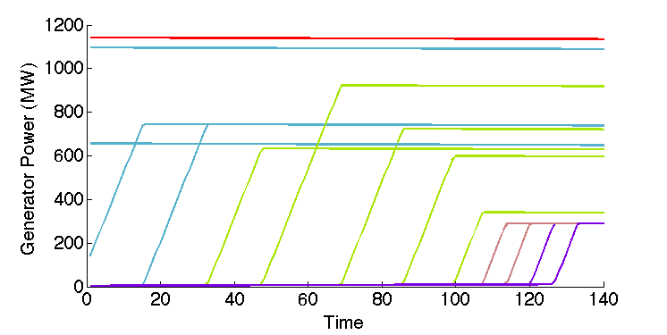
Economic Dispatch
Nuclear
Coal
Combined Cycle Gas
Single Cycle Gas
Oil

Slide 11


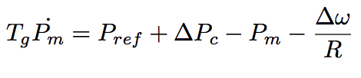

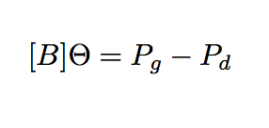
Numerical Integration
Swing Equation: Physical Model of Generator
Droop Control
Automatic Generation Control (A.G.C.)
Algebraic Equations: Power Injection
Notes:
Trap method

Slide 12
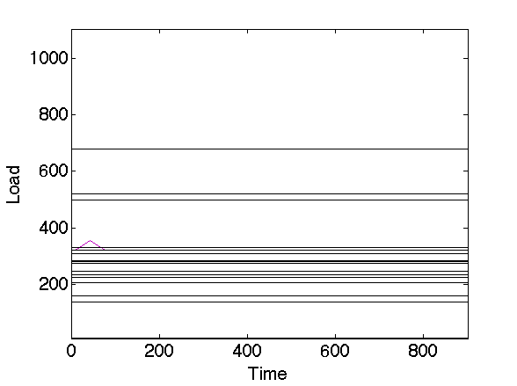
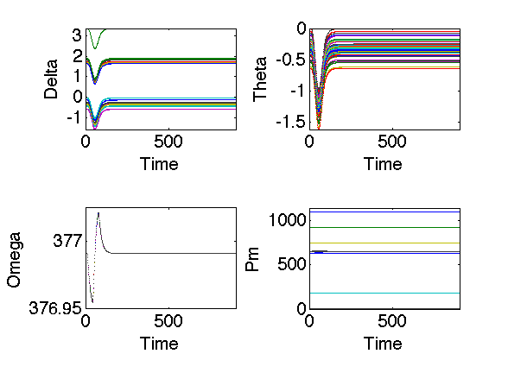
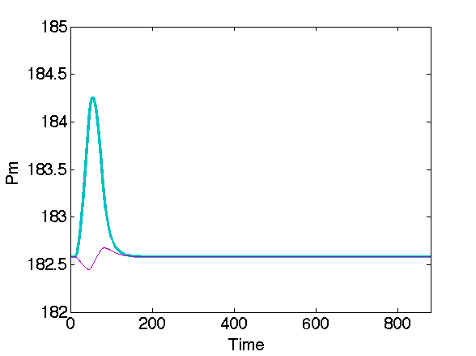
Numerical Integration

Slide 13
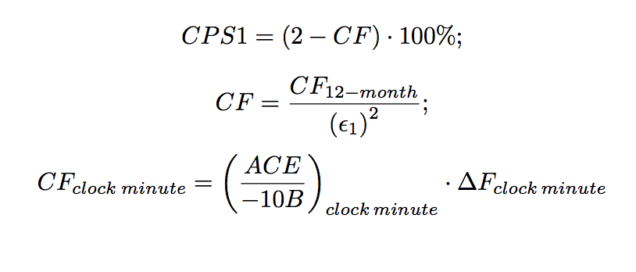
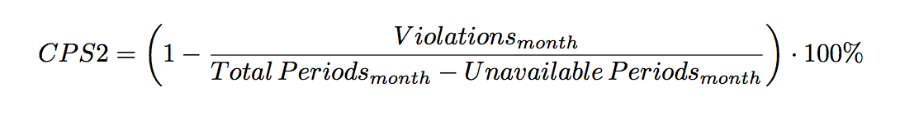
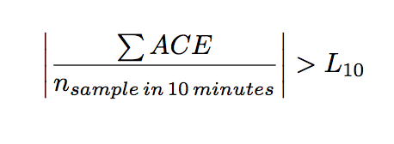
Performance Check
A
SCHEDULED: 100 MW
ACTUAL: 110 MW
B
Notes:
Eval of performance – not stability (stability is 0/1)
Area control picture

Slide 14
Thesis Experiments
Increase regulation percentage from 1% until adequate performance is achieved for a given wind percentage
Increase wind penetration percentages and repeat the above
Determine the functional relationship between wind percentage and required regulation percentage
Decrease dispatch time & measure improvements in stability
Consolidate balancing areas & measure improvements in stability
Vary system inertia and measure changes in stability
Notes:
Explain wind penetration?
Additional params – for each wind penetration level one before?
Any combinations?
Compare to simpler heuristics for regulation – 3stdev, 95%tile,
SPP system’s heuristic?
Regultion vs CPS score plot?
Animate bullets

Slide 15
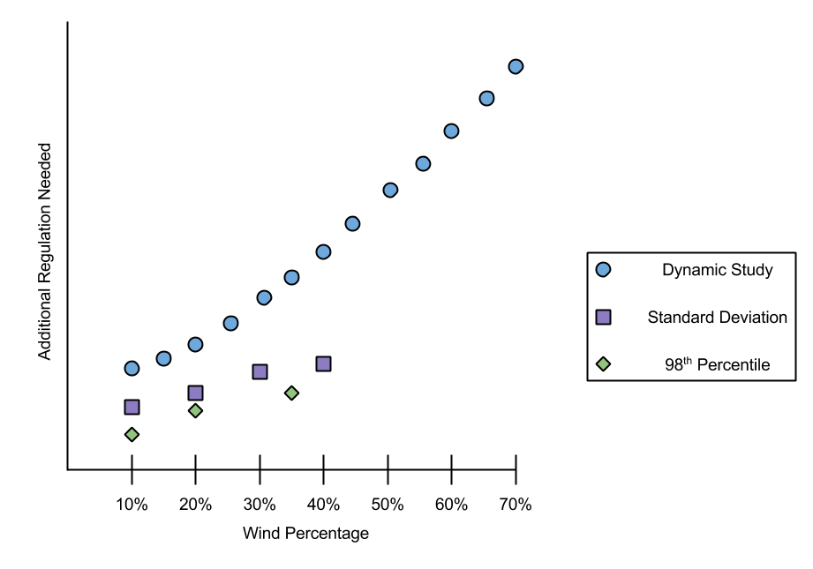
Hypothetical Results
Notes:
Put in slides of prelimnary results (ED (by gen type?), step response for numerical integration),

Slide 16
Thesis Outline
Introduction
Detailed Literature Review
Dynamics
Statistics
Design and Validation of Model
Regulation as a function Wind Percentage
Inertia
Statistics
Decrease in Dispatch Time
Consolidation of Balancing Authority
Conclusions

Slide 17
Works Cited
Jon Dowds et al, A Review of Large-Scale Wind Integration Studies. U.S.: Renewable & Sustainable Energy Reviews, 2014.
Includes review of 11 Industry Wind Studies
KEMA 2010, Research evaluation of wind generation, solar generation, and storage impact on the california grid.: Public Interest Energy Research Program, California Energy Commission.
Katzenstein, Warren & Apt, Jay "Air Emissions Due to Wind and Solar Power," Environmental Science and Technology, vol. 43, no. 2, pp. 253-258, 2009.
Mark O'Malley et al, "Comment on 'Air Emissions Due to Wind and Solar Power'," Environmental Science and Technology, vol. 43, no. 15, pp. 6106-6107, July 2009.
Holttinen, Hannele et al. "Impacts of large amounts of wind power design and operation of power ystems, results of IEA collaboration," Wind Energy, 2010.
Holttinen, Hannele et all "Steps for a Complete Wind Integration Stud," in Hawaii International Conference on System Sciences, 2013

