Slide 1

ESO 208A: Computational Methods in Engineering
Abhas Singh
Department of Civil Engineering
IIT Kanpur
Acknowledgements: Profs. Saumyen Guha and Shivam Tripathi (CE)

Slide 2
Instructor: Abhas Singh
Office: FB 306; Phone: 7665
e-mail: abhas@iitk.ac.in
Course Website: home.iitk.ac.in/~abhas
Tutors:
Section Rm Name Dept Email
1 T103 Arghya Das CE arghya
2 T104 Pradhi Rajeev CE pradhi
3 T105 Anamika Maurya ChE anamikak
T106 Mohammad Khalid ChE mkhalid
T107 Soukat Kumar Das CE soukat
6 T108 Abhishek Savarnya CE savarnya
7 T109 Rahul Yadav ME yrahul
8 T110 Siva Krishna ChE svsiva
9 T111 Arshad Afzal ME aafzal

Slide 3
Text Book
Guha, S. and Srivastava, R. Numerical Method for Engineering and Science, 3rd Reprint 2015, Oxford University Press.
Corrections to the 1st Edition (2010) and 2nd Reprint (2012) are available here: http://home.iitk.ac.in/~rajeshs/ErrorsInFirstEditionNM.pdf
Reference Books
Chapra, S. C., and Canale, R. P. (2012). Numerical Methods for Engineers, 6th Edition, McGraw-Hill Education (India).
Atkinson, K. E. (2008). An Introduction to Numerical Analysis, 2nd Edition, John Wiley & Sons.

Slide 4
Evaluation
Final Exam: 40%
Mid Sem Exam: 25%
Quizzes (2 nos): 10%
Programming Assignments: 10%
Quizzes in Tutorials: 10 %
Class Conduct (attendance, occasional class problems): 3% + 2%
Mark your calendar for the Quiz Dates:
Quiz I: Saturday, August 31, 2019, 10:00-10:40 am
Quiz II: Saturday, November 2, 2019, 10:00-10:40 am
Programming Assignments: MATLAB, C, Python

Slide 5
What are Computational Methods or Numerical Methods in Engineering?
Formulation of mathematical problems in such a way that numerical answers can be computed using arithmetic operations in a computer
Computer can only perform: + - × /
All kinds of problems can be solved: linear and non-linear systems of equations; approximation and interpolation of data; differentiation and integration, ODE, PDE

Slide 6
Objectives of the course
Introduce you to computational methods and algorithms for the solution of engineering problems.
Familiarize you to the algorithms behind the software packages so that you don’t use them as black boxes.
Expose you to the analysis of these algorithms so that, if needed, you can modify an existing algorithm or develop your own algorithm for the problem at hand.

Slide 7
Scope of the course
Engineering Problems
Physical laws/rules/ relationships
Data
Initial/Boundary conditions
Mathematical Models
Experimental
Numerical
Analytical
Computational Resources
Methods/Algorithms
Programming
Results

Slide 8
Recap
What are computational methods? How they are used for solving engineering problems?
The choice of computational method depends on the problem and intended use of the results.
Example: Object falling from a building
Formulation of mathematical model
Choice of methods, convergence, convergence rate, errors [model, data, round-off and truncation], propagation of errors, stability & condition number.
Number representation in computers
Binary and decimal representation

Slide 10
What is Numerical Analysis ?
Mathematical method to analyze whether the solution obtained from a Numerical Method represents the solution of the original mathematical problem !
A way to test for convergence!
Convergence can be conditional or unconditional!
A method cannot be used for a given problem without the analysis!

Slide 11
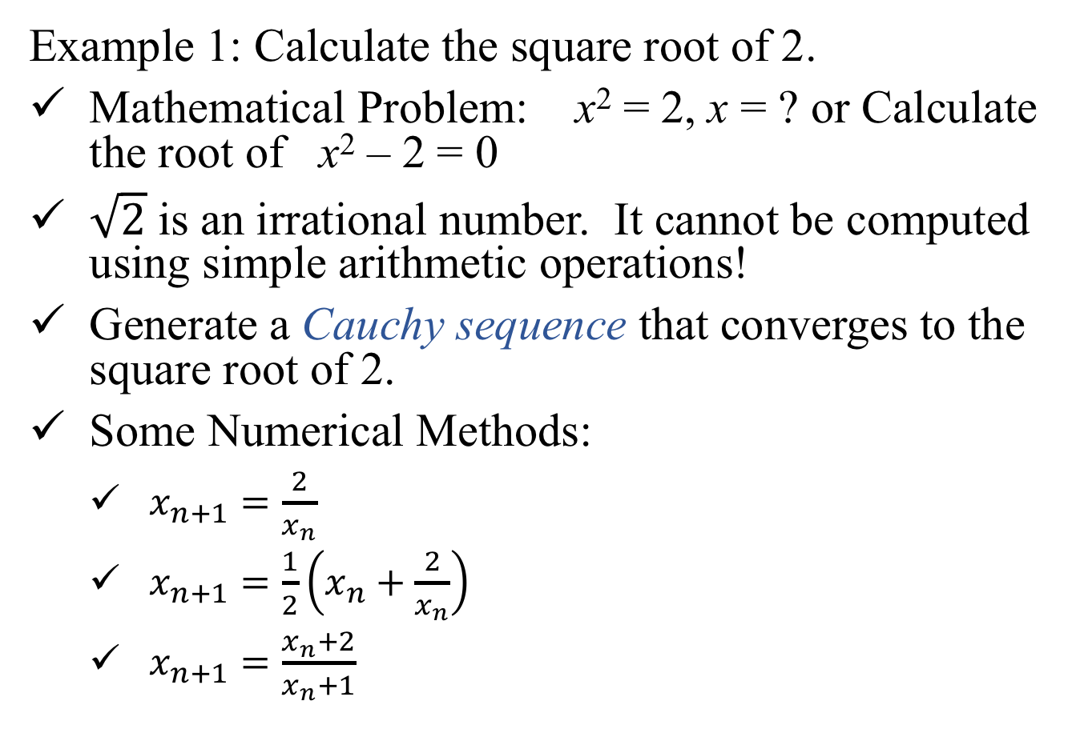
Example 1: Calculate the square root of 2.
Mathematical Problem: x² = 2, x = ? or Calculate the root of x² – 2 = 0
$\sqrt{2}$ is an irrational number. It cannot be computed using simple arithmetic operations!
Generate a Cauchy sequence that converges to the square root of 2.
Some Numerical Methods:
$x_{n+1}=\frac{2}{x_{n}}$
$x_{n+1}=\frac{1}{2}\left(x_{n}+\frac{2}{x_{n}}\right)$
$x_{n+1}=\frac{x_{n}+2}{x_{n}+1}$

Slide 12
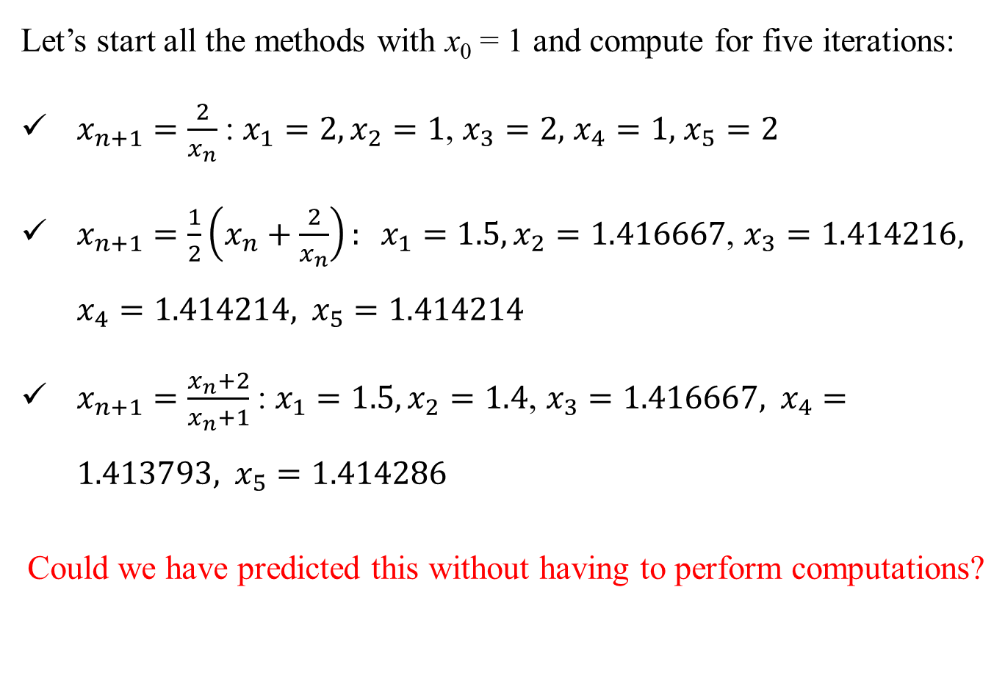
Let’s start all the methods with x₀ = 1 and compute for five iterations:
$x_{n+1}=\frac{2}{x_{n}}$: $x_{1}=2,x_{2}=1$, $x_{3}=2,$ $x_{4}=1,$ $x_{5}=2$
$x_{n+1}=\frac{1}{2}\left(x_{n}+\frac{2}{x_{n}}\right): x_{1}=1.5,x_{2}=1.416667\text{, }x_{3}=1.414216, x_{4}=1.414214, x_{5}=1.414214$
$x_{n+1}=\frac{x_{n}+2}{x_{n}+1}$: $x_{1}=1.5,x_{2}=1.4\text{, }x_{3}=1.416667, x_{4}=1.413793, x_{5}=1.414286$
Could we have predicted this without having to perform computations?

Slide 13
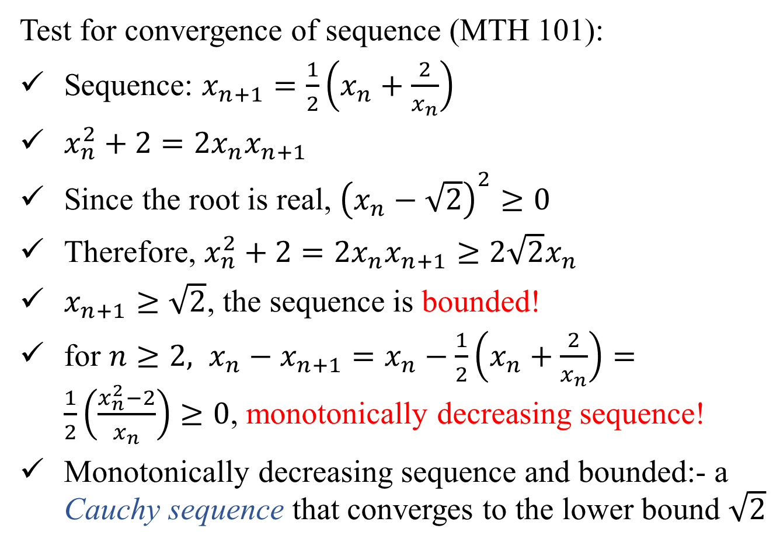
Test for convergence of sequence (MTH 101):
Sequence: $x_{n+1}=\frac{1}{2}\left(x_{n}+\frac{2}{x_{n}}\right)$
$x_{n}^{2}+2=2x_{n}x_{n+1}$
Since the root is real, ${\left(x_{n}−\sqrt{2}\right)}^{2}≥0$
Therefore, $x_{n}^{2}+2=2x_{n}x_{n+1}≥2\sqrt{2}x_{n}$
$x_{n+1}≥\sqrt{2}$, the sequence is bounded!
for $n≥2, x_{n}−x_{n+1}=x_{n}−\frac{1}{2}\left(x_{n}+\frac{2}{x_{n}}\right)=\frac{1}{2}\left(\frac{x_{n}^{2}−2}{x_{n}}\right)≥0$, monotonically decreasing sequence!
Monotonically decreasing sequence and bounded:- a Cauchy sequence that converges to the lower bound $\sqrt{2}$

Slide 14
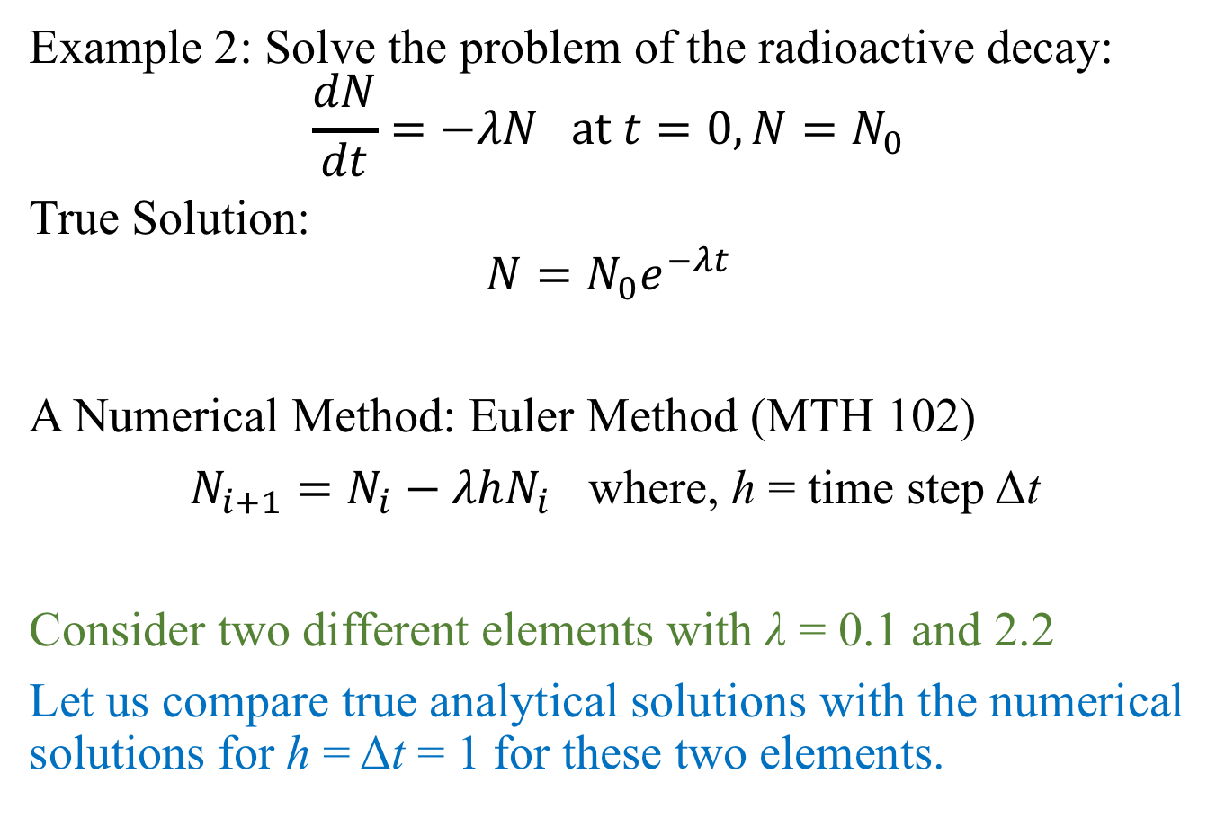
Example 2: Solve the problem of the radioactive decay:
$$\frac{dN}{dt}=−λN at t=0, N=N_{0}$$
True Solution:
$$N=N_{0}e^{−λt}$$
A Numerical Method: Euler Method (MTH 102)
$N_{i+1}=N_{i}−λhN_{i}$ where, h = time step Δt
Consider two different elements with λ = 0.1 and 2.2
Let us compare true analytical solutions with the numerical solutions for h = Δt = 1 for these two elements.

Slide 15
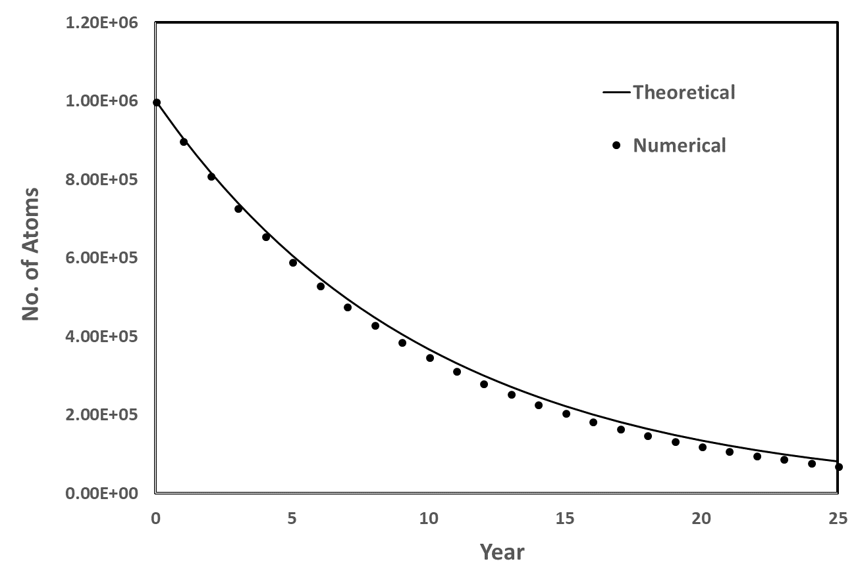
λ = 0.1 /day, N₀ = 10⁶, h = Δt = 1, solution for 25 days
There is some error but the numerical solution behaves like the true solution

Slide 16
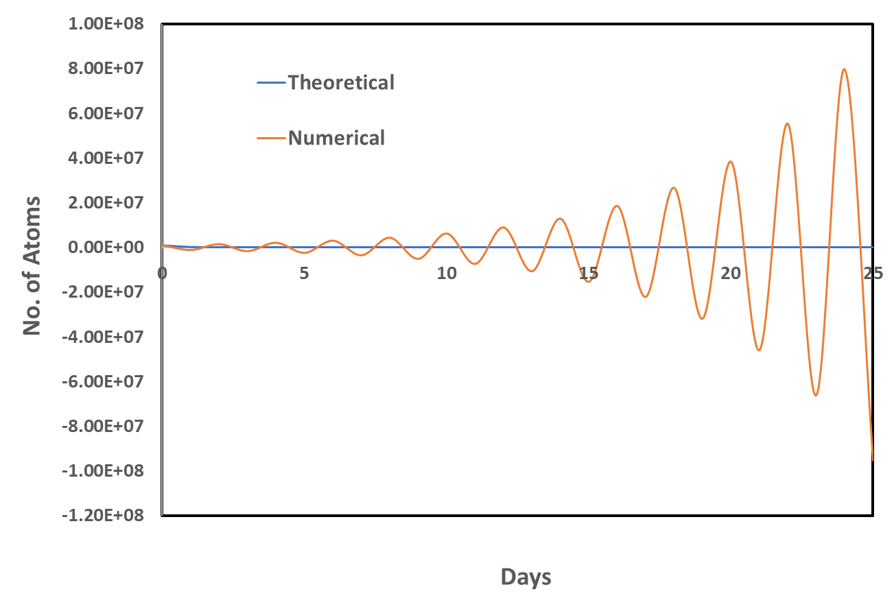
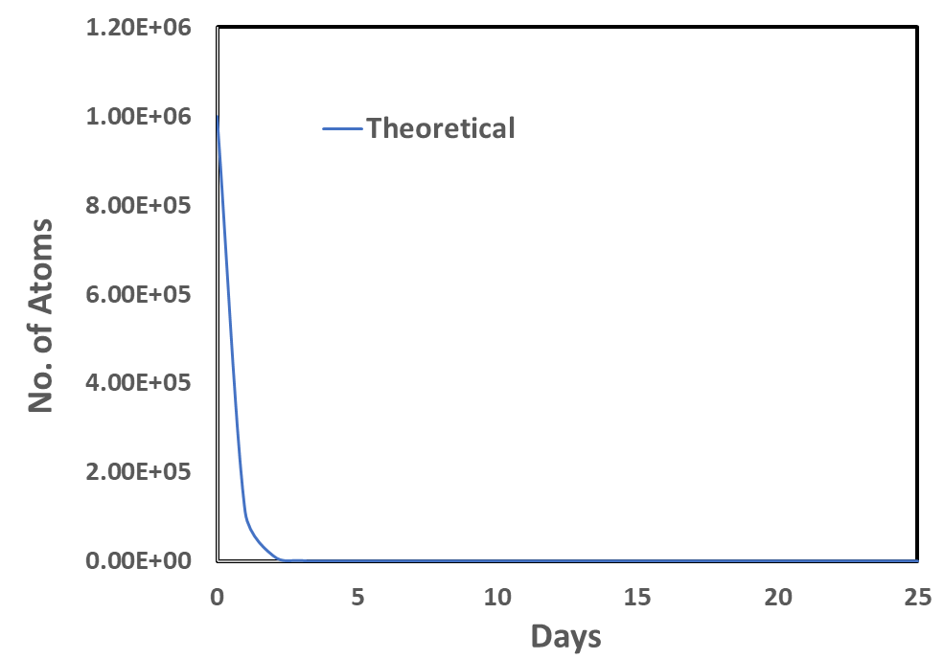
λ = 2.2 /day, N₀ = 10⁶, h = Δt = 1, solution for 25 days
The error can grow to make the solution unacceptable!
Numerical analysis could have told me this, saving much time of programming and computation!

Slide 17
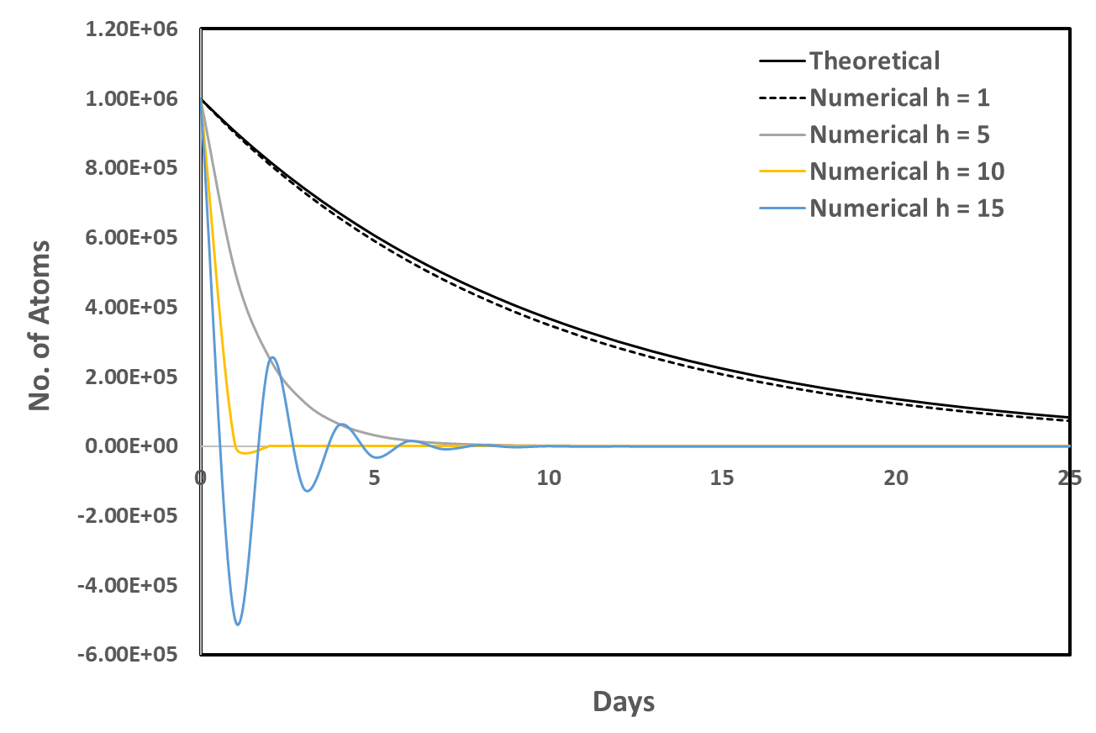
λ = 0.1 /day, N₀ = 10⁶, varying h, solution for 25 days
Numerical analysis could have told me this, saving much time of programming and computation!

Slide 18
Take away message:
Learning Numerical Analysis is as important as the Numerical Method for you to be able to apply the method for a given problem!!
This is true irrespective of whether you are writing the program or using an existing program or package or software!

Slide 19
Errors and Error Analysis

Slide 20
Accuracy vs Precision
Accuracy - How closely a measured/computed value agrees with the true value
opposite sense: Inaccuracy (or bias) A systematic deviation from the actual value
Precision (or reproducibility)- How closely individual computed/measured values agree with each other
opposite sense: Imprecision (or uncertainty). Magnitude of scatter

Slide 21
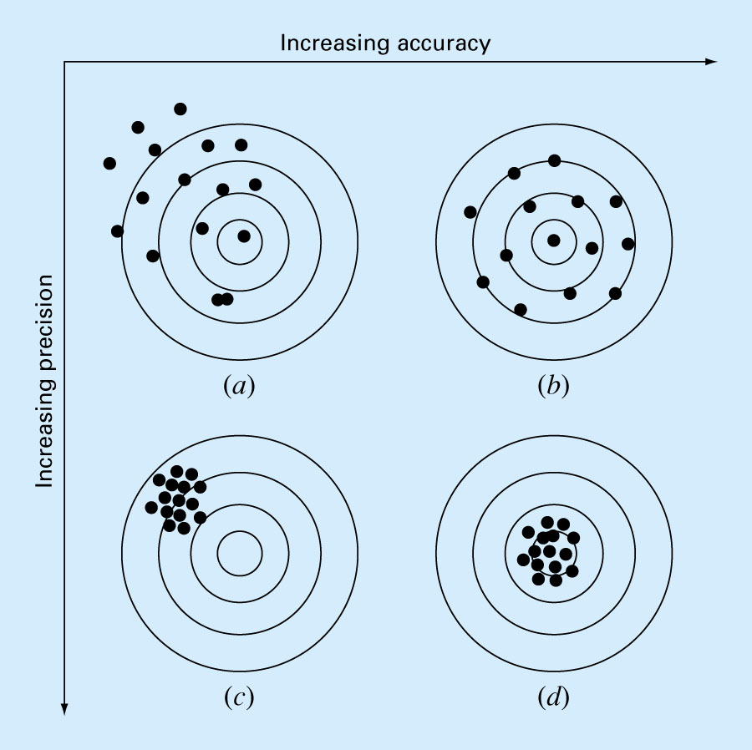
Errors and Error Analysis
Source: Chapra and Canale

Slide 22
Significant digits
Number | Significant digits | Rule
228.18 | 5 | All non-zero digits are significant
10.08 | 4 | Zeros between non-zero digits are significant.
0034.5 | 3 | Leading zeros are not significant.
34.500 | 5 | In a decimal number trailing zeros are significant.
34500 | 3 or 4 or 5 | In a non-decimal number trailing zeros may or may not be significant
3.450 x 10⁴ | 4 | No ambiguity in scientific notation

Slide 23
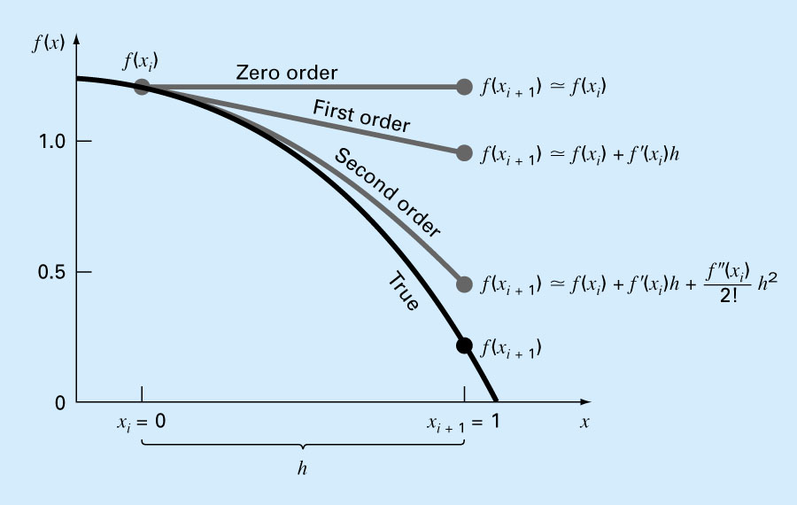
Truncation error
Source: Chapra and Canale

Slide 24
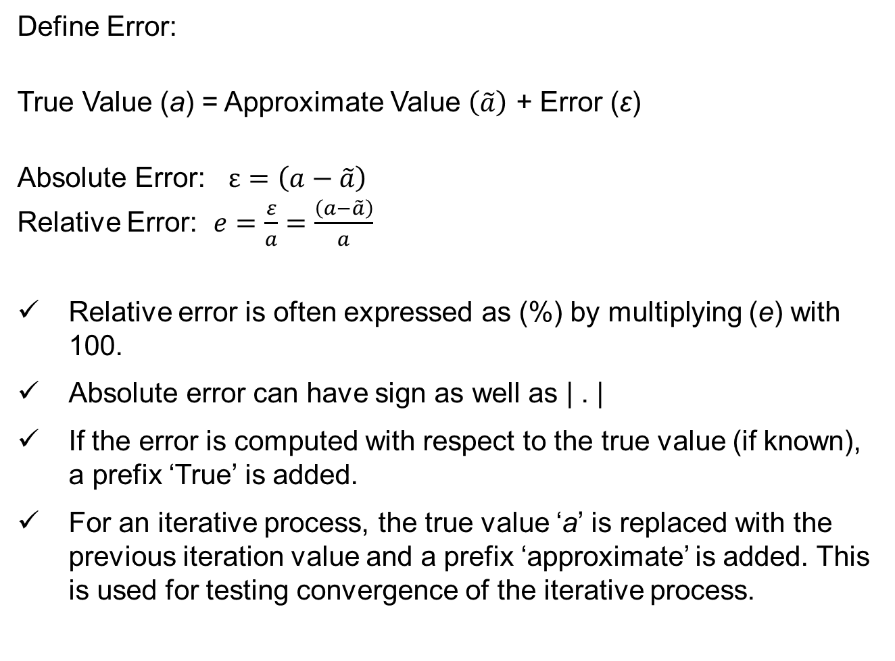
Define Error:
True Value (a) = Approximate Value $\left(\tilde{a}\right)$ + Error (ε)
Absolute Error: $ε=\left(a−\tilde{a}\right)$
Relative Error: $e=\frac{ε}{a}=\frac{\left(a−\tilde{a}\right)}{a}$
Relative error is often expressed as (%) by multiplying (e) with 100.
Absolute error can have sign as well as | . |
If the error is computed with respect to the true value (if known), a prefix ‘True’ is added.
For an iterative process, the true value ‘a’ is replaced with the previous iteration value and a prefix ‘approximate’ is added. This is used for testing convergence of the iterative process.

Slide 25
Sources of Error in computation?
Errors in the Input data: initial and boundary conditions, measured values of the parameters and constants in the model
Round-off error: irrational numbers, product and division of two numbers, limited by the machine capability
Truncation error: truncation of an infinite series, often arises in the design of the numerical method through approximation of the mathematical problem.

Slide 26
Integer Representation
Binary | Unsigned | Signed bit | Excess-p | 2’s complement
000 | 0 | 0 | -3 | 0
001 | 1 | 1 | -2 | 1
010 | 2 | 2 | -1 | 2
011 | 3 | 3 | 0 | 3
100 | 4 | -0 | 1 | -4
101 | 5 | -1 | 2 | -3
110 | 6 | -2 | 3 | -2
111 | 7 | -3 | 4 | -1

