Slide 1
Methods for Solution of the System of Equations:
Ax = b
Direct Methods: one obtains the exact solution (ignoring the round-off errors) in a finite number of steps. These group of methods are more efficient for dense and banded matrices.
Gauss Elimination; Gauss-Jordon Elimination
LU-Decomposition
Thomas Algorithm (for tri-diagonal banded matrix)

Slide 2
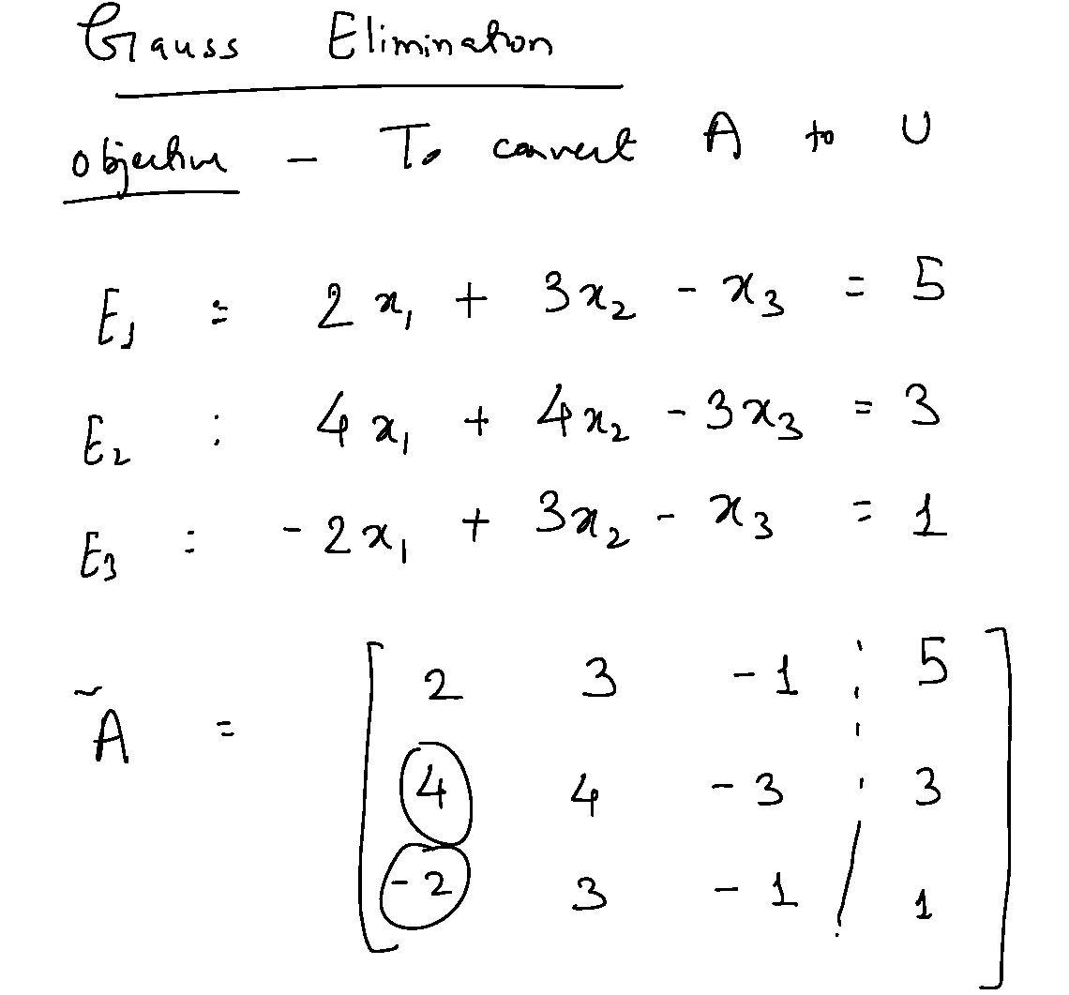

Slide 3
LU-Decomposition: A general method
Ax = b
In most engineering problems, the matrix A remains constant while the vector b changes with time. The matrix A describes the system and the vector b describes the external forcing. e.g., all network problems (pipes, electrical, canal, road, reactors, etc.); structural frames; many financial analyses.
If all b’s are available together, one can solve the system by augmented matrix but in practice, they are not!
Instead of performing ⁓ n³ floating point operations to solve whenever a new b becomes available, it is possible to solve the system by performing ⁓ n² floating point operations if a LU Decomposition is available for matrix A
LU-decomposition requires ⁓ n³ floating point operations!

Slide 4
Consider the system: (b changes!)
Ax = b
Perform a decomposition of the form A = LU, where L is a lower-triangular and U is an upper-triangular matrix!
LU-decomposition requires ⁓ n³ floating point operations!
For any given b, solve Ax = LUx = b
This is equivalent to solving two triangular systems:
Solve Ly = b using forward substitution to obtain y (~n² operations)
Solve Ux = y using back substitution to obtain x (~n² operations)
Most frequently used method for engineering applications!
We will derive LU-decomposition from Gauss Elimination!

Slide 5
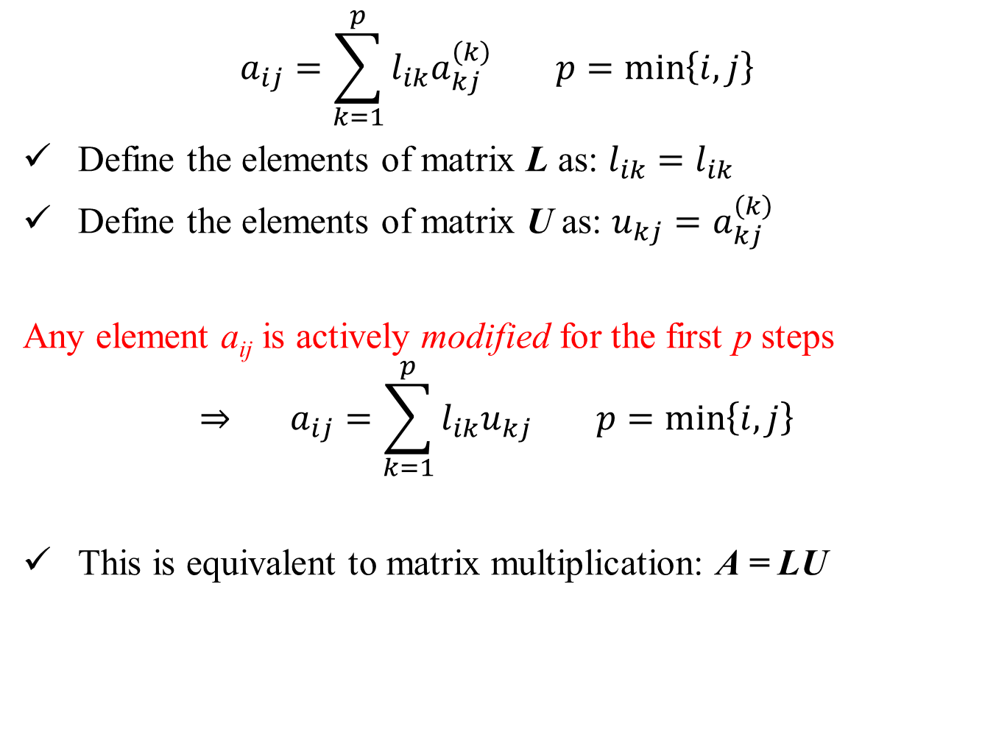
$$a_{ij}=\sum_{k=1}^{p}{l_{ik}a_{kj}^{\left(k\right)}} p=\min\left\{i,j\right\}$$
Define the elements of matrix L as: $l_{ik}=l_{ik}$
Define the elements of matrix U as: $u_{kj}=a_{kj}^{\left(k\right)}$
Any element a_{ij} is actively modified for the first p steps
$$⇒ a_{ij}=\sum_{k=1}^{p}{l_{ik}u_{kj}} p=\min\left\{i,j\right\}$$
This is equivalent to matrix multiplication: A = LU

Slide 6
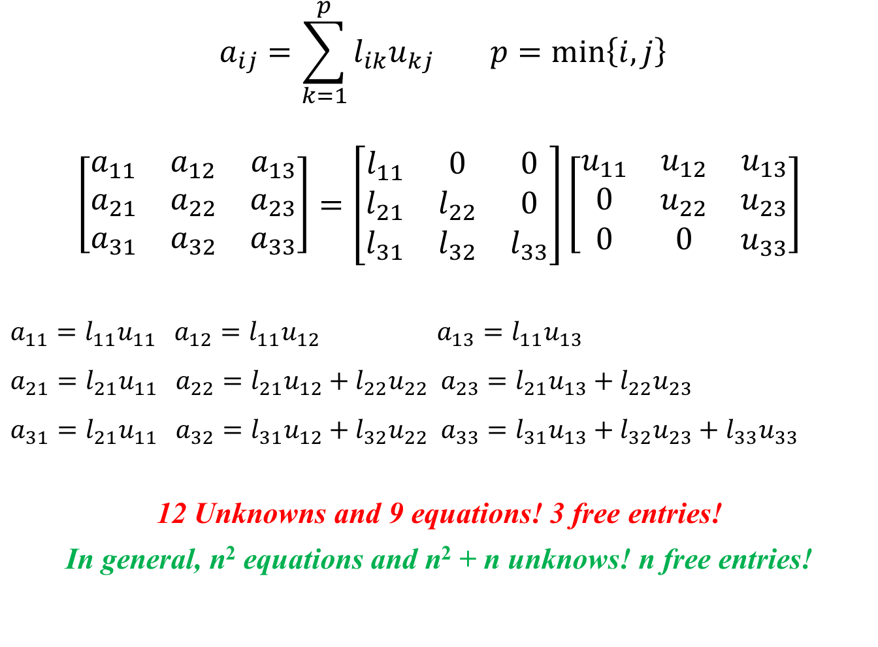
$$a_{ij}=\sum_{k=1}^{p}{l_{ik}u_{kj}} p=\min\left\{i,j\right\}$$
$$\left[\begin{matrix}a_{11} & a_{12} & a_{13} \\ a_{21} & a_{22} & a_{23} \\ a_{31} & a_{32} & a_{33}\end{matrix}\right]=\left[\begin{matrix}l_{11} & 0 & 0 \\ l_{21} & l_{22} & 0 \\ l_{31} & l_{32} & l_{33}\end{matrix}\right]\left[\begin{matrix}u_{11} & u_{12} & u_{13} \\ 0 & u_{22} & u_{23} \\ 0 & 0 & u_{33}\end{matrix}\right]$$
$a_{11}=l_{11}u_{11}$ $a_{12}=l_{11}u_{12}$ $a_{13}=l_{11}u_{13}$
$a_{21}=l_{21}u_{11}$ $a_{22}=l_{21}u_{12}+l_{22}u_{22} a_{23}=l_{21}u_{13}+l_{22}u_{23}$
$a_{31}=l_{21}u_{11}$ $a_{32}=l_{31}u_{12}+l_{32}u_{22} a_{33}=l_{31}u_{13}+l_{32}u_{23}+l_{33}u_{33}$
12 Unknowns and 9 equations! 3 free entries!
In general, n² equations and n² + n unknows! n free entries!

Slide 7

Doolittle’s Algorithm:
Define: $l_{ii}=l_{jj}=1$
The U matrix: i ≤ j
$$u_{ij}=a_{ij}−\sum_{k=1}^{i−1}{l_{ik}u_{kj}} i=1,2,…n; j=i,i+1,…n$$
The L matrix: j < i
$$a_{ij}= \sum_{k=1}^{j}{l_{ik}u_{kj}}$$
$$l_{ij}=\frac{a_{ij}−\sum_{k=1}^{j−1}{l_{ik}u_{kj}}}{u_{jj}} i=j+1,…n; j=1,2,…n$$

Slide 8
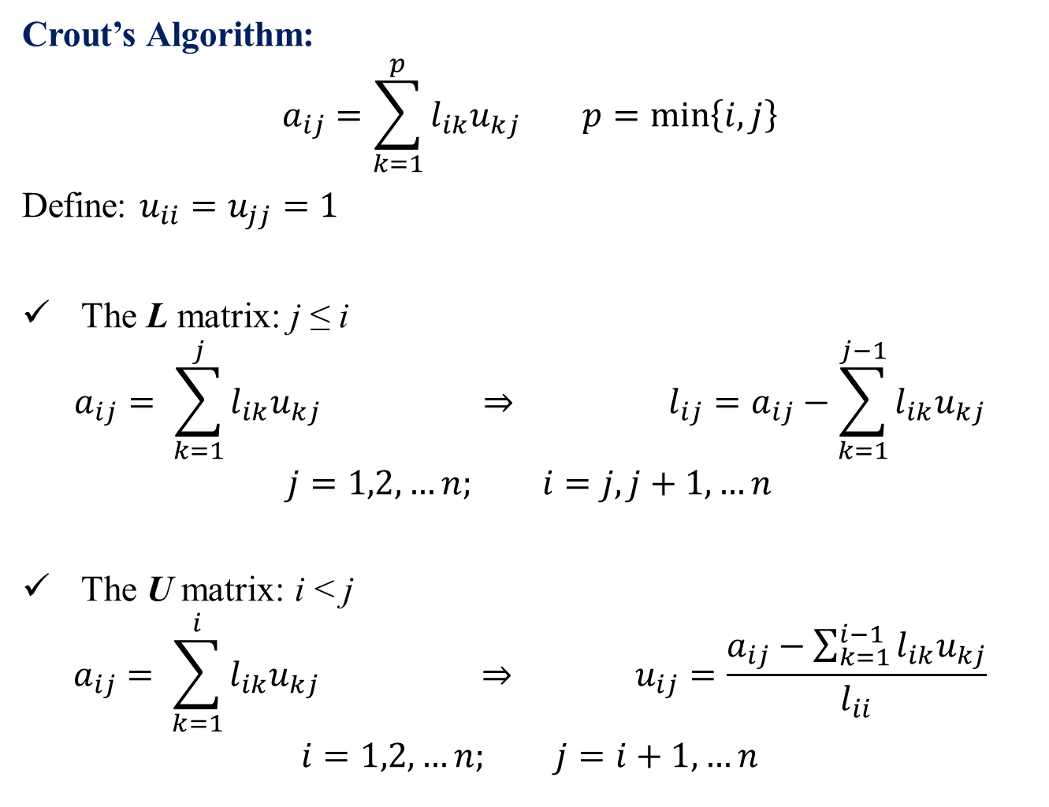
Crout’s Algorithm:
$$a_{ij}=\sum_{k=1}^{p}{l_{ik}u_{kj}} p=\min\left\{i,j\right\}$$
Define: $u_{ii}=u_{jj}=1$
The L matrix: j ≤ i
$$a_{ij}= \sum_{k=1}^{j}{l_{ik}u_{kj}} ⇒ l_{ij}=a_{ij}−\sum_{k=1}^{j−1}{l_{ik}u_{kj}}$$
$$j=1,2,…n; i=j, j+1,…n$$
The U matrix: i < j
$$a_{ij}= \sum_{k=1}^{i}{l_{ik}u_{kj}} ⇒ u_{ij}=\frac{a_{ij}−\sum_{k=1}^{i−1}{l_{ik}u_{kj}}}{l_{ii}}$$
$$i=1,2,…n; j=i+1,…n$$

Slide 9

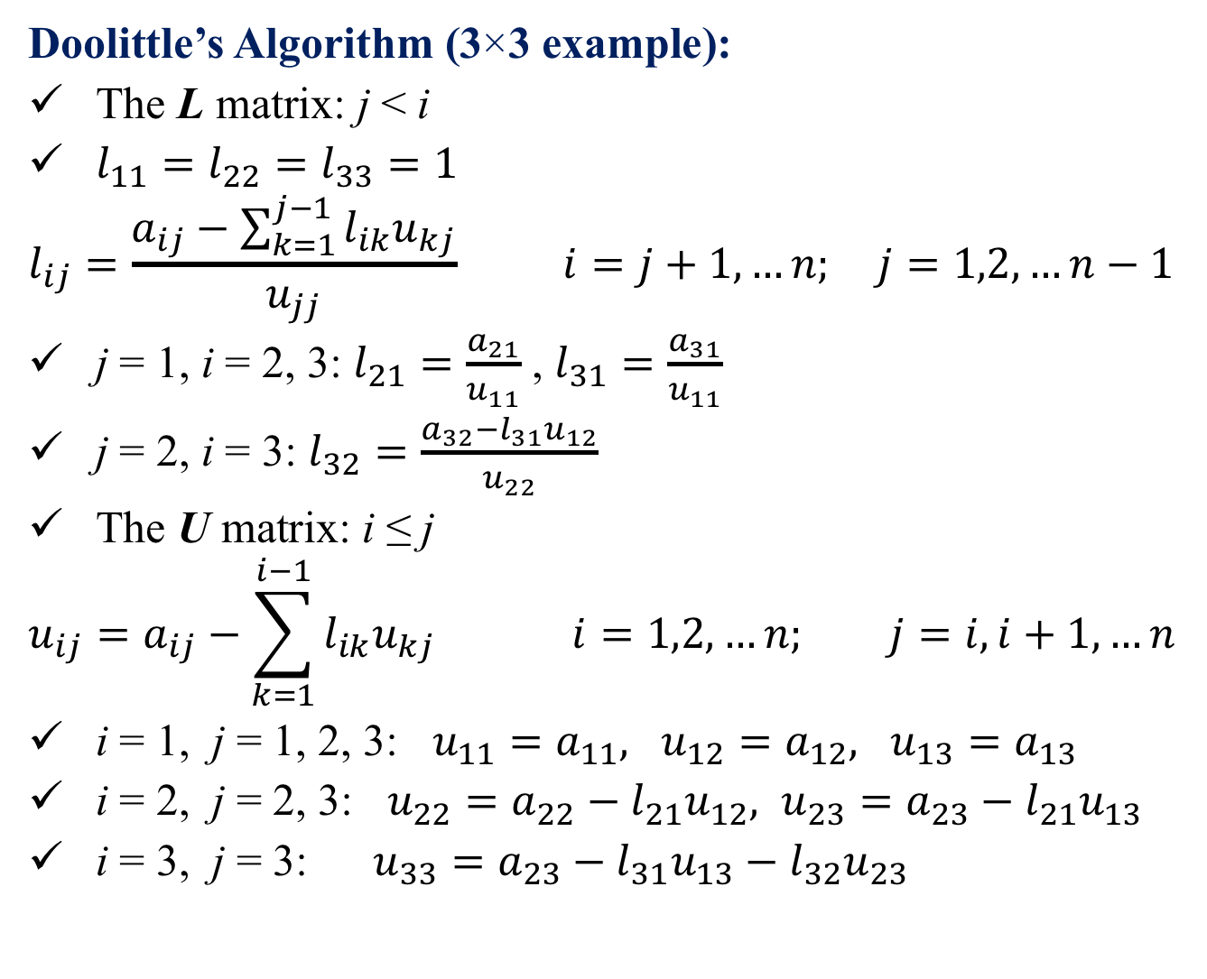

Doolittle’s Algorithm (3×3 example):
The L matrix: j < i
$l_{11}=l_{22}=l_{33}=1$
$$l_{ij}=\frac{a_{ij}−\sum_{k=1}^{j−1}{l_{ik}u_{kj}}}{u_{jj}} i=j+1,…n; j=1,2,…n−1$$
j = 1, i = 2, 3: $l_{21}=\frac{a_{21}}{u_{11}}$ , $l_{31}=\frac{a_{31}}{u_{11}}$
j = 2, i = 3: $l_{32}=\frac{a_{32}−l_{31}u_{12}}{u_{22}}$
The U matrix: i ≤ j
$$u_{ij}=a_{ij}−\sum_{k=1}^{i−1}{l_{ik}u_{kj}} i=1,2,…n; j=i,i+1,…n$$
i = 1, j = 1, 2, 3: $u_{11}=a_{11}, u_{12}=a_{12}, u_{13}=a_{13}$
i = 2, j = 2, 3: $u_{22}=a_{22}−l_{21}u_{12}, u_{23}=a_{23}−l_{21}u_{13}$
i = 3, j = 3: $u_{33}=a_{23}−l_{31}u_{13}−l_{32}u_{23}$
2
4
$$\left[\begin{matrix}1 & 0 & 0 \\ l_{21} & 1 & 0 \\ l_{31} & l_{32} & 1\end{matrix}\right]$$
1
$$\left[\begin{matrix}u_{11} & u_{12} & u_{13} \\ 0 & u_{22} & u_{23} \\ 0 & 0 & u_{33}\end{matrix}\right]$$
3
5

Slide 10

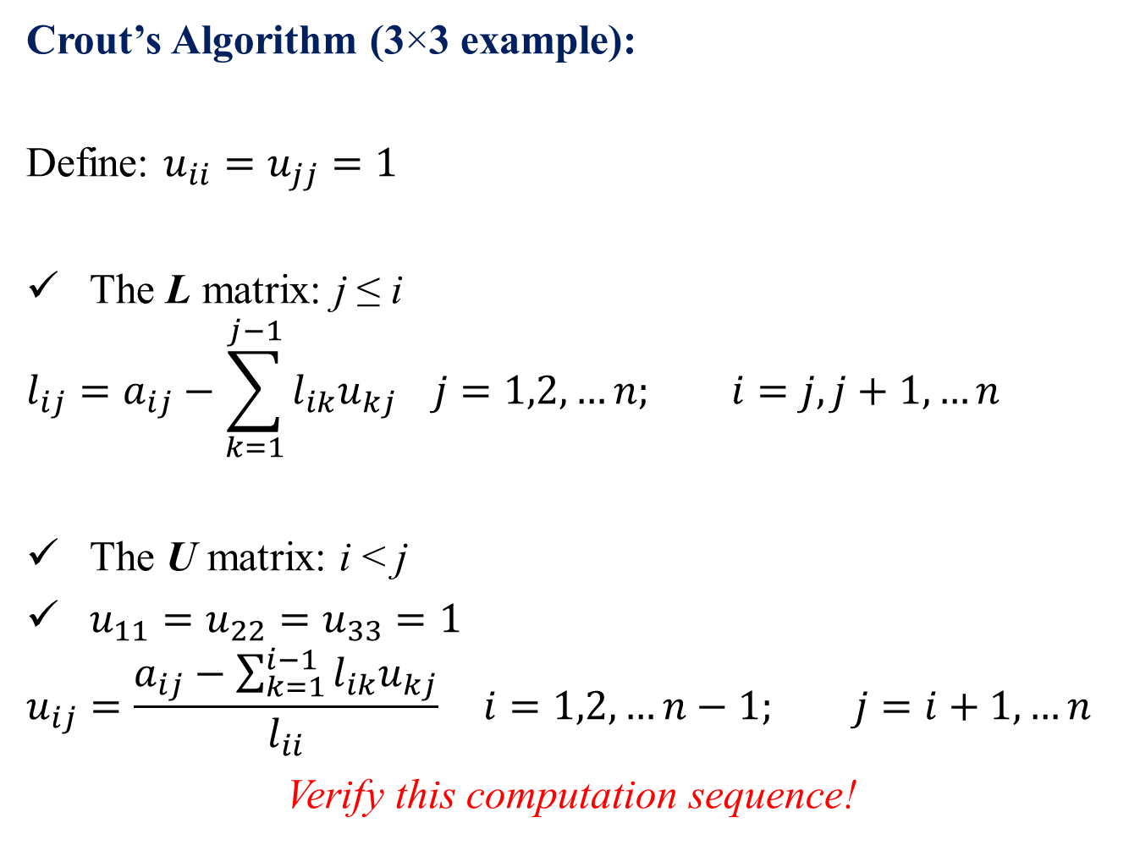

Crout’s Algorithm (3×3 example):
Define: $u_{ii}=u_{jj}=1$
The L matrix: j ≤ i
$$l_{ij}=a_{ij}−\sum_{k=1}^{j−1}{l_{ik}u_{kj}} j=1,2,…n; i=j, j+1,…n$$
The U matrix: i < j
$u_{11}=u_{22}=u_{33}=1$
$$u_{ij}=\frac{a_{ij}−\sum_{k=1}^{i−1}{l_{ik}u_{kj}}}{l_{ii}} i=1,2,…n−1; j=i+1,…n$$
Verify this computation sequence!
1
3
5
$$\left[\begin{matrix}l_{11} & 0 & 0 \\ l_{21} & l_{22} & 0 \\ l_{31} & l_{32} & l_{33}\end{matrix}\right]$$
2
$$\left[\begin{matrix}1 & u_{12} & u_{13} \\ 0 & 1 & u_{23} \\ 0 & 0 & 1\end{matrix}\right]$$
4

Slide 11
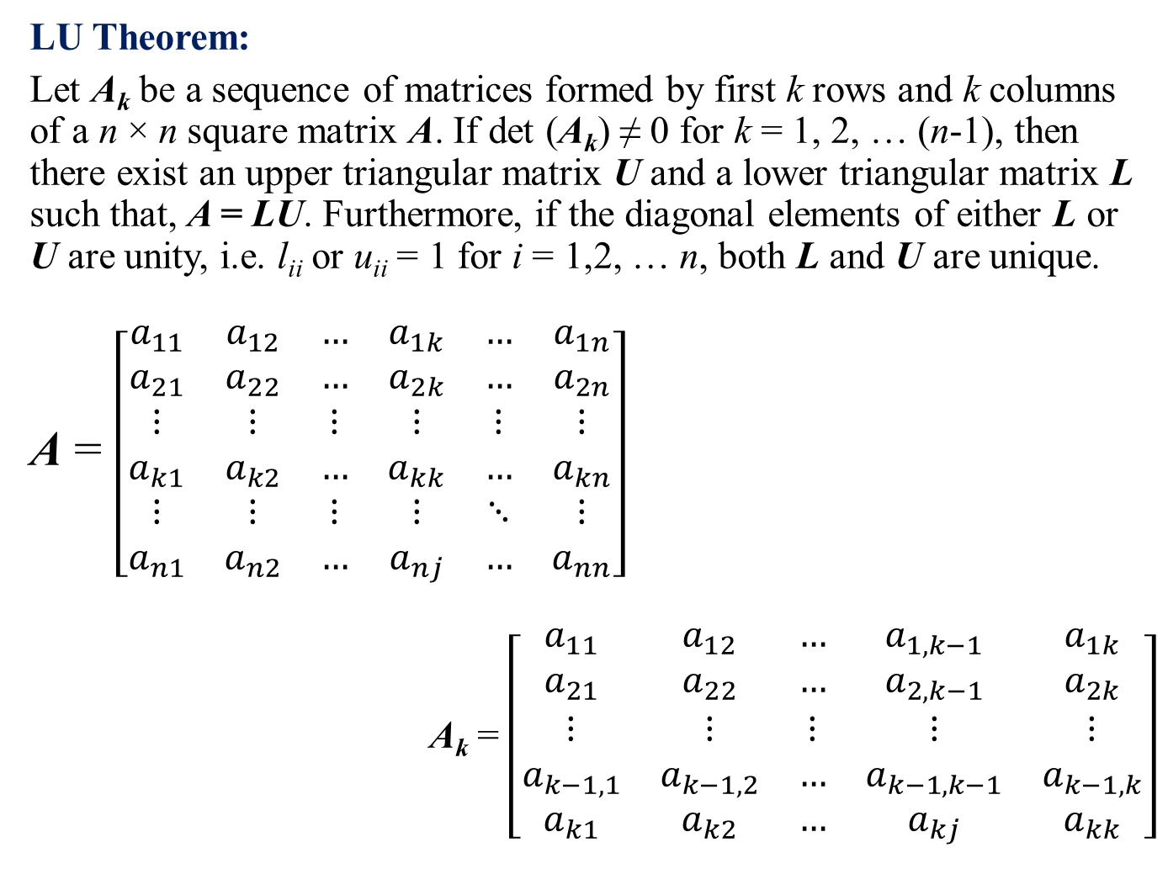
LU Theorem:
Let A_{k} be a sequence of matrices formed by first k rows and k columns of a n × n square matrix A. If det (A_{k}) ≠ 0 for k = 1, 2, … (n-1), then there exist an upper triangular matrix U and a lower triangular matrix L such that, A = LU. Furthermore, if the diagonal elements of either L or U are unity, i.e. l_{ii} or u_{ii} = 1 for i = 1,2, … n, both L and U are unique.
A = $\left[\begin{matrix}a_{11} & a_{12} & … & a_{1k} & … & a_{1n} \\ a_{21} & a_{22} & … & a_{2k} & … & a_{2n} \\ ⋮ & ⋮ & ⋮ & ⋮ & ⋮ & ⋮ \\ a_{k1} & a_{k2} & … & a_{kk} & … & a_{kn} \\ ⋮ & ⋮ & ⋮ & ⋮ & ⋱ & ⋮ \\ a_{n1} & a_{n2} & … & a_{nj} & … & a_{nn}\end{matrix}\right]$
A_{k} = $\left[\begin{matrix}a_{11} & a_{12} & … & a_{1,k−1} & a_{1k} \\ a_{21} & a_{22} & … & a_{2,k−1} & a_{2k} \\ ⋮ & ⋮ & ⋮ & ⋮ & ⋮ \\ a_{k−1,1} & a_{k−1,2} & … & a_{k−1,k−1} & a_{k−1,k} \\ a_{k1} & a_{k2} & … & a_{kj} & a_{kk}\end{matrix}\right]$
A_{k}
For k = 1, the theorem is trivially valid!
A_{k-1}
b
Let’s assume that, the theorem is valid for (k - 1) and prove it for k
c^{T}

Slide 12
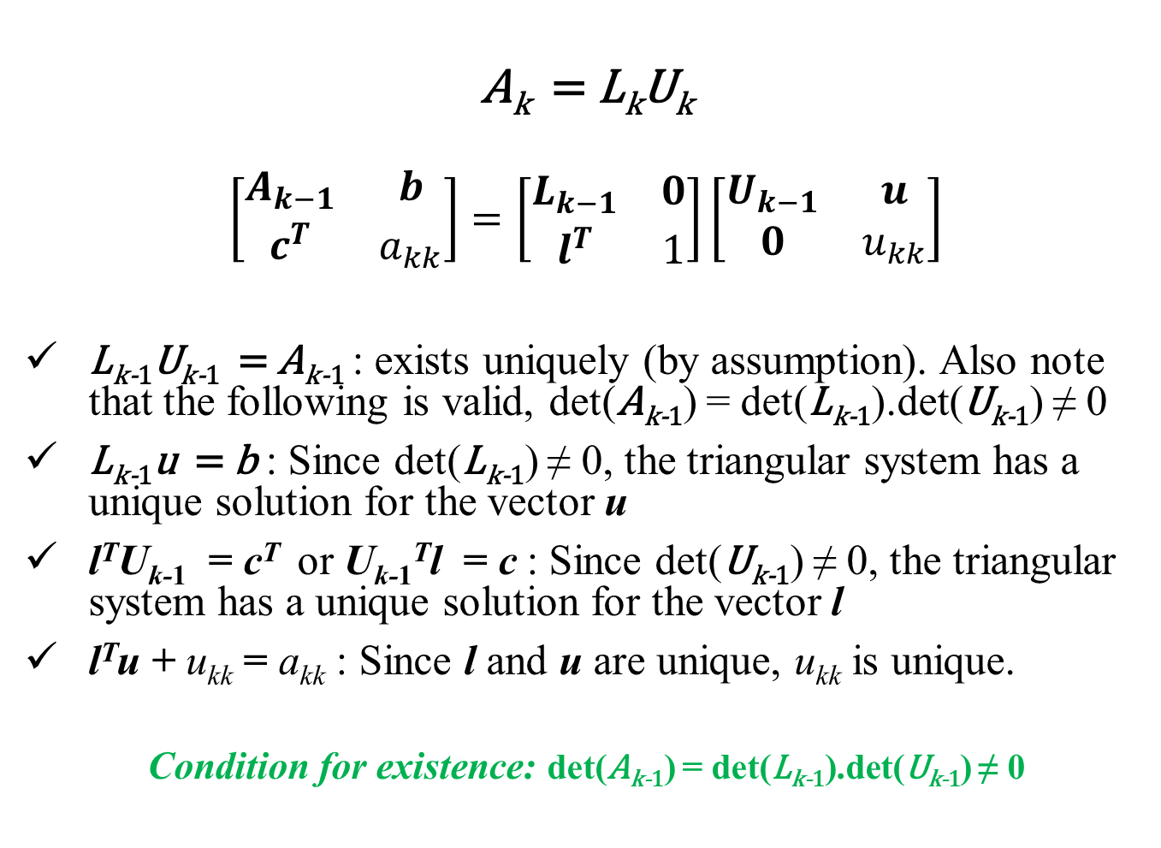
A_{k} = L_{k}U_{k}
$$\left[\begin{matrix}A_{k−1} & b \\ c^{T} & a_{kk}\end{matrix}\right]=\left[\begin{matrix}L_{k−1} & 0 \\ l^{T} & 1\end{matrix}\right]\left[\begin{matrix}U_{k−1} & u \\ 0 & u_{kk}\end{matrix}\right]$$
L_{k-1}U_{k-1} = A_{k-1} : exists uniquely (by assumption). Also note that the following is valid, det(A_{k-1}) = det(L_{k-1}).det(U_{k-1}) ≠ 0
L_{k-1}u = b : Since det(L_{k-1}) ≠ 0, the triangular system has a unique solution for the vector u
l^{T}U_{k-1} = c^{T} or U_{k-1}^{T}l = c : Since det(U_{k-1}) ≠ 0, the triangular system has a unique solution for the vector l
l^{T}u + u_{kk} = a_{kk} : Since l and u are unique, u_{kk} is unique.
Condition for existence: det(A_{k-1}) = det(L_{k-1}).det(U_{k-1}) ≠ 0

Slide 13
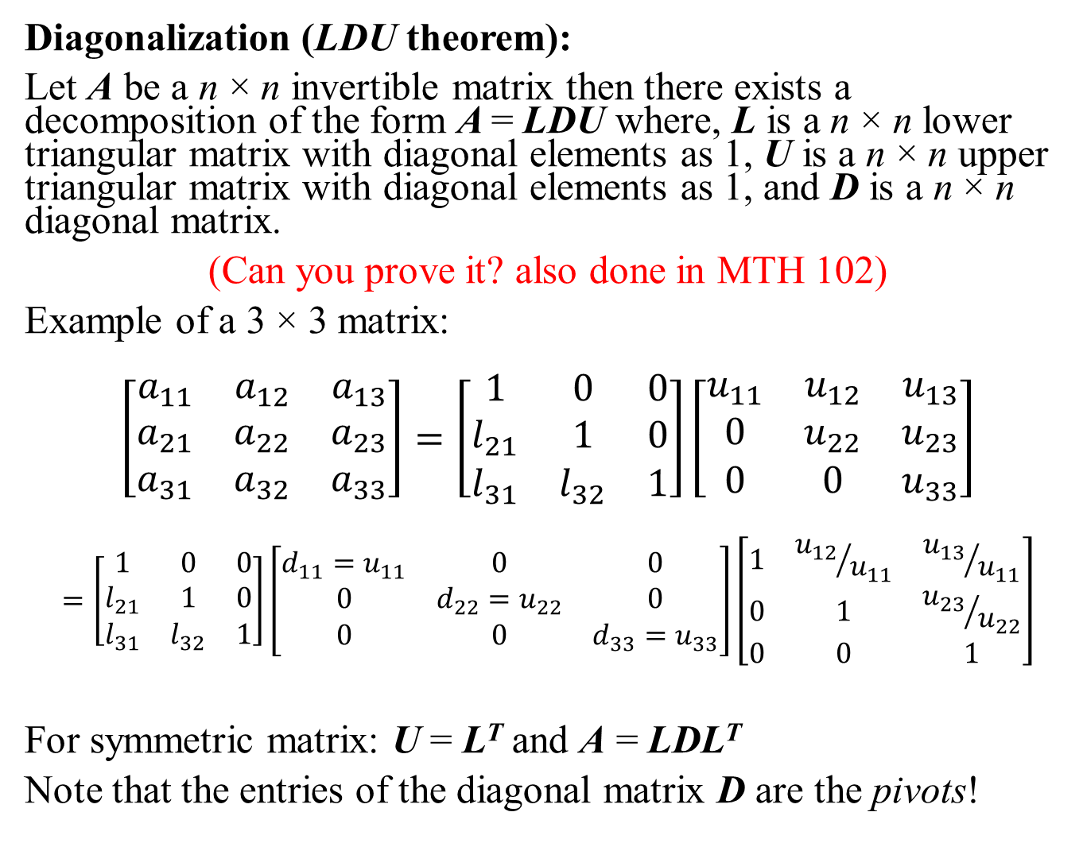
Diagonalization (LDU theorem):
Let A be a n × n invertible matrix then there exists a decomposition of the form A = LDU where, L is a n × n lower triangular matrix with diagonal elements as 1, U is a n × n upper triangular matrix with diagonal elements as 1, and D is a n × n diagonal matrix.
(Can you prove it? also done in MTH 102)
Example of a 3 × 3 matrix:
$$\left[\begin{matrix}a_{11} & a_{12} & a_{13} \\ a_{21} & a_{22} & a_{23} \\ a_{31} & a_{32} & a_{33}\end{matrix}\right]=\left[\begin{matrix}1 & 0 & 0 \\ l_{21} & 1 & 0 \\ l_{31} & l_{32} & 1\end{matrix}\right]\left[\begin{matrix}u_{11} & u_{12} & u_{13} \\ 0 & u_{22} & u_{23} \\ 0 & 0 & u_{33}\end{matrix}\right]$$
$$=\left[\begin{matrix}1 & 0 & 0 \\ l_{21} & 1 & 0 \\ l_{31} & l_{32} & 1\end{matrix}\right]\left[\begin{matrix}d_{11}=u_{11} & 0 & 0 \\ 0 & d_{22}=u_{22} & 0 \\ 0 & 0 & d_{33}=u_{33}\end{matrix}\right]\left[\begin{matrix}1 & {u_{12}}/{u_{11}} & {u_{13}}/{u_{11}} \\ 0 & 1 & {u_{23}}/{u_{22}} \\ 0 & 0 & 1\end{matrix}\right]$$
For symmetric matrix: U = L^{T} and A = LDL^{T}
Note that the entries of the diagonal matrix D are the pivots!

Slide 14
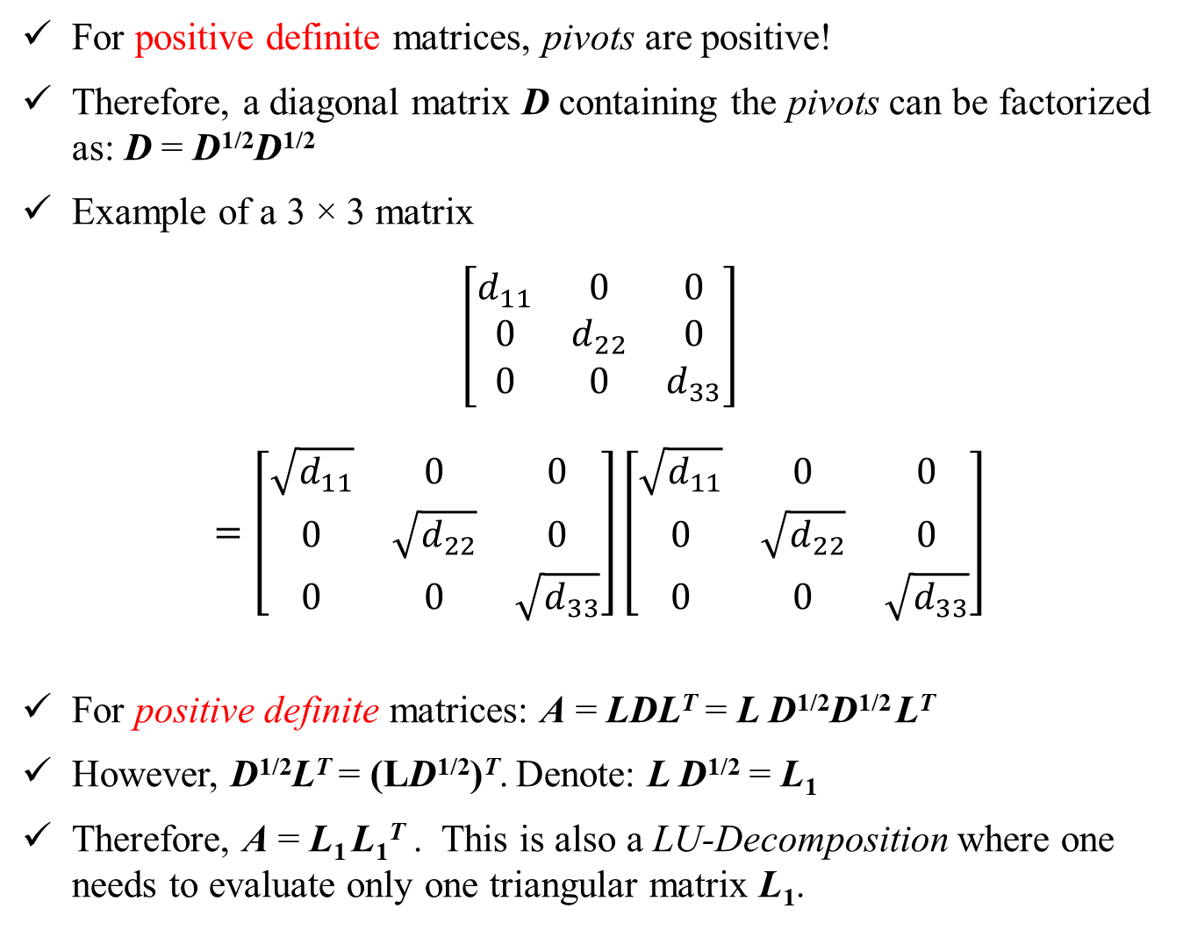
For positive definite matrices, pivots are positive!
Therefore, a diagonal matrix D containing the pivots can be factorized as: D = D^{1/2}D^{1/2}
Example of a 3 × 3 matrix
$$\left[\begin{matrix}d_{11} & 0 & 0 \\ 0 & d_{22} & 0 \\ 0 & 0 & d_{33}\end{matrix}\right]$$
$$=\left[\begin{matrix}\sqrt{d_{11}} & 0 & 0 \\ 0 & \sqrt{d_{22}} & 0 \\ 0 & 0 & \sqrt{d_{33}}\end{matrix}\right]\left[\begin{matrix}\sqrt{d_{11}} & 0 & 0 \\ 0 & \sqrt{d_{22}} & 0 \\ 0 & 0 & \sqrt{d_{33}}\end{matrix}\right]$$
For positive definite matrices: A = LDL^{T} = L D^{1/2}D^{1/2} L^{T}
However, D^{1/2}L^{T} = (LD^{1/2})^{T}. Denote: L D^{1/2} = L₁
Therefore, A = L₁ L₁^{T} . This is also a LU-Decomposition where one needs to evaluate only one triangular matrix L₁.

Slide 15
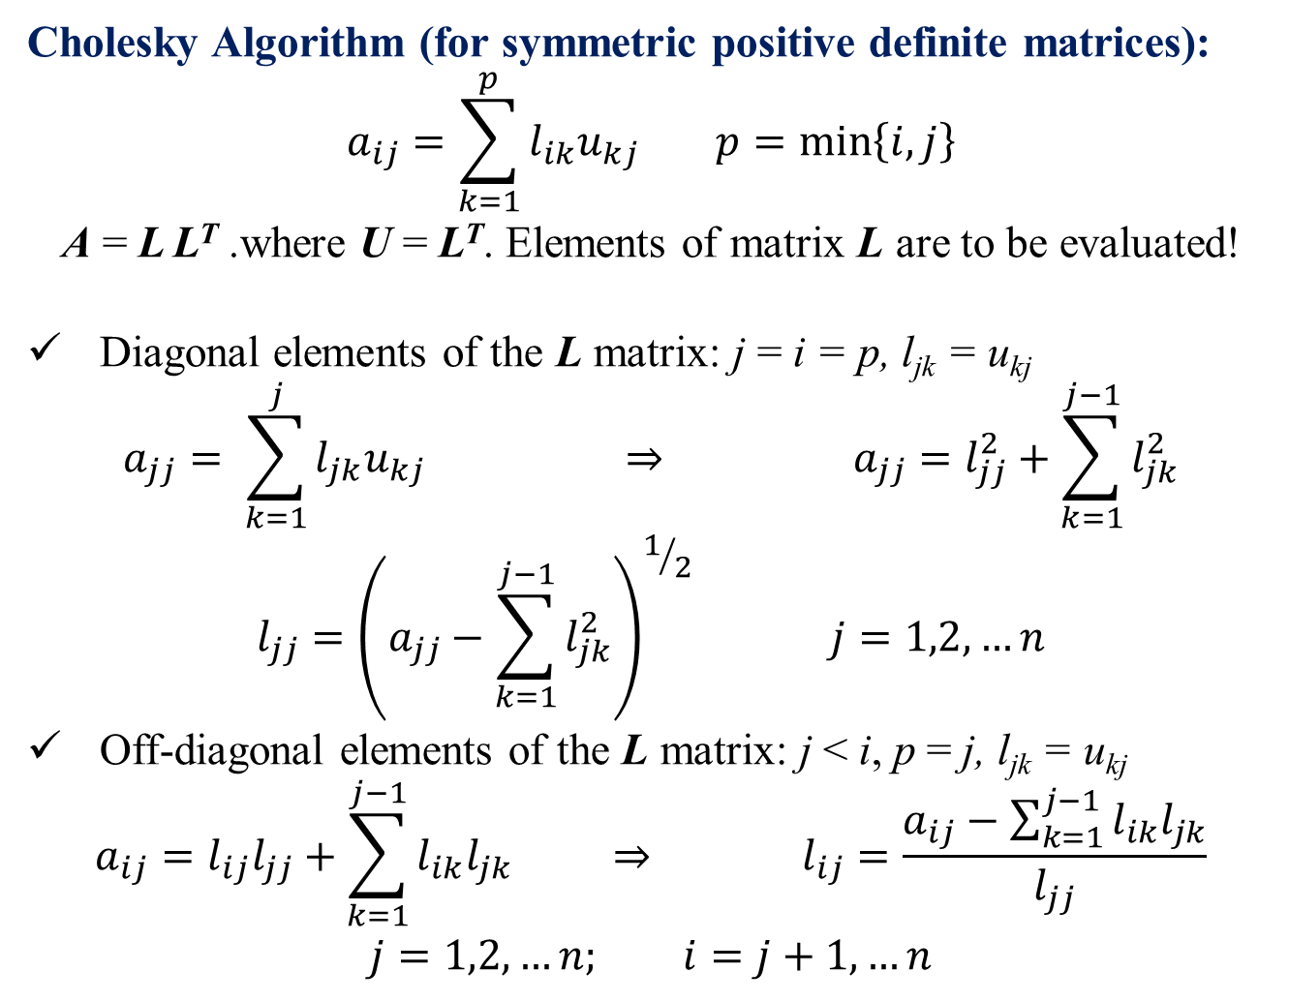
Cholesky Algorithm (for symmetric positive definite matrices):
$$a_{ij}=\sum_{k=1}^{p}{l_{ik}u_{kj}} p=\min\left\{i,j\right\}$$
A = L L^{T} .where U = L^{T}. Elements of matrix L are to be evaluated!
Diagonal elements of the L matrix: j = i = p, l_{jk} = u_{kj}
$$a_{jj}= \sum_{k=1}^{j}{l_{jk}u_{kj}} ⇒ a_{jj}=l_{jj}^{2}+\sum_{k=1}^{j−1}{l_{jk}^{2}}$$
$$l_{jj}={\left(a_{jj}−\sum_{k=1}^{j−1}{l_{jk}^{2}}\right)}^{1/2} j=1,2,…n$$
Off-diagonal elements of the L matrix: j < i, p = j, l_{jk} = u_{kj}
$$a_{ij}=l_{ij}l_{jj}+\sum_{k=1}^{j−1}{l_{ik}l_{jk}} ⇒ l_{ij}=\frac{a_{ij}−\sum_{k=1}^{j−1}{l_{ik}l_{jk}}}{l_{jj}}$$
$$j=1,2,…n; i=j+1,…n$$

Slide 16
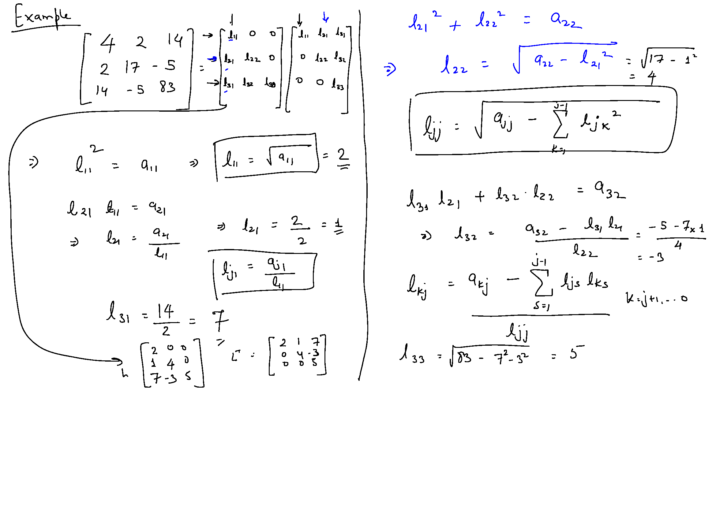
Cholesky Algorithm: Example Problem
A is a positive definite matrix.
This implies:-
A is a symmetric matrix, A = A^{T}
For any non-zero column vector x of n real numbers, x^{T}Ax > 0
Hence, it can be decomposed into LL^{T} by Cholesky algorithm

Slide 17
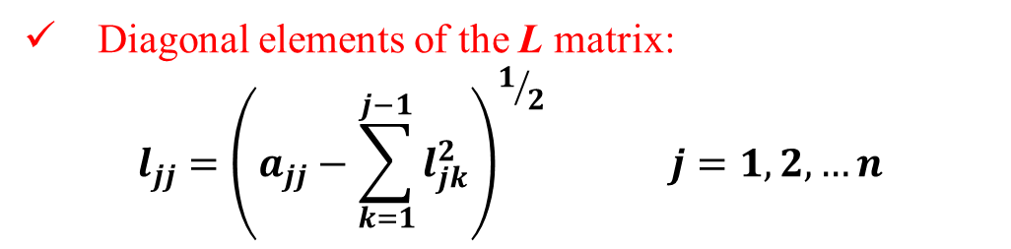
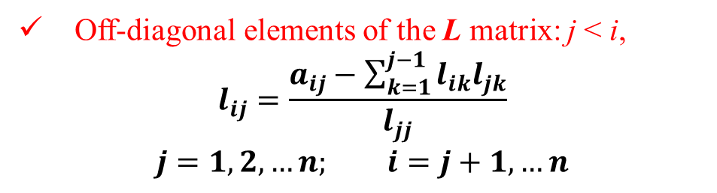
Cholesky Algorithm: Example Problem
Solve for coefficients of the L matrix, column by column (increasing j)
Diagonal elements of the L matrix:
$$l_{jj}={\left(a_{jj}−\sum_{k=1}^{j−1}{l_{jk}^{2}}\right)}^{1/2} j=1,2,…n$$
Off-diagonal elements of the L matrix: j < i,
$$l_{ij}=\frac{a_{ij}−\sum_{k=1}^{j−1}{l_{ik}l_{jk}}}{l_{jj}}$$
$$j=1,2,…n; i=j+1,…n$$

Slide 18
Cholesky Algorithm: Example Problem

Slide 19
Cholesky Algorithm: Example Problem

Slide 20
Cholesky Algorithm: Example Problem

Slide 21
If you already have a LU-decomposition available for matrix A:
Can you use it to compute the inverse?
Can you use it compute the determinant?

Slide 22
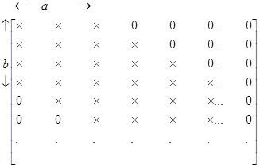
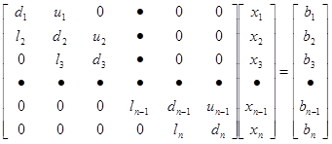
Banded Matrix
Band Width = a + b - 1
A system of equation with Tri-diagonal coefficient matrix. Total number of elements = n². Non-zero elements = 3n-2

Slide 23
Tri-Diagonal Matrix: Origin
Solution of differential equations of the form:
Interpolation, such as by cubic splines:

Slide 24
Thomas Algorithm (for Tridiagonal)
No need to store n² + n elements!
Store only 4n elements in the form of four vectors l, d, u and b
i^{th} equation is:
Notice: l₁ = u_{n} = 0

Slide 25
Thomas Algorithm
Initialize two new vectors α and β as α₁ = d₁ and β₁ = b₁
Take the first two equations and eliminate x₁ :
Resulting equation is:
where,
Similarly, we can eliminate x₂, x₃ ……

Slide 26
Thomas Algorithm
At the i^{th} step:
Eliminate x_{i-1} to obtain:
where,

Slide 27
Thomas Algorithm
Last two equations are:
Eliminate x_{n-1} to obtain:

Slide 28
Thomas Algorithm
Given: four vectors l, d, u and b
Generate: two vectors α and β as
α₁ = d₁ and β₁ = b₁
i = 2, 3, ….. n
Solution:
i = n-1 …… 3, 2, 1
FP operations: 8(n-1) + 3(n-1) + 1 = 11n - 10

Slide 29
Thomas Algorithm: Example

