Slide 1
Methods for Solution of the System of Equations:
Ax = b
Direct Methods: one obtains the exact solution (ignoring the round-off errors) in a finite number of steps. These group of methods are more efficient for dense and banded matrices.
Gauss Elimination; Gauss-Jordon Elimination
LU-Decomposition (Doolittle, Crout, Cholesky)
Thomas Algorithm (for tri-diagonal banded matrix)

Slide 2
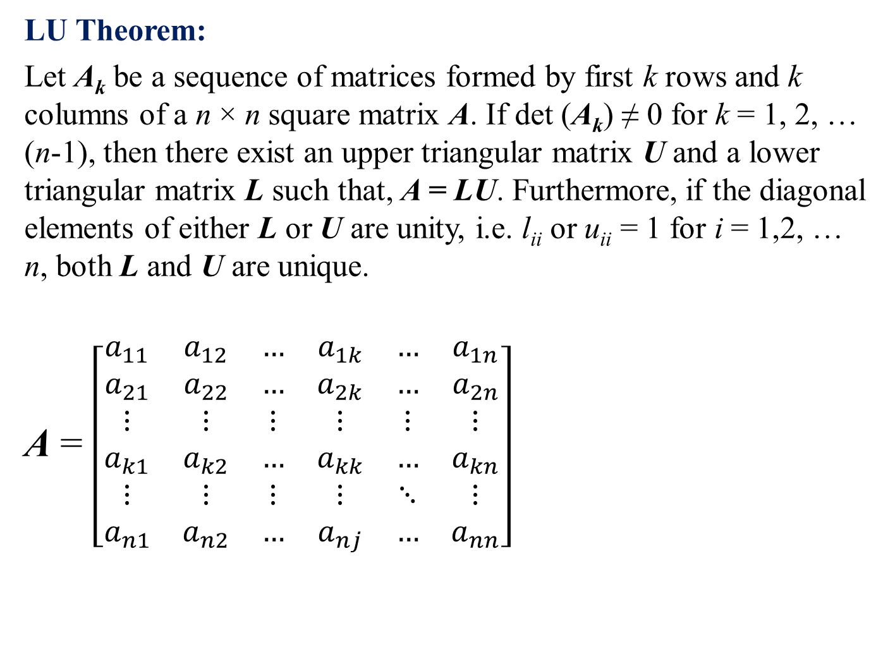
LU Theorem:
Let A_{k} be a sequence of matrices formed by first k rows and k columns of a n × n square matrix A. If det (A_{k}) ≠ 0 for k = 1, 2, … (n-1), then there exist an upper triangular matrix U and a lower triangular matrix L such that, A = LU. Furthermore, if the diagonal elements of either L or U are unity, i.e. l_{ii} or u_{ii} = 1 for i = 1,2, … n, both L and U are unique.
A = $\left[\begin{matrix}a_{11} & a_{12} & … & a_{1k} & … & a_{1n} \\ a_{21} & a_{22} & … & a_{2k} & … & a_{2n} \\ ⋮ & ⋮ & ⋮ & ⋮ & ⋮ & ⋮ \\ a_{k1} & a_{k2} & … & a_{kk} & … & a_{kn} \\ ⋮ & ⋮ & ⋮ & ⋮ & ⋱ & ⋮ \\ a_{n1} & a_{n2} & … & a_{nj} & … & a_{nn}\end{matrix}\right]$
A_{k}

Slide 3
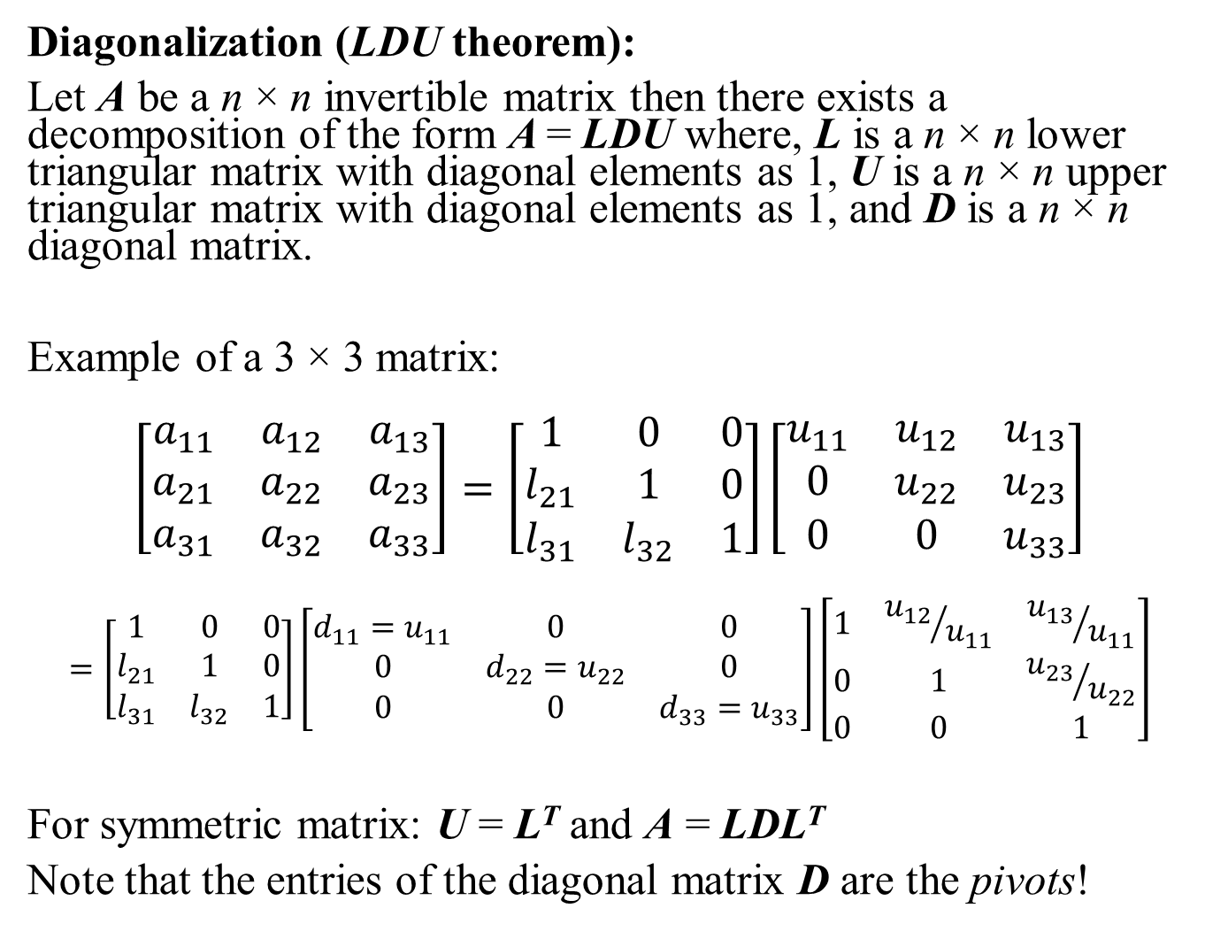
Diagonalization (LDU theorem):
Let A be a n × n invertible matrix then there exists a decomposition of the form A = LDU where, L is a n × n lower triangular matrix with diagonal elements as 1, U is a n × n upper triangular matrix with diagonal elements as 1, and D is a n × n diagonal matrix.
Example of a 3 × 3 matrix:
$$\left[\begin{matrix}a_{11} & a_{12} & a_{13} \\ a_{21} & a_{22} & a_{23} \\ a_{31} & a_{32} & a_{33}\end{matrix}\right]=\left[\begin{matrix}1 & 0 & 0 \\ l_{21} & 1 & 0 \\ l_{31} & l_{32} & 1\end{matrix}\right]\left[\begin{matrix}u_{11} & u_{12} & u_{13} \\ 0 & u_{22} & u_{23} \\ 0 & 0 & u_{33}\end{matrix}\right]$$
$$=\left[\begin{matrix}1 & 0 & 0 \\ l_{21} & 1 & 0 \\ l_{31} & l_{32} & 1\end{matrix}\right]\left[\begin{matrix}d_{11}=u_{11} & 0 & 0 \\ 0 & d_{22}=u_{22} & 0 \\ 0 & 0 & d_{33}=u_{33}\end{matrix}\right]\left[\begin{matrix}1 & {u_{12}}/{u_{11}} & {u_{13}}/{u_{11}} \\ 0 & 1 & {u_{23}}/{u_{22}} \\ 0 & 0 & 1\end{matrix}\right]$$
For symmetric matrix: U = L^{T} and A = LDL^{T}
Note that the entries of the diagonal matrix D are the pivots!

Slide 4
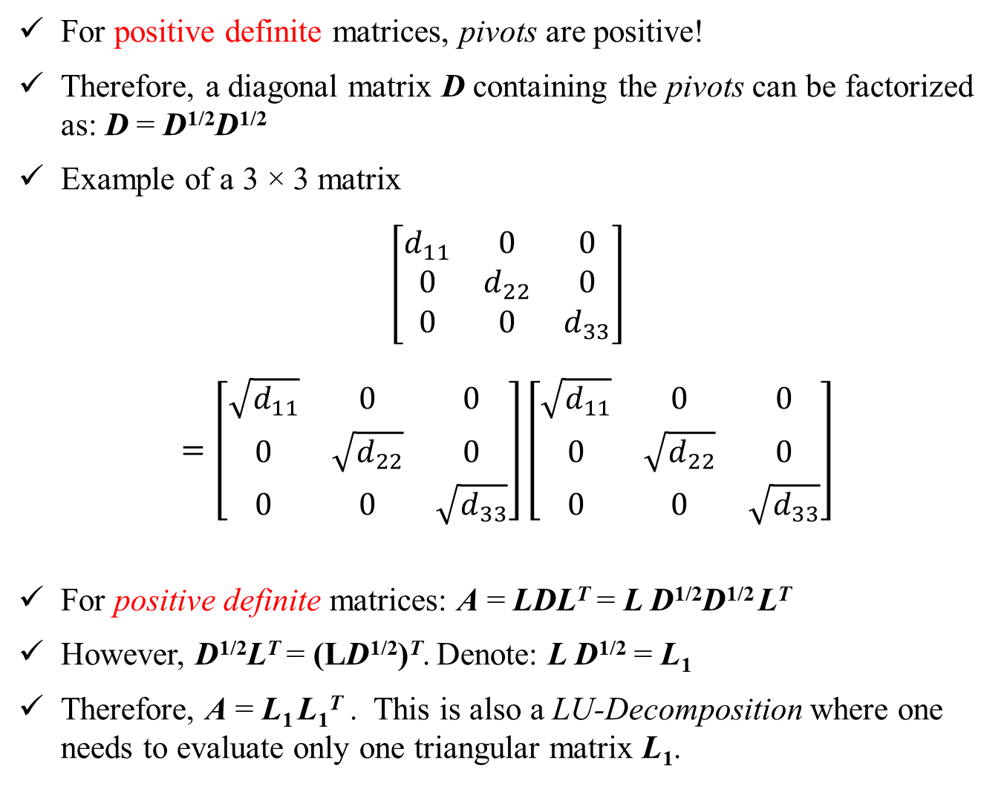
For positive definite matrices, pivots are positive!
Therefore, a diagonal matrix D containing the pivots can be factorized as: D = D^{1/2}D^{1/2}
Example of a 3 × 3 matrix
$$\left[\begin{matrix}d_{11} & 0 & 0 \\ 0 & d_{22} & 0 \\ 0 & 0 & d_{33}\end{matrix}\right]$$
$$=\left[\begin{matrix}\sqrt{d_{11}} & 0 & 0 \\ 0 & \sqrt{d_{22}} & 0 \\ 0 & 0 & \sqrt{d_{33}}\end{matrix}\right]\left[\begin{matrix}\sqrt{d_{11}} & 0 & 0 \\ 0 & \sqrt{d_{22}} & 0 \\ 0 & 0 & \sqrt{d_{33}}\end{matrix}\right]$$
For positive definite matrices: A = LDL^{T} = L D^{1/2}D^{1/2} L^{T}
However, D^{1/2}L^{T} = (LD^{1/2})^{T}. Denote: L D^{1/2} = L₁
Therefore, A = L₁ L₁^{T} . This is also a LU-Decomposition where one needs to evaluate only one triangular matrix L₁.

Slide 5
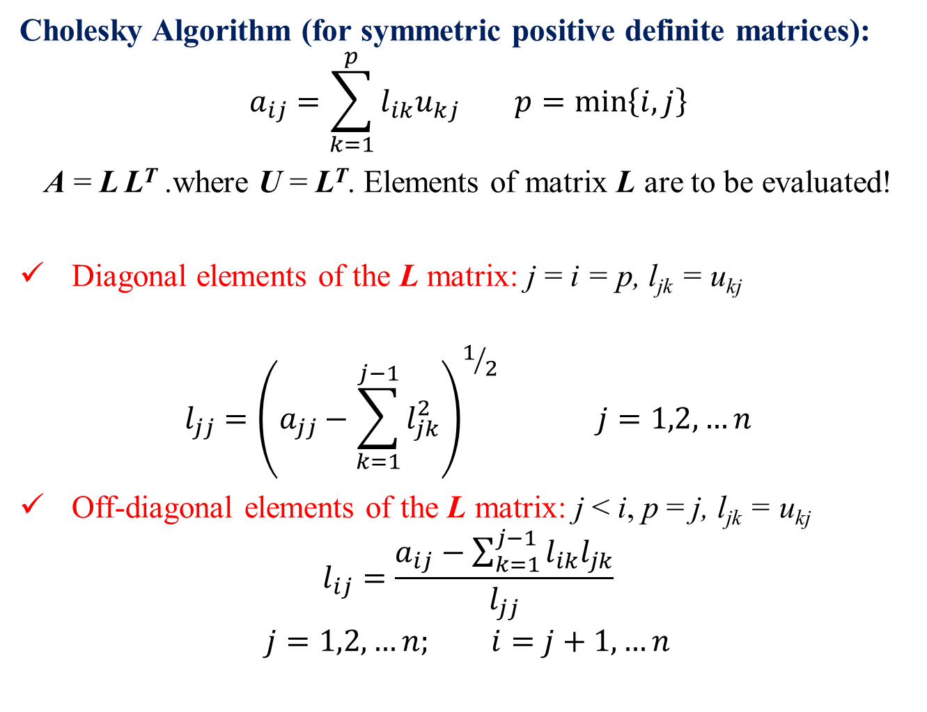
Cholesky Algorithm (for symmetric positive definite matrices):
$$a_{ij}=\sum_{k=1}^{p}{l_{ik}u_{kj}} p=\min\left\{i,j\right\}$$
A = L L^{T} .where U = L^{T}. Elements of matrix L are to be evaluated!
Diagonal elements of the L matrix: j = i = p, l_{jk} = u_{kj}
$$l_{jj}={\left(a_{jj}−\sum_{k=1}^{j−1}{l_{jk}^{2}}\right)}^{1/2} j=1,2,…n$$
Off-diagonal elements of the L matrix: j < i, p = j, l_{jk} = u_{kj}
$$l_{ij}=\frac{a_{ij}−\sum_{k=1}^{j−1}{l_{ik}l_{jk}}}{l_{jj}}$$
$$j=1,2,…n; i=j+1,…n$$

Slide 6
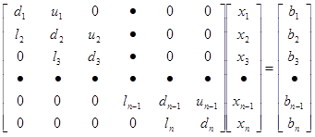
Thomas Algorithm (for Tridiagonal)
No need to store n² + n elements!
Store only 4n elements in the form of four vectors l, d, u and b
i^{th} equation is:
Notice: l₁ = u_{n} = 0

Slide 7



Thomas Algorithm
Initialize two new vectors α and β as α₁ = d₁ and β₁ = b₁
Take the first two equations and eliminate x₁ :
Resulting equation is:
where,
Similarly, we can eliminate x₂, x₃ ……
$$i=1,2,…n$$
$$i=1$$
$$i=2$$

Slide 8
Thomas Algorithm
At the i^{th} step:
Eliminate x_{i-1} to obtain:
where,

Slide 9
Thomas Algorithm
Last two equations are:
Eliminate x_{n-1} to obtain:

Slide 10
Thomas Algorithm
Given: four vectors l, d, u and b
Generate: two vectors α and β as
α₁ = d₁ and β₁ = b₁
i = 2, 3, ….. n
Solution:
i = n-1 …… 3, 2, 1
FP operations: 8(n-1) + 3(n-1) + 1 = 11n - 10

Slide 11

Thomas Algorithm: Example
$$i=1,2,…n$$

Slide 12

Thomas Algorithm: Example
$$i=1,2,…n−1$$

Slide 13
Thomas Algorithm: Example
$$i=1,2,…n−1$$

Slide 14
Thomas Algorithm: Example
$$i=1,2,…n−1$$

Slide 15
Thomas Algorithm: Example
$$i=1,2,…n−1$$

Slide 16

Thomas Algorithm: Example
$$i=1,2,…n−1$$

Slide 17

ESO 208A: Computational Methods in Engineering Iterative Methods
Abhas Singh
Department of Civil Engineering
IIT Kanpur
Acknowledgements: Profs. Saumyen Guha and Shivam Tripathi (CE)

Slide 18
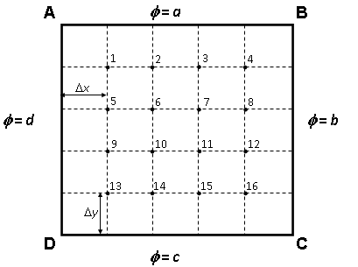
Sparse Matrix: Origin
Laplace Equation:
Boundary Conditions:
Size of the matrix 16×16
Total number of elements = 256
Number of non-zero elements = 56
Also applicable for Network Analysis

Slide 19
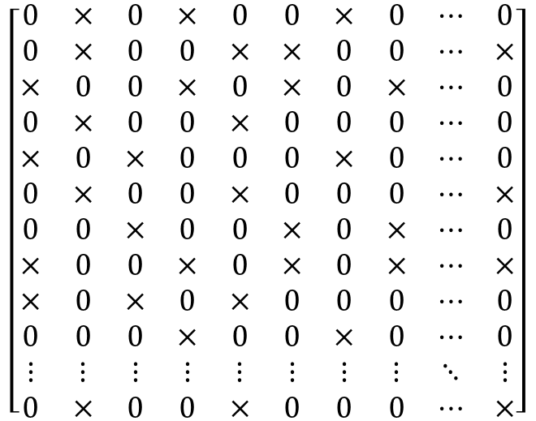
Sparse Matrix
$$\left[\begin{matrix}0 & × & 0 & × & 0 & 0 & × & 0 & ⋯ & 0 \\ 0 & × & 0 & 0 & × & × & 0 & 0 & ⋯ & × \\ × & 0 & 0 & × & 0 & × & 0 & × & ⋯ & 0 \\ 0 & × & 0 & 0 & × & 0 & 0 & 0 & ⋯ & 0 \\ × & 0 & × & 0 & 0 & 0 & × & 0 & ⋯ & 0 \\ 0 & × & 0 & 0 & × & 0 & 0 & 0 & ⋯ & × \\ 0 & 0 & × & 0 & 0 & × & 0 & × & ⋯ & 0 \\ × & 0 & 0 & × & 0 & × & 0 & × & ⋯ & × \\ × & 0 & × & 0 & × & 0 & 0 & 0 & ⋯ & 0 \\ 0 & 0 & 0 & × & 0 & 0 & × & 0 & ⋯ & 0 \\ ⋮ & ⋮ & ⋮ & ⋮ & ⋮ & ⋮ & ⋮ & ⋮ & ⋱ & ⋮ \\ 0 & × & 0 & 0 & × & 0 & 0 & 0 & ⋯ & ×\end{matrix}\right]$$
Total number of elements = n²
Number of non-zero elements ~ O(n)
Direct methods algorithms such as Gauss elimination, Gauss Jordon, LU decomposition are inefficient for Banded and Sparse Matrices!

Slide 20
Iterative Methods
a₁₁x₁ + a₁₂x₂ + a₁₃x₃ • • • • • • • • + a_{1n}x_{n} = b₁
a₂₁x₁ + a₂₂x₂ + a₂₃x₃ • • • • • • • • + a_{2n}x_{n} = b₂
a₃₁x₁ + a₃₂x₂ + a₃₃x₃ • • • • • • • • + a_{3n}x_{n} = b₃
• • • • •
a_{i1}x₁ + a_{i2}x₂ + a_{i3}x₃ • • • • • • • • + a_{in}x_{n} = b_{i}
• • • • •
a_{n1}x₁ + a_{n2}x₂ + a_{n3}x₃ • • • • • • • • + a_{nn}x_{n} = b_{n}
Assume (initialize) a solution vector x
Compute a new solution vector x_{new}
Iterate until ║ x- x_{new} ║∞ ≤ ε
We will learn two methods: Jacobi and Gauss Seidel

Slide 21
Jacobi and Gauss Seidel
Jacobi: for the iteration index k (k = 0 for the initial guess)
Gauss Seidel: for the iteration index k (k = 0 for the initial guess)

Slide 22
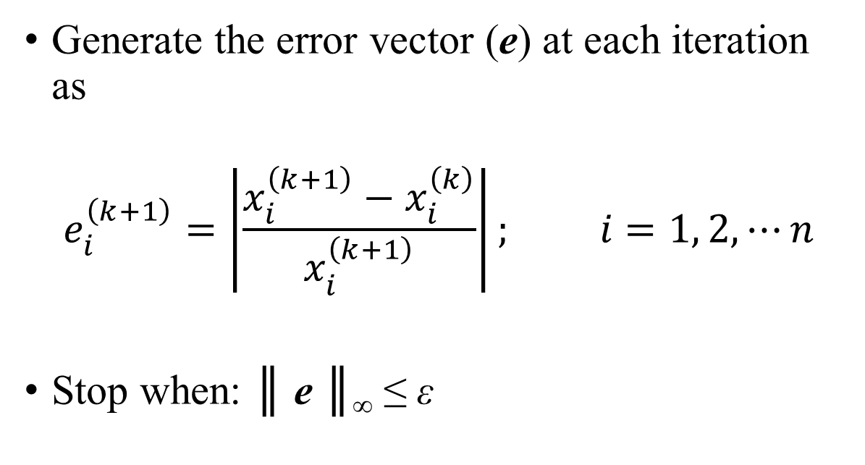
Stopping Criteria
Generate the error vector (e) at each iteration as
$$e_{i}^{\left(k+1\right)}=\left|\frac{x_{i}^{\left(k+1\right)}−x_{i}^{\left(k\right)}}{x_{i}^{\left(k+1\right)}}\right|; i=1, 2, ⋯n$$
Stop when: ║ e ║∞ ≤ ε
Let us see an example?

Slide 23
Iterative Methods (Example)
Solve the following system of equations using Jacobi and Gauss Seidel methods and using initial guess as zero for all the variables with error less than 0.01%. Compare the number iterations required for solution using two methods:
Jacobi
Gauss Seidel

Slide 24
Iterative methods (Example)
If you iterate, both the methods will diverge
Jacobi
Iter | x1 | x2 | x3 | x4
0 | 0 | 0 | 0 | 0
1 | 1 | 1.5 | -1.5 | -2
2 | -4 | 4.5 | -5.5 | -4 | 90.9
3 | -12 | 12.5 | -9.5 | -17 | 76.5
4 | -41 | 20.5 | -35.5 | -33 | 70.7
5 | -73 | 72.5 | -67.5 | -114 | 71.1
6 | -258 | 136.5 | -229.5 | -210 | 71.7
7 | -482 | 460.5 | -421.5 | -719 | 70.8
8 | -1639 | 844.5 | -1439.5 | -1327 | 70.6
9 | -3015 | 2880.5 | -2655.5 | -4520 | 70.6
10 | -10280 | 5312.5 | -9041.5 | -8328 | 70.7
11 | -18952 | 18084.5 | -16657.5 | -28365 | 70.6
12 | -64533 | 33316.5 | -56731.5 | -52269 | 70.6
Gauss Seidel
Iter | x1 | x2 | x3 | x4
0 | 0 | 0 | 0 | 0
1 | 1 | 1.5 | -1.5 | -4
2 | -6 | 4.5 | -9.5 | -27 | 85.2
3 | -35 | 20.5 | -55.5 | -148 | 81.8
4 | -188 | 112.5 | -297.5 | -785 | 81.1
5 | -1009 | 596.5 | -1571.5 | -4154 | 81.1
6 | -5346 | 3144.5 | -8309.5 | -21967 | 81.1
7 | -28255 | 16620.5 | -43935.5 | -116128 | 81.1
8 | -149368 | 87872.5 | -232258 | -613885 | 81.1
9 | -789629 | 464516.5 | -1227772 | -3245174 | 81.1
10 | -4174206 | 2455545 | -6490350 | -1.7E+07 | 81.1
11 | -2.2E+07 | 12980701 | -3.4E+07 | -9.1E+07 | 81.1
12 | -1.2E+08 | 68619633 | -1.8E+08 | -4.8E+08 | 81.1
Is the problem ill conditioned? The answer is NO!

Slide 25
Iterative methods (Example)
Original Problem
A= | 1 | 2 | 0 | -1 | b= | 1
 | 0 | 1 | 2 | 0 |  | 1.5
 | 0 | 0 | -1 | 2 |  | 1.5
 | 1 | 0 | 2 | -1 |  | 2
Pivoting: Columns 2 to 1, 3 to 2, 4 to 3 and 1 to 4.
This is equivalent to change of variables:
x₁ (new) = x₂ (original)
x₂ (new) = x₃ (original)
x₃ (new) = x₄ (original)
x₄ (new) = x₁ (original)
After Pivoting
A= | 2 | 0 | -1 | 1 | b= | 1
 | 1 | 2 | 0 | 0 |  | 1.5
 | 0 | -1 | 2 | 0 |  | 1.5
 | 0 | 2 | -1 | 1 |  | 2

Slide 26
Iterative Methods (Example)
New Iteration Equations after pivoting (variable identifiers in the subscript are for the new renamed variables):
A= | 2 | 0 | -1 | 1 | b= | 1
 | 1 | 2 | 0 | 0 |  | 1.5
 | 0 | -1 | 2 | 0 |  | 1.5
 | 0 | 2 | -1 | 1 |  | 2
Jacobi
Gauss Seidel

Slide 27
Solution: Jacobi
Iter | x1 | x2 | x3 | x4 | ||e||
0 | 0.000 | 0.000 | 0.000 | 0.000
1 | 0.500 | 0.750 | 0.750 | 2.000
2 | -0.125 | 0.500 | 1.125 | 1.250 | 60.000
3 | 0.438 | 0.813 | 1.000 | 2.125 | 41.176
4 | -0.063 | 0.531 | 1.156 | 1.375 | 54.545
5 | 0.391 | 0.781 | 1.016 | 2.094 | 34.328
6 | -0.039 | 0.555 | 1.141 | 1.453 | 44.086
7 | 0.344 | 0.770 | 1.027 | 2.031 | 28.462
8 | -0.002 | 0.578 | 1.135 | 1.488 | 36.483
9 | 0.323 | 0.751 | 1.039 | 1.979 | 24.778
10 | 0.030 | 0.588 | 1.125 | 1.537 | 28.717
11 | 0.294 | 0.735 | 1.044 | 1.949 | 21.123
12 | 0.048 | 0.603 | 1.117 | 1.574 | 23.771
13 | 0.271 | 0.726 | 1.051 | 1.912 | 17.637
14 | 0.070 | 0.614 | 1.113 | 1.599 | 19.537
15 | 0.257 | 0.715 | 1.057 | 1.885 | 15.143
16 | 0.086 | 0.622 | 1.108 | 1.627 | 15.827
17 | 0.240 | 0.707 | 1.061 | 1.864 | 12.734
18 | 0.098 | 0.630 | 1.103 | 1.647 | 13.200
19 | 0.228 | 0.701 | 1.065 | 1.844 | 10.664
20 | 0.111 | 0.636 | 1.100 | 1.663 | 10.858
21 | 0.219 | 0.695 | 1.068 | 1.829 | 9.054
22 | 0.120 | 0.641 | 1.097 | 1.679 | 8.940
23 | 0.209 | 0.690 | 1.070 | 1.816 | 7.568
24 | 0.127 | 0.645 | 1.095 | 1.690 | 7.458
25 | 0.203 | 0.686 | 1.073 | 1.804 | 6.344
26 | 0.134 | 0.649 | 1.093 | 1.700 | 6.157
27 | 0.197 | 0.683 | 1.074 | 1.796 | 5.344
28 | 0.139 | 0.652 | 1.091 | 1.708 | 5.110
29 | 0.192 | 0.680 | 1.076 | 1.788 | 4.458
30 | 0.144 | 0.654 | 1.090 | 1.715 | 4.260
31 | 0.188 | 0.678 | 1.077 | 1.782 | 3.736
32 | 0.148 | 0.656 | 1.089 | 1.721 | 3.529
33 | 0.184 | 0.676 | 1.078 | 1.777 | 3.131
34 | 0.151 | 0.658 | 1.088 | 1.726 | 2.940
35 | 0.181 | 0.675 | 1.079 | 1.772 | 2.612
36 | 0.153 | 0.659 | 1.087 | 1.730 | 2.449
37 | 0.179 | 0.673 | 1.080 | 1.768 | 2.186
38 | 0.156 | 0.661 | 1.087 | 1.733 | 2.035
39 | 0.177 | 0.672 | 1.080 | 1.765 | 1.827
40 | 0.157 | 0.662 | 1.086 | 1.736 | 1.697
41 | 0.175 | 0.671 | 1.081 | 1.763 | 1.525
42 | 0.159 | 0.662 | 1.086 | 1.738 | 1.413
43 | 0.174 | 0.671 | 1.081 | 1.761 | 1.275
44 | 0.160 | 0.663 | 1.085 | 1.740 | 1.177
45 | 0.173 | 0.670 | 1.082 | 1.759 | 1.064
46 | 0.161 | 0.664 | 1.085 | 1.742 | 0.982
47 | 0.172 | 0.669 | 1.082 | 1.757 | 0.888
48 | 0.162 | 0.664 | 1.085 | 1.743 | 0.818
49 | 0.171 | 0.669 | 1.082 | 1.756 | 0.742
50 | 0.163 | 0.665 | 1.084 | 1.744 | 0.682
51 | 0.170 | 0.669 | 1.082 | 1.755 | 0.619
52 | 0.164 | 0.665 | 1.084 | 1.745 | 0.569
53 | 0.169 | 0.668 | 1.082 | 1.754 | 0.516
54 | 0.164 | 0.665 | 1.084 | 1.746 | 0.474
55 | 0.169 | 0.668 | 1.083 | 1.754 | 0.431
56 | 0.165 | 0.665 | 1.084 | 1.747 | 0.395
57 | 0.169 | 0.668 | 1.083 | 1.753 | 0.360
58 | 0.165 | 0.666 | 1.084 | 1.747 | 0.330
59 | 0.168 | 0.668 | 1.083 | 1.753 | 0.300
60 | 0.165 | 0.666 | 1.084 | 1.748 | 0.275
61 | 0.168 | 0.667 | 1.083 | 1.752 | 0.250
62 | 0.165 | 0.666 | 1.084 | 1.748 | 0.229
63 | 0.168 | 0.667 | 1.083 | 1.752 | 0.209
64 | 0.166 | 0.666 | 1.084 | 1.748 | 0.191
65 | 0.168 | 0.667 | 1.083 | 1.751 | 0.174
66 | 0.166 | 0.666 | 1.084 | 1.749 | 0.159
67 | 0.167 | 0.667 | 1.083 | 1.751 | 0.145
68 | 0.166 | 0.666 | 1.084 | 1.749 | 0.133
69 | 0.167 | 0.667 | 1.083 | 1.751 | 0.121
70 | 0.166 | 0.666 | 1.084 | 1.749 | 0.111
71 | 0.167 | 0.667 | 1.083 | 1.751 | 0.101
72 | 0.166 | 0.666 | 1.083 | 1.749 | 0.093
73 | 0.167 | 0.667 | 1.083 | 1.751 | 0.084
74 | 0.166 | 0.666 | 1.083 | 1.749 | 0.077
75 | 0.167 | 0.667 | 1.083 | 1.751 | 0.070
76 | 0.166 | 0.666 | 1.083 | 1.749 | 0.064
77 | 0.167 | 0.667 | 1.083 | 1.750 | 0.059
78 | 0.166 | 0.667 | 1.083 | 1.750 | 0.054
79 | 0.167 | 0.667 | 1.083 | 1.750 | 0.049
80 | 0.166 | 0.667 | 1.083 | 1.750 | 0.045
81 | 0.167 | 0.667 | 1.083 | 1.750 | 0.041
82 | 0.166 | 0.667 | 1.083 | 1.750 | 0.037
83 | 0.167 | 0.667 | 1.083 | 1.750 | 0.034
84 | 0.166 | 0.667 | 1.083 | 1.750 | 0.031
85 | 0.167 | 0.667 | 1.083 | 1.750 | 0.028
86 | 0.167 | 0.667 | 1.083 | 1.750 | 0.026
87 | 0.167 | 0.667 | 1.083 | 1.750 | 0.024
88 | 0.167 | 0.667 | 1.083 | 1.750 | 0.022
89 | 0.167 | 0.667 | 1.083 | 1.750 | 0.020
90 | 0.167 | 0.667 | 1.083 | 1.750 | 0.018
91 | 0.167 | 0.667 | 1.083 | 1.750 | 0.017
92 | 0.167 | 0.667 | 1.083 | 1.750 | 0.015
93 | 0.167 | 0.667 | 1.083 | 1.750 | 0.014
94 | 0.167 | 0.667 | 1.083 | 1.750 | 0.013
95 | 0.167 | 0.667 | 1.083 | 1.750 | 0.011
96 | 0.167 | 0.667 | 1.083 | 1.750 | 0.010
97 | 0.167 | 0.667 | 1.083 | 1.750 | 0.010
Number of iteration required to achieve a relative error of < 0.01% = 97

Slide 28
Solution: Gauss Seidel
Iter | x1 | x2 | x3 | x4 | ||e||
0 | 0.000 | 0.000 | 0.000 | 0.000
1 | 0.500 | 0.500 | 1.000 | 2.000
2 | 0.000 | 0.750 | 1.125 | 1.625 | 30.769
3 | 0.250 | 0.625 | 1.063 | 1.813 | 13.793
4 | 0.125 | 0.688 | 1.094 | 1.719 | 7.273
5 | 0.188 | 0.656 | 1.078 | 1.766 | 3.540
6 | 0.156 | 0.672 | 1.086 | 1.742 | 1.794
7 | 0.172 | 0.664 | 1.082 | 1.754 | 0.891
8 | 0.164 | 0.668 | 1.084 | 1.748 | 0.447
9 | 0.168 | 0.666 | 1.083 | 1.751 | 0.223
10 | 0.166 | 0.667 | 1.083 | 1.750 | 0.112
11 | 0.167 | 0.667 | 1.083 | 1.750 | 0.056
12 | 0.167 | 0.667 | 1.083 | 1.750 | 0.028
13 | 0.167 | 0.667 | 1.083 | 1.750 | 0.014
14 | 0.167 | 0.667 | 1.083 | 1.750 | 0.007
Number of iteration required to achieve a relative error of < 0.01% = 14
So, what makes the methods diverge? When do we need pivoting or scaling or equilibration for the iterative methods? Let’s analyze for the convergence criteria!

Slide 29
Questions?
What are the condition of convergence for the iterative methods?
Rate of convergence? Can we make them converge faster?

