Slide 1
Methods for Solution of the System of Equations (ReCap):
Ax = b
Direct Methods: one obtains the exact solution (ignoring the round-off errors) in a finite number of steps. These group of methods are more efficient for dense and banded matrices.
Gauss Elimination; Gauss-Jordon Elimination
LU-Decomposition
Thomas Algorithm (for tri-diagonal banded matrix)
Iterative Methods: solution is obtained through successive approximation. Number of computations is a function of desired accuracy/precision of the solution and are not known apriori. More efficient for sparse matrices.
Jacobi Iterations
Gauss Seidal Iterations with Successive Over/Under Relaxation

Slide 2
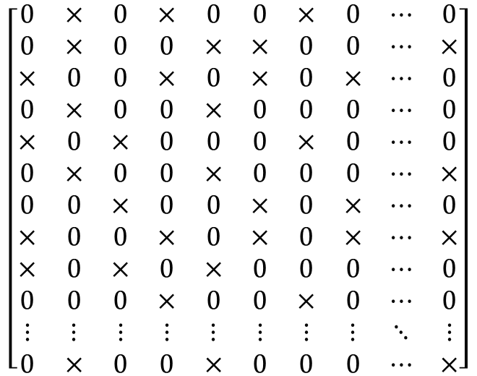
Sparse Matrix
$$\left[\begin{matrix}0 & × & 0 & × & 0 & 0 & × & 0 & ⋯ & 0 \\ 0 & × & 0 & 0 & × & × & 0 & 0 & ⋯ & × \\ × & 0 & 0 & × & 0 & × & 0 & × & ⋯ & 0 \\ 0 & × & 0 & 0 & × & 0 & 0 & 0 & ⋯ & 0 \\ × & 0 & × & 0 & 0 & 0 & × & 0 & ⋯ & 0 \\ 0 & × & 0 & 0 & × & 0 & 0 & 0 & ⋯ & × \\ 0 & 0 & × & 0 & 0 & × & 0 & × & ⋯ & 0 \\ × & 0 & 0 & × & 0 & × & 0 & × & ⋯ & × \\ × & 0 & × & 0 & × & 0 & 0 & 0 & ⋯ & 0 \\ 0 & 0 & 0 & × & 0 & 0 & × & 0 & ⋯ & 0 \\ ⋮ & ⋮ & ⋮ & ⋮ & ⋮ & ⋮ & ⋮ & ⋮ & ⋱ & ⋮ \\ 0 & × & 0 & 0 & × & 0 & 0 & 0 & ⋯ & ×\end{matrix}\right]$$
Total number of elements = n²
Number of non-zero elements ~ O(n)
Direct method algorithms such as Gauss elimination, Gauss Jordon, LU decomposition are inefficient for Banded and Sparse Matrices!

Slide 3
Iterative Methods
a₁₁x₁ + a₁₂x₂ + a₁₃x₃ • • • • • • • • + a_{1n}x_{n} = b₁
a₂₁x₁ + a₂₂x₂ + a₂₃x₃ • • • • • • • • + a_{2n}x_{n} = b₂
a₃₁x₁ + a₃₂x₂ + a₃₃x₃ • • • • • • • • + a_{3n}x_{n} = b₃
• • • • •
a_{i1}x₁ + a_{i2}x₂ + a_{i3}x₃ • • • • • • • • + a_{in}x_{n} = b_{i}
• • • • •
a_{n1}x₁ + a_{n2}x₂ + a_{n3}x₃ • • • • • • • • + a_{nn}x_{n} = b_{n}
Assume (initialize) a solution vector x
Compute a new solution vector x_{new}
Iterate until ║ x- x_{new} ║∞ ≤ ε
We will learn two methods: Jacobi and Gauss Seidel

Slide 4
Jacobi and Gauss Seidel
Jacobi: for the iteration index k (k = 0 for the initial guess)
Gauss Seidel: for the iteration index k (k = 0 for the initial guess)

Slide 5
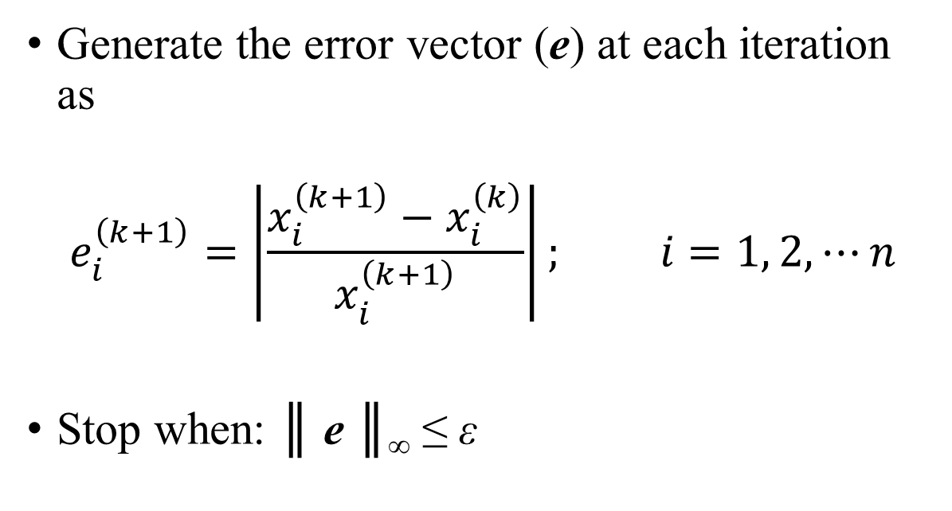
Stopping Criteria
Generate the error vector (e) at each iteration as
$$e_{i}^{\left(k+1\right)}=\left|\frac{x_{i}^{\left(k+1\right)}−x_{i}^{\left(k\right)}}{x_{i}^{\left(k+1\right)}}\right|; i=1, 2, ⋯n$$
Stop when: ║ e ║∞ ≤ ε
Let’s review last lecture’s example

Slide 6
Iterative methods (Example)
Original Problem
A= | 1 | 2 | 0 | -1 | b= | 1
 | 0 | 1 | 2 | 0 |  | 1.5
 | 0 | 0 | -1 | 2 |  | 1.5
 | 1 | 0 | 2 | -1 |  | 2
Pivoting: Columns 2 to 1, 3 to 2, 4 to 3 and 1 to 4.
This is equivalent to change of variables:
x₁ (new) = x₂ (original)
x₂ (new) = x₃ (original)
x₃ (new) = x₄ (original)
x₄ (new) = x₁ (original)
After Pivoting
A= | 2 | 0 | -1 | 1 | b= | 1
 | 1 | 2 | 0 | 0 |  | 1.5
 | 0 | -1 | 2 | 0 |  | 1.5
 | 0 | 2 | -1 | 1 |  | 2

Slide 7
Iterative Methods (Example)
New Iteration Equations after pivoting (variable identifiers in the subscript are for the new renamed variables):
A= | 2 | 0 | -1 | 1 | b= | 1
 | 1 | 2 | 0 | 0 |  | 1.5
 | 0 | -1 | 2 | 0 |  | 1.5
 | 0 | 2 | -1 | 1 |  | 2
Jacobi
Gauss Seidel

Slide 8
Solution: Jacobi
Iter | x1 | x2 | x3 | x4 | ||e||
0 | 0.000 | 0.000 | 0.000 | 0.000
1 | 0.500 | 0.750 | 0.750 | 2.000
2 | -0.125 | 0.500 | 1.125 | 1.250 | 60.000
3 | 0.438 | 0.813 | 1.000 | 2.125 | 41.176
4 | -0.063 | 0.531 | 1.156 | 1.375 | 54.545
5 | 0.391 | 0.781 | 1.016 | 2.094 | 34.328
6 | -0.039 | 0.555 | 1.141 | 1.453 | 44.086
7 | 0.344 | 0.770 | 1.027 | 2.031 | 28.462
8 | -0.002 | 0.578 | 1.135 | 1.488 | 36.483
9 | 0.323 | 0.751 | 1.039 | 1.979 | 24.778
10 | 0.030 | 0.588 | 1.125 | 1.537 | 28.717
11 | 0.294 | 0.735 | 1.044 | 1.949 | 21.123
12 | 0.048 | 0.603 | 1.117 | 1.574 | 23.771
13 | 0.271 | 0.726 | 1.051 | 1.912 | 17.637
14 | 0.070 | 0.614 | 1.113 | 1.599 | 19.537
15 | 0.257 | 0.715 | 1.057 | 1.885 | 15.143
16 | 0.086 | 0.622 | 1.108 | 1.627 | 15.827
17 | 0.240 | 0.707 | 1.061 | 1.864 | 12.734
18 | 0.098 | 0.630 | 1.103 | 1.647 | 13.200
19 | 0.228 | 0.701 | 1.065 | 1.844 | 10.664
20 | 0.111 | 0.636 | 1.100 | 1.663 | 10.858
21 | 0.219 | 0.695 | 1.068 | 1.829 | 9.054
22 | 0.120 | 0.641 | 1.097 | 1.679 | 8.940
23 | 0.209 | 0.690 | 1.070 | 1.816 | 7.568
24 | 0.127 | 0.645 | 1.095 | 1.690 | 7.458
25 | 0.203 | 0.686 | 1.073 | 1.804 | 6.344
26 | 0.134 | 0.649 | 1.093 | 1.700 | 6.157
27 | 0.197 | 0.683 | 1.074 | 1.796 | 5.344
28 | 0.139 | 0.652 | 1.091 | 1.708 | 5.110
29 | 0.192 | 0.680 | 1.076 | 1.788 | 4.458
30 | 0.144 | 0.654 | 1.090 | 1.715 | 4.260
31 | 0.188 | 0.678 | 1.077 | 1.782 | 3.736
32 | 0.148 | 0.656 | 1.089 | 1.721 | 3.529
33 | 0.184 | 0.676 | 1.078 | 1.777 | 3.131
34 | 0.151 | 0.658 | 1.088 | 1.726 | 2.940
35 | 0.181 | 0.675 | 1.079 | 1.772 | 2.612
36 | 0.153 | 0.659 | 1.087 | 1.730 | 2.449
37 | 0.179 | 0.673 | 1.080 | 1.768 | 2.186
38 | 0.156 | 0.661 | 1.087 | 1.733 | 2.035
39 | 0.177 | 0.672 | 1.080 | 1.765 | 1.827
40 | 0.157 | 0.662 | 1.086 | 1.736 | 1.697
41 | 0.175 | 0.671 | 1.081 | 1.763 | 1.525
42 | 0.159 | 0.662 | 1.086 | 1.738 | 1.413
43 | 0.174 | 0.671 | 1.081 | 1.761 | 1.275
44 | 0.160 | 0.663 | 1.085 | 1.740 | 1.177
45 | 0.173 | 0.670 | 1.082 | 1.759 | 1.064
46 | 0.161 | 0.664 | 1.085 | 1.742 | 0.982
47 | 0.172 | 0.669 | 1.082 | 1.757 | 0.888
48 | 0.162 | 0.664 | 1.085 | 1.743 | 0.818
49 | 0.171 | 0.669 | 1.082 | 1.756 | 0.742
50 | 0.163 | 0.665 | 1.084 | 1.744 | 0.682
51 | 0.170 | 0.669 | 1.082 | 1.755 | 0.619
52 | 0.164 | 0.665 | 1.084 | 1.745 | 0.569
53 | 0.169 | 0.668 | 1.082 | 1.754 | 0.516
54 | 0.164 | 0.665 | 1.084 | 1.746 | 0.474
55 | 0.169 | 0.668 | 1.083 | 1.754 | 0.431
56 | 0.165 | 0.665 | 1.084 | 1.747 | 0.395
57 | 0.169 | 0.668 | 1.083 | 1.753 | 0.360
58 | 0.165 | 0.666 | 1.084 | 1.747 | 0.330
59 | 0.168 | 0.668 | 1.083 | 1.753 | 0.300
60 | 0.165 | 0.666 | 1.084 | 1.748 | 0.275
61 | 0.168 | 0.667 | 1.083 | 1.752 | 0.250
62 | 0.165 | 0.666 | 1.084 | 1.748 | 0.229
63 | 0.168 | 0.667 | 1.083 | 1.752 | 0.209
64 | 0.166 | 0.666 | 1.084 | 1.748 | 0.191
65 | 0.168 | 0.667 | 1.083 | 1.751 | 0.174
66 | 0.166 | 0.666 | 1.084 | 1.749 | 0.159
67 | 0.167 | 0.667 | 1.083 | 1.751 | 0.145
68 | 0.166 | 0.666 | 1.084 | 1.749 | 0.133
69 | 0.167 | 0.667 | 1.083 | 1.751 | 0.121
70 | 0.166 | 0.666 | 1.084 | 1.749 | 0.111
71 | 0.167 | 0.667 | 1.083 | 1.751 | 0.101
72 | 0.166 | 0.666 | 1.083 | 1.749 | 0.093
73 | 0.167 | 0.667 | 1.083 | 1.751 | 0.084
74 | 0.166 | 0.666 | 1.083 | 1.749 | 0.077
75 | 0.167 | 0.667 | 1.083 | 1.751 | 0.070
76 | 0.166 | 0.666 | 1.083 | 1.749 | 0.064
77 | 0.167 | 0.667 | 1.083 | 1.750 | 0.059
78 | 0.166 | 0.667 | 1.083 | 1.750 | 0.054
79 | 0.167 | 0.667 | 1.083 | 1.750 | 0.049
80 | 0.166 | 0.667 | 1.083 | 1.750 | 0.045
81 | 0.167 | 0.667 | 1.083 | 1.750 | 0.041
82 | 0.166 | 0.667 | 1.083 | 1.750 | 0.037
83 | 0.167 | 0.667 | 1.083 | 1.750 | 0.034
84 | 0.166 | 0.667 | 1.083 | 1.750 | 0.031
85 | 0.167 | 0.667 | 1.083 | 1.750 | 0.028
86 | 0.167 | 0.667 | 1.083 | 1.750 | 0.026
87 | 0.167 | 0.667 | 1.083 | 1.750 | 0.024
88 | 0.167 | 0.667 | 1.083 | 1.750 | 0.022
89 | 0.167 | 0.667 | 1.083 | 1.750 | 0.020
90 | 0.167 | 0.667 | 1.083 | 1.750 | 0.018
91 | 0.167 | 0.667 | 1.083 | 1.750 | 0.017
92 | 0.167 | 0.667 | 1.083 | 1.750 | 0.015
93 | 0.167 | 0.667 | 1.083 | 1.750 | 0.014
94 | 0.167 | 0.667 | 1.083 | 1.750 | 0.013
95 | 0.167 | 0.667 | 1.083 | 1.750 | 0.011
96 | 0.167 | 0.667 | 1.083 | 1.750 | 0.010
97 | 0.167 | 0.667 | 1.083 | 1.750 | 0.010
Number of iteration required to achieve a relative error of < 0.01% = 97

Slide 9
Solution: Gauss Seidel
Iter | x1 | x2 | x3 | x4 | ||e||
0 | 0.000 | 0.000 | 0.000 | 0.000
1 | 0.500 | 0.500 | 1.000 | 2.000
2 | 0.000 | 0.750 | 1.125 | 1.625 | 30.769
3 | 0.250 | 0.625 | 1.063 | 1.813 | 13.793
4 | 0.125 | 0.688 | 1.094 | 1.719 | 7.273
5 | 0.188 | 0.656 | 1.078 | 1.766 | 3.540
6 | 0.156 | 0.672 | 1.086 | 1.742 | 1.794
7 | 0.172 | 0.664 | 1.082 | 1.754 | 0.891
8 | 0.164 | 0.668 | 1.084 | 1.748 | 0.447
9 | 0.168 | 0.666 | 1.083 | 1.751 | 0.223
10 | 0.166 | 0.667 | 1.083 | 1.750 | 0.112
11 | 0.167 | 0.667 | 1.083 | 1.750 | 0.056
12 | 0.167 | 0.667 | 1.083 | 1.750 | 0.028
13 | 0.167 | 0.667 | 1.083 | 1.750 | 0.014
14 | 0.167 | 0.667 | 1.083 | 1.750 | 0.007
Number of iteration required to achieve a relative error of < 0.01% = 14
So, what makes the methods diverge? When do we need pivoting or scaling or equilibration for the iterative methods? Let’s analyze for the convergence criteria!

Slide 10
Questions?
What are the conditions of convergence for the iterative methods?
Rate of convergence? Can we make them converge faster?

Slide 11
Iterative Methods
How the iteration schemes look in the matrix form ?

Slide 12
Iterative Methods
A
L
=
+
D
U
+

Slide 13
Iterative Methods
A = L + D + U
Ax = b translates to (L + D + U)x = b
Jacobi: for an iteration counter k
Gauss Seidel: for an iteration counter k

Slide 14
Iterative Methods: Convergence
For all iterative methods:
Jacobi:
Gauss Seidel:
For true solution vector (x): x = Sx + c
True error: e^{(k)} = x - x^{(k)}
e^{(k+1)} = x - x^{(k+1)} = (Sx+c) – (Sx^{(k)}+c) = Se^{(k)}
This constant matrix S governs whether error at each iteration step will increase or decrease: Stationery Iterative Methods
Thus, e^{(k)} = S^{k}e⁽⁰⁾
Methods will converge if:

Slide 15
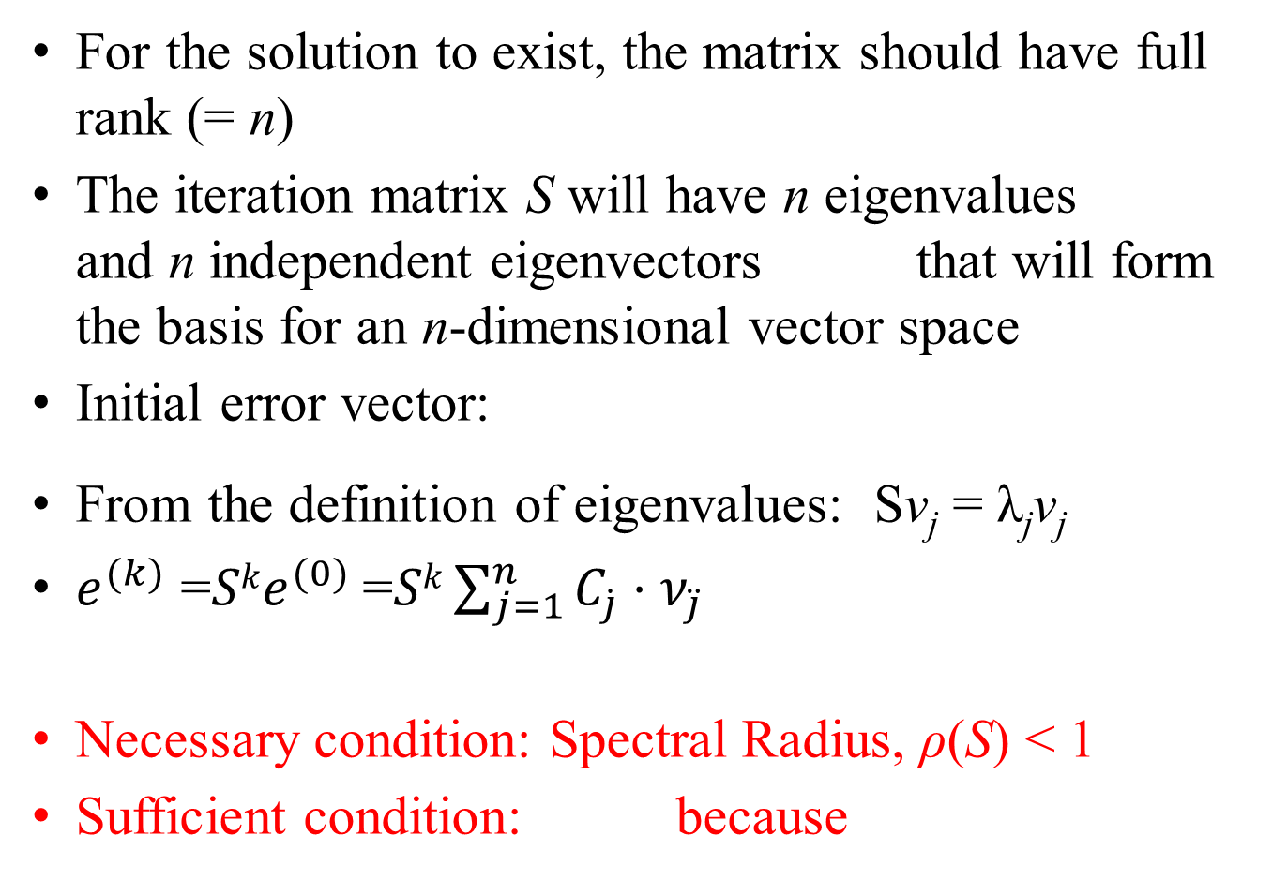
Iterative Methods: Convergence
For the solution to exist, the matrix should have full rank (= n)
The iteration matrix S will have n eigenvalues and n independent eigenvectors that will form the basis for an n-dimensional vector space
Initial error vector:
From the definition of eigenvalues: Sv_{j} = λ_{j}v_{j}
$e^{(k)}$ =$Ske^{(0)}$=$Sk\sum_{j=1}^{n}{C_{\dot{j}}⋅ν_{\ddot{j}}}{ }^{}$
Necessary condition: Spectral Radius, ρ(S) < 1
Sufficient condition: because

Slide 16
Defining Vector and Matrix Norms

Slide 17
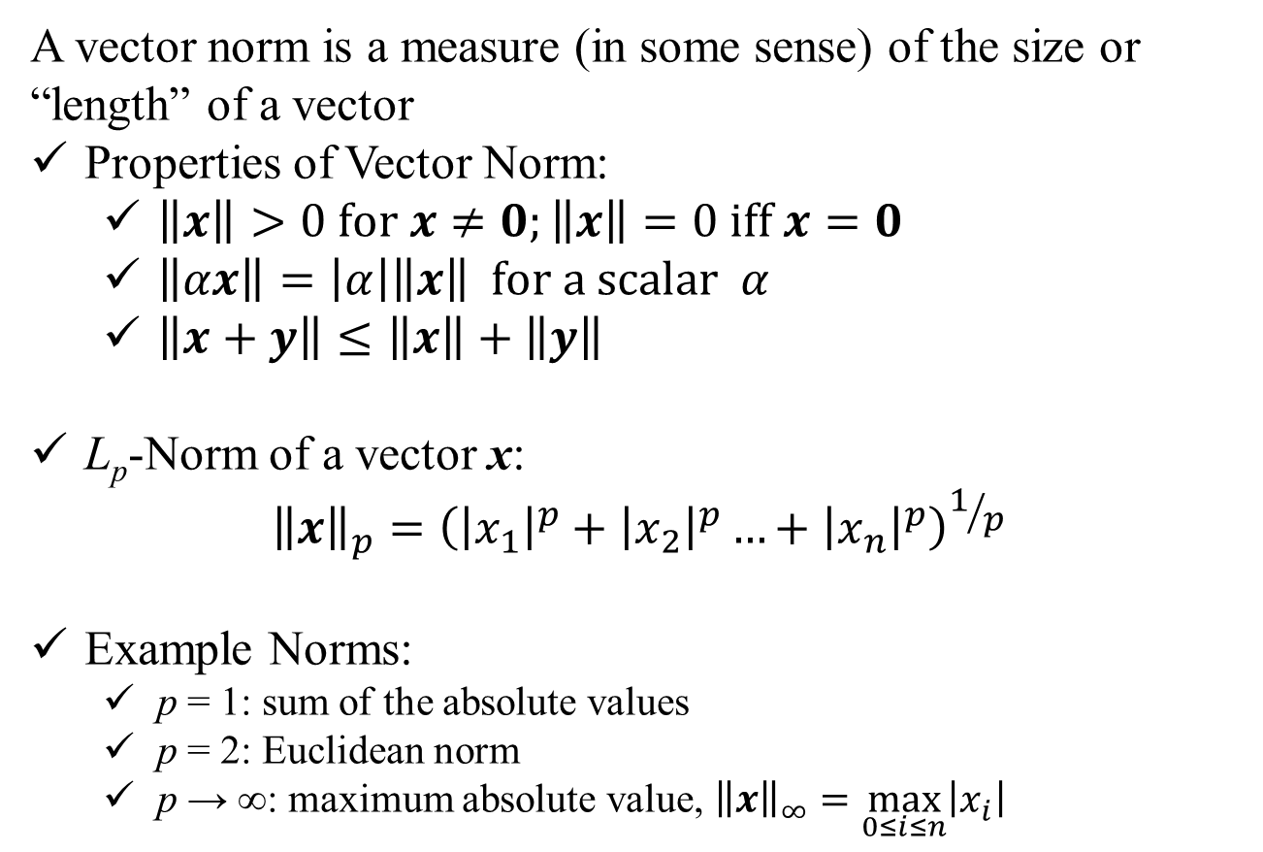
Vector Norms:
A vector norm is a measure (in some sense) of the size or “length” of a vector
Properties of Vector Norm:
$\left\|x\right\|>0 for x≠0;\left\|x\right\|=0 iff x=0$
$\left\|αx\right\|=\left|α\right|\left\|x\right\| for a scalar α$
$\left\|x+y\right\|≤\left\|x\right\|+\left\|y\right\|$
L_{p}-Norm of a vector x:
$${\left\|x\right\|}_{p}={\left({\left|x_{1}\right|}^{p}+{\left|x_{2}\right|}^{p}…+{\left|x_{n}\right|}^{p}\right)}^{1/p}$$
Example Norms:
p = 1: sum of the absolute values
p = 2: Euclidean norm
p → ∞: maximum absolute value, ${\left\|x\right\|}_{∞}=\max_{0≤i≤n}\left|x_{i}\right|$

Slide 18
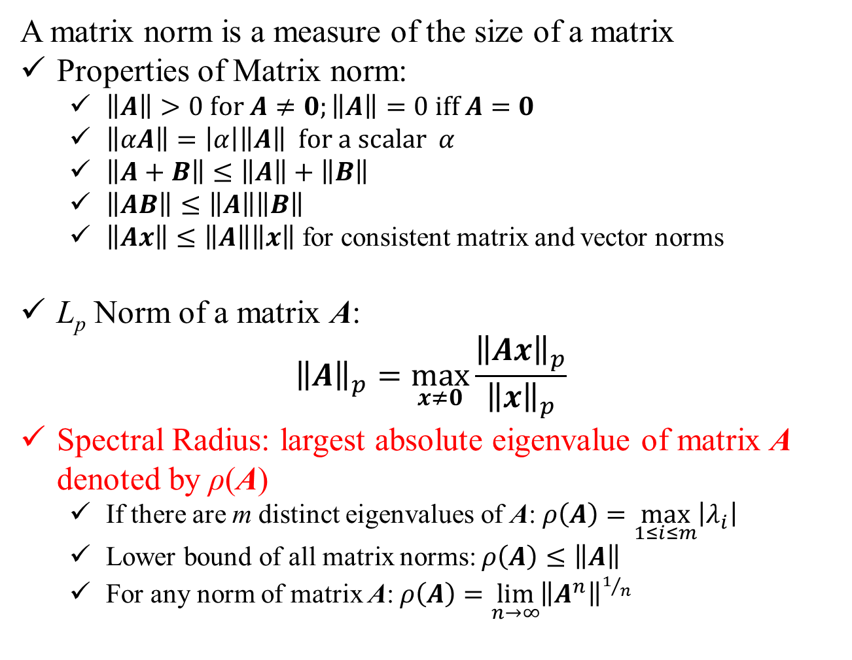
Matrix Norms:
A matrix norm is a measure of the size of a matrix
Properties of Matrix norm:
$\left\|A\right\|>0 for A≠0;\left\|A\right\|=0 iff A=0$
$\left\|αA\right\|=\left|α\right|\left\|A\right\| for a scalar α$
$\left\|A+B\right\|≤\left\|A\right\|+\left\|B\right\|$
$\left\|AB\right\|≤\left\|A\right\|\left\|B\right\|$
$\left\|Ax\right\|≤\left\|A\right\|\left\|x\right\|$ for consistent matrix and vector norms
L_{p} Norm of a matrix A:
$${\left\|A\right\|}_{p}=\max_{x≠0}{\frac{{\left\|Ax\right\|}_{p}}{{\left\|x\right\|}_{p}}}$$
Spectral Radius: largest absolute eigenvalue of matrix A denoted by ρ(A)
If there are m distinct eigenvalues of A: $ρ\left(A\right)=\max_{1≤i≤m}\left|λ_{i}\right|$
Lower bound of all matrix norms: $ρ\left(A\right)≤\left\|A\right\|$
For any norm of matrix A: $ρ\left(A\right)=\lim_{n→∞}{{\left\|A^{n}\right\|}^{1/n}}$

Slide 19
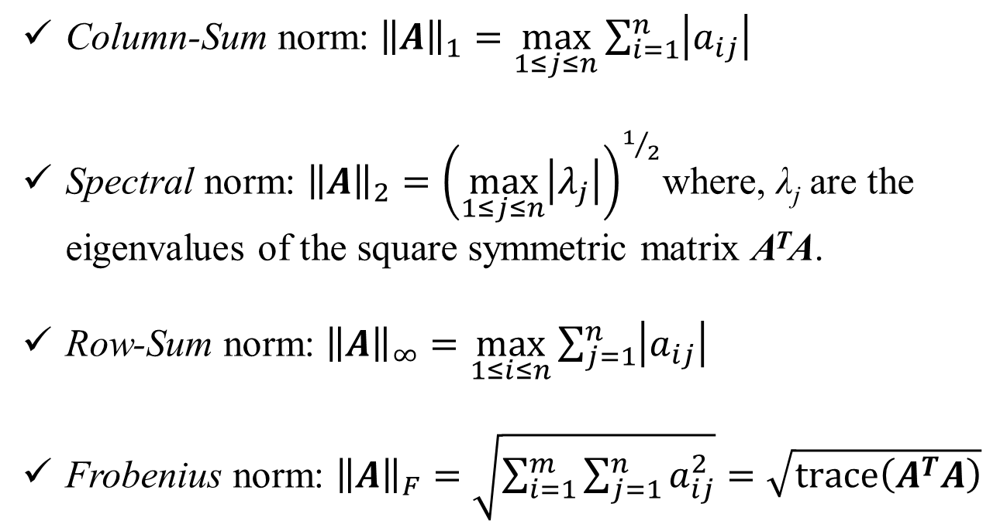
Matrix Norms:
Column-Sum norm: ${\left\|A\right\|}_{1}=\max_{1≤j≤n}{\sum_{i=1}^{n}{\left|a_{ij}\right|}}$
Spectral norm: ${\left\|A\right\|}_{2}={\left(\max_{1≤j≤n}\left|λ_{j}\right|\right)}^{1/2}$where, λ_{j} are the eigenvalues of the square symmetric matrix A^{T}A.
Row-Sum norm: ${\left\|A\right\|}_{∞}=\max_{1≤i≤n}{\sum_{j=1}^{n}{\left|a_{ij}\right|}}$
Frobenius norm: ${\left\|A\right\|}_{F}=\sqrt{\sum_{i=1}^{m}{\sum_{j=1}^{n}{a_{ij}^{2}}}}=\sqrt{\operatorname{trace}\left(A^{T}A\right)}$
Trace of a matrix is the sum of elements on the main diagonal

Slide 20
Coming back to Convergence of Iterative Methods

Slide 21

Iterative Methods: Convergence
For the solution to exist, the matrix should have full rank (= n)
The iteration matrix S will have n eigenvalues and n independent eigenvectors that will form the basis for an n-dimensional vector space
Initial error vector:
From the definition of eigenvalues: Sv_{j} = λ_{j}v_{j}
$e^{(k)}$ =$Ske^{(0)}$=$Sk\sum_{j=1}^{n}{C_{\dot{j}}⋅ν_{\ddot{j}}}{ }^{}$
Necessary condition: Spectral Radius, ρ(S) < 1
Sufficient condition: because

Slide 22
Jacobi Convergence
S = - D⁻¹(L+U)
If we use row-sum norm:
Recall, Sufficient Condition for Convergence:

Slide 23
Iterative Methods: Convergence
Using the definition of S and using row-sum norm for matrix S, we obtain the following as the sufficient condition for convergence for both Jacobi and Gauss Seidel:
If the original matrix is diagonally dominant, it will always converge!

Slide 24

Rate of Convergence
For large k:
$$\frac{\left\|e^{\left(k+1\right)}\right\|}{\left\|e^{\left(k\right)}\right\|}≅ρ\left(S\right)$$
or
$$\frac{\left\|e^{\left(k\right)}\right\|}{\left\|e^{\left(0\right)}\right\|}≅{ρ\left(S\right)}^{k}$$
Why?

Slide 25
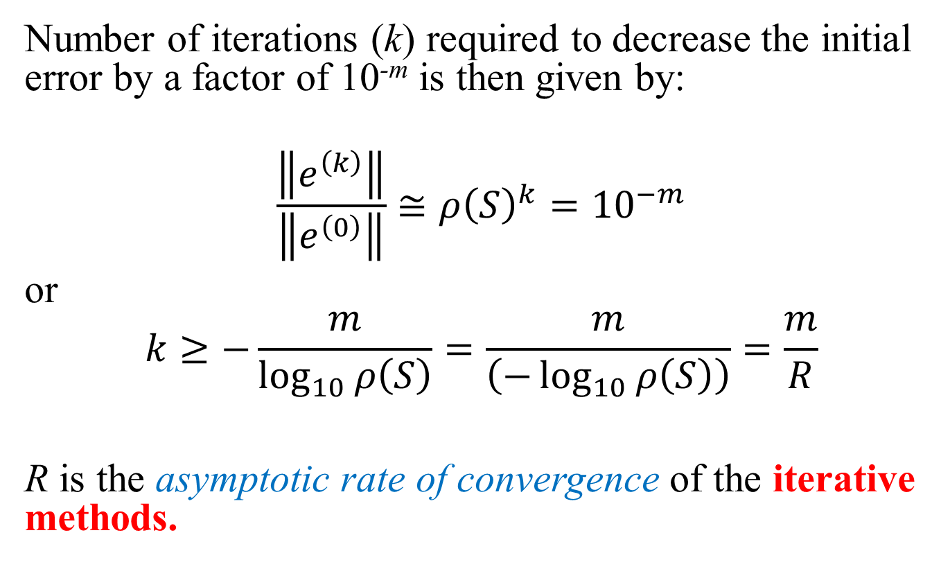
Rate of Convergence
Number of iterations (k) required to decrease the initial error by a factor of 10^{-m} is then given by:
$$\frac{\left\|e^{\left(k\right)}\right\|}{\left\|e^{\left(0\right)}\right\|}≅{ρ\left(S\right)}^{k}={10}^{−m}$$
or
$$k≥−\frac{m}{\log_{10}{ρ\left(S\right)}}=\frac{m}{\left(−\log_{10}{ρ\left(S\right)}\right)}=\frac{m}{R}$$
R is the asymptotic rate of convergence of the iterative methods.

Slide 26
Improving Convergence
Recall Gauss Seidel:
Re-Write As:

Slide 27
Improving Convergence
Denoting:
For any iterative method: x^{(k+1)} = x^{(k)} + d^{(k)}

Slide 28
Successive Over/Under Relaxation
0 < ω < 1 : Under relaxation
ω = 1 : Gauss Seidel
1 < ω < 2 : Over Relaxation

Slide 29
Pivoting, Scaling and Equilibration, Perturbation Analysis

Slide 30
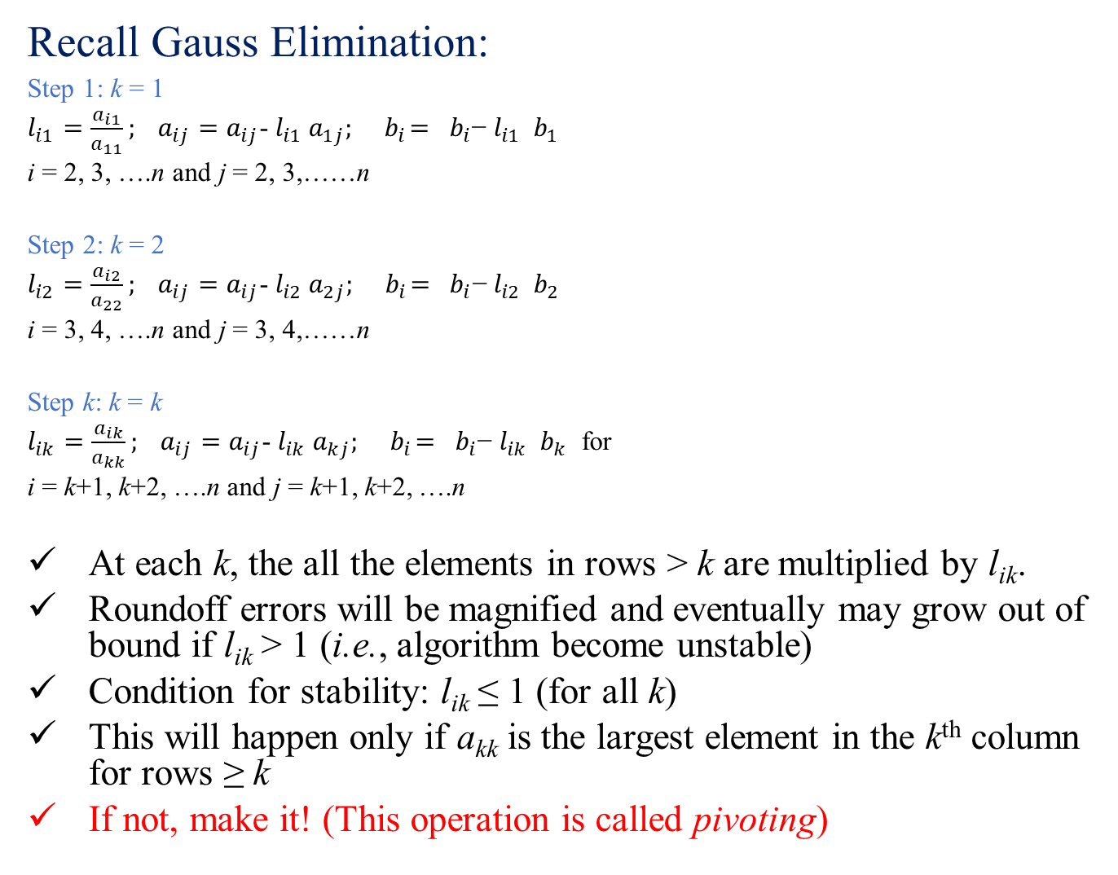
Recall Gauss Elimination:
Step 1: k = 1
$l_{i1}=\frac{a_{i1}}{a_{11}}; a_{ij}=a_{ij}$- $l_{i1}$ $a_{1j}; { b}_{i}={ b}_{i}\text{−} l_{i1}{ b}_{1}$
i = 2, 3, ….n and j = 2, 3,……n
Step 2: k = 2
$l_{i2}=\frac{a_{i2}}{a_{22}}; a_{ij}=a_{ij}$- $l_{i2}$ $a_{2j}; { b}_{i}={ b}_{i}\text{−} l_{i2}{ b}_{2}$
i = 3, 4, ….n and j = 3, 4,……n
Step k: k = k
$l_{ik}=\frac{a_{ik}}{a_{kk}}; a_{ij}=a_{ij}$- $l_{ik}$ $a_{kj}; { b}_{i}={ b}_{i}\text{−} l_{ik}{ b}_{k}$ for
i = k+1, k+2, ….n and j = k+1, k+2, ….n
At each k, the all the elements in rows > k are multiplied by l_{ik}.
Roundoff errors will be magnified and eventually may grow out of bound if l_{ik} > 1 (i.e., algorithm become unstable)
Condition for stability: l_{ik} ≤ 1 (for all k)
This will happen only if a_{kk} is the largest element in the k^{th} column for rows ≥ k
If not, make it! (This operation is called pivoting)

Slide 31
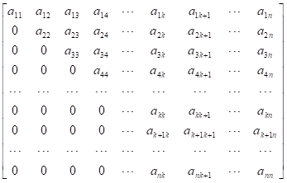
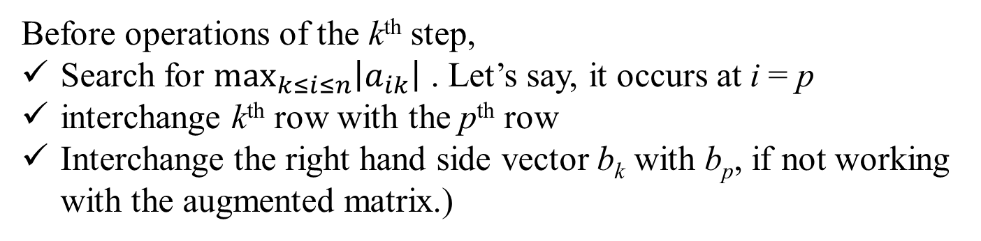
Partial Pivoting: Matrix at the start of the k^{th} Step:
Row Exchange
a_{pk}
Before operations of the k^{th} step,
Search for $\max_{k≤i≤n}\left|a_{ik}\right|$ . Let’s say, it occurs at i = p
interchange k^{th} row with the p^{th} row
Interchange the right hand side vector b_{k} with b_{p}, if not working with the augmented matrix.)

Slide 32
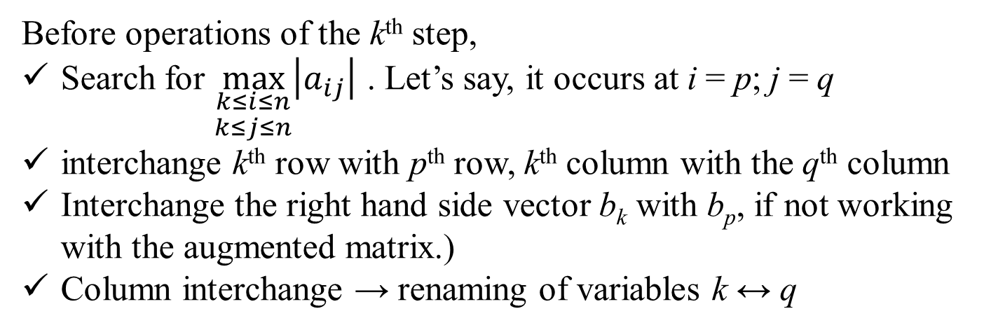
Full Pivoting: Matrix at the start of the k^{th} Step:
Column Exchange
Row Exchange
a_{pq}
Before operations of the k^{th} step,
Search for $\max_{\begin{aligned}k≤i≤n \\ k≤j≤n\end{aligned}}\left|a_{ij}\right|$ . Let’s say, it occurs at i = p; j = q
interchange k^{th} row with p^{th} row, k^{th} column with the q^{th} column
Interchange the right hand side vector b_{k} with b_{p}, if not working with the augmented matrix.)
Column interchange → renaming of variables k ↔ q

Slide 33
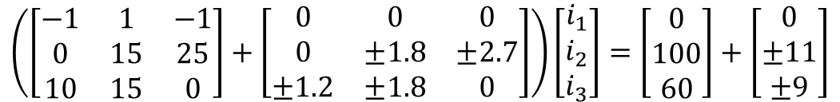
Perturbation Analysis
Consider the system of equation Ax = b
Question: If small perturbation is given in the matrix A and/or the vector b, what is the effect on the solution vector x ? Alternatively, how sensitive is the solution to small perturbations in the coefficient matrix and the forcing function.
Example:
R₁ = 10.0 ± 1.2 Ω; R₂ = 15.0 ± 1.8 Ω; R₃ = 25.0 ± 2.7 Ω
V_{A} - V_{C} = 100.0 ± 11.0 V; V_{A} - V_{B}= 60.0 ± 9.0 V
C
Let’s denote the resulting perturbation in the solution vector x as δx
R₃
B
i₃
R₁
i₁
A
δA
b
δb
i₂
$$\left(\left[\begin{matrix}−1 & 1 & −1 \\ 0 & 15 & 25 \\ 10 & 15 & 0\end{matrix}\right]+\left[\begin{matrix}0 & 0 & 0 \\ 0 & ±1.8 & ±2.7 \\ ±1.2 & ±1.8 & 0\end{matrix}\right]\right)\left[\begin{matrix}i_{1} \\ i_{2} \\ i_{3}\end{matrix}\right]=\left[\begin{matrix}0 \\ 100 \\ 60\end{matrix}\right]+\left[\begin{matrix}0 \\ ±11 \\ ±9\end{matrix}\right]$$
R₂
A

Slide 34
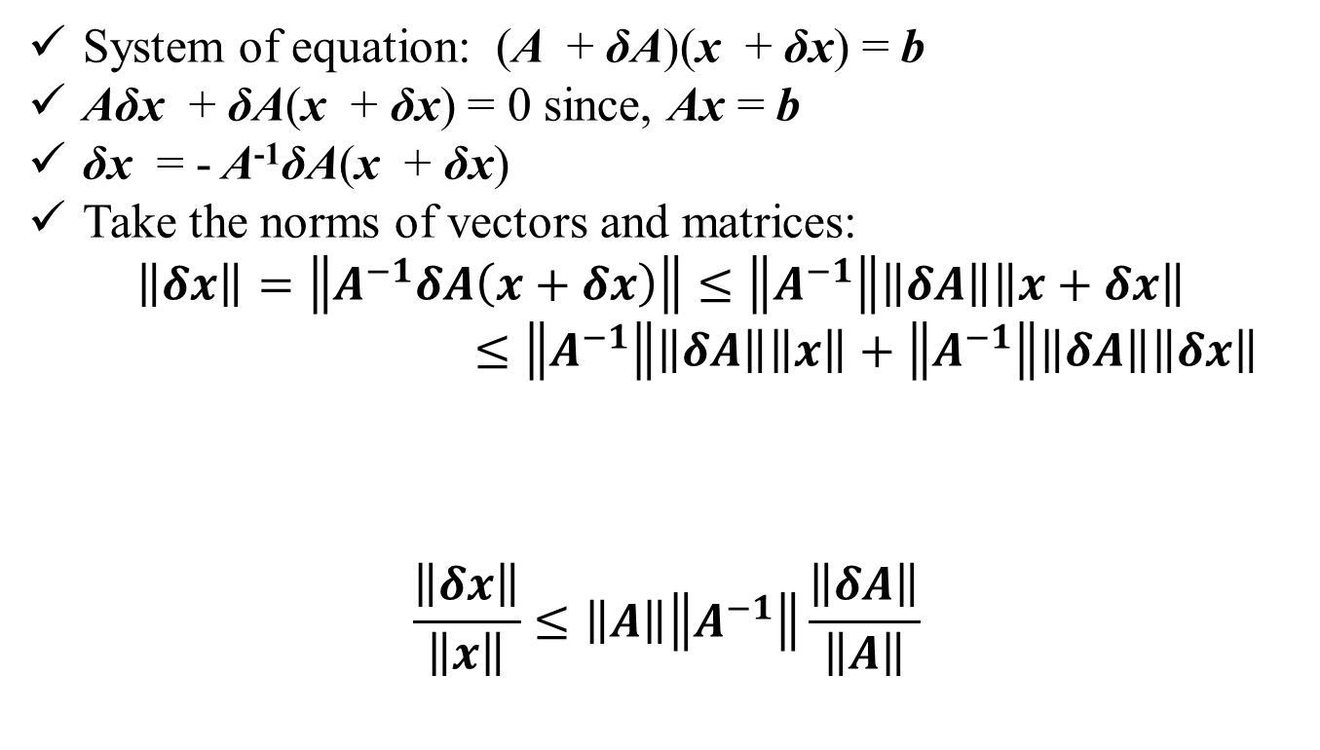
Perturbation in matrix A:
System of equation: (A + δA)(x + δx) = b
Aδx + δA(x + δx) = 0 since, Ax = b
δx = - A⁻¹δA(x + δx)
Take the norms of vectors and matrices:
$$\left\|δx\right\|=\left\|A^{−1}δA\left(x+δx\right)\right\|≤\left\|A^{−1}\right\|\left\|δA\right\|\left\|x+δx\right\|$$
$≤\left\|A^{−1}\right\|\left\|δA\right\|\left\|x\right\|+\left\|A^{−1}\right\|\left\|δA\right\|\left\|δx\right\|$
$$\frac{\left\|δx\right\|}{\left\|x\right\|}≤\left\|A\right\|\left\|A^{−1}\right\|\frac{\left\|δA\right\|}{\left\|A\right\|}$$
Product of perturbation quantities

Slide 35
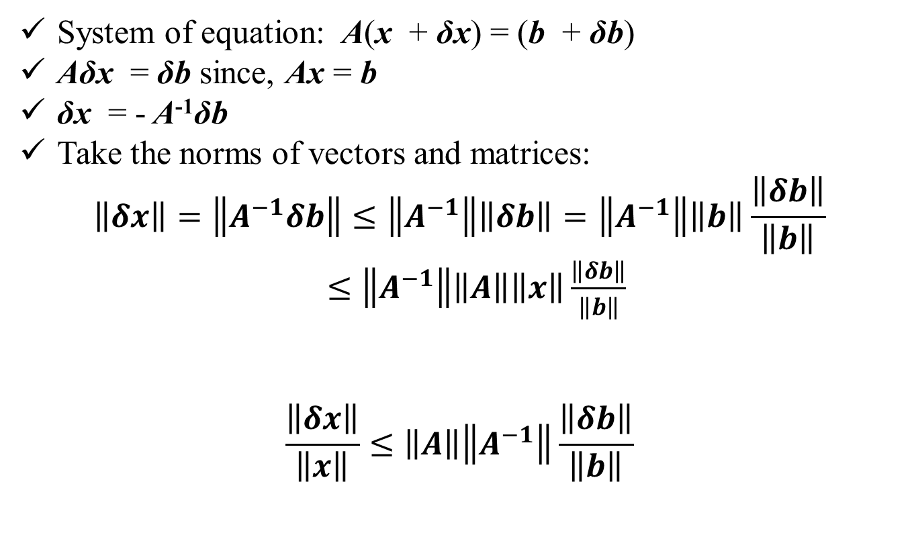
Perturbation in forcing vector b:
System of equation: A(x + δx) = (b + δb)
Aδx = δb since, Ax = b
δx = - A⁻¹δb
Take the norms of vectors and matrices:
$$\left\|δx\right\|=\left\|A^{−1}δb\right\|≤\left\|A^{−1}\right\|\left\|δb\right\|=\left\|A^{−1}\right\|\left\|b\right\|\frac{\left\|δb\right\|}{\left\|b\right\|}$$
$≤\left\|A^{−1}\right\|\left\|A\right\|\left\|x\right\|\frac{\left\|δb\right\|}{\left\|b\right\|}$
$$\frac{\left\|δx\right\|}{\left\|x\right\|}≤\left\|A\right\|\left\|A^{−1}\right\|\frac{\left\|δb\right\|}{\left\|b\right\|}$$

Slide 36
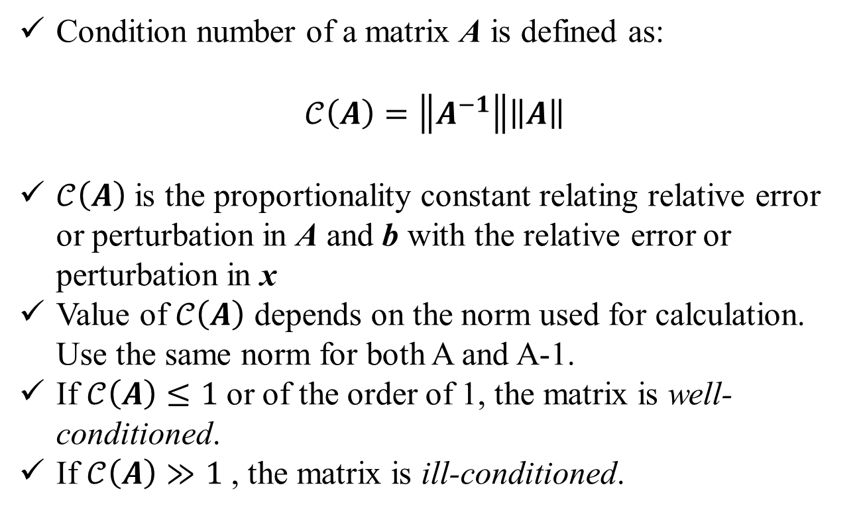
Condition Number:
Condition number of a matrix A is defined as:
$$𝒞\left(A\right)=\left\|A^{−1}\right\|\left\|A\right\|$$
$𝒞\left(A\right)$ is the proportionality constant relating relative error or perturbation in A and b with the relative error or perturbation in x
Value of $𝒞\left(A\right)$ depends on the norm used for calculation. Use the same norm for both A and A-1.
If $𝒞\left(A\right)≤1$ or of the order of 1, the matrix is well-conditioned.
If $𝒞\left(A\right)≫1$ , the matrix is ill-conditioned.

Slide 37


Scaling and Equilibration:
It helps to reduce the truncation errors during computation.
Helps to obtain a more accurate solution for moderately ill-conditioned matrix.
Example: Consider the following set of equation
Scale variable x₁ = 10³ × x₁ʹ and multiply the second equation by 100. Resulting equation is:

Slide 38


Scaling
Vector x is replaced by xʹ such that, x = Sxʹ.
S is a diagonal matrix containing the scale factors!
For the example problem:
Ax = b becomes: Ax = ASxʹ = Aʹxʹ = b where, Aʹ = AS
For the example problem:
Scaling operation is equivalent to post-multiplication of the matrix A by a diagonal matrix S containing the scale factors on the diagonal

Slide 39
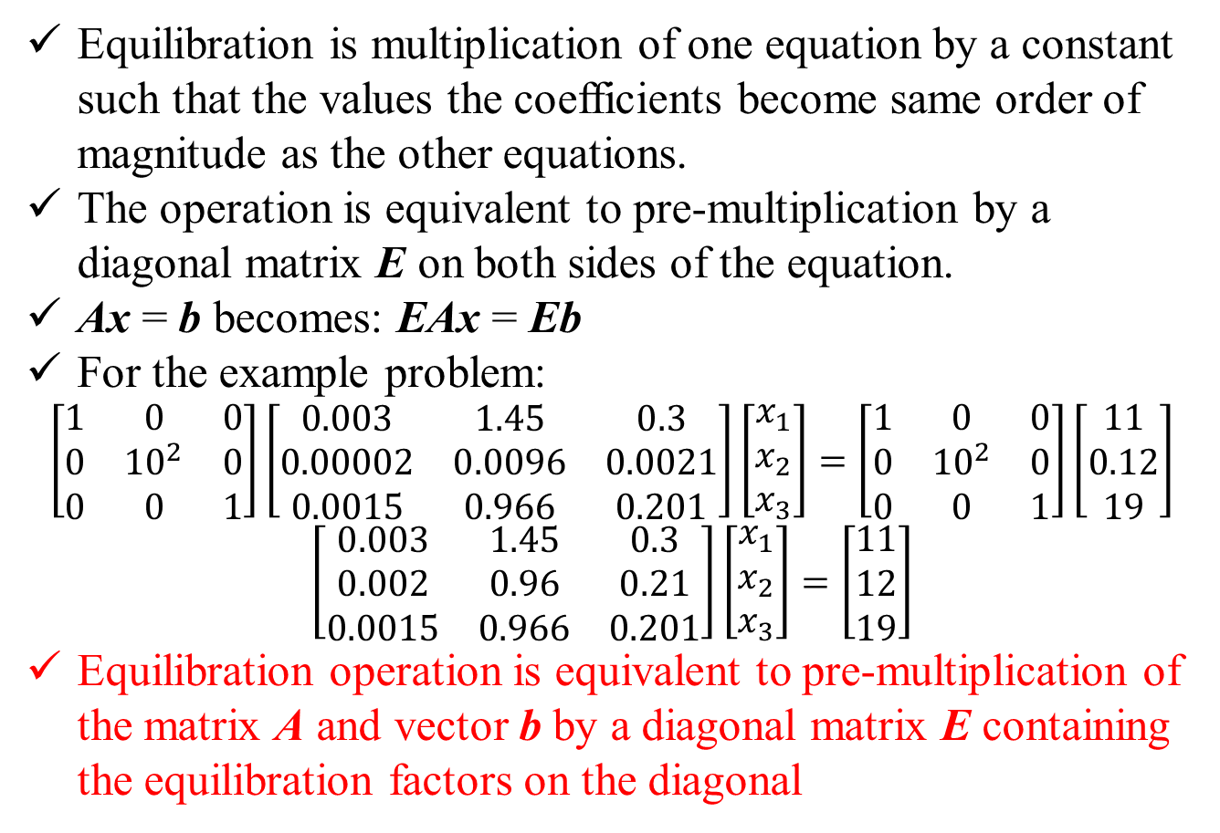
Equilibration
Equilibration is multiplication of one equation by a constant such that the values the coefficients become same order of magnitude as the other equations.
The operation is equivalent to pre-multiplication by a diagonal matrix E on both sides of the equation.
Ax = b becomes: EAx = Eb
For the example problem:
$$\left[\begin{matrix}1 & 0 & 0 \\ 0 & {10}^{2} & 0 \\ 0 & 0 & 1\end{matrix}\right]\left[\begin{matrix}0.003 & 1.45 & 0.3 \\ 0.00002 & 0.0096 & 0.0021 \\ 0.0015 & 0.966 & 0.201\end{matrix}\right]\left[\begin{matrix}x_{1} \\ x_{2} \\ x_{3}\end{matrix}\right]=\left[\begin{matrix}1 & 0 & 0 \\ 0 & {10}^{2} & 0 \\ 0 & 0 & 1\end{matrix}\right]\left[\begin{matrix}11 \\ 0.12 \\ 19\end{matrix}\right]$$
$$\left[\begin{matrix}0.003 & 1.45 & 0.3 \\ 0.002 & 0.96 & 0.21 \\ 0.0015 & 0.966 & 0.201\end{matrix}\right]\left[\begin{matrix}x_{1} \\ x_{2} \\ x_{3}\end{matrix}\right]=\left[\begin{matrix}11 \\ 12 \\ 19\end{matrix}\right]$$
Equilibration operation is equivalent to pre-multiplication of the matrix A and vector b by a diagonal matrix E containing the equilibration factors on the diagonal

Slide 40
Pivoting, Scaling and Equilibration
Before starting the solution algorithm, take a look at the entries in A and decide on the scaling and equilibration factors. Construct matrices E and S.
Transform the set of equation Ax = b to EASxʹ = Eb
Solve the system of equation Aʹxʹ = bʹ for xʹ, where Aʹ = EAS and bʹ = Eb
Compute: x = Sxʹ
Gauss Elimination: perform partial pivoting at each step k
For all other methods: perform full pivoting before the start of the algorithm to make the matrix diagonally dominant, as far as practicable!
These steps will guarantee the best possible solution for all well-conditioned and mildly ill-conditioned matrices!
However, none of these steps can transform an ill-conditioned matrix to a well-conditioned one.

Slide 41
Iterative Improvement by Direct Methods
For moderately ill-conditioned matrices an approximate solution x͂ to the set of equation Ax = b can be improved through iterations using direct methods.
Compute: r = b - A x͂
Recognize: r = b - A x͂ + Ax - b
Therefore: A(x - x͂ ) = AΔx = r
Compute: x = x͂ + Δx
The iteration sequence can be repeated until ǁ Δx ǁ ≤ ε

